Slide 1
Governor’s Task Force on Broadband Overview of the Office of Broadband Development and Border to Border Broadband Grant Program
December 10, 2019
Angie Dickison
angie.dickison@state.mn.us
Diane Wells
diane.wells@state.mn.us
MN Office of Broadband Development
Department of Employment and Economic Development

Slide 2
Timeline Minnesota Broadband Development Policy
2008-2010
2009 - First broadband map created (prior to federal mapping program)
2010 - Broadband goals established (10/5 by 2015)
2011-2013
2013 - Office of Broadband Development was created by law; placed at DEED
2014-2016
2014 - Border to Border Broadband Infrastructure Grant created; $20M appropriated
2008 - First broadband taskforce created
2011 – Dayton Administration broadband taskforce created
2015 - Additional funding for broadband grants; $10.58M
2016 - Broadband goals revised (25/3 by 2022) ; $35M appropriated
2017 - 2019
2017 - Border to Border program renewed; $20M
2018 - Bi-partisan support but in the end, no funding for grants in 2018
2019 – Border to Border grant: $20M for 2019 and $20M for 2020; Telecommuter Forward!; Walz Administration Broadband Task Force created--YOU
Notes:
This is our timeline that shows the state has been working on this issue for some time

Slide 3
MN Broadband Policy Framework
Statutory Goals
Broadband Office and Task Force
Data (Mapping Program)
Tools (Grant Program)

Slide 4
Broadband Goals
No later than 2022, all Minnesota businesses and homes have access to high-speed broadband that provides minimum download speeds of at least 25Mbps and minimum upload speeds of at least 3Mbps
No later than 2026, all Minnesota businesses and homes have access to at least one provider of broadband with download speeds of at least 100Mbps and upload speeds of at least 20Mbps (MN Stat. 237.012, revised 2016)

Slide 5
Office of Broadband Development
Work to facilitate, promote, and improve broadband infrastructure development
Measure and map broadband availability across the state
Dig Once/conduit/ROW mgmt/permitting
Provide technical assistance to providers and communities
Administer the Border to Border broadband grant program
Inform and support state broadband policy discussions
Clearinghouse for state and federal program resources
Measure, analyze, and support community anchor institution needs
Support digital inclusion (literacy and affordability)
Support inclusion of broadband needs into local planning processes
Provide support to the Broadband Task Force

Slide 6
Governor’s Task Force on Broadband
Governor Walz Executive Order 19-10
Advise the executive and legislative branches on broadband policy
15 members
Meet at least 10 times per year
Annual report
Inventory and assessment
Updated recommendations on state level actions

Slide 7
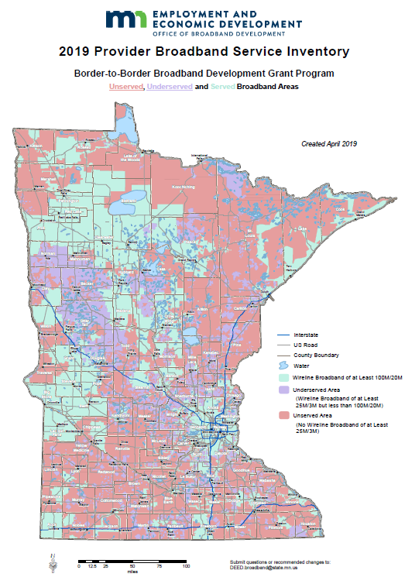
MN Broadband Mapping Program
We gather data once a year
112 known providers in MN
State Statutory
Broadband Goals:
All Homes and Businesses will have access to broadband service of at least:
25 Mbps download by 3 Mbps upload (Current FCC definition) by 2022
100 Mbps download by 20 Mbps upload by 2026

Slide 8
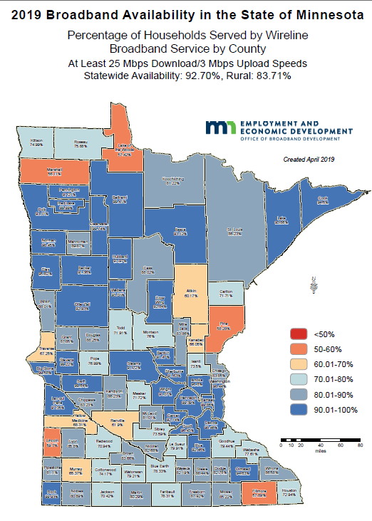
County Map
152,000 households without access to a wireline service of at least 25Mbps/3Mbps
At the FCC minimum definition of broadband
(and state speed goal)
First time with no counties showing red (less than 50%)*
Notes:
We also produce maps that show coverage by county, school district and township. This is the county map showing percentages of households served at the 2022 goal.
*Question this due to overstatement of DSL availability/speeds

Slide 9
County Map—with 100/20 availability
This year: 85.98% statewide availability
Last year: 74.11% statewide availability

Slide 10
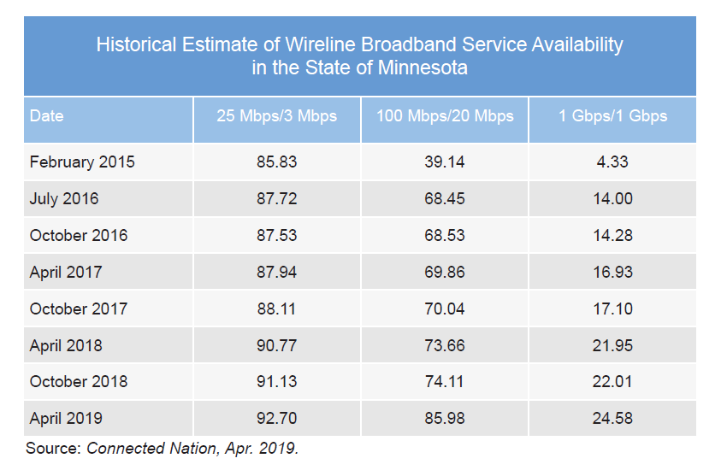

Slide 11
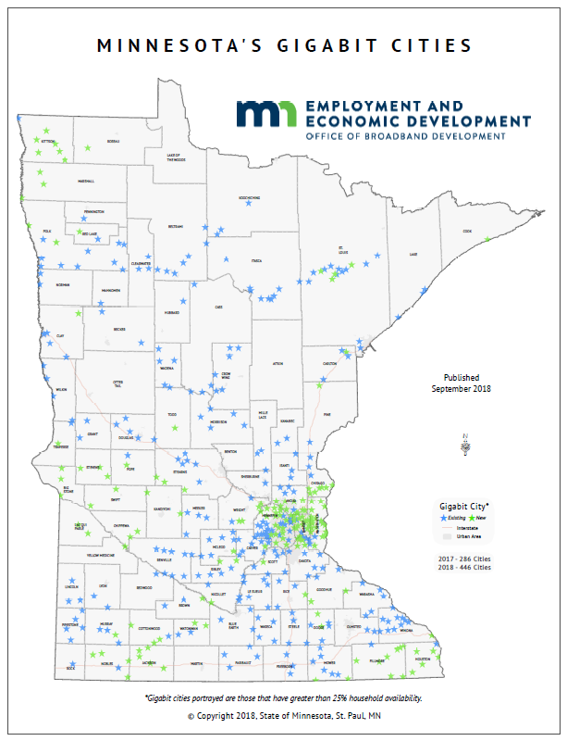
Using the Maps: Minnesota Gigabit Cities
446
Minnesota Cities have Gigabit capabilities
Economic Development
Professional recruiting
Attract returning alumni

Slide 12
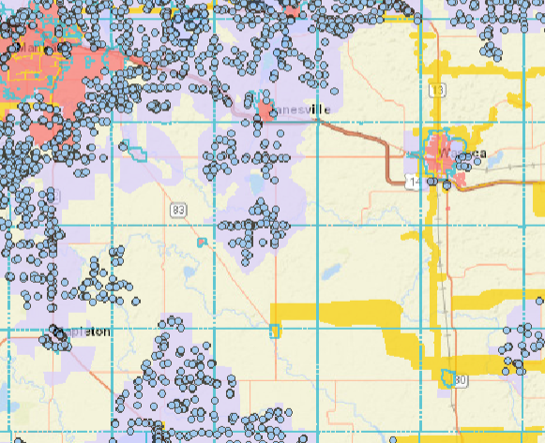
Interactive Map
Gold-fiber
Pink-cable
Purple-DSL
Blue dots—locations reported to FCC as being served with CAF
Notes:
This is a screen shot from our interactive map.

Slide 13
Border to Border Broadband Development Grant – Overview
General fund appropriation of $20M for 2019 and 2020
Distributed in a single competitive grant round each year
Technology must be scalable to at least 100Mbps Up/Down
Cap of $5M per grant award
At least 1 to 1 match (50% of eligible expenses) required (More points awarded for higher match from applicant/partners)
Grant awards are to be geographically dispersed
2019 grant round:
Received 80 applications requesting ~$70M in funding.

Slide 14
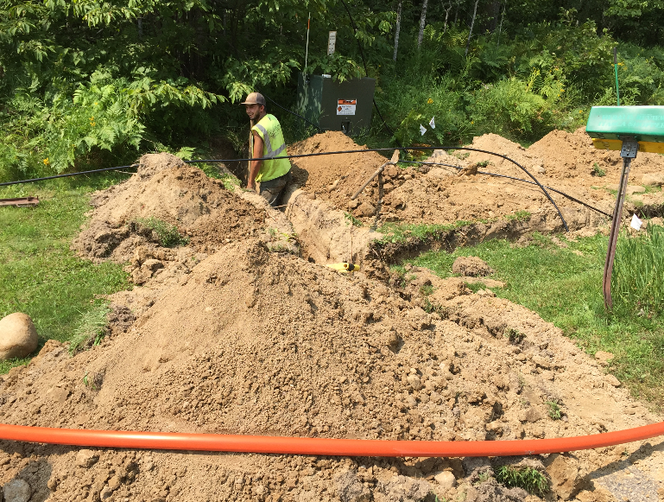
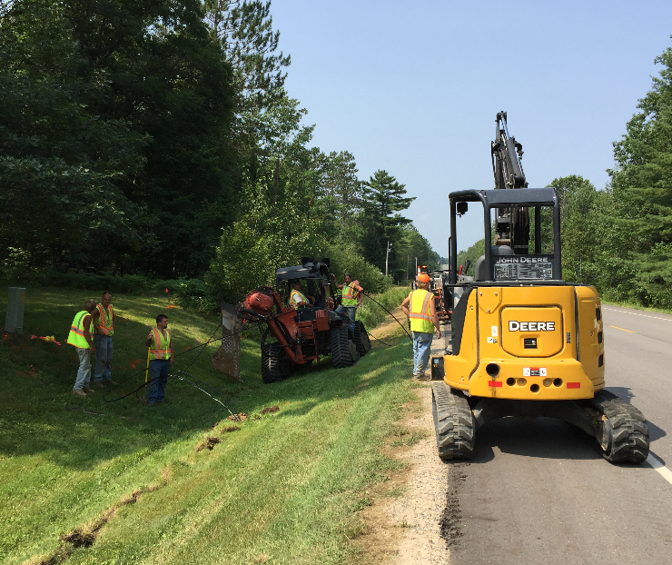
Examples of what it takes to deploy broadband
Notes:
The grant helps build projects in areas where a provider wouldn’t build on its own. These are photos from some of the grant funded projects deployed by cable providers. Note the backgrounds—rural.

Slide 15
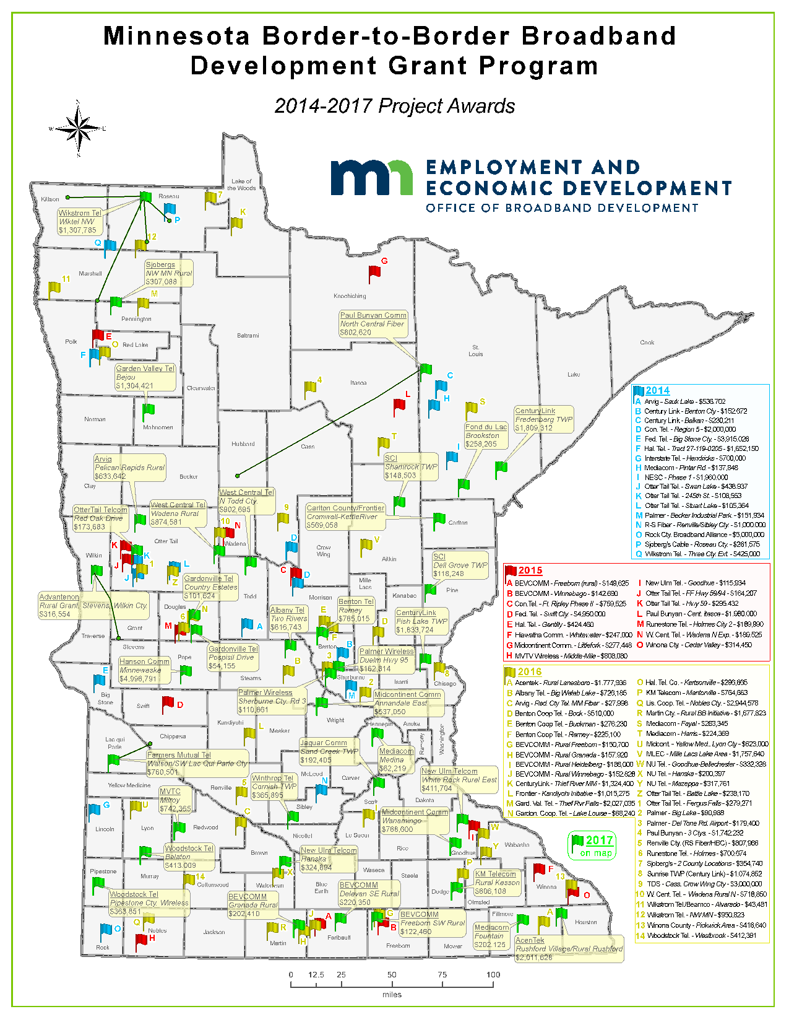
MN Border to Border Broadband Incentive Grants
 | 2017 | All 4 Years
Funding | $20M ($26.4M) | $85M
Applications Received | 70 | 216
Awards:
Awards Made | 39 | 110
Households Served | 9,973 | 33,852
Businesses Served | 2,169 | 5,189
Institutions Served | 60 | 300
Projects:
Matching Investments | $34.2M | $110.6M
Completed |  | 55+

