Slide 1
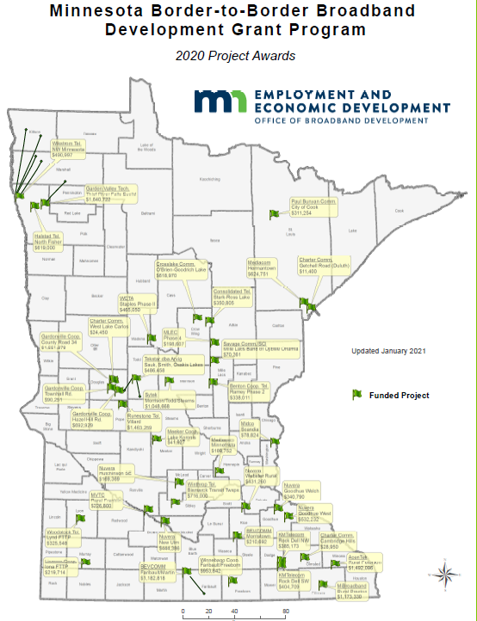
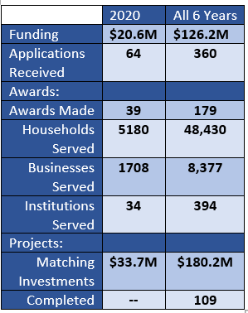
MN Border to Border Broadband Infrastructure Grants

Slide 2
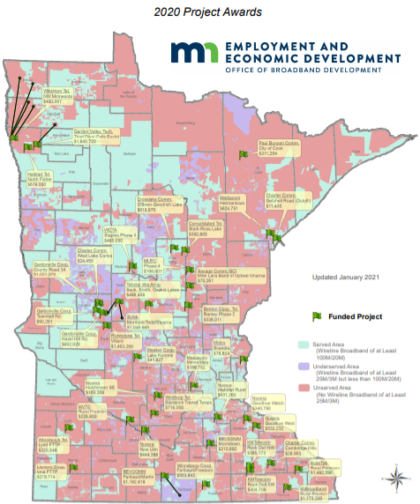
2020 MN Border to Border Broadband Infrastructure Grant Awards

Slide 3
Federal Funding Opportunities
USDA-ReConnect, Community Connect
Waiting on possible Round 3 for ReConnect
Community Connect apps were due 12/23/20
RDOF
MN: 22 bidders; $408M; 142,841 locations
Long form applications due 1/29/21
LOC, System design due 2/15/21
ETC designation & audited financials due 6/7/21
Default penalty is $3000 X no. of CBGs in bid or 15% of total bid
NTIA $300M in stimulus act
FCC Emergency Broadband Benefit - $3.2B
Comments due 1/25/21; replies 2/16/21
Up to $50/month HH credit to ISP

