Slide 1
DEED, Vocational Rehabilitation Services, and State Services for the Blind Strategic Overview
August 3, 2021
DEED Commissioner Steve Grove
SSB Director Natasha Jerde | VRS Director Dee Torgerson

Slide 2
Agenda
Kickoff: Kim Babine, VRS Director of Community Partnerships
Welcome and Commissioner Updates: Commissioner Grove
CareerForce Updates: Dee Torgerson, VRS Director
SSB Updates: Natasha Jerde, SSB Director
VRS Updates: Dee Torgerson, VRS Director
Chris McVey: VRS Director of Strategic Initiatives, Kim Babine: VRS Director of Community Partnerships, Amanda Jensen-Stahl: VRS Manager of Interagency Partnerships and Business Engagement
Q&A: Moderated by Kim Babine, VRS Director of Community Partnerships
Closing Remarks: Dee Torgerson, VRS Director and Natasha Jerde, SSB Director

Slide 3
Employment Rates Among Minnesotans with Disabilities

Slide 4
What We’ve Learned from the COVID-19 Pandemic
Many of our services can be delivered remotely
Service delivery often improves when delivered remotely because it removes physical barriers
We can run a much more efficient system than we currently operate
In-person services still matter, especially to bridge the digital divide
Digital transformation means delivering the right service to the right person
We work in a networked space – partnerships are key to success

Slide 5
Our Evolving Service Model – Core Principles
Equity: Center everything we do around equity
Proactivity: Take a proactive stance – meet people where they are
Flexibility: Embrace the opportunity to try new things and learn as we go

Slide 6
DEED-VRS and DEED-SSB Meets Business Needs
Shares vital information on in demand careers with students and adults with disabilities
Connects Minnesota business to an untapped talent pool
Partners with business to provide disability related information, resources and training

Slide 7
CareerForce Updates

Slide 8
The Job Service Customer
CareerForce serves everyone:
Re-opening to the public and by appointment August 2, 2021.
We must provide equal access for employment services to everyone inside and outside of the CareerForce system.
We will do this through a mixture of in-person, remote, and online self-services across the state.
The customers we'll proactively focus on are:
People with barriers to employment: BIPOC, veterans, those with no access to technology.
People receiving UI and MFIP services.

Slide 9
SSB Updates

Slide 10
SSB: A Hybrid Approach
Philosophy and approach remains the same: “We go to you”
Hybrid service model based on customer needs and informed choice
In home
In the community
Virtual
Decreased physical footprint in CareerForce locations, increased presence in the community
No waiting list for services!

Slide 11
SSB: Resumption of Services Timeline
April 2021: SSU resumed 1 person per day in-person services;
May 2021: WDU employment specialists, assistive technologists, and rehabilitation teacher resumed 1 person per day in-person services
July 2021: No limits to in-person services
August 2021: Return of Communication Center volunteers
August 2021: Doors open to the public by appointment only

Slide 12
SSB: Current Trends
Applications exceeding pre-COVID numbers
Successful closures in competitive integrated employment trending upwards but can be better
A virtual world forced everyone to look at long-term accessibility of systems and documents, thus increasing opportunities and access for blind, visually impaired, and DeafBlind Minnesotans
Transportation barriers both increased and decreased
Public transportation options/schedules have been significantly reduced
But remote work is becoming standard

Slide 13
SSB: Priorities and Future Vision
Hybrid service delivery approach based on individual needs and informed choice
Spending challenges mean opportunities for initiatives that improve services to customers, especially around Pre-ETS
Long-term recruitment and retention of diverse and skilled staff
Community Partner collaboration around service delivery
Increased and intentional outreach to underserved communities
A focus on mental health
Ramping up Aging Eyes Initiative within Senior Services to reach more seniors than ever before

Slide 14
VRS Updates

Slide 15
Changing Landscape: Serving Individuals with More Significantly Impacting Disabilities
2013-2020 Waiting List
Workforce Innovation and Opportunities Act
Section 511
Pre-ETS 15% federal funding spending requirement serving students
E1MN MOU (Collaboration with MN Department of Human Services)

Slide 16
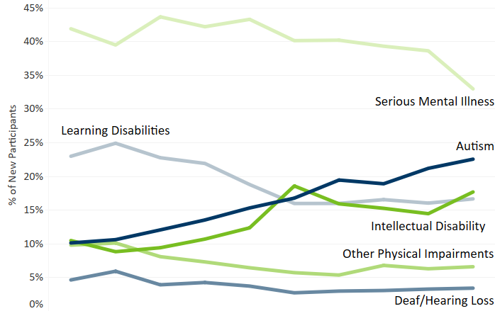
The Changing Landscape of VRS – Disability Types

Slide 17
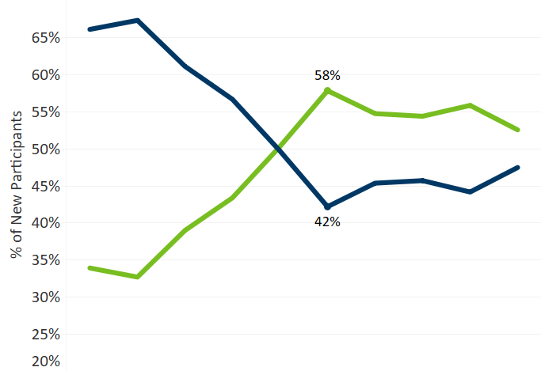
The Changing Landscape of VRS – Complexity

Slide 18
Changing Landscape: Serving More Students
Services to students are growing:
Nearly 60% of VRS participants were youth at the time they started VRS services; almost 3,000 (22%) are current high school students.
In addition, we make services available through schools to another 50,000 students with disabilities through pre-employment transition services, more commonly referred to as Pre-ETS.

Slide 19
Changing Landscape: VRS is Ready
Categories 1, 2, & 3 opened in 2020 – VRS is ready to serve people with one or more functional limitations at this time
VRS supports people with wide variety of disabilities reach their career goals
Benefits Planning is key to making fully informed decisions
VRS supports people with disabilities plan for careers earning family sustaining wages

Slide 20
VRS Transitioning to a New Model of Services
VRS Mission:
Empower youth and adults with disabilities to achieve their goals for competitive, integrated employment.
Increased choice for our participants
Person Centered Services
Eliminate barriers to services
Increase outreach and engagement to underserved populations
Increase collaboration with agencies and partners (E1MN)
Increase access and flexibility for parents and families
Keep categories of services open

Slide 21
VRS Person-Centered Services
VRS envisions a future for Minnesotans with disabilities where:
There is freedom for meaningful choice and self-determination through a planning process directed by the individual and opportunities for economic self-sufficiency in competitive, integrated employment
Person-centered approaches are best practices and employment opportunities are identified and developed beyond the choices available today.
VRS, the business community, Community Rehabilitation Programs, educators, employers, other agencies and representatives:
engage with one another as trusted workforce development partners that break down barriers to employment and independent living, and
are leaders, successful learners, take risks with new ideas, share knowledge, engage, think critically and adopt change

Slide 22
VRS Service Model Focus on equity, Accessibility, and Person-Centered Services
VRS will offer expanded services options for individuals with disabilities. We want to meet people where they are. The expanded service options include:
Colleges, Universities and Technical Colleges
High Schools – VRS is present in over 400 school districts across the state
County Offices
Remote or Virtual Services – VRS’s new WF1 app will be launched Fall 2021. The new app will support greater remote connection and communication.
VRS, CareerForce MN, or partner offices, as well as other community locations in which the individual feels comfortable
The potential or current participant’s home

Slide 23
DEED Digital Services – where we're headed
Replacing Minnesotaworks.net with a modern, accessible, mobile-friendly labor exchange and account management platform
Reviewing customer-facing content to make sure information is accessible, updated, accurate, and easy to find
Exploring new tools and platforms to provide better direct services
Launching Workforce One Connect app to help participants communicate with counselors, submit documents, and get information about local resources

Slide 24
DEED - Our approach to physical space
We are choosing a space footprint that fits our service delivery models
Our footprint will be a combination of leased space in CareerForce and other partner locations, use of third-party spaces, and mobile services
Shifting of costs from physical space to direct services
Physical space reduction is a national trend for VR
We need your support

Slide 25
VRS: Resumption of Services Timeline
Safety Protocols for Staff and Individuals Served in Place
June 2021: Phased In-Person Services Began
August 2, 2021: In-Person Services Available at VRS onsite and offsite by appointment only
Continue virtual or remote services if preferred by the individual served

Slide 26
VRS – Partnering with Business
Employer visits, tours, and meetings to understand an employer’s specific hiring needs and better connect VRS’s talented pool of job seekers to jobs.
Assist employers with their recruitment needs by reaching out to our wide network of job seekers and coordinating with our partners to meet hiring needs.
Provide no cost training and consultation on important topics such as creating disability inclusive work environments, understanding who is covered/protected under the Americans with Disabilities Act (ADA), and recognizing an accommodation request and implementing reasonable accommodations.

Slide 27
What this means for you
Advocacy Organizations?
for Individuals and their Families?
Individuals and their Families
VRS Community Partners and Potential Community Partners
Advocacy Organizations and Advocates

Slide 28
Discussion

Slide 29
Q & A: We want to hear from you
Please Submit Questions Using this Form: https://forms.office.com/g/KiVJK6ZuPD
Which changes are you most excited about?
What challenges do you anticipate?
How can VRS/SSB collaborate more intently with you on reaching individuals needing services?
What additional VRS/SSB changes would you recommend to best serve the persons that you represent?
What other ideas do you have for VRS/SSB to best meet the needs of employers seeking qualified job candidates?

Slide 30
In Conclusion
NO wait list! Categories are open.
Utilize new learning and digital technologies
Increased availability and more opportunities to connect
Dedicated to sustaining strong partnerships
Stronger business partnerships
Decreasing physical footprint in order to
divert funds into direct services for individuals with disabilities
keep categories of services OPEN long term

Slide 31
Contact for more information
SSB
mn.gov/deed/ssb
Main Line: 651-539-2300
Director Natasha Jerde
Natasha.Jerde@state.mn.us
651-539-2272
VRS
mn.gov/deed/job-seekers/disabilities
Dee Torgerson, VRS Director: Dee.Torgerson@state.mn.us
Chris McVey, VRS Director of Strategic Initiatives: Chris.McVey@state.mn.us
Kim Babine. VRS Director of Community Partnerships: Kim.Babine@state.mn.us
Amanda Jensen-Stahl, VRS Manager of Interagency Partnerships and Business Engagement: Amanda.Jensen-Stahl@state.mn.us
To be added to the email list for general VRS information: contact Karla.Eckhoff@state.mn.us

Slide 32
Thank You!

