Slide 1
Office of Small Business & Innovation

Slide 2
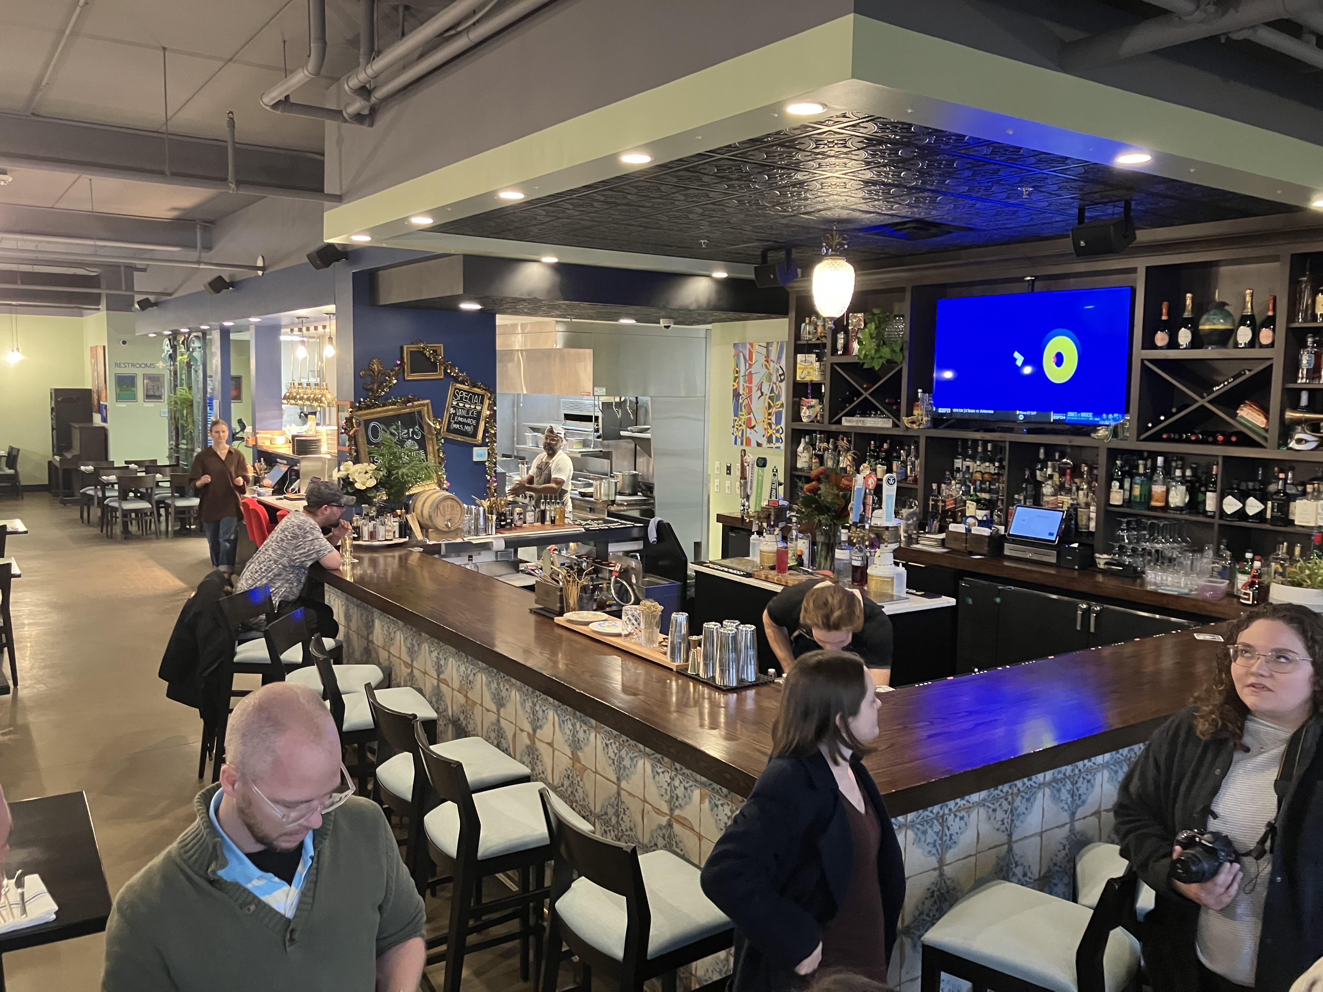
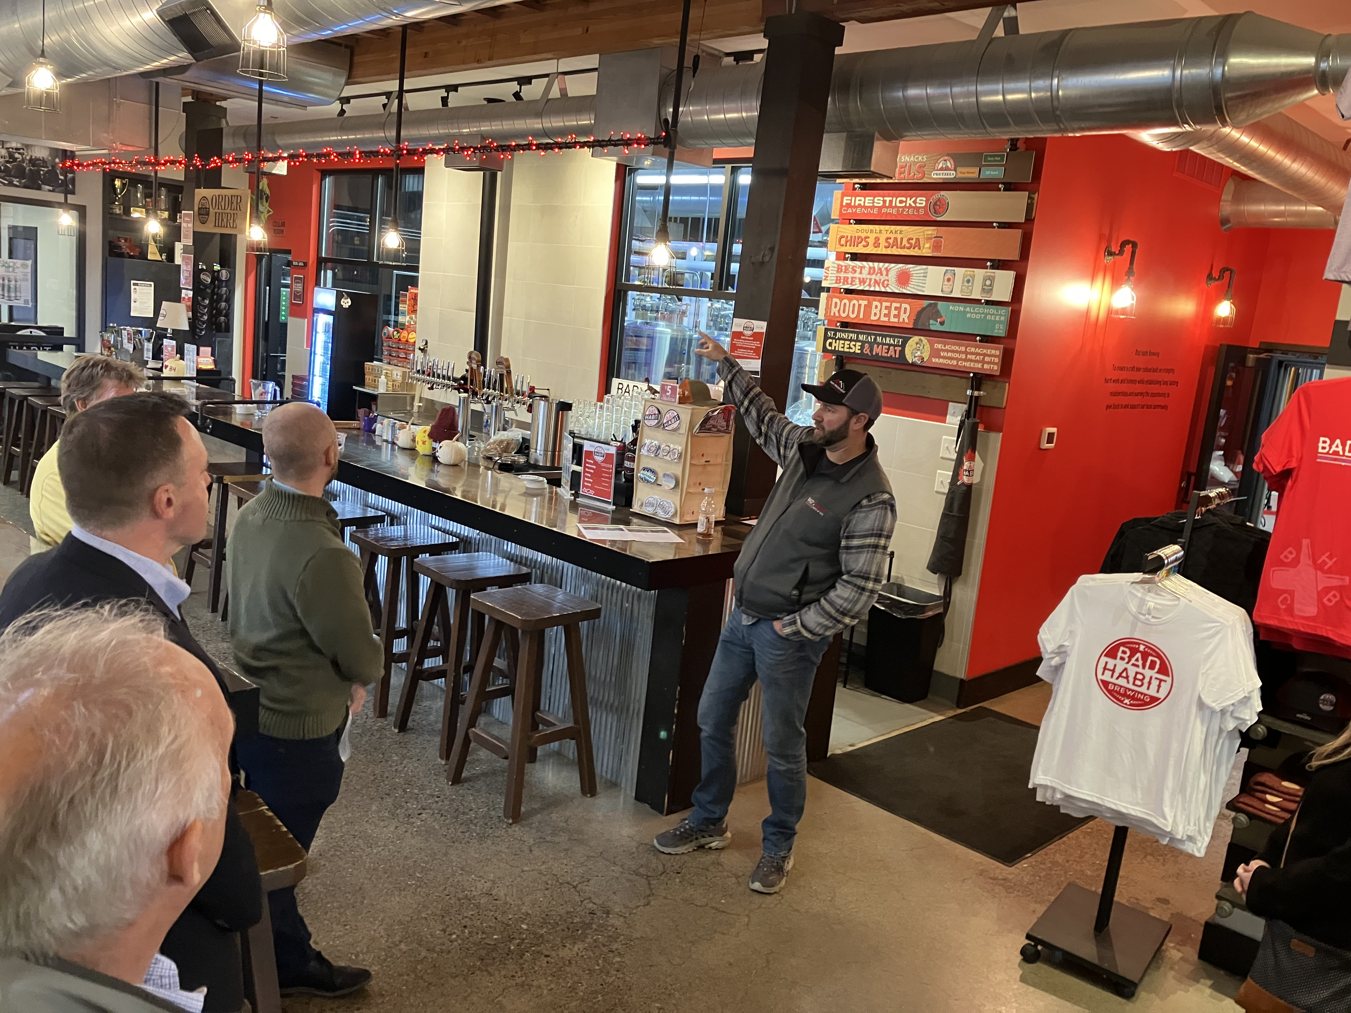
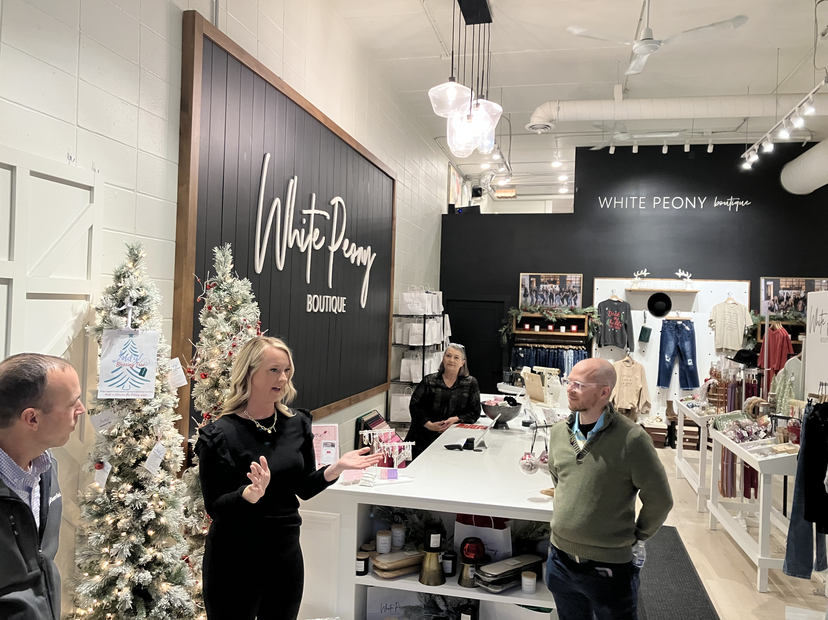
MN Small Business Development Center
9 regional centers with additional satellite locations across all of Minnesota
Season of Small Business – St. Joe's and Lake Street
2024 YTD:
Nearly 5,000 clients served
$200 million in capital infusion/equity
218 new businesses started in underserved communities
2025 Initiatives
Access to capital
Succession transitions

Slide 3
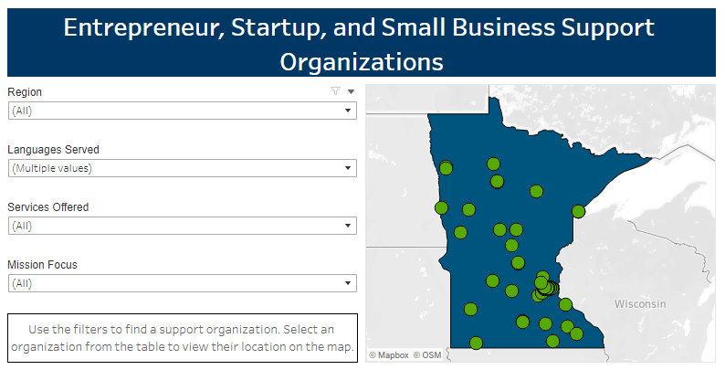
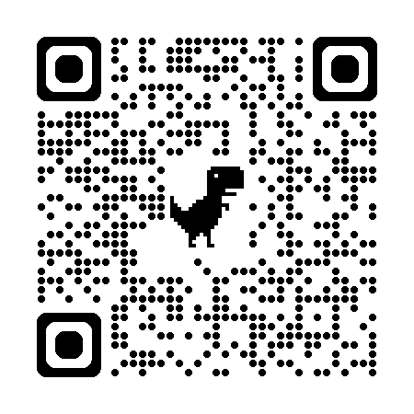
Community Partnerships
Find a partner that meets your needs:
Link to Partner Directory
https://mn.gov/deed/joinusmn/doing-business-here/grow-your-business/support/
Over 12,000 businesses served in the past 12 months!

Slide 4
Small Business Assistance
Provides timely, accurate and comprehensive information on the start-up, and operation of a small business in Minnesota. Information provided by:
Email : smallbusiness@state.mn.us
Telephone: 651-556-8425 800-310-8323
Online
Intake form
MN Small Business Call – 2nd Tuesday of each month at 2pm
Major topical publications available in print and online include (at no cost):
A Guide To Starting A Business in Minnesota
A Flipping Book version of the Guide
A Chatbot for Starting a Business (Launching Soon)
MN ELicensing Web portal –state licensing, permitting, registrations

Slide 5
Launch Minnesota
Regional Hub Leaders
Network dedicated 912.75 hours of support to 310 entrepreneurs statewide
227 new entrepreneurs entered the pipeline
112 new businesses formed during reporting period (~60% high tech)
Minnesota Medtech 3.0
Strategic team stood up
Managing director job posted and in process.
Submitting grant applications to fund MNCubator and HQ
Star of the North innovation conference
Broad-based innovation and economic development conf.
Multiple tracks, global footprint
Fall 2025/early 2026
Broad participation from across ecosystem and solid volunteer supply across workstreams
Currently prospecting financial support
Innovation Grant Cycle
Action | Date
Applications closed | November 29
Internal DEED scoring complete | December 27
Board discussion | January 14
Applicants notified | January 31
$1.5M awarded to 54 companies in 2024.
74% of funds went to targeted groups.
Notes:
Creating the future of global medical technology from Minnesota, delivering health outcomes for patients while inclusively growing the economy. Market MN to key global audiences. Onboard and connect innovators to assets and experts.

Slide 6
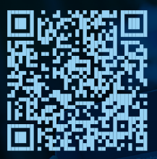
Small Business Funding
Small Business funding resources:
Grant opportunities
Tax credits
Loan capital (direct/indirect)
Equity investments
Finance / Join Us MN
https://joinusmn.com/doing-business-here/grow-your-business/capital/index.jsp

Slide 7
Grow Minnesota! Small Business Resources
One-on-one business assistance
Get started by completing this short Grow Minnesota! form and let us know how we can assist your business
Business resource guides
Download free resource guides to help you navigate existing programs and providers to access business funding, exporting assistance and workforce resources.
Other Chamber resources for small businesses
ChamberHealth
HR Now
Up to two hours of free consultation and follow-up assistance to identify potential resources and connections for your business.
Energy Smart and Waste Wise
More information here!

Slide 8
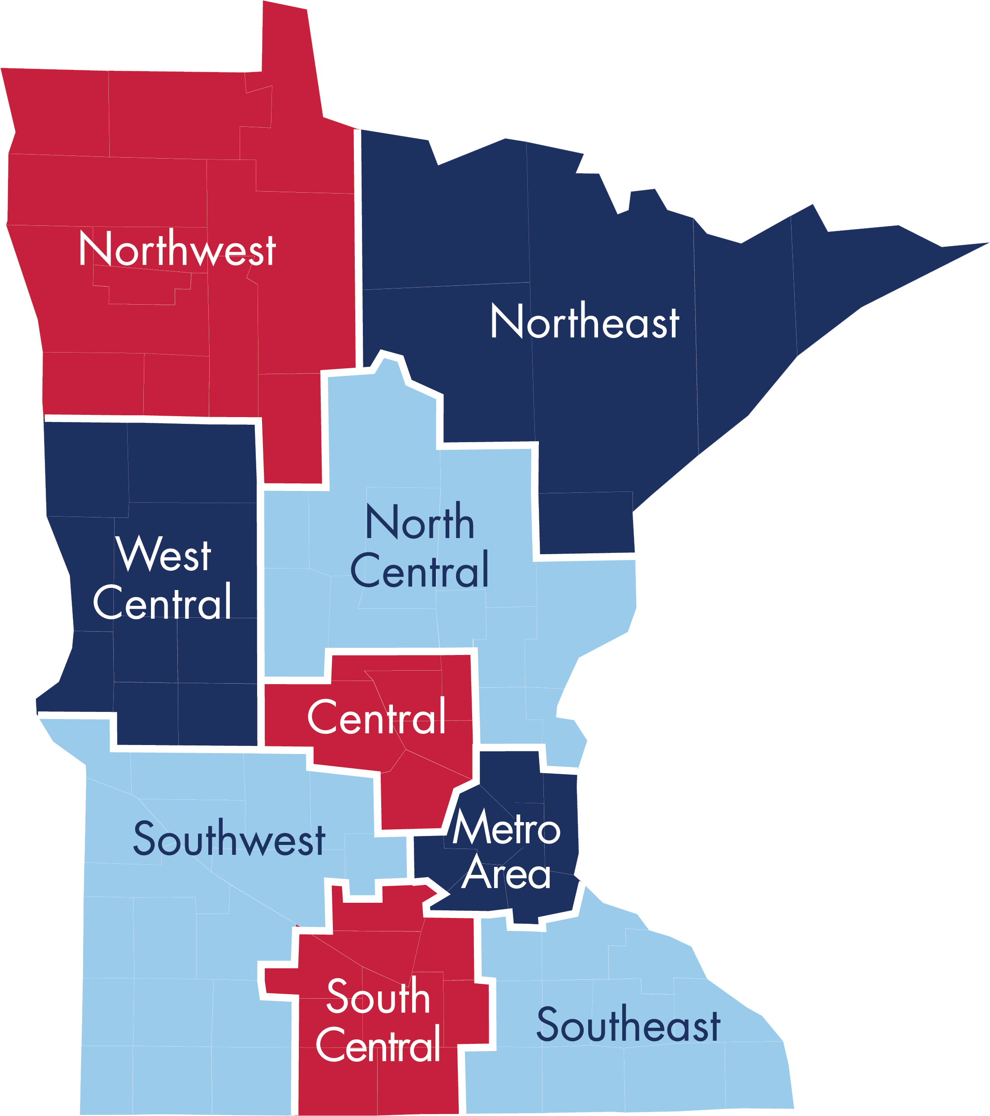
SBA Resource Partners are available to help small business owners start, grow, and thrive during the holiday season and beyond!
Supporting Entrepreneurs During
SCORE Business Mentoring
Services provided: small business owners are paired with volunteer current/former entrepreneurs in their industry for mentorship.
How to connect: find a nearby mentor here!
Small Business Development Centers (SBDCs)
Services provided: 1:1 counseling and Technical Assistance (TA) to small businesses (both start-ups and existing businesses).
How to connect: there are nine main regional SBDC offices and several satellite centers throughout the state. Find your local SBDC here!
Women’s Business Centers (WBCs)
Services provided: free to low-cost counseling and training focused on women entrepreneurs.
Locations: there are three WBC offices throughout the state.
Twin Cities Metro Region location is WomenVenture in St. Paul.
Greater Minnesota locations are Women’s Business Alliances (WBA) – Central in Little Falls & North in Duluth.

Slide 9
Transformative Career Pathway - Diversity and Inclusion for Small Employers Competitive Grants
Small businesses encouraged to apply for grants to help foster a more inclusive workplace
DEED’s Office of Adult Career Pathways is soliciting applications from eligible Minnesota small businesses for funding diversity and inclusion training to increase their ability to engage, hire, and retain people of color in a variety of roles.
Grants of up to $30,000 will be awarded to eligible businesses to contract with an established independent organization or accredited educational institution to provide diversity and inclusion training to the small business's employees.
Applicants must submit a diversity and inclusion implementation plan to DEED upon completion of the grant.
Applications will be accepted on a continual basis until all funds have been awarded.
Find out more and access application materials:
https://mn.gov/deed/about/contracts/open-rfp.jsp#9
Notes:
Small businesses are encouraged to apply for grants to help foster a more inclusive workplace through the Transformative Career Pathway Diversity and Inclusion for Small Employers Competitive Grant program
DEED’s Office of Adult Career Pathways is soliciting applications from eligible Minnesota small businesses for funding diversity and inclusion training to increase their ability to engage, hire, and retain people of color in a variety of roles.
An eligible small Minnesota business:
(1) is not an affiliate or subsidiary of a business dominant in its field of operation; and
(2) has 20 or fewer full-time employees; or
(3) in the preceding fiscal year has not had more than the equivalent of $1,000,000 in annual gross revenues; or
(4) if the business is a technical or professional service, shall not have had more than the equivalent of $2,500,000 in annual gross revenues in the preceding fiscal year.
Grants of up to $30,000 will be awarded to eligible businesses to contract with an established independent organization or accredited educational institution to provide diversity and inclusion training to the small business's employees.
Expenses under this grant are limited to costs incurred for diversity and inclusion training.
Applicants must submit a diversity and inclusion implementation plan to DEED upon completion of the grant.
Applications will be accepted on a continual basis until all funds have been awarded.
You can find out more and access application materials at the link on your screen, we’ll put that in chat as well.

