Slide 1
Airband Initiative
Connecting the Unconnected
Minnesota Governor's Task Force on Broadband
June 24, 2020
Aimee Sprung
Director, Airband aimees@microsoft.com

Slide 2
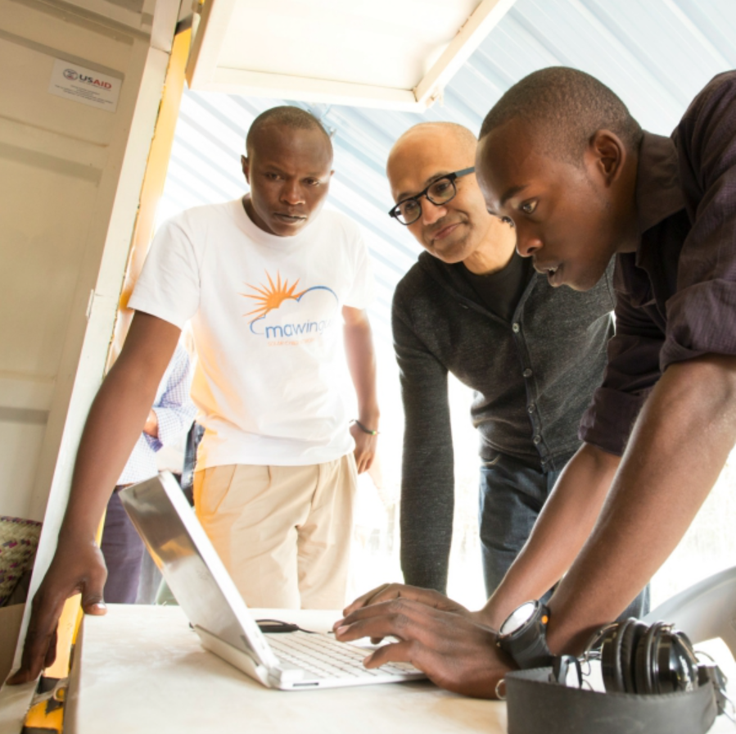
Microsoft Mission
“Empower every person and every organization on the planet to achieve more.” - Satya Nadella

Slide 3
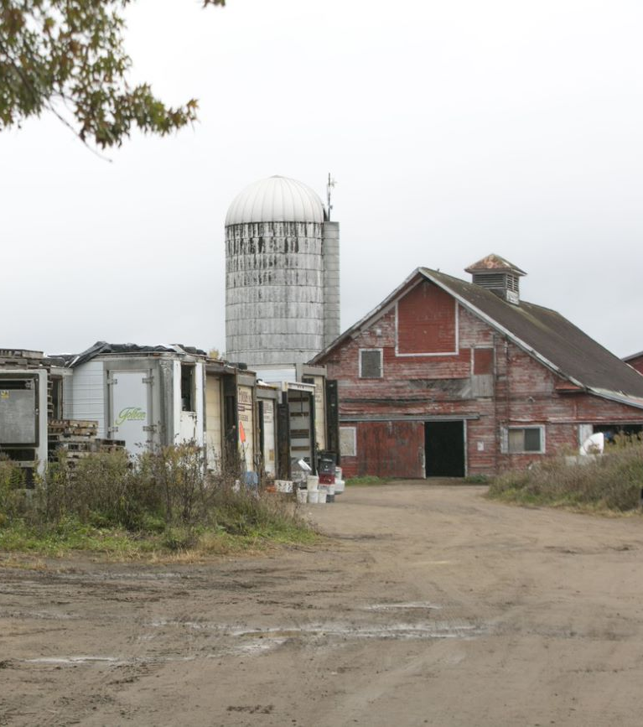
The connectivity gap in the United States
At least
18.3 million people
lack access to broadband¹
At least
14.4 million people
reside in rural communities¹
!. Source: FCC Broadband Deployment Report, 2019

Slide 4
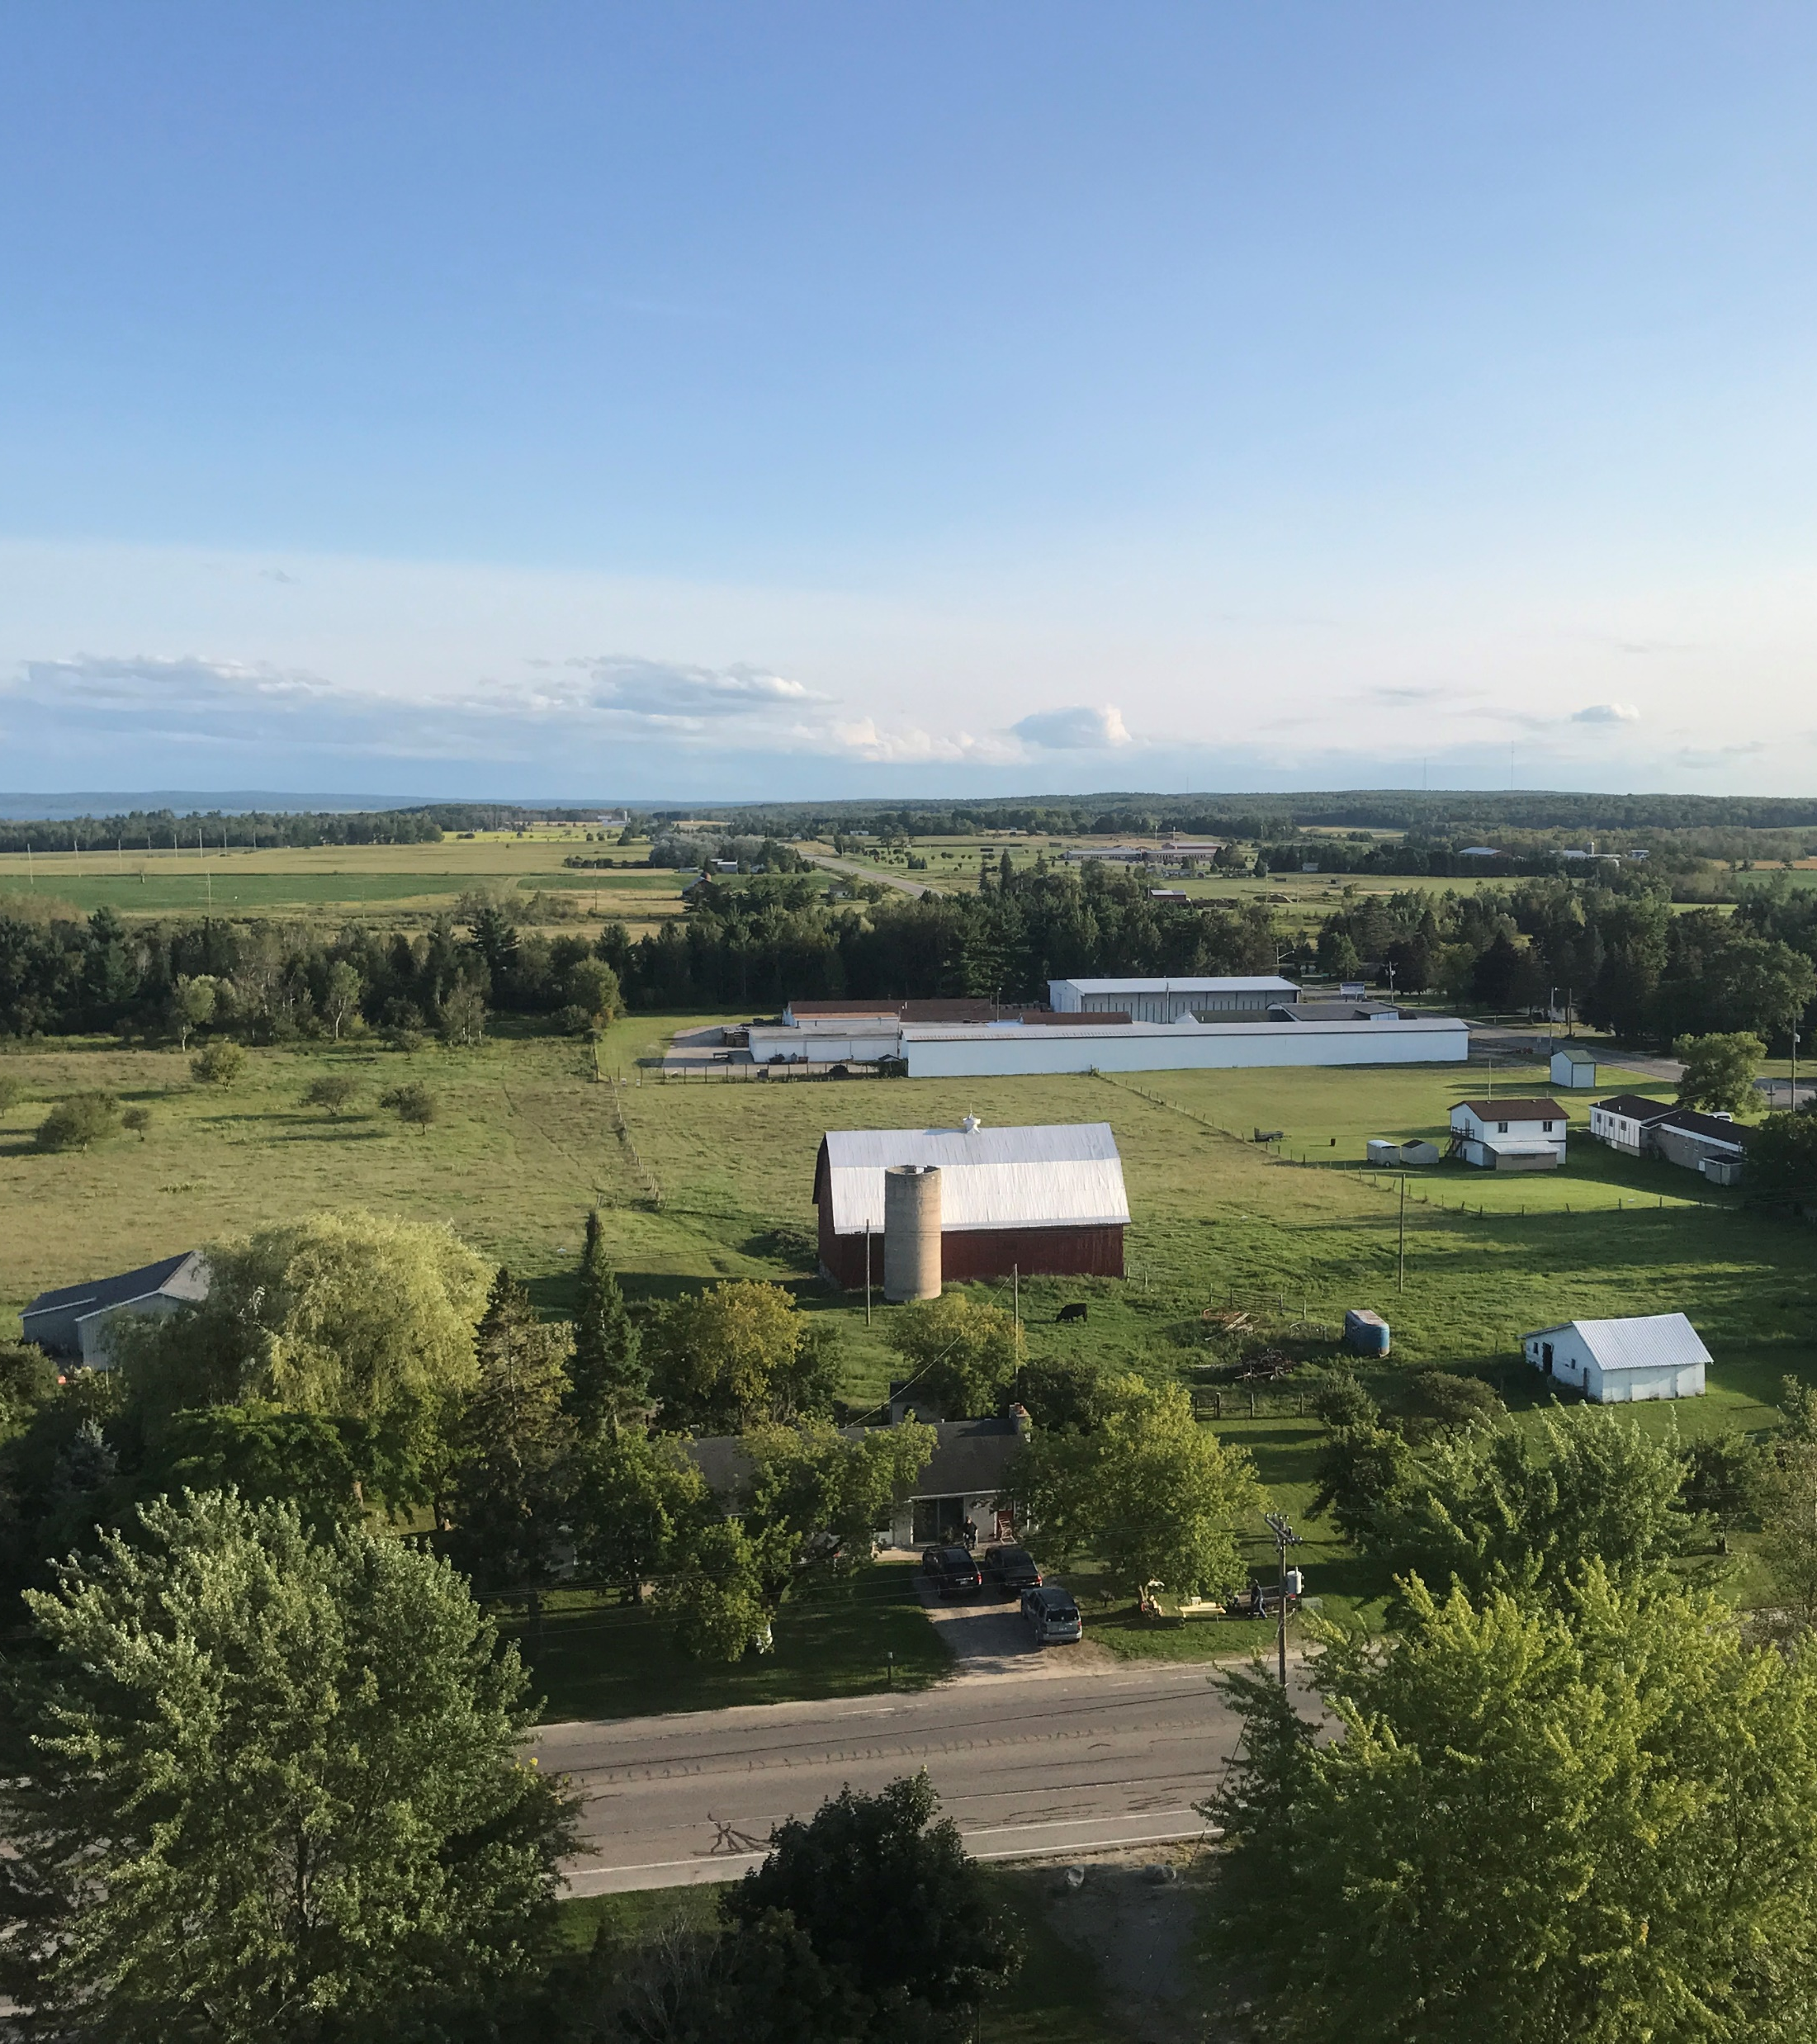
Airband mission - to connect the unconnected
Partner with equipment makers, internet and energy access providers, and local entrepreneurs to make affordable broadband access a reality for communities around the world.
3 Million
Projected people covered in
rural U.S. by July 2022
40 Million
Projected people covered globally by July 2022

Slide 5
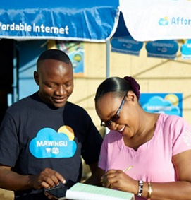
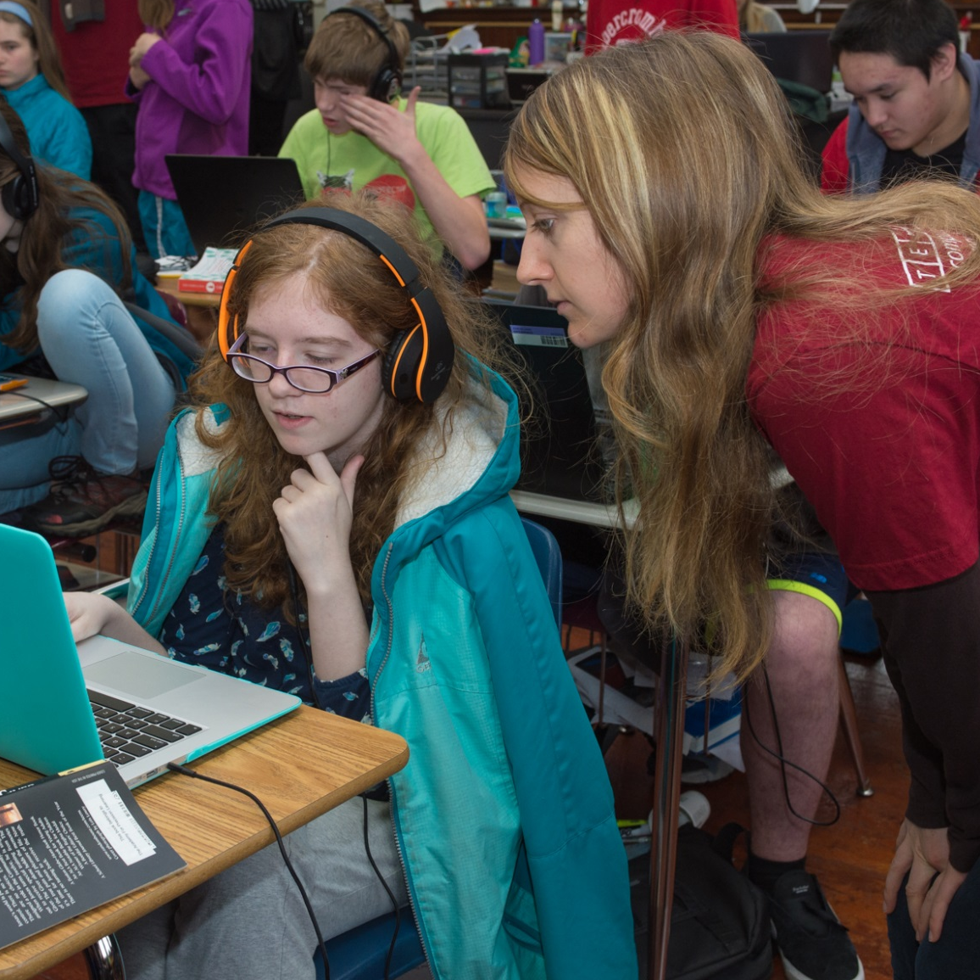
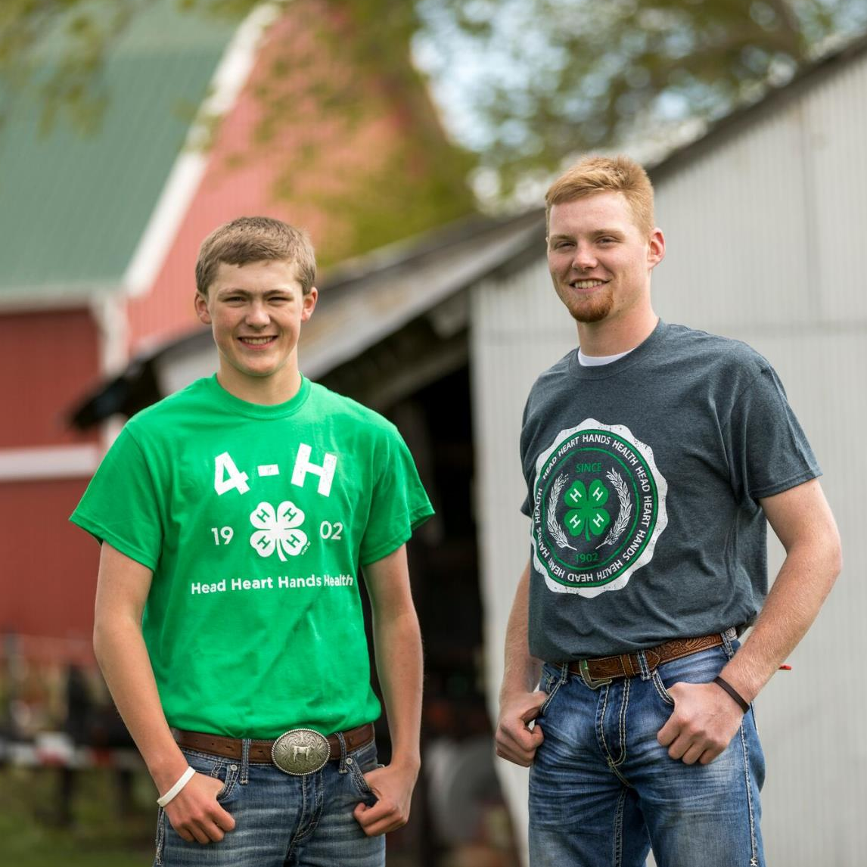
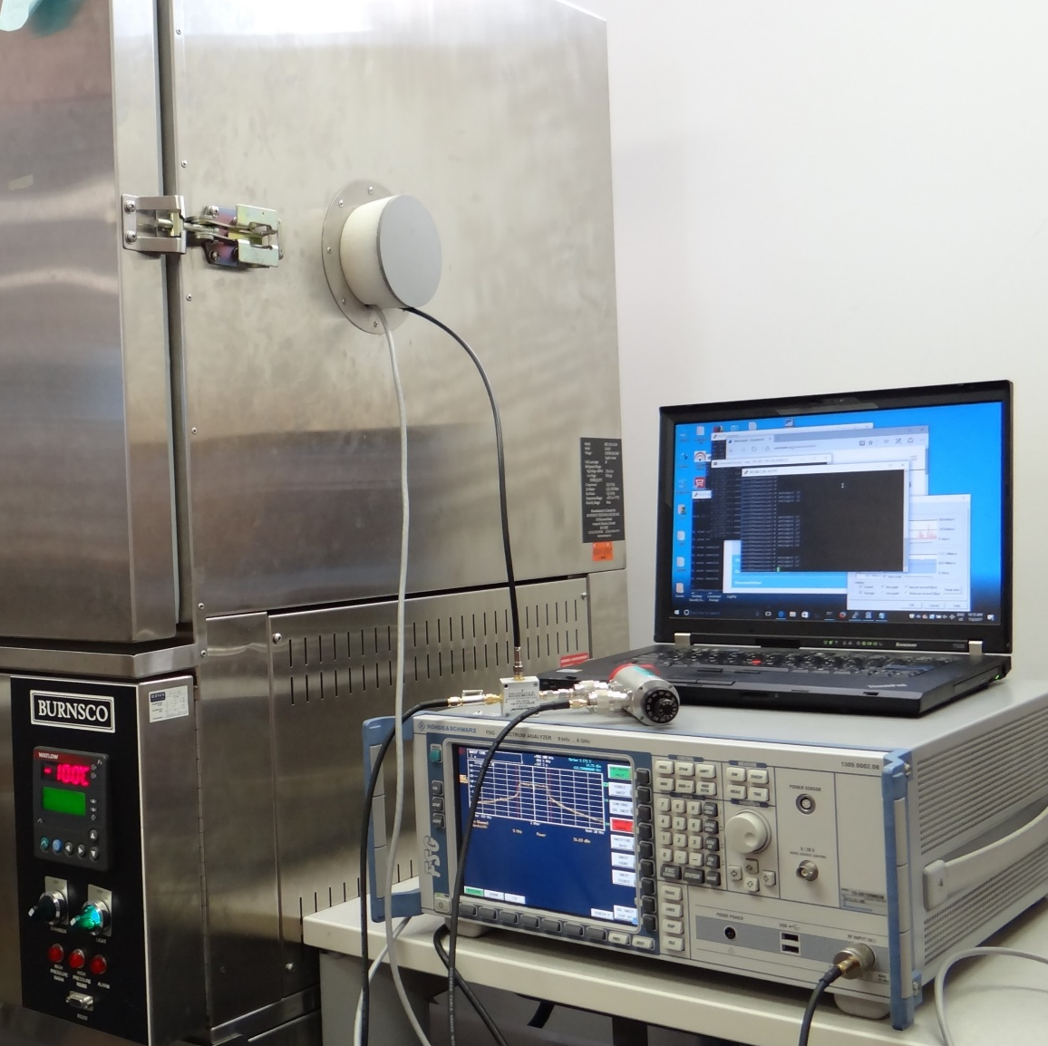
Our Approach
Incubate partnerships with ISPs and hardware manufacturers
Foster economic development in key broadband-enabled verticals: precision agriculture, healthcare, education, and small business
Commercialize scalable technologies and deployments

Slide 6
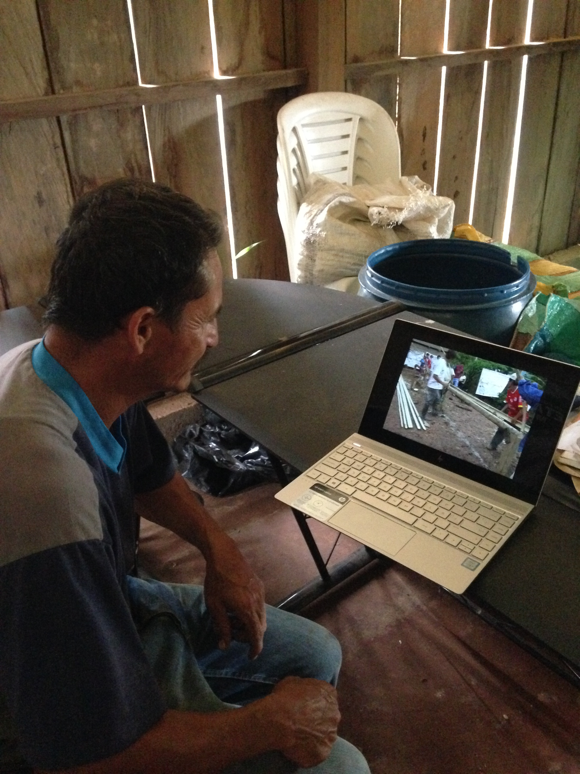
Focus areas
Healthcare
Telehealth services such as remote monitoring and videoconferencing can improve health outcomes while reducing costs
Agriculture
Farmers can boost income by finding new customers, improving productivity and reducing costs through technology
Education
Schools can expand learning options, offer virtual courses, and enable remote collaboration
Small business
Small businesses can use broadband to work remotely, provide more services and reach more customers around the world
Notes:
The Airband Initiative focuses on expanding broadband to bring digital transformation to four key areas:
Healthcare
Agriculture
Education
Small business
Broadband can enable telehealth services, help expand revenue and reduce costs in agriculture, facilitate virtual learning, and help small businesses reach more customers. These digital transformation efforts can help level the playing field for millions of people.

Slide 7
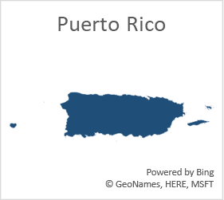
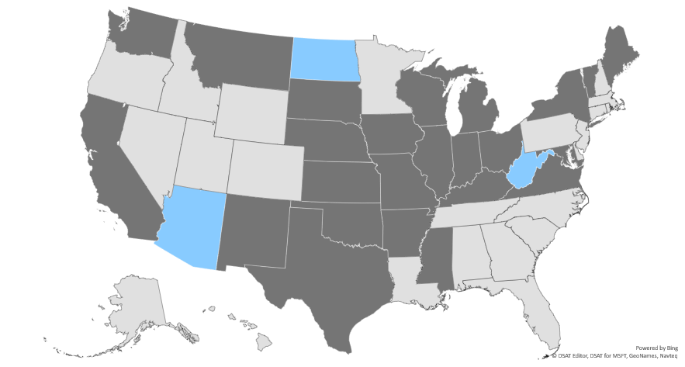
Airband Projects in 25 States & Puerto Rico
The overall NEW goal is to cover 3 million people in unserved rural USA by July 4, 2022
US States/Territories covered by Airband partnerships
as of April 2020
Pilot / Grant | Commercial
3 | 25
Commercial deals
Pilots/Grants

Slide 8


Astrea: Connecting Wisconsin and Michigan
Astrea is an internet service provider (ISP) servicing 85,000 customers in rural Wisconsin and Michigan’s Upper Peninsula. Astrea will leverage their fiber, hybrid fiber / coax (HFC) and wireless technologies to deliver low-cost high speed broadband access to some of the most rural areas in Wisconsin and Michigan.

Slide 9


Watch Communications: Connecting Indiana, Illinois, Ohio & Kentucky
Watch Communications is an internet service provider based in Lima, Ohio awarded funding from the Federal Communications Commission in the Connect America Fund Auction II to deploy fixed wireless services in Illinois, Indiana, and Ohio. Their CAF and current areas include extremely rural, low-density regions. They will deploy a variety of technologies and spectrums to bring these areas under coverage with an emphasis on TVWS in terrain-challenged areas to achieve improved coverage.

Slide 10
Airband COVID Response
The Airband COVID response is aligned to our initiative model, consisting of two channels: programmatic actions, and policy actions. Both channels are for, with, and through our existing partnerships. A customer-ready document provides more detail.
Programmatic actions | Policy actions
Mobilize Airband partners to maintain connectivity to customers financially impacted by the crisis. Support the deployment of hundreds of free public Wi-Fi hotspots. Work with Airband partners to develop low/no-touch installation protocols for socially distant service equipment installation and upgrades. Donate PPE to Airband partners. Fund and procure Television White Space (TVWS) radios to enable Airband partners to deploy Wi-Fi hotspots in locations not easily reached with other technologies. | Engage in with regulators to provide funding and policy recommendations in response to the connectivity crisis. Provide thought leadership around legislative solutions directed toward enabling connectivity for students, telehealth, and maintaining broadband connectivity for people facing COVID-related economic hardships. Advocate for state and local governments to remove blockers and accelerate permitting processes to eliminate delays in broadband infrastructure construction. In response to the rapidly-evolving government funding landscape, support our partners as they seek national funding for rapid rural broadband deployments, in support of telemedicine and distance learning in rural communities.

Slide 11
Innovative State Examples
Sell Through Member Based Organizations – Airband is partnering with a large corporation and the members of their cooperative. An Airband ISP will deploy a network and sell broadband services through these coop members to business and residential customers in rural unserved markets.
Public Library Association / Nebraska – The Public Library Association and the State of Nebraska have independently initiated projects to use anchor institutions (libraries or schools) who have access to fiber connectivity as broadband hubs. Community members would use fixed wireless access (FWA) to wirelessly connect to these anchor institutions to bring broadband access to people without additional infrastructure.
Broadband & Device Bundle for Students – Sell through the community college Airband is coordinating a partnership with an ISP and local device reseller to deliver a bundle of internet access and a device for their students.
Statewide Remote Learning RFP – States can use these Education Stabilization funds for remote learning and this may include broadband, devices and software. One state has issued an RFP for broadband, a virtual private network and devices and Airband can respond through a partnership with an Airband ISP and the Microsoft Store or a local device / software reseller.

Slide 12

Asks
Identify an ISP for Airband partnership
Extend skills for employability offerings
Consider innovative solutions

Slide 13
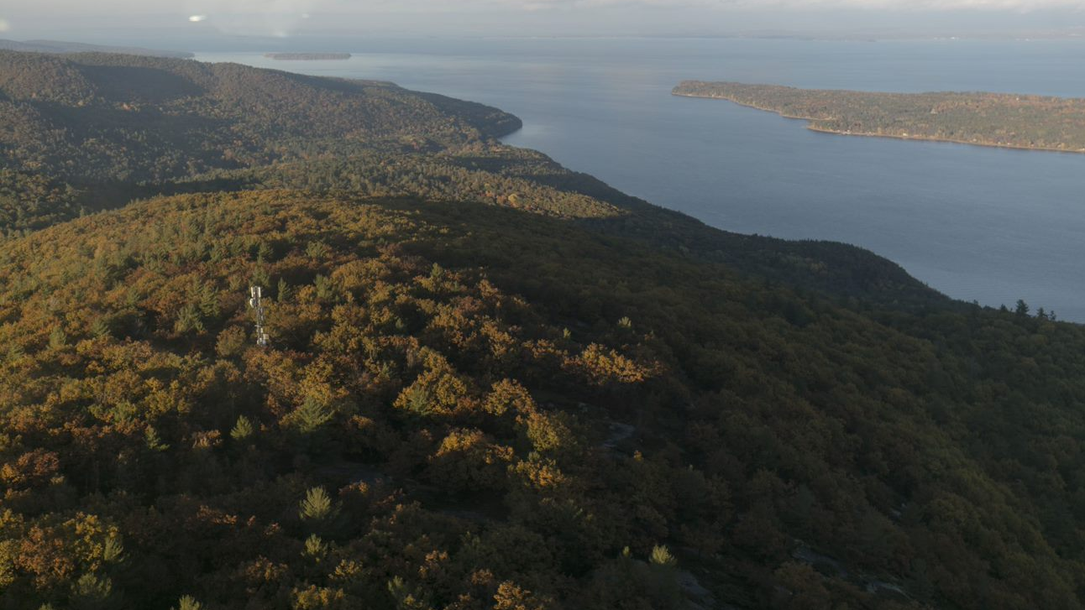
To learn more, visit microsoft.com/airband

Slide 14
Appendix

Slide 15




Airband COVID Response: Policy Recommendations
From its inception, the Airband Initiative has focused on both programmatic and policy solutions to the rural broadband gap. Federal, state, and local governments can move quickly to release funding and remove policy roadblocks to serving more rural Americans faster. Key examples include:
Congress We are calling on Congress to provide special, time-limited funding appropriations to address urgent needs, including establishing connectivity for students lacking broadband at home and maintaining broadband connections for people facing economic hardships as a result of COVID-19.
FCC We have provided specific proposals to the FCC for short and longer-term actions to leverage the Federal Universal Service Fund (USF) Programs and make spectrum policy changes. For example, we have called on the FCC to grant our long-standing petition clarifying that schools can wirelessly extend E-Rate-subsidized connections to students at home.
Other federal agencies We call on the United States Department of Agriculture (USDA) to make swift revisions to the ReConnect program and other broadbandfocused initiatives to promote broader participation, including the creation of shortterm emergency funding. We encourage the Bureau of Indian Affairs (BIA) to fast-track tribal broadband accessibility initiatives to mitigate the current crisis.
State and local governments State and local governments should, to whatever extent possible, remove blockers and accelerate permitting processes so that ISPs are not delayed in building and accessing towers and other pieces of key broadband infrastructure.

