Slide 1
Agricultural Worker Wellness Committee (AWWC)
Background on Executive Order
Interdepartmental committee forms in Spring of 2020
COVID-19 pandemic exposes and exacerbates challenges workers face.
Overview of Executive Order
Seeking to protect the ongoing safety, health, and wellbeing of workers critical to Minnesota's agricultural sector.
The wellness of these workers is essential to their families, communities, and the uninterrupted operation of Minnesota’s agricultural production and processing industries.
Notes:
An interdepartmental team convened in hopes of preparing for the upcoming season – the team included DEED, MDH, DLI, MDA. During the chaos of the pandemic, members of the team frequently changed. Both Maureen Ramirez and I were on this team from early on representing DEED.
In the first few months, we tried to get our hands around the migrant seasonal farmworker universe - we learned about some of the gaps and disjointedness inherent in the migrant and seasonal farmworker system
Housing is treated differently – some is employer provided, in some cases, workers find housing in communities. Some housing camps are inspected by the health department; some are inspected on a complaint basis by Fed. DOL Wage and Hour division.
Workplace conditions –
Data on migrant farmworkers is difficult to come by and not sure of its reliability
In ____, we held an agricultural employers forum pertaining most specifically employers of foreign workers (H2A visas) and migrant seasonal farmworkers
Provided resources and sounding board
Problem solved for specific instances during COVID
We found that services/assistance for MSFWs were not seamless even before COVID
As we neared the end of summer and continued to discuss next steps, the team decided that proposing a Governor’s Committee might help with the following season as well as address gaps in the system regardless COVID
And so the initial concept of the Governor’s Committee on the Safety, Health, and Wellbeing of Agricultural and Food Processing Workers was drafted.

Slide 2
Agricultural Worker Wellness Committee (AWWC)
AWWC Objectives
Respond to safety and health challenges confronting agricultural and food processing workers during the COVID-19 pandemic.
Develop a plan to effectively deploy public, private, and non-profit compliance resources to promote wellness of these workers with a focus on housing, transportation, and workplaces.
Develop effective communication between state agencies, community organizations, advocacy groups, and employers and workers.
Provide a forum to engage, collect, and analyze data and information, coordinate resources, and plan for future growing seasons.

Slide 3
Questions?

Slide 4
Agricultural Worker Terminology
Migrant and Seasonal Farmworker Services connects farmworkers to agricultural/food processing employment among other services.
Migrant Farm Worker is a person who travels to do seasonal farm work and is unable to return to his/her permanent residence the same day.
Seasonal Farm Worker is a person who performs seasonal farm work and able is to return to his/her permanent residence the same day.
Immigrant is a person who comes to live permanently in a foreign country.

Slide 5
Migrant Seasonal Farmworker Services
Minnesota Department of Employment and Economic Development (DEED) CareerForce Division oversees Migrant Seasonal Farmworker (MSFW) Services
Migrant Labor Representatives (MLRs) work directly with migrant workers
State Monitor Advocate ensures that MSFW services are implemented correctly
Services Provided
Outreach to farmworkers
Assistance to agricultural employers

Slide 6
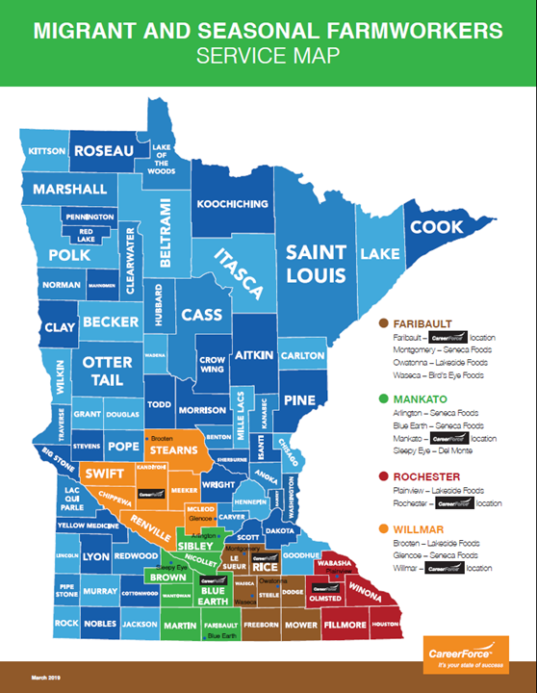
Migrant and Seasonal Farmworker Services
Faribault
Martha Castaneda – MLR
Willmar
Josefina (Josie) Chavez - MLR
Mankato
Janie Sandoval - MLR
Rochester
Silvia Owens - MLR

Slide 7
Migrant and Seasonal Farmworkers
Who are Minnesota’s migrant seasonal farmworkers?
Most migrant farmworkers come to Minnesota via the Midwest Migrant Stream, primarily from Texas (supply state)
510 registered MSFWs in Minnesota - a fraction of the actual number
81% travel to Minnesota for work (migrant vs. seasonal)
25% are 60+ years old
97% identified as Hispanic/Latino
61% reported Limited English Proficiency (often a barrier for workers)
37% report earning wages of $10-10.99/hour
Strong work ethic oftentimes working 12 hour shifts and working when ill or injured.

Slide 8
Questions?

