Slide 1
Improving Broadband Access and Opportunities
Bree Maki | Executive Director, Office of Broadband Development
September 19, 2023

Slide 2
Minnesota Office of Broadband Development (OBD)
Created in State Law in 2013, first grant round 2014
Purpose: to encourage, foster, develop, and improve broadband within the state in order to: drive job creation, promote innovation, and expand markets for MN businesses; to serve the growing needs of Minnesotans for education, healthcare, public safety, industries and businesses, governmental operations and citizens; and improve accessibility for underserved communities and populations (Written 7 years before COVID!)

Slide 3
MN Broadband Policy Framework
Statutory Goals
Broadband Office/Task Force
Data (Mapping Program)
Tools (Infrastructure Grants/Digital Equity)

Slide 5
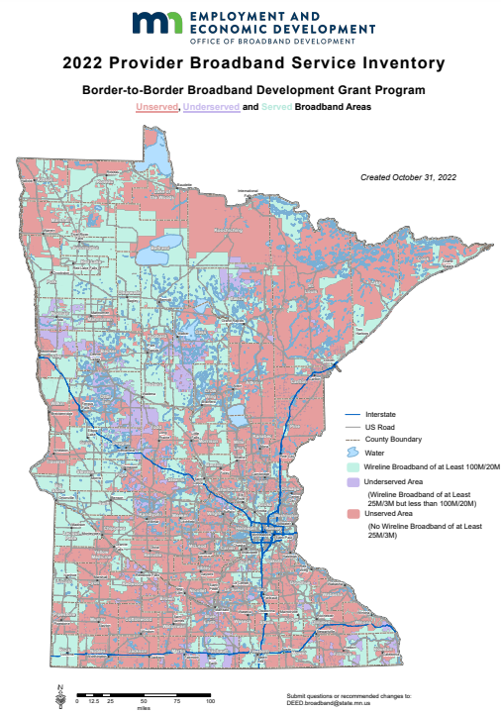
Minnesota’s Unmet Needs
198,000 households without access to 25/3 (2022 goal)
291,000 without access to 100/20 (2026 goal)
State Statutory
Broadband Goals:
All homes and businesses will have access to broadband service of at least:
25 Mbps download by 3 Mbps upload (current FCC definition) by 2022
100 Mbps download by 20 Mbps upload by 2026
Numbers from November 2022

Slide 6
Infrastructure Grant Programs
Border-to-Border Broadband Infrastructure Grant Program (premier program);
Lower Population Density Program (within Border-to-Border program framework);
Line Extension Program

Slide 7
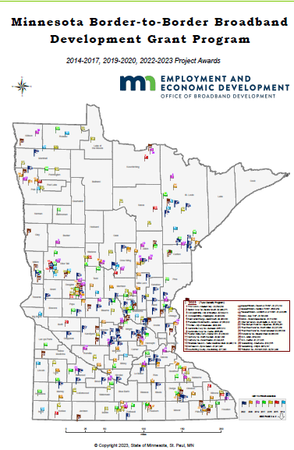
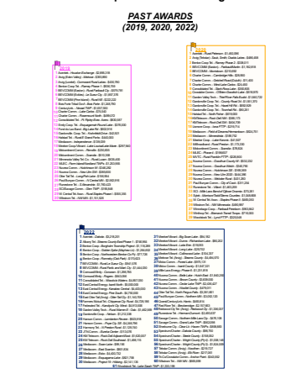
Historical Project Awards

Slide 8
Infrastructure Investment and Jobs Act (IIJA)
The Federal Government is making approximately $65 billion available for broadband nationwide. There are two programs under that broadband funding include state involvement with funding administered through the National Telecommunications and Information Administration (NTIA) of the U.S. Dept. of Commerce. Minnesota will receive a formula-based allocation for each program. Each program requires the state to develop a plan for how it will spend its allocation.
The Broadband Equity, Access and Deployment (or BEAD) Program - $42.5 billion
Development of this Plan has started and is due July 12, 2023 (Initial plan for the plan)
5 – year Action Plan submitted and posted July 2023
Draft BEAD Plan due December 31, 2023 and final plan due 365 days after initial plan approved
Projects to be complete 4 years after final plan approved

Slide 9
How Broadband Equity, Access and Deployment (BEAD) Funds Will Be Used
The MN Legislature has directed that any funding from IIJA for Broadband (i.e. BEAD) flow through the existing Border-to-Border programs
Details will be in the Initial Proposal (challenge process, eligible locations, subgrantee selection, high-cost threshold formula)
BEAD has priorities that the Initial Proposal has to demonstrate are met:
Priority #1: Service to all unserved locations (those identified on FCC maps as not having broadband service at speeds of at least 25Mbps download/3Mbps upload from broadband service provided over a wired connection or licensed fixed wireless)
Priority #2: Service to all underserved locations (those identified on FCC maps as having broadband service of at least 25/3 but not at or above 100/20 over a wired or licensed fixed wireless service)
Priority #3: Gigabit symmetrical service to Community Anchor Institutions
Minnesota’s allocation is $651,839,368 and will all be needed to address Priorities #1 and #2
Challenge process in early 2024 to establish final list of eligible locations—only local governments, nonprofits and providers can participate in the challenge process—more information will be coming on how to participate

Slide 10
Timeline from the Minnesota Five Year Action Plan submitted to NTIA in July 2023

Slide 11
Locations Eligible for BEAD Funding
NTIA defines eligibility--
If a location does not have reliable broadband service of 25/3 it is unserved (red on map)
If a location has reliable broadband service of 25/3 but not at or above 100/20 it is underserved (orange)
If a location has reliable broadband service at or above 100/20 it is served (green on map)
Reliable broadband service per NTIA includes wired or licensed fixed wireless service
State eligibility for Border-to-Border and Lower Population Density grants have historically only considered wired broadband service
We are planning the challenge process which will follow guidelines issued by NTIA—possible some areas that are green on map will flip to red if valid challenges are filed

Slide 12
Digital Equity Act: The Basics
Provides $2.75B for digital equity programs and activities
Three funding categories:
$60M in planning grants to states, tribes, and territories (MN = $881,905.10)
$1.44B in capacity grants to states, tribes, and territories
$1.25B in competitive grants to local governments, anchor institutions, etc.
2023
2024 - 2028
MN uses a Capacity Grant to implement the Digital Opportunity Plan
NTIA administers one Competitive Grant round each year
MN uses Planning Grant to develop statewide Digital Opportunity Plan due November 30

Slide 13
Where We’ve Been and Where We’re Going
January
25: OBD kickoff event at Mystic Lake
February
8, 15, 22: Virtual office hours for prospective DCCs
March
April
3: DCC work began
May
3: Grant apps due
All month: 1:1 check-ins with grantees
June
July
30: Data submission deadline
So much writing
August
21: Draft posted, public comment period opened
September
29: Final day for public comment on draft plan
October
Revisions
November
30: Final plan due
December

Slide 14
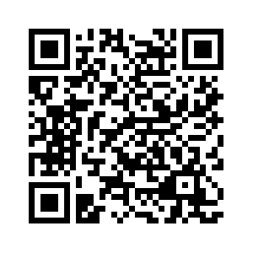
Where We Are Now
A full draft of the plan is posted online
The public comment period is open through September 29
Online form
By mail
Listening sessions: 16 in-person + 2 virtual
Tomorrow at 6pm in Deer River
Thursday at 1pm in Minneapolis
9/26 at 6:30pm in International Falls
9/27 at 10am in Bemidji and virtually at 2pm
OBD’s Digital Opportunity Website
https://shorturl.at/wNOST

Slide 15
FCC Affordable Connectivity Program
Funding (up to $30/month for eligible households, $75/month for eligible households on tribal lands) to assist with the monthly cost of broadband service
Administered by the FCC (not OBD)—households sign up and funding goes to participating provider serving the household—funding could exhaust by May 2024
More information is available on our website and on the FCC's website
Notes:
We understand that one of the barriers to having broadband service is the ability to afford the monthly fee. The Federal Communications Commission has a program where eligible households can qualify for up to a $30/ month discount. We do have a handout on this as well.

Slide 16
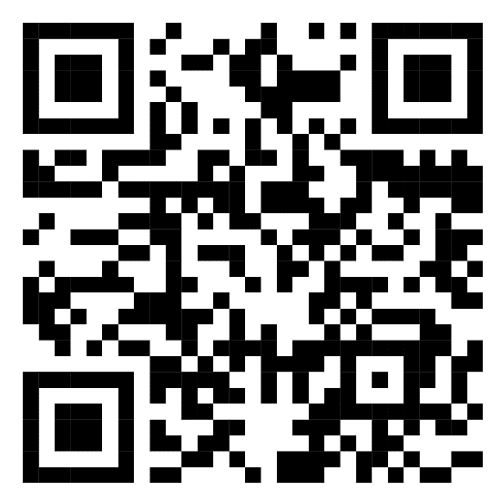
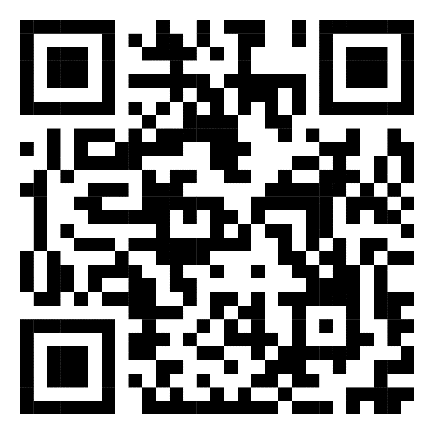
Contact Information
bree.maki@state.mn.us
deed.broadband@state.mn.us
deed.broadband.equity@state.mn.us
(651) 259-7610
OBD’s Main Website
Digital Equity Plan
tiny.cc/OBDwebsite
tiny.cc/OBDinclusion

