Slide 1
Broadband Navigator™
Challenge and Rebuttal Submission

Slide 2
The Broadband Navigator™
The Broadband Navigator consists of 3 distinct parts:
The Public Facing Map
Use the Public Facing Map to navigate your state’s broadband environment. This map is open to all users and the public.
The Challenge Hub
The public can submit speed tests and availability evidence submissions. Registered users can submit challenges through The Broadband Navigator™ Challenge Hub. The challenge hub will guide users through the evidence and challenge submission steps of the BEAD Challenge Process.
The Challenge Dashboard
This feature is available to all registered users and can be used to manage, view, and track challenges through their BEAD Challenge Process lifecycle.
Today, we will be focusing on the Challenge Dashboard for Broadband Providers

Slide 3
Recap: Using the Broadband Navigator Tools and Submitting a Challenge

Slide 4
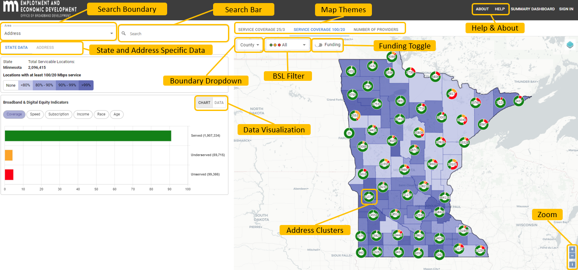
Recap: The Public Facing Map

Slide 5
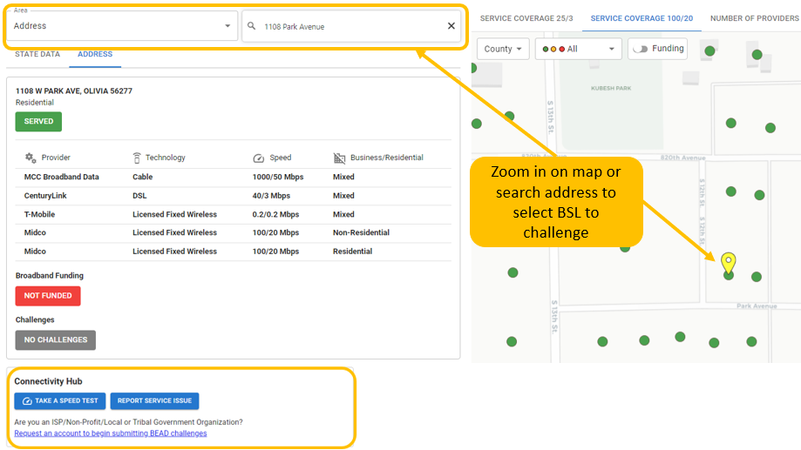
Finding the BSL

Slide 6
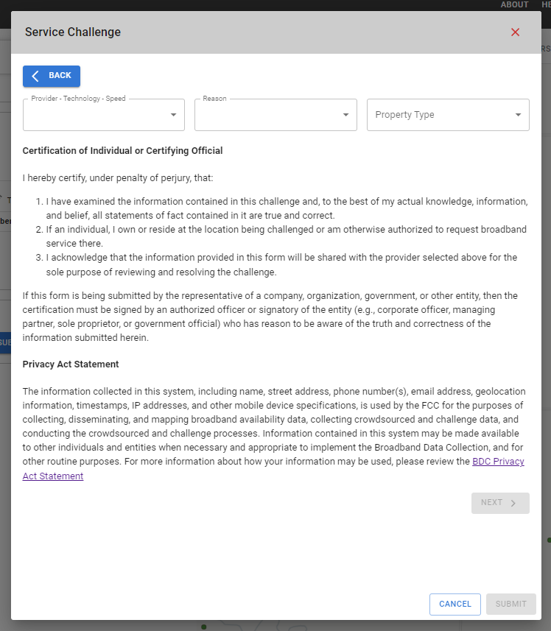
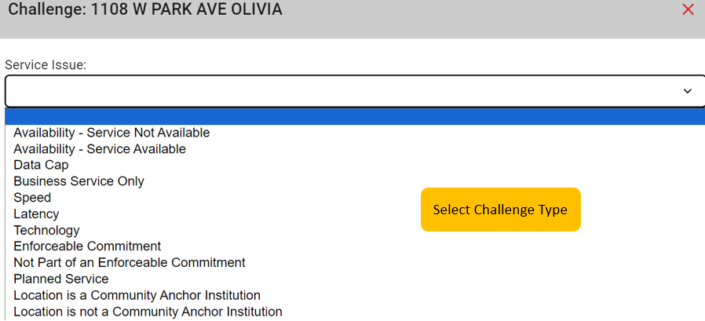
Using the Challenge Hub

Slide 7
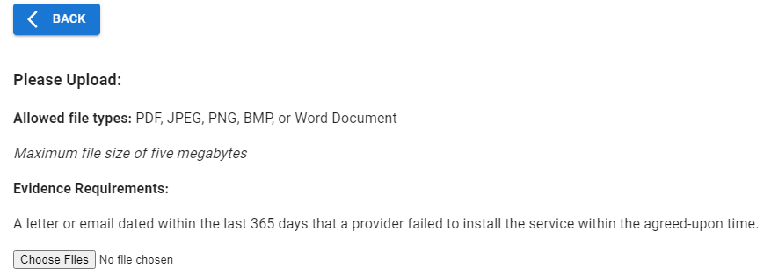
Submitting Evidence
Upload Challenge Evidence

Slide 8
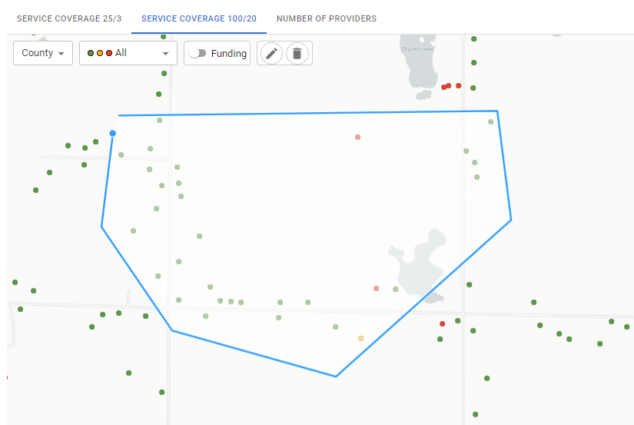
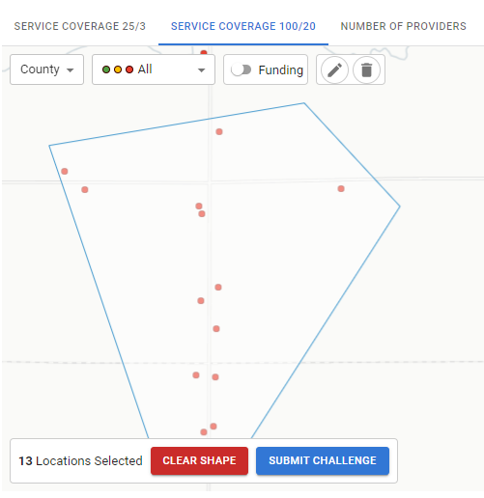
Bulk Challenge Submission
Delete Drawing
Draw Boundary
Once draw tool is selected, click for boundary starting point, turning point, and to connect to end point

Slide 9
Adjudicating a Challenge

Slide 10
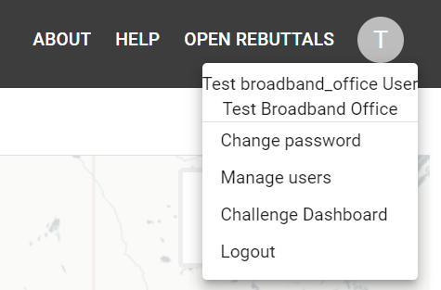
The Challenge Dashboard
Access the challenge dashboard by selecting the user icon in the top right corner of the application.
Select ‘Challenge Dashboard’ from the options on the dropdown.

Slide 11
Challenges
Review and manage all submitted challenges through the BEAD lifecycle!
​Review Challenge details:
Address
Challenger
Assignee
Bulk Challenge ID
Provider
Challenge ID
Challenge Type
Submitted Date
Actions
Search for a challenge by challenge ID or address.​

Slide 12
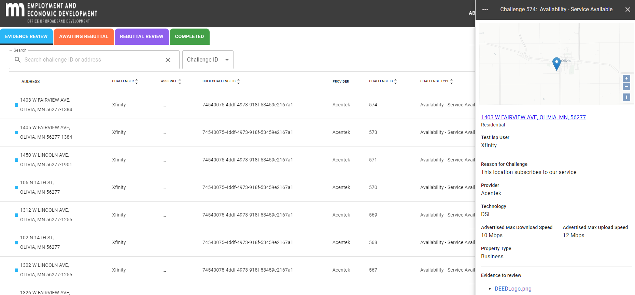
Select a challenge to initiate a pop-up window with more information on the challenge.​

Slide 13
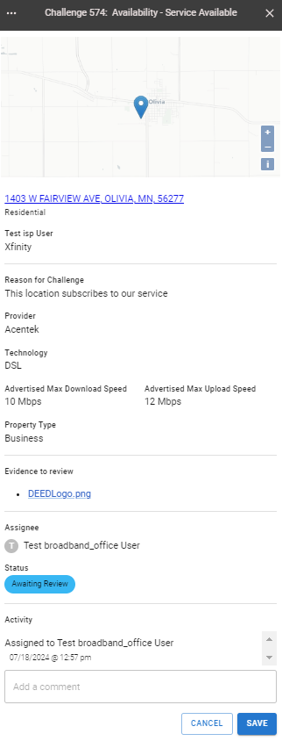
View challenge details such as address, location, challenger, challenged provider, and property information.
Download evidence for every challenge.
Assign reviewers in your organization. ​
View each challenge's current status.
Leave comments for other reviewers and follow comment history attached to the challenge.

Slide 14
Accept or Reject challenges based on evidence:

Slide 15
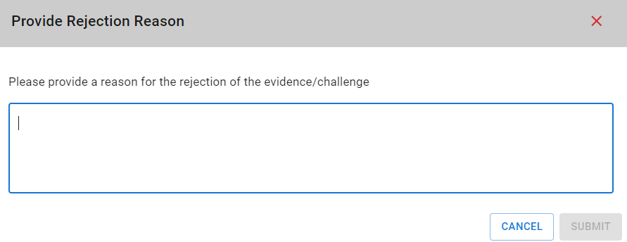
Reject a challenge and will ask you to state the reason for rejection before being moved to 'Completed' with a Challenge Status of 'Evidence Rejected'. This challenge's lifecycle is over, as it has been rejected.

Slide 16
Accept a challenge and will be moved to 'Awaiting Rebuttal.' The challenge will remain here until a registered user submits a rebuttal or until the challenge phase is over.

Slide 17
Rebuttals
If a user submits a rebuttal, the challenge will be moved to the 'Rebuttal Review' section.

Slide 18
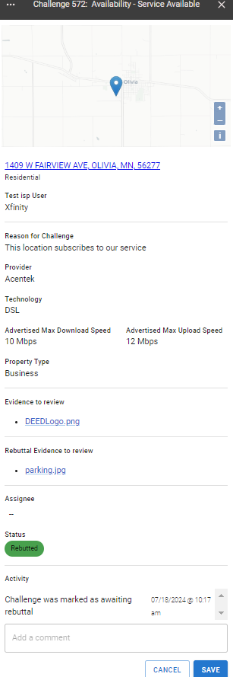
Select the challenge to view more information on the challenge and rebuttal.
Download evidence for the rebuttal.

Slide 19
Accept or Reject the challenges and they will be moved to 'Completed'.

Slide 20
This is the end of the challenge's life cycle! The final status will be shown here for users.

