Slide 1


CAREER PATHWAY
Demonstration
Project
Kati Neher, Program Coordinator
Kati.Neher@co.anoka.mn.us
763-324-2277

Slide 2



CAREER PATHWAY TRAINING OPTIONS
Business Services Industry Manufacturing Industry Health Care Industry
Call Center Agent Training Warehouse Associate Training Basic Life Support/First Aid
Office & Administrative Training Precision Sheet Metal Training Certified Nursing Training
911 Telecommunications
In Partnership with:
Metro North Adult Basic Education Anoka Ramsey Community College
Anoka Technical College CareerForce in Blaine
Various Local Employers

Slide 3
Information Sessions
Offered every Monday. No registration necessary.
Detailed information is presented about all Career Pathways for customers to make an informed choice about which program they would like to enter.
If interested in training, a Universal Application is filled out and the eligibility verification process is started.
Notes:
Information Sessions or offered in AM one week, and in the PM the week after
Facilitated by Career Navigators
Intake Technicians review applications

Slide 4
Career Pathway
On-Boarding Navigator’s
Role
Engage customers early on in the process.
Once determined eligible, On-Boarding Navigator will advise applicant about the next steps to take place.
If ineligible or interested in a different training, follow up with customers to provide an overview of other services available.
If applicant needs to brush up on basic skills, bring applicant back to reapply for training when ready.
Seamless transition to assigned Career Navigator
Notes:
Assist with career exploration and vocational counseling when interested in multiple pathways trainings or other career search activities
Goal setting and case management for participants who don’t meet initial assessment cut scores
Collaborate with Metro North
Track participant progress
Connect with community programs and resources
After completion of intake and assessment testing process pass file to Navigator

Slide 5

On-Boarding Navigator will set up 2-hour Refresher Course:
  Prepare for math and reading assessment
  Reduce text anxiety and other barriers
  Increase individual’s confidence
  Review how to use a graphing calculator
  Additional Next Steps:
    TABE Testing
    Computer and typing assessments, if needed
If applicant meets test scores they are referred to the assigned Career Navigator to develop a Career Pathway Training plan.
Notes:
test taking basics/strategies
practice questions for both subject areas
brush up basic math skills formulas and how to use the calculator
relaxation techniques and ways to combat test anxiety
go over sample tests and answer any questions they may have
can refer them to Distance Learning opportunities if they are interested

Slide 6
Leveraging Funding and Resources
Intake Technicians will assess Eligibility for other Anoka County programs:
  Senior Employment Services
  WIOA Adult and Dislocated Worker Program
  WIOA Youth Program and Minnesota Youth Programs
On-Boarding Navigator will Refer to other Programs or Services:
  Disability Resource Coordinator for assistance with accommodations like Assistive Technology for Training and Employment or Advocacy
  Job Search Classes offered at CareerForce in Blaine
  Metro North or other training facility for brush up on basic skills
  Other Community Resources
Notes:
Universal Application

Slide 7
Career Pathway
Navigator’s
Role
Assist participants through training, job placement and retention.
Work individually and within group cohort to promote active engagement in program components.
Review rules and expectations, troubleshoot problems and issue support services as needed.
Coordinate resume and interviewing workshops for participants.
Provide coaching and guidance regarding career decision making and employment opportunities.
Work with Workforce Development Specialist to coordinate industry specific hiring events.
Notes:
Collaborate with Metro North and college
Track participant progress
Connect with community programs and resources

Slide 8
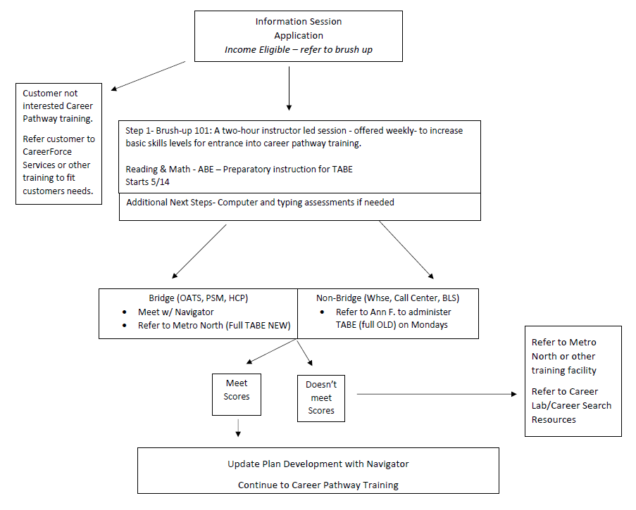

Slide 9
Successful Graduation and Follow-up
Upon graduation each career pathway has committed employer partners who actively seek out successful graduates for employment.
Industry specific hiring events at CareerForce in Blaine, coordinated by Workforce Development Specialist.
Career Navigator will follow-up with participant to establish how things are going on the job and help resolve any professional or personal issues that could impact job retention.
Notes:
Hiring events scheduled around training graduations

Slide 10


Questions?

