Slide 1

Notes:
Welcome to Comcast! We’re glad you’re here and we’re excited to give you an overview of our industry, our company and the important work we’re doing across the Twin Cities Region to support strong businesses and strong communities.

Slide 2


Chris Hanna
Sales Engineering Manager
Comcast Business
Notes:
While Comcast Business is the fastest-growing segment within the Comcast portfolio, people are often surprised by the scope and breadth of our offerings.
Whether businesses want to connect with customers via the Internet, use advanced cloud services or link multi-site operations together on a secure, private network, Comcast Business provides network solutions that work.
We offer business-to-business Internet, Voice, Video and fiber optic services.
From a single-person office to large, multi-national corporations, Comcast Business has affordable, reliable and scalable technology solutions . . . and as businesses change, Comcast Business changes with them.

Slide 3

How It’s All Possible: We Invest
Comcast invested more than $40 million in Twin Cities Region network expansion since 2016
More than $6 million in network expansions in downtown Minneapolis, bringing greater competitive choice to hundreds of new businesses
Introduction of ubiquitous 1-Gig internet service to Twin Cities area businesses using Comcast’s existing network
Activation of enterprise-level Comcast Business ActiveCore SDN platform, the first cable-delivered, gigabit-ready SDN platform allowing businesses to manage networks, systems and costs across multiple locations.
Notes:
How do we do it? We invest to ensure we can meet consumer demand.

Slide 4

How It’s All Possible: We Leverage Our Reliable & Scalable Network
Introduced world’s first DOCSIS 3.1 technology to deliver gigabit internet speeds.
Comcast’s DOCSIS 3.1-based business internet service provides gigabit speeds for any business environment – whether a distributed enterprise with locations across the country or a small business with only a handful of locations.
Its speed and cost efficiencies make it ideally suited for government agencies and organizations in the retail, healthcare, manufacturing, hospitality and education industries.
The service tiers complement existing gigabit and multi-gigabit options already available to Comcast Business customers, including Comcast Business Ethernet, which the company launched in, and has been expanding nationally since, 2011
Notes:
We leverage the power of our network. And, we work hard to connect you to what’s most important—better than anyone else.

Slide 5
WHY COMCAST BUSINESS?
COMCAST’S ENTERPRISE SERVICES PROVIDES A ONE-STOP SHOP FOR YOUR MANAGED NETWORK NEEDS
We will design, build, implement, and manage a customized communications network for you anywhere in the continental US.
WE WILL ACCOMPLISH THIS BY LEVERAGING:
Our industry leading Business Internet and Ethernet network infrastructure
Our deep, rich relationships with leading providers
Our continual network investment; $4.5B and we’re not done
Our extensive Managed Services portfolio
One Source.
One Company.
Built for Performance.
Built for Business.

Slide 6
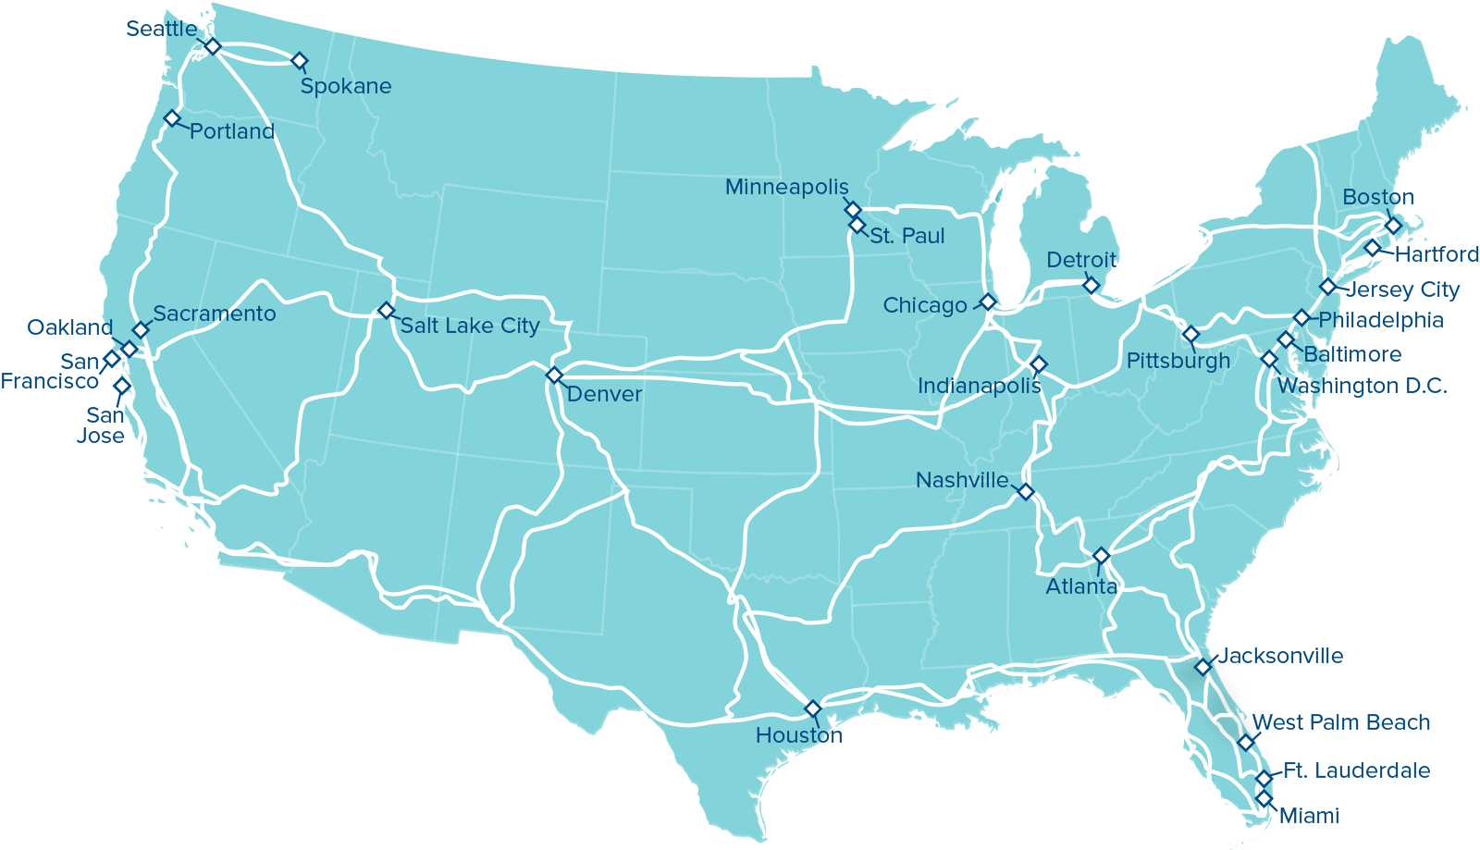

DIVERSE NETWORK
WITH NATIONAL REACH
OUR NETWORK:
Far-reaching fiber and HFC infrastructure
Physically diverse network from telcos (routes, access points, building access, etc.)
Largest converged IP network in the country
Comcast continues to double its network Capacity every 18 – 24 months
Network monitoring and management in every market 24x7x365
Customer Monitoring from Redundant NOCs
Voice SLA; 99.9% availability
Metro Ethernet Forum Multiple Award Winner Every Year Since 2013
Over 1 Million Ethernet enabled buildings
Backbone carries 12% of the worlds Internet traffic
15 miles of fiber built every day
400+ connected
data centers
4th Largest Voice Provider
in the Nation

Slide 7
Super Bowl 52 Overview
  ~ 70 New accounts built for temporary services in the Metro
  Broad Range of products provided at a variety of venues
  Dark Fiber
  Metro Ethernet
  Business Internet
  Voice Services (BCV, Mobility, PRI, BVE)
  Video
  Discussions took place early in 2017 but things didn’t really heat up until the state of MN started to get really cold.
Notes:
Self service support for MPLS networks is non existent
Legacy network changes/updates are still performed site by site, often manually and must be scheduled sometimes weeks in advance
Customers want to interact with their service, make changes in real time and have their service tell them what they need to know

Slide 8
Super Bowl 52 Overview
  The Comcast Team
Agile
Easy to Work With
Notes:
Self service support for MPLS networks is non existent
Legacy network changes/updates are still performed site by site, often manually and must be scheduled sometimes weeks in advance
Customers want to interact with their service, make changes in real time and have their service tell them what they need to know

Slide 9
Comcast Investment
We would not have been able to provide the services that we did and execute effectively without the investment we have made in our infrastructure.

Slide 10
Q&A
Notes:
Thank you.

