Slide 1
Current Context of Computer Science Education in Minnesota
MN Broadband Task Force
2/22/23
Slides: https://z.umn.edu/csed

Slide 2
Dr. Lana Peterson
Director of Community Engagement
Learning + Technologies Collaborative at the University of Minnesota
Educational Technology
Computer Science Education
Online Learning

Slide 3
Research-Practice Partnerships
Long-term
Focused on problems of practice
Learning at the boundaries of research and practice
Austin Public Schools
Bloomington Public Schools

Slide 4
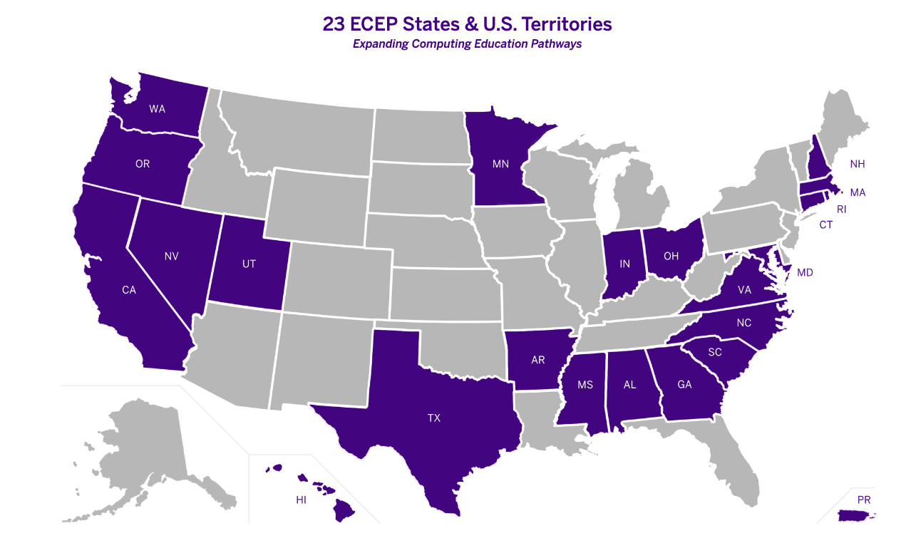
Expanding Computing Education Pathways Alliance
Computer Science for All MN
ecepalliance.org
csforallmn.org

Slide 5
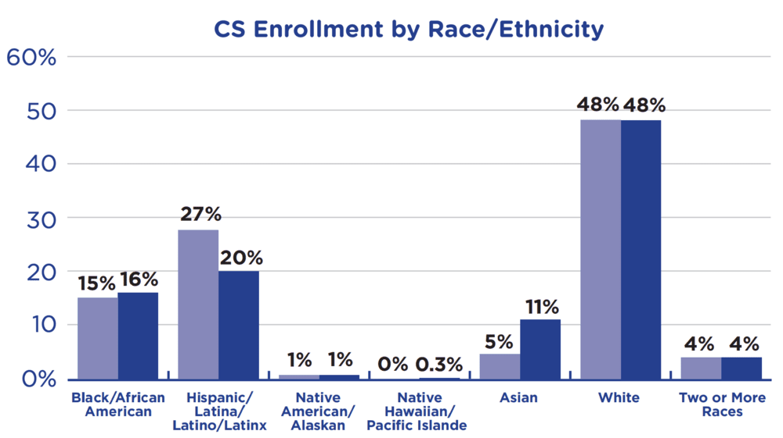
Access & Representation
Rural schools, urban schools, and schools with high percentages of economically disadvantaged students are less likely to offer computer science.
Black/African American students, Hispanic students, and Native American/Alaskan students are less likely to attend a school that offers computer science.
Studies show that children who study computer science perform better in other subjects, excel at problem-solving, and are 17% more likely to enroll in college.
Image & stats from: code.org/diversity

Slide 6
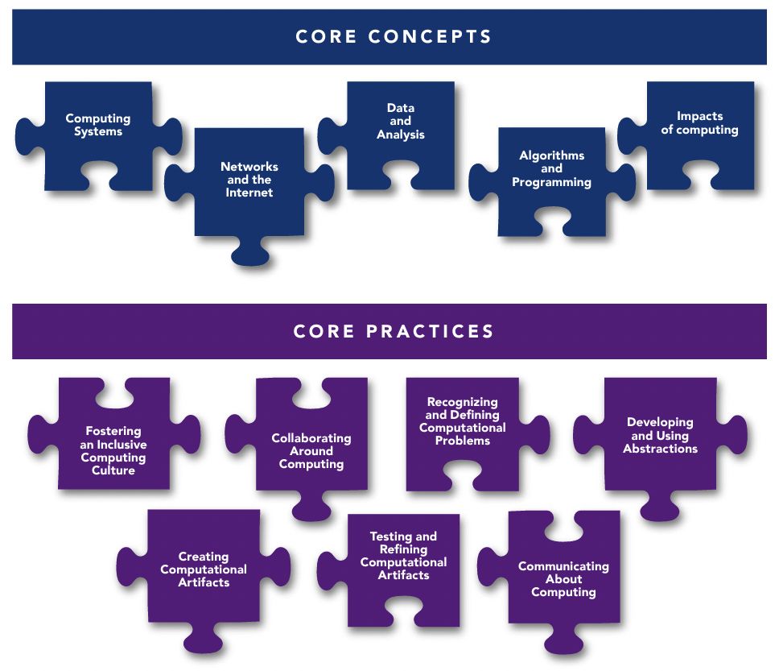
K-12 Computer Science Framework

Slide 7
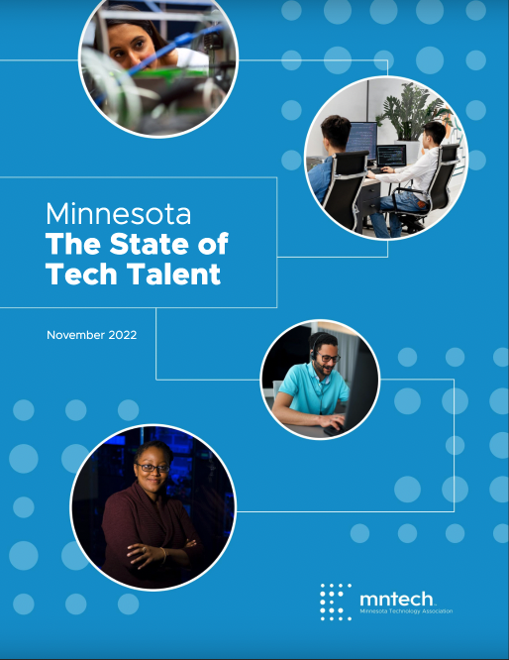
Agency, Skills, and Opportunities
Minnesota Key Industries:
Advanced manufacturing
Leading Life Sciences
Clean Tech & Renewable Energy
Food & Agriculture
Technology & Innovation
World Class Retail
Services Supporting our Ecosystem
Finance and & Insurance Ecosystem
List from: mn.gov/deed/joinusmn/key-industries/
mntech.org/report-the-state-of-tech-talent/

Slide 8
Agency, Skills, and Opportunities
Young people of all races and cultures want to learn computer science (CS).
CS equips young people with the problem solving, critical thinking, collaboration, and technical skills to create solutions for issues they care about now.
There are some initial studies that show participation in CS education improves creativity, math, metacognition, and spatial skills and that these skills transfer to performance in other subjects. (https://codeorg.medium.com/cs-helps-students-outperform-in-school-college-and-workplace-66dd64a69536)
https://centerx.gseis.ucla.edu/computer-science-equity-project/student-voice/

Slide 9
Agency, Skills, and Opportunities
Young people of all races and cultures want to learn computer science (CS).
CS equips young people with the problem solving, critical thinking, collaboration, and technical skills to create solutions for issues they care about now.
There are some initial studies that show participation in CS education improves creativity, math, metacognition, and spatial skills and that these skills transfer to performance in other subjects. (https://codeorg.medium.com/cs-helps-students-outperform-in-school-college-and-workplace-66dd64a69536)
https://centerx.gseis.ucla.edu/computer-science-equity-project/student-voice/

Slide 10
Agency, Skills, and Opportunities
Young people of all races and cultures want to learn computer science (CS).
CS equips young people with the problem solving, critical thinking, collaboration, and technical skills to create solutions for issues they care about now.
There are some initial studies that show participation in CS education improves creativity, math, metacognition, and spatial skills and that these skills transfer to performance in other subjects. (https://codeorg.medium.com/cs-helps-students-outperform-in-school-college-and-workplace-66dd64a69536)
https://centerx.gseis.ucla.edu/computer-science-equity-project/student-voice/

Slide 11
Driving Questions
How did Minnesota become last in the nation for access to computer science education?
What current initiatives are underway to address the shortage of computer science education opportunities?

Slide 12
Complexities of Local Control

Slide 13
Complexities of Local Control
Local vision and leadership

Slide 14
Complexities of Local Control
Local vision and leadership
Parent input and advocacy

Slide 15
Complexities of Local Control
Local vision and leadership
Parent input and advocacy
Lack of centralized support and feedback loops

Slide 16
Complexities of Local Control
Local vision and leadership
Parent input and advocacy
Lack of centralized support and feedback loops
Lack of investment in computer science education at the state level

Slide 17
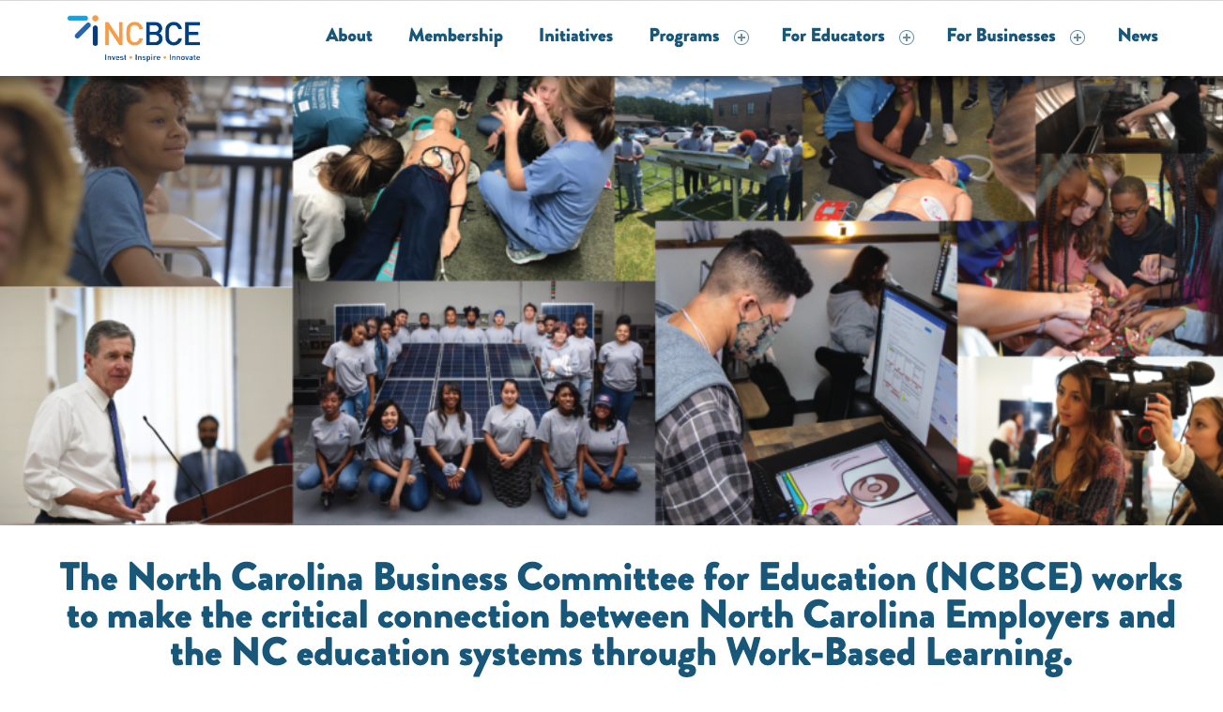
https://www.codevirginia.org/
https://ncbce.org/
https://www.infohio.org/about

Slide 18
Systemic Barriers
No state standards or definition of computer science
Computer science absent within teacher preparation programs
Course offering and tracking constraints
Computer science counting toward graduation requirements
Support for local structure and systems change
Funding for computer science professional development
Equitable and early computer science education
Outdated and indirect computer science teacher licensing
Computer science absent within teacher preparation programs
Data systems and participation

Slide 19
Systemic Barriers
No state standards or definition of computer science
Computer science absent within teacher preparation programs
Course offering and tracking constraints
Computer science counting toward graduation requirements
Support for local structure and systems change
Funding for computer science professional development
Equitable and early computer science education
Outdated and indirect computer science teacher licensing
Computer science absent within teacher preparation programs
Data systems and participation

Slide 20
Systemic Barriers
No state standards or definition of computer science
Course offering and tracking constraints
Computer science counting toward graduation requirements
Support for local structure and systems change
Funding for computer science professional development
Equitable and early computer science education
Outdated and indirect computer science teacher licensing
Computer science absent within teacher preparation programs
Data systems and participation

Slide 21
Systemic Barriers
No state standards or definition of computer science
Course offering and tracking constraints
Computer science counting toward graduation requirements
Support for local structure and systems change
Funding for computer science professional development
Equitable and early computer science education
Outdated and indirect computer science teacher licensing
Computer science absent within teacher preparation programs
Data systems and participation

Slide 22
Systemic Barriers
No state standards or definition of computer science
Course offering and tracking constraints
Computer science counting toward graduation requirements
Support for local structure and systems change
Funding for computer science professional development
Equitable and early computer science education
Outdated and indirect computer science teacher licensing
Computer science absent within teacher preparation programs
Data systems and participation

Slide 23
Systemic Barriers
No state standards or definition of computer science
Course offering and tracking constraints
Computer science counting toward graduation requirements
Support for local structure and systems change
Funding for computer science professional development
Equitable and early computer science education
Outdated and indirect computer science teacher licensing
Computer science absent within teacher preparation programs
Data systems and participation

Slide 24
Systemic Barriers
No state standards or definition of computer science
Course offering and tracking constraints
Computer science counting toward graduation requirements
Support for local structure and systems change
Funding for computer science professional development
Equitable and early computer science education
Outdated and indirect computer science teacher licensing
Computer science absent within teacher preparation programs
Data systems and participation

Slide 25
Systemic Barriers
No state standards or definition of computer science
Course offering and tracking constraints
Computer science counting toward graduation requirements
Support for local structure and systems change
Funding for computer science professional development
Equitable and early computer science education
Outdated and indirect computer science teacher licensing
Computer science absent within teacher preparation programs
Data systems and participation

Slide 26
Systemic Barriers
No state standards or definition of computer science
Course offering and tracking constraints
Computer science counting toward graduation requirements
Support for local structure and systems change
Funding for computer science professional development
Equitable and early computer science education
Outdated and indirect computer science teacher licensing
Computer science absent within teacher preparation programs
Data systems and participation

Slide 27
CSinBPS: K-12 Computer Science Pathway
Funder: Local Tech Referendum

Slide 28
P-Tech Information Technology Program
Funder: Minnesota Department of Ed

Slide 29
K12 CS Pathways for Rural and Tribal Schools
Fond du Lac Ojibwe School, Cloquet
Hermantown Community Schools
Funder: National Science Foundation

Slide 30
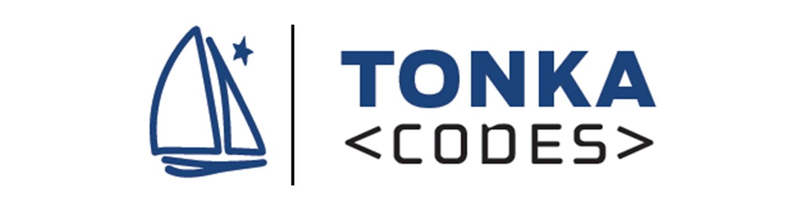
District Specialized Programs

Slide 31
Current Legislative Action
Computer Science Advancement Fund: $ 4 million per year 2024 & 2025
Defines computer science
1 full time computer science position at MDE
Computer science advisory committee
Educator training & district planning
Computer science as math and science graduation credit
Updated data system
Updated teacher licensure
Incentives for teacher preparation programs
MN Governor 2023 Budget: Computer Science (page 109)
State Plan
Task Force
Grants for schools
$400K
MN House- HF759
MN Senate- SF757

Slide 32
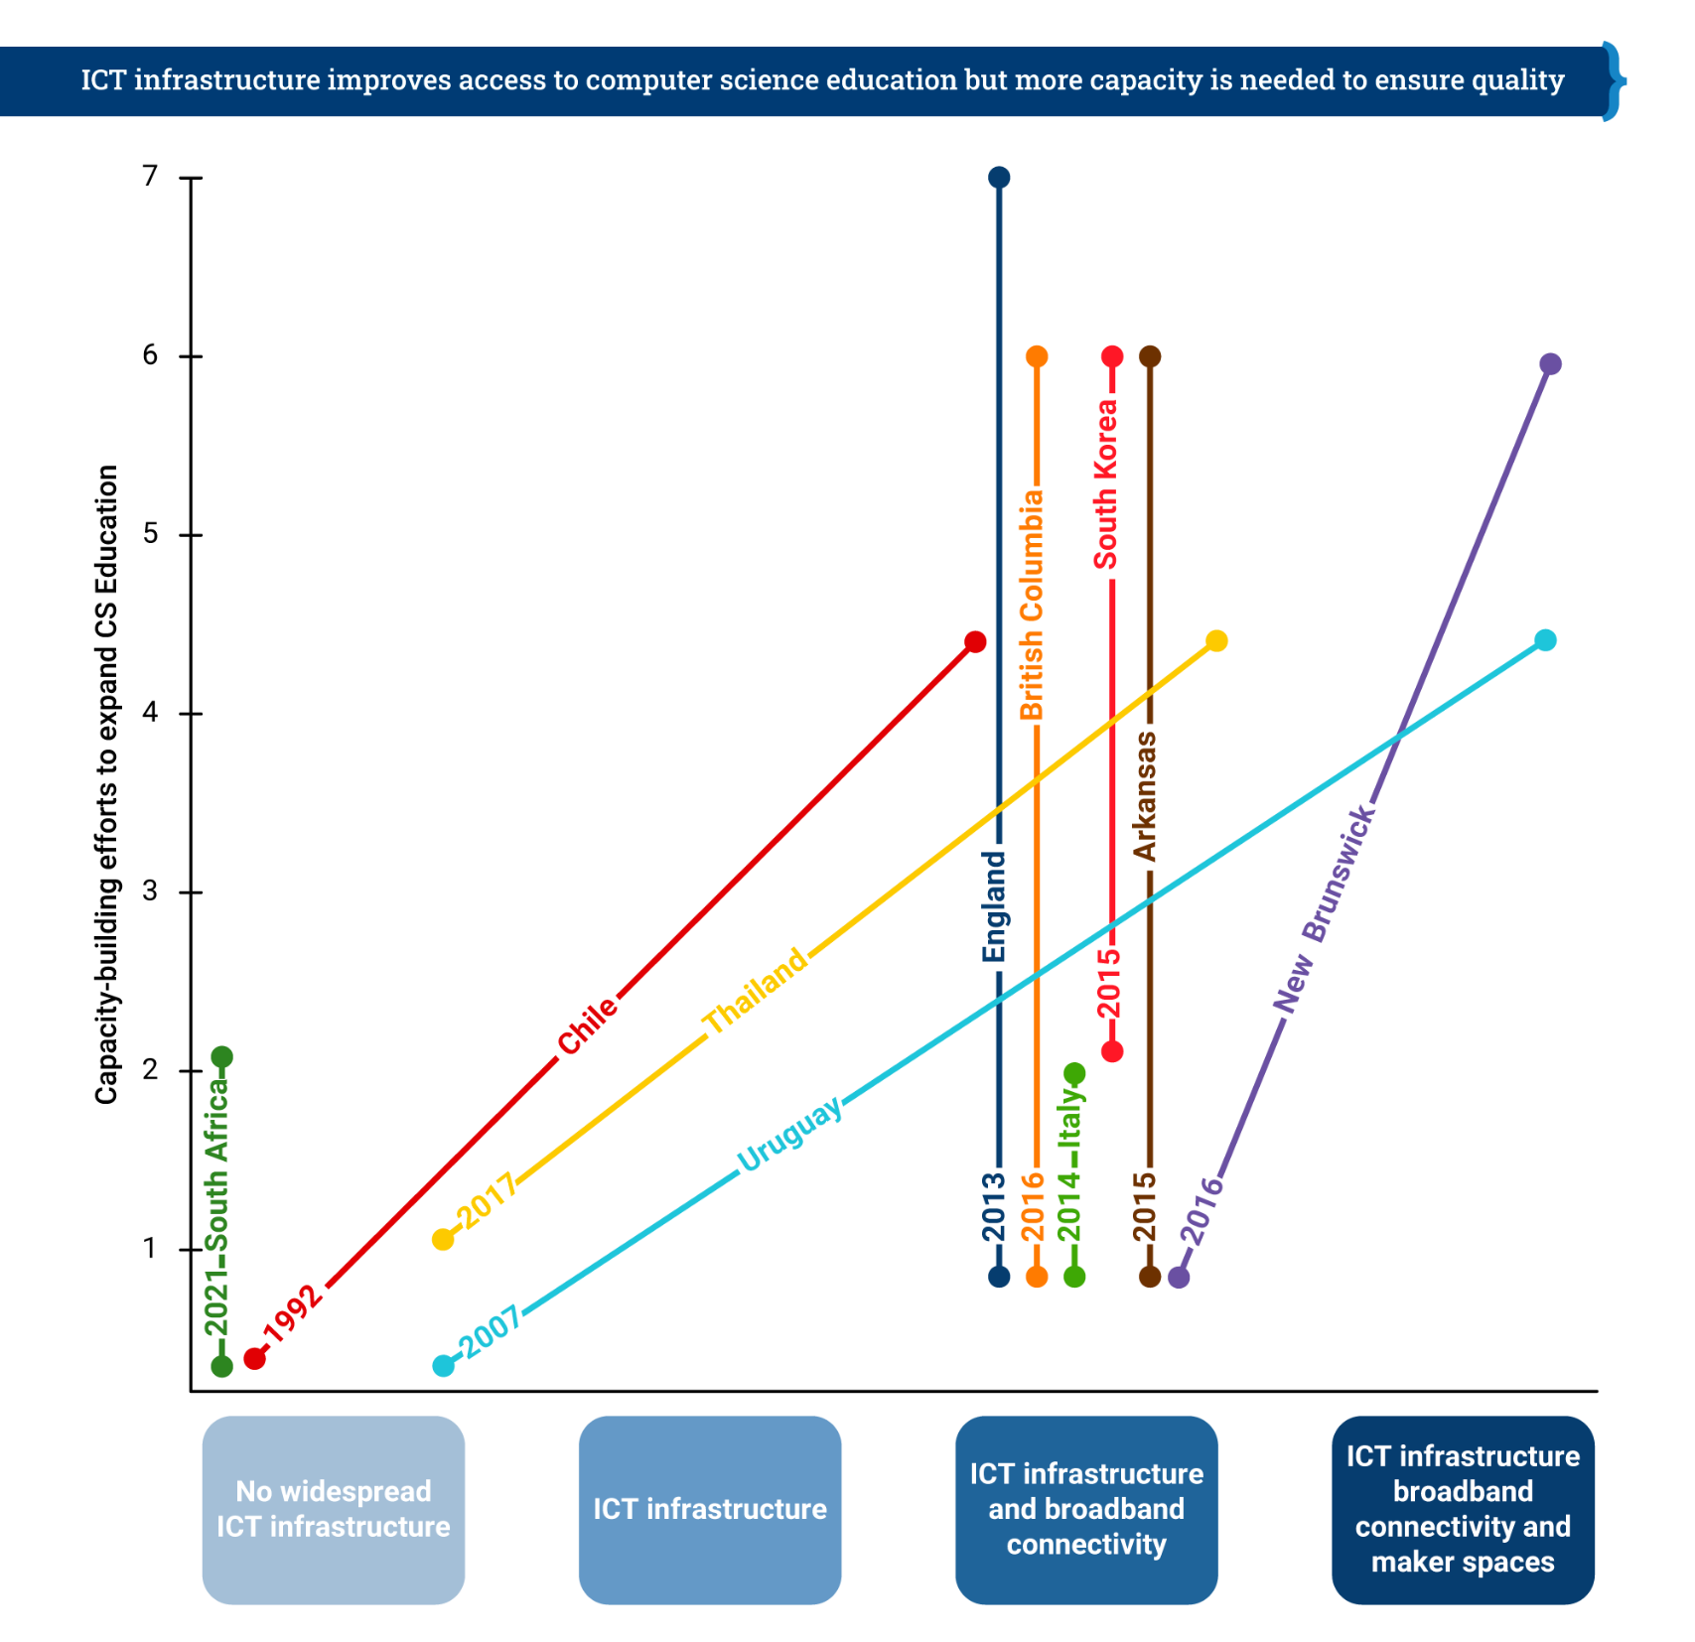
Horizontal axis indicates the level of ICT infrastructure (information, communication, technology) present in each education system. Vertical axis indicates the degree to which the education system has implemented the (non infrastructure) capacity to expand CS education.
Building Skills for Life: How to expand and improve computer science education around the world
Brookings, 2021

Slide 33
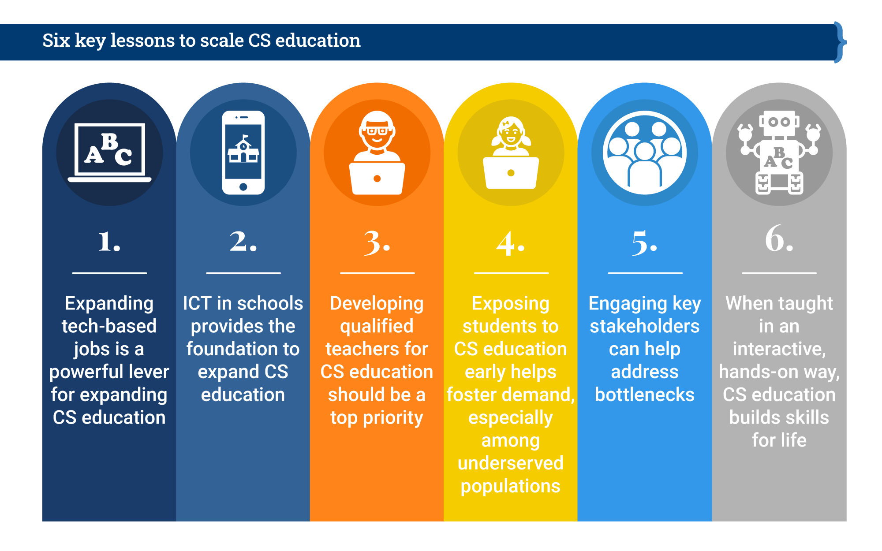
Building Skills for Life: How to expand and improve computer science education around the world
Brookings, 2021

Slide 34
Building Skills for Life: How to expand and improve computer science education around the world
Brookings, 2021

Slide 35
Building Skills for Life: How to expand and improve computer science education around the world
Brookings, 2021

Slide 36
Building Skills for Life: How to expand and improve computer science education around the world
Brookings, 2021

Slide 37
Building Skills for Life: How to expand and improve computer science education around the world
Brookings, 2021

Slide 38
Building Skills for Life: How to expand and improve computer science education around the world
Brookings, 2021

Slide 39
Questions?

Slide 40
Let’s connect
pete6118@umn.edu
linkedin.com/in/lanapeterson/
Lana Peterson
Director of Community Engagement
Learning + Technologies Collaborative
University of Minnesota

