Slide 1

Coyote Gym
An employee who will get the job done!

Slide 2
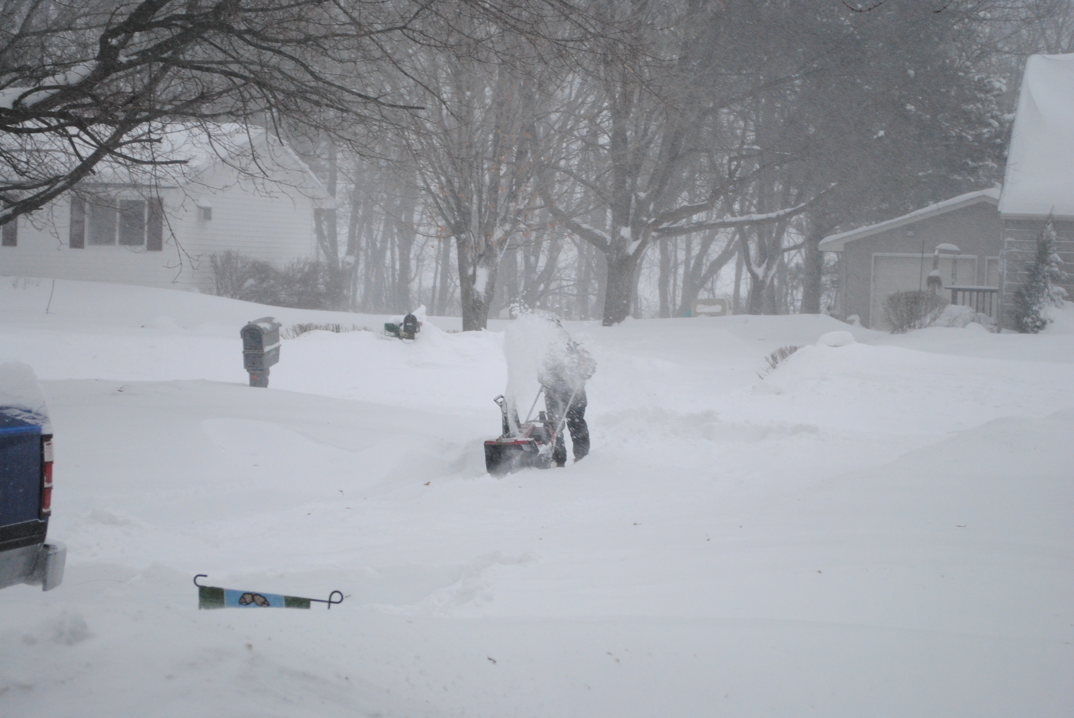
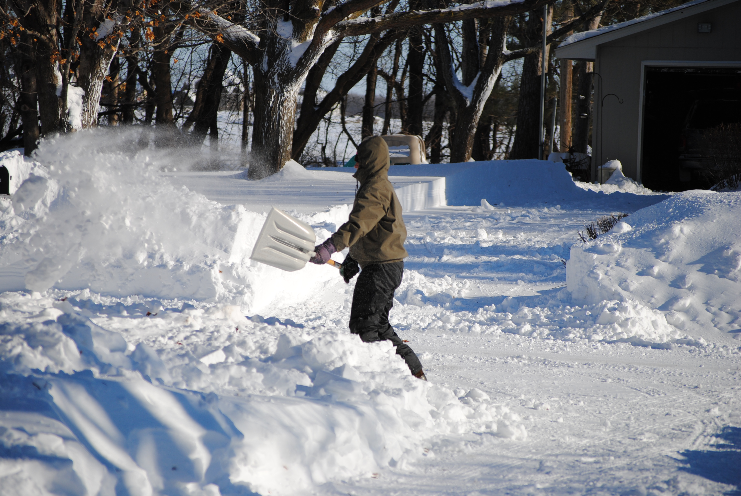
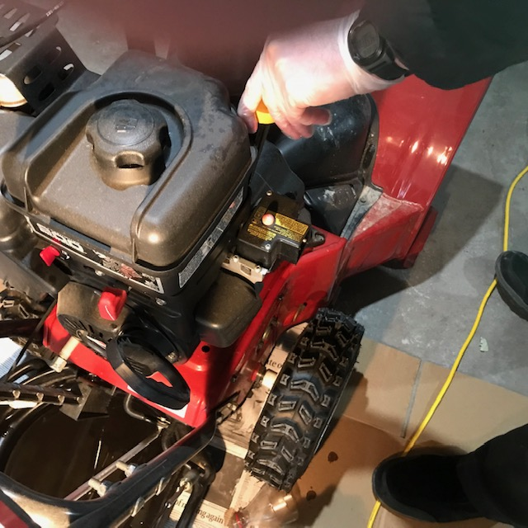
Snow Removal
Shovel
Check oil level & gas,refill
fluids
Operate snow blower

Slide 3
I’m at my Best when..
Working outdoors
Work materials are accessible to me, in my area
Completing physical tasks
Contributing to preserve our natural environment
Reusing or repurposing items and materials to minimize waste
Working on my own or in a small group with few public interactions required

Slide 4
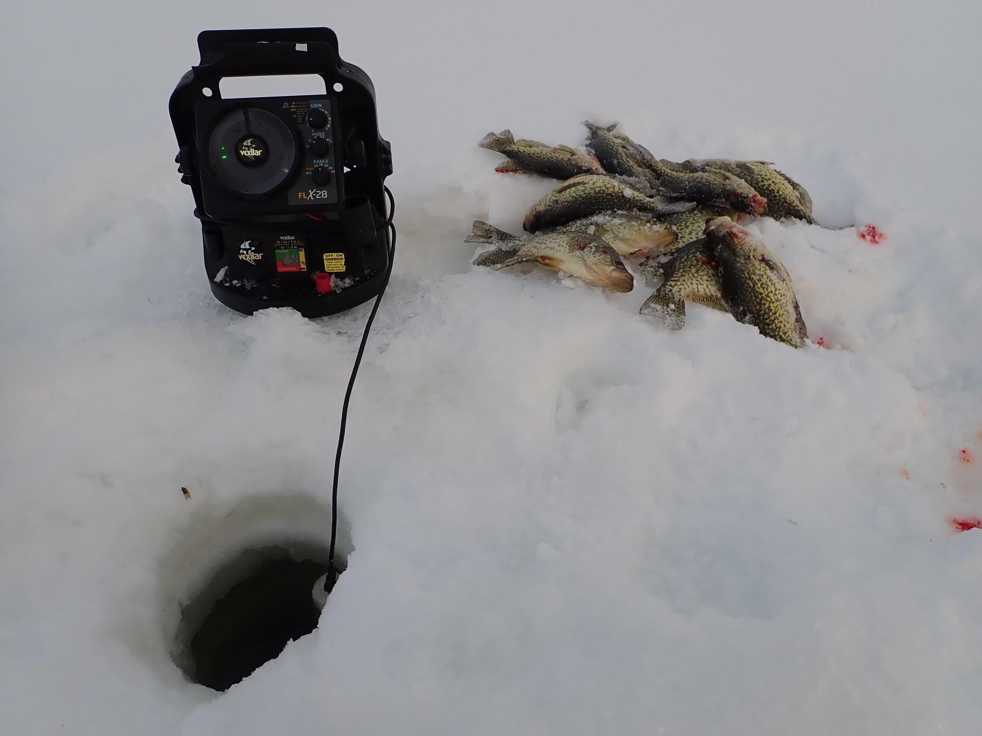
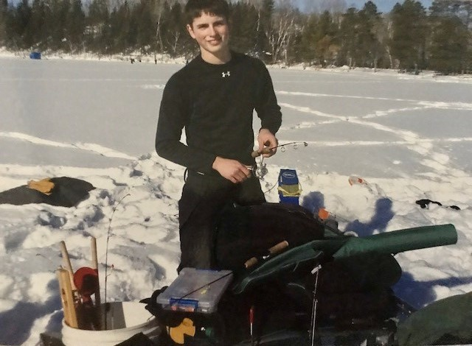
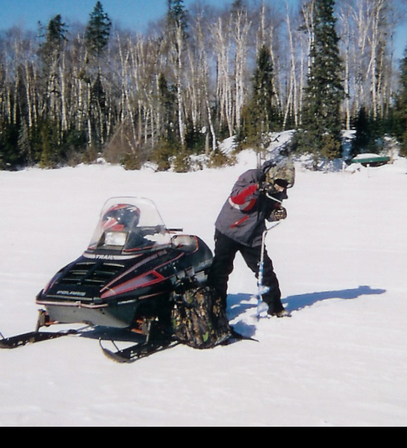
Ice Fishing
Use hand ice auger
Set up depth finder
Set up fish locater
Tie jigs on lines
Catch fish
Fillet & eat fish

Slide 5
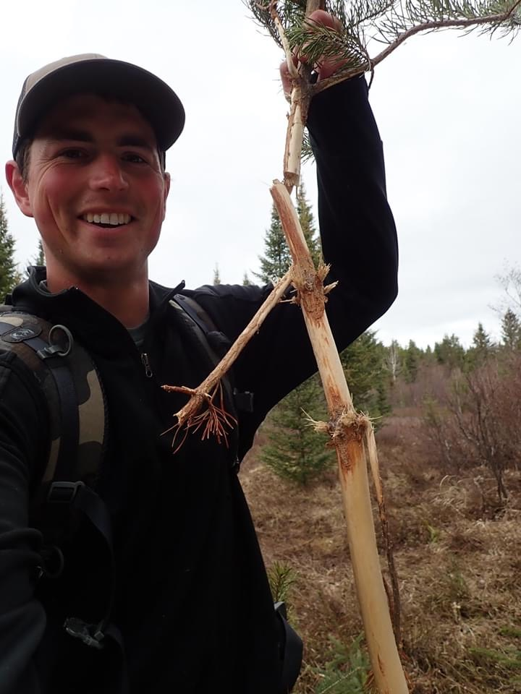
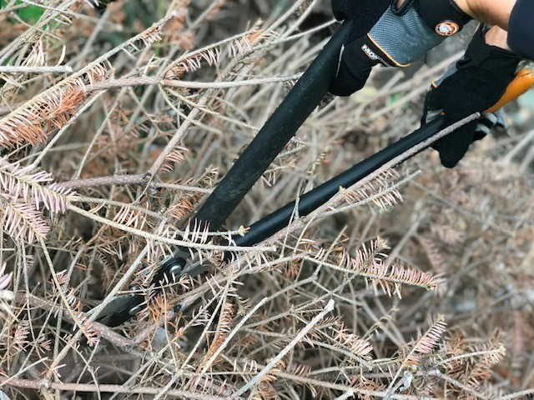
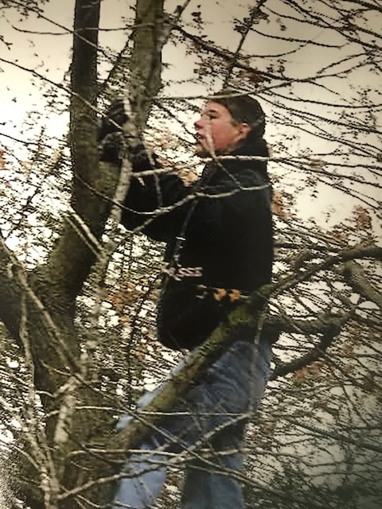
Tree Pruning at Three Rivers
Checking trees for disease by inspecting the bark
Removing damaged limbs
Trimming branches that have grown into trail areas
Removing debris from trails
Pruning extra growth to promote health in trees and shrubs in the park

Slide 6
Skills and Attributes
Artistic
Follows directions
Gets assignments completed
Eye for detail
Safety conscious
Trained in First Aid & CPR
Attained rank of Eagle Scout
Checks and maintains equipment
Environmentally conscious
Enjoys being outdoors
Designs and crafts hand made gifts

Slide 7

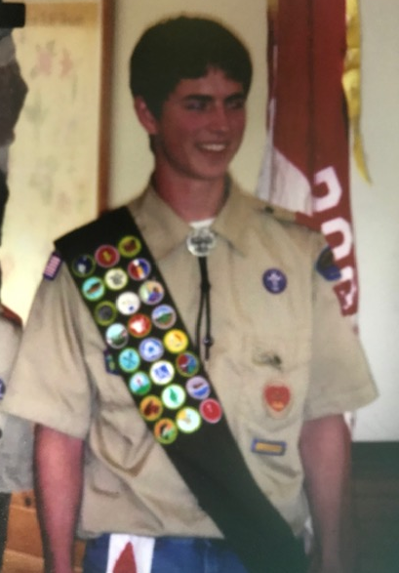
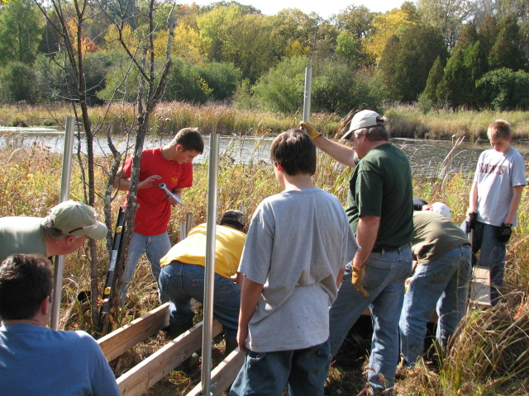
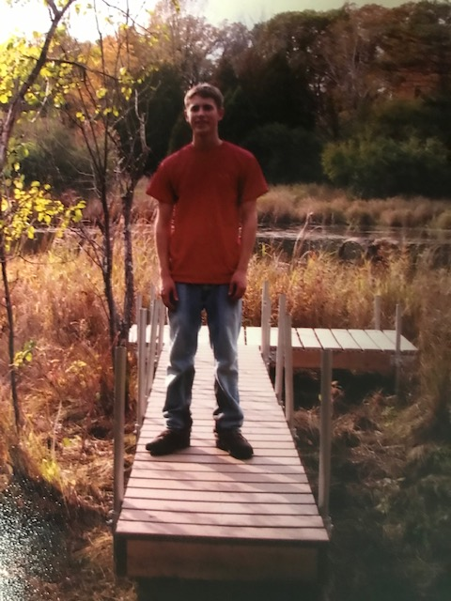
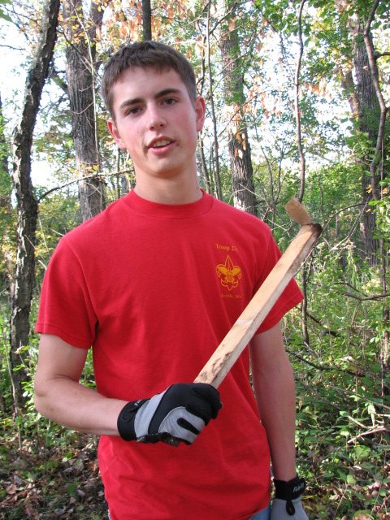
Eagle Scout Project
Planned Pier Nature Observation deck
Obtained donations from Lowes
Planned pier project
Organized scout crew for construction
Built nature pier at the Marine on St. Croix in Stillwater

Slide 8
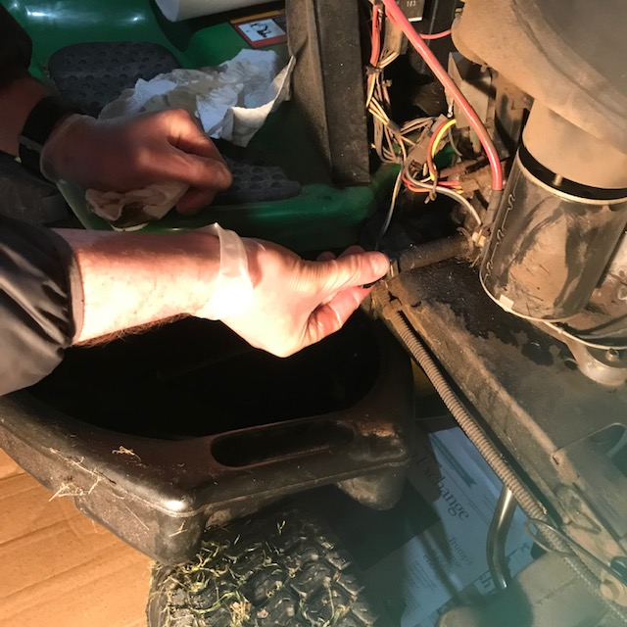
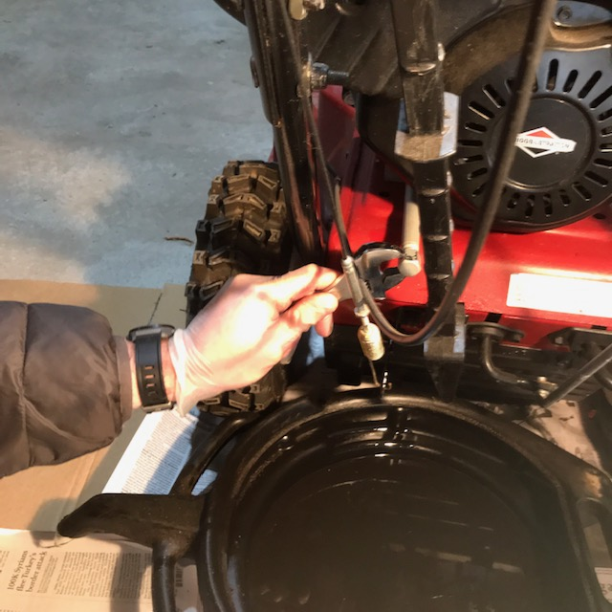
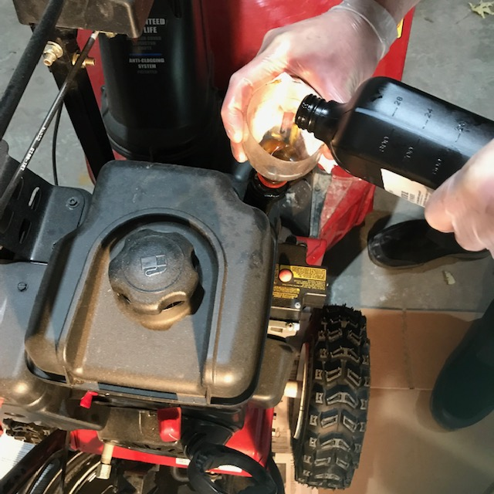
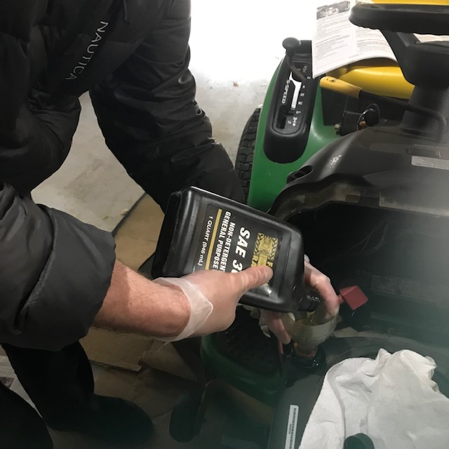
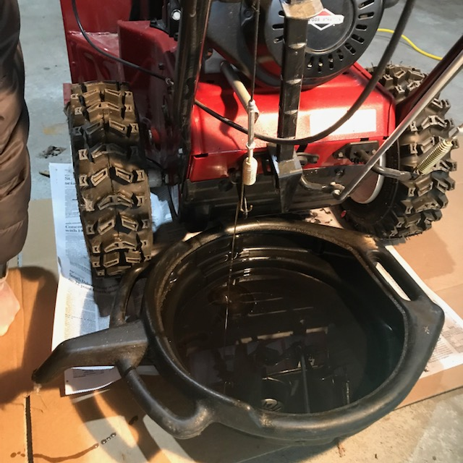
Engine Maintenance
Refill to full
Drain oil
Unscrew plug to drain oil
Unscrew
drain bolt
Refill oil to full

Slide 9
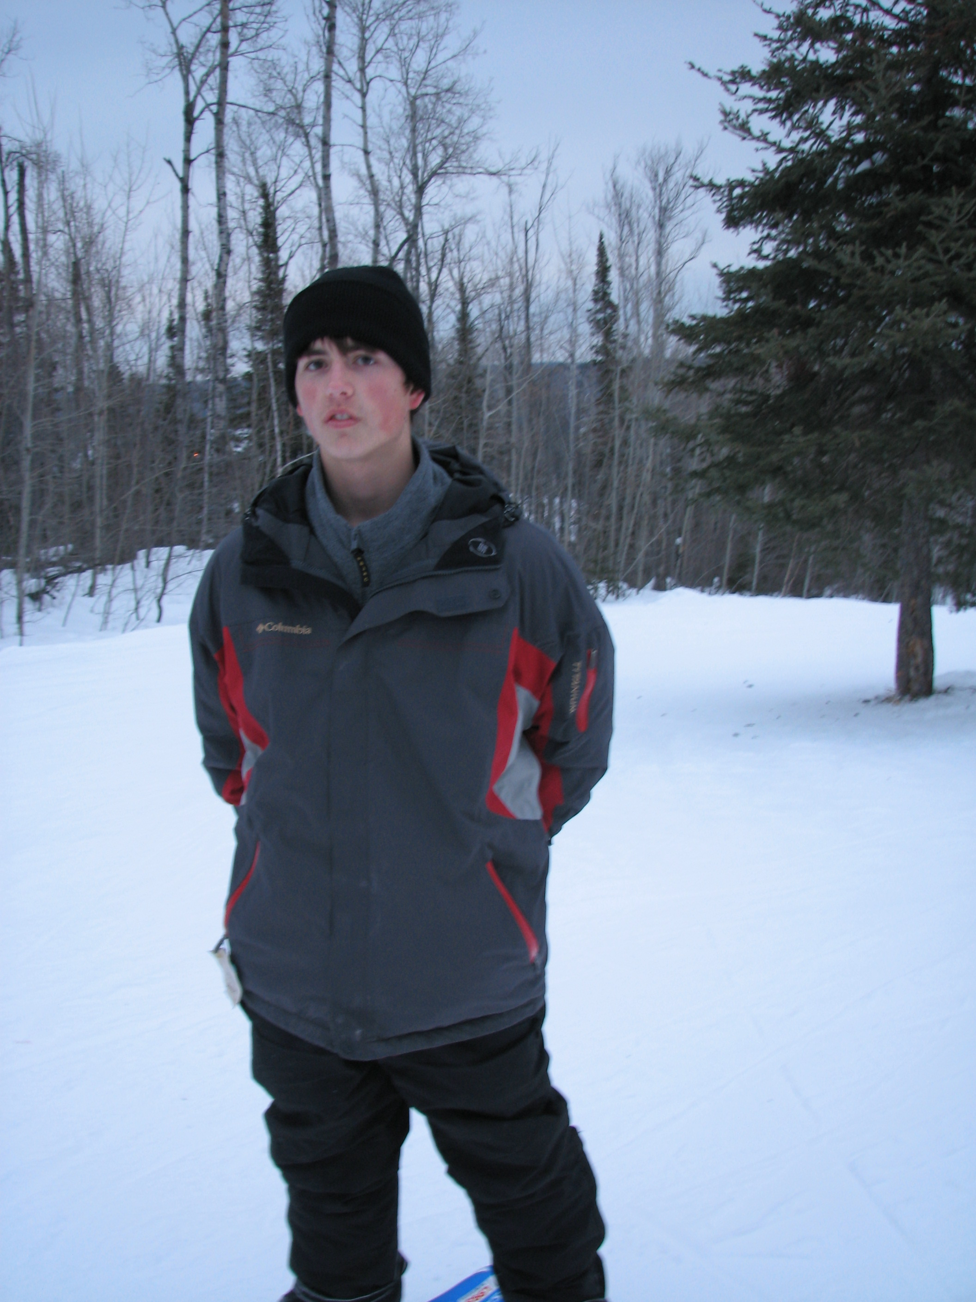
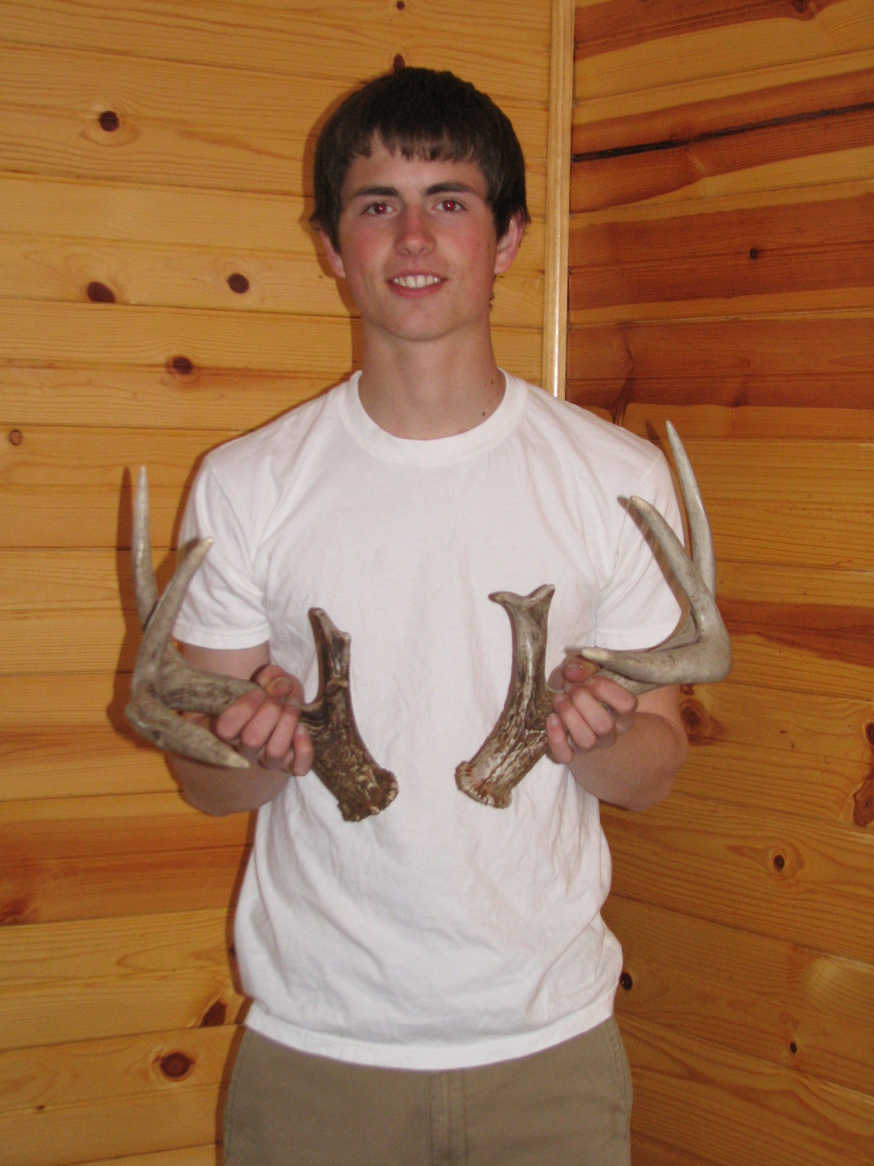
Snowshoe trail tour at Lebanon Hills
Snowshoe 1.5 mile trail
Coyote pointed out various tree types by name
Found matching set of deer antlers just off the trail lying in the snow
Picture of Coyote in the lodge with the antlers, which he donated to the nature center for education purposes

Slide 10
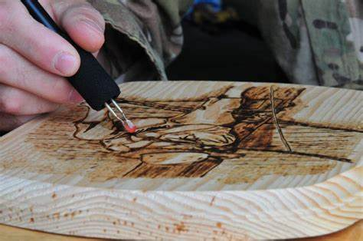
Wood burning
Use electric wood burning tool to create intricate wood nature sketches
Manipulate tool to create sketch patterns
Apply protective coating on wood
Practice and warm up board
Canoe paddle Coyote made as a gift for his father

Slide 11
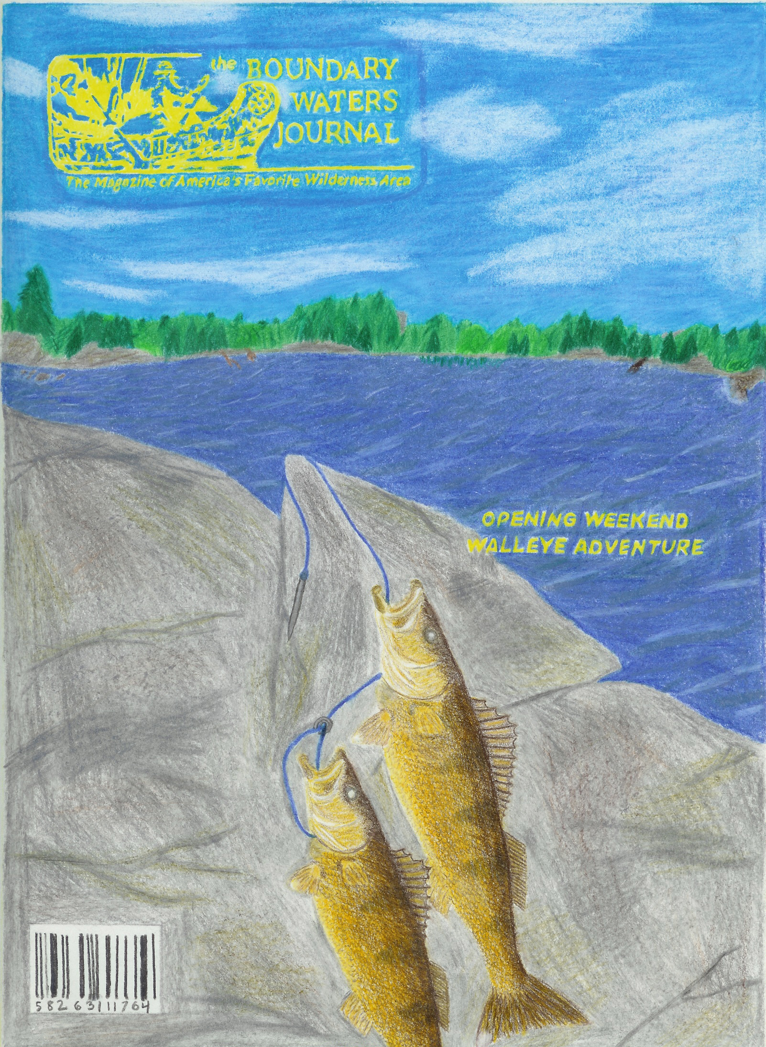
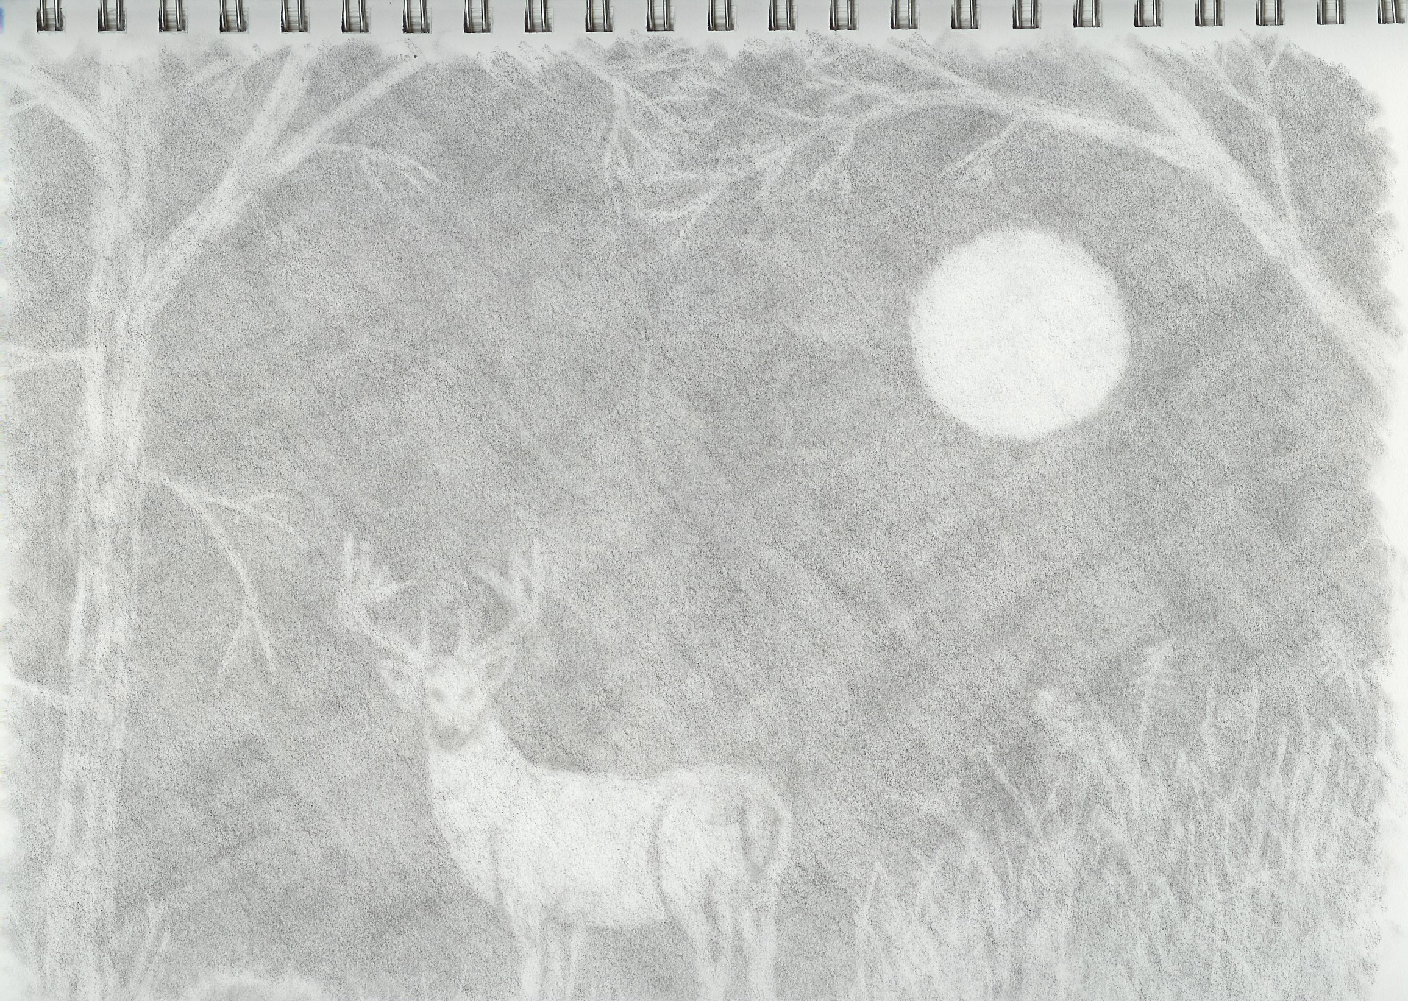
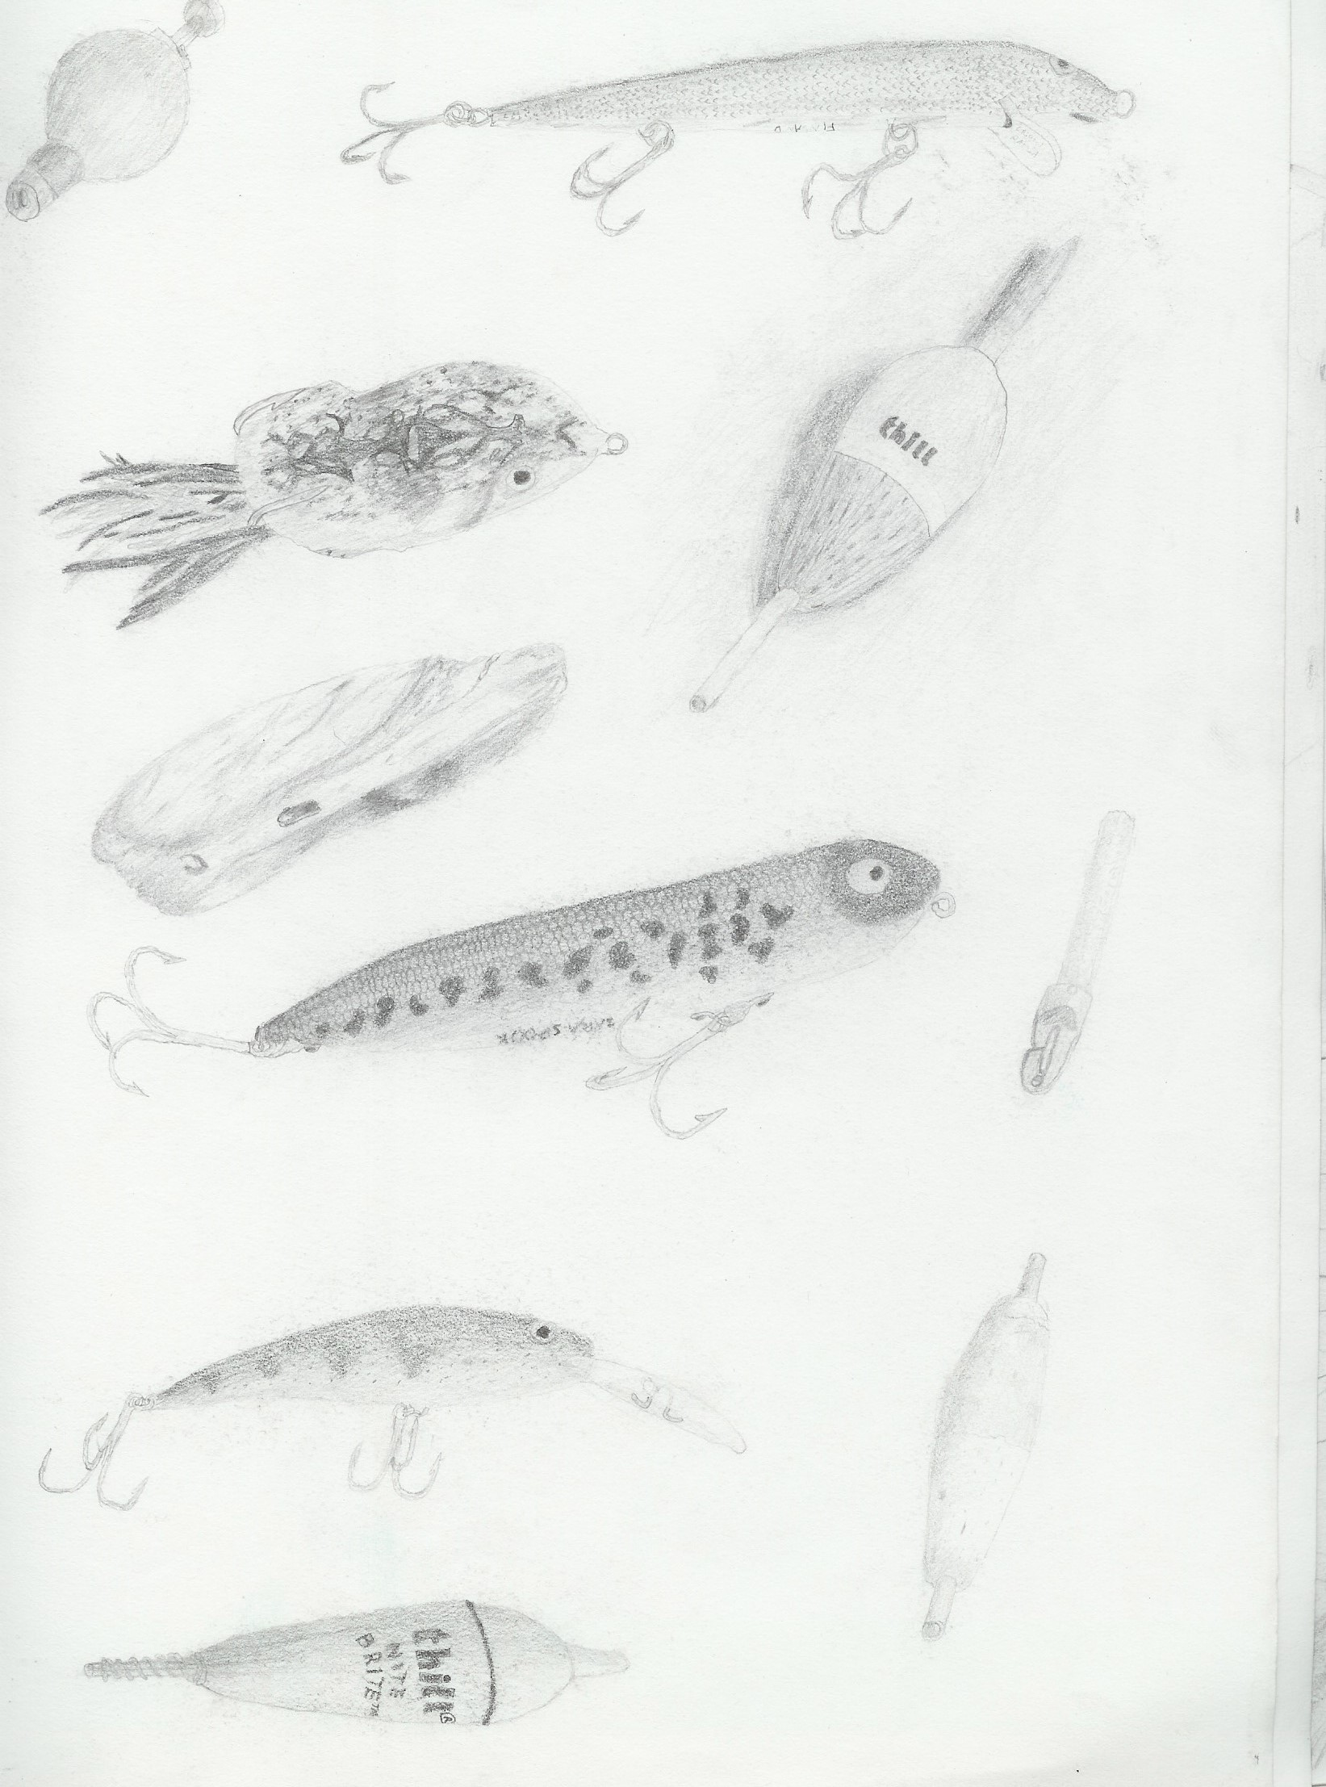
Pencil Sketching

Slide 12
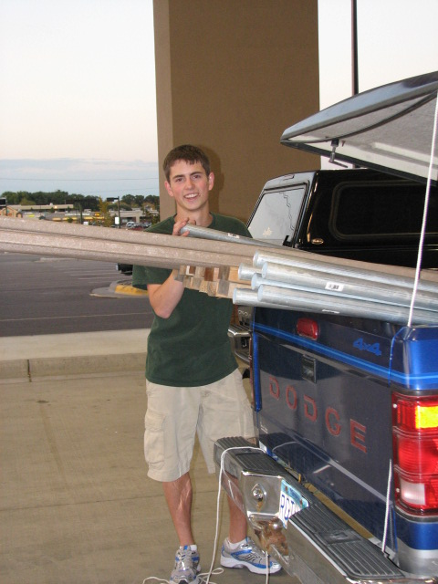
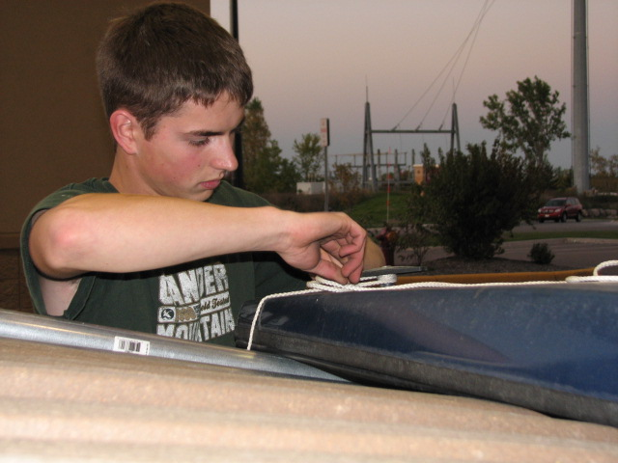
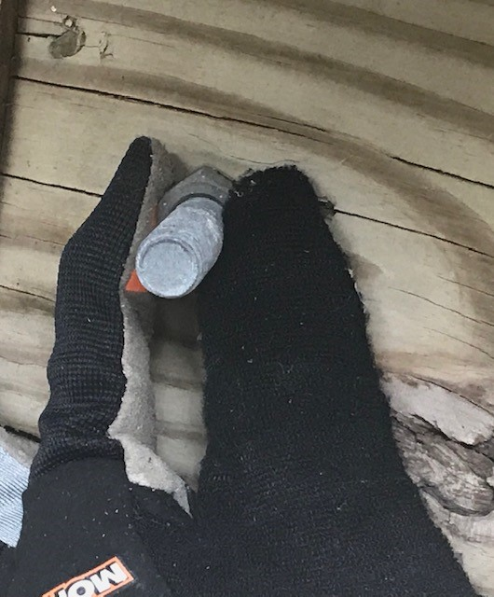
Deck Construction
Load and unload materials for deck construction into shop
Measure deck boards for cutting
Assemble metal support brackets by inserting and tightening bolts
Screw decking boards to base

Slide 13
Contributions to Your Business
Plant, tree, nature identification
Safety skills, first aid training
Use of small hand & power tools
Trim, prune, extract invasive trees, bushes, and shrubs
Physical strength and stamina in all weather conditions
Operate, maintain lawn & snow equipment
Load, unload, move raw materials
Pencil drawings, wood burning
Accurately measure lengths
Eye for detail and observations

Slide 14

Explore employment options with Coyote!
Please contact Margie Webb Margie.webb@state.mn.us or 612-799-8776

