Slide 1
Disability Equity Meeting
Office of Youth Development
MN Dept. of Employment & Economic Development
January 25, 2018

Slide 2
PIRL Definition of Individual with a Disability
If the participant indicates that he/she has any "disability”, as defined in Section 3(2)(a) of the Americans with Disabilities Act of 1990 (42 U.S.C. 12102). Under that definition, a "disability" is a physical or mental impairment that substantially limits one or more of the person's major life activities.

Slide 3
Federal Funding/Youth Served in Minnesota: 2007 to 2017
Notes:
WIA funding through 2014. WIOA funding starting in 2015. Does NOT include any ARRA Youth funds from 2009.

Slide 4
Comparison of PY10 to PY17 WIA/WIOA Youth Allocations by WDA

Slide 5
Youth with a Disability as Pct. Of Total Served by WDA under WIOA

Slide 6
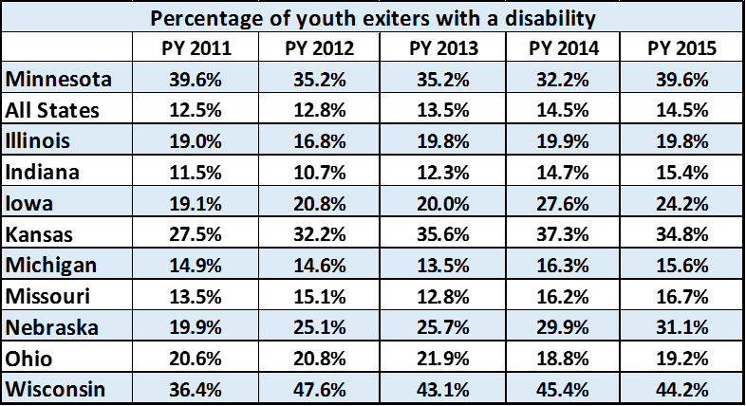
Youth with a Disability as Pct. of Total Exited

Slide 7
WIA Youth Performance: PY 2013 to 2015
All Youth |  |  | PY 2013 |  |  |  | PY 2014 |  |  |  | PY 2015
 |  |  |  | Percent of |  |  |  | Percent of |  |  |  | Percent of
Younger Youth |  | National | Minnesota | Nat. Avg. |  | National | Minnesota | Nat. Avg. |  | National | Minnesota | Nat. Avg.
Skill Attainment Rate |  | 82.0% | 95.4% | 116.3% |  | 77.1% | 97.3% | 126.2% |  | 78.4% | 94.7% | 120.8%
Diploma or Equivalent Rate |  | 73.6% | 88.4% | 120.1% |  | 71.8% | 87.4% | 121.7% |  | 69.6% | 78.0% | 112.1%
Retention Rate |  | 64.9% | 91.7% | 141.3% |  | 65.7% | 81.7% | 124.4% |  | 66.6% | 83.8% | 125.8%
Older Youth |  | National | Minnesota |  |  | National | Minnesota |  |  | National | Minnesota
Entered Employment Rate |  | 68.2% | 83.0% | 121.7% |  | 71.1% | 88.1% | 123.9% |  | 71.7% | 82.4% | 114.9%
Employment Retention Rate |  | 82.6% | 91.2% | 110.4% |  | 83.0% | 89.9% | 108.3% |  | 85.5% | 89.0% | 104.1%
Earnings Change in Six Months |  | $4,485 | $5,786 | 129.0% |  | $4,455 | $5,310 | 119.2% |  | $4,820 | $6,382 | 132.4%
Employment & Credential Rate |  | 39.3% | 58.3% | 148.3% |  | 38.1% | 68.5% | 179.8% |  | 38.6% | 60.1% | 155.7%
Youth With Disabilities
 |  |  | PY 2013 |  |  |  | PY 2014 |  |  |  | PY 2015
 |  |  |  | Percent of |  |  |  | Percent of |  |  |  | Percent of
Younger Youth |  | National | Minnesota | Nat. Avg. |  | National | Minnesota | Nat. Avg. |  | National | Minnesota | Nat. Avg.
Skill Attainment Rate |  | 83.6% | 87.8% | 105.0% |  | 79.9% | 96.9% | 121.3% |  | 81.1% | 96.9% | 119.5%
Diploma or Equivalent Rate |  | 80.3% | 88.6% | 110.3% |  | 78.3% | 89.8% | 114.7% |  | 76.4% | 89.8% | 117.5%
Retention Rate |  | 60.3% | 92.2% | 152.9% |  | 61.2% | 73.9% | 120.8% |  | 62.3% | 73.9% | 118.6%
Older Youth |  | National | Minnesota |  |  | National | Minnesota |  |  | National | Minnesota
Entered Employment Rate |  | 62.1% | 78.6% | 126.6% |  | 63.7% | 86.3% | 135.5% |  | 63.7% | 81.1% | 127.3%
Employment Retention Rate |  | 81.3% | 91.2% | 112.2% |  | 80.8% | 89.7% | 111.0% |  | 83.2% | 85.1% | 102.3%
Earnings Change in Six Months |  | $4,341 | $5,393 | 124.2% |  | $4,328 | $5,567 | 128.6% |  | $4,604 | $5,623 | 122.1%
Employment & Credential Rate |  | 38.3% | 57.0% | 148.8% |  | 38.5% | 71.7% | 186.2% |  | 35.0% | 58.5% | 167.1%

Slide 8
Questions?
Cory.Schmid@state.mn.us
651-259-7541
Jenny.Nelson@state.mn.us
651-259-7308

