Slide 1
Digital Equity Update
January 31, 2023

Slide 2
Required Digital Equity Plan Components
Statewide digital equity vision statement
Local inventories:
Existing digital inclusion programs, services, etc.
Existing broadband and/or digital inclusion plans prepared by cities and counties
Local community engagement:
Summary of barriers to internet/technology adoption faced by any/all covered populations
Inventory of organizations, local partners, etc. that serve any/all covered populations
Statewide digital equity goals
Implementation strategy for associated activities
Timeline for associated activities
Due November 30, 2023

Slide 3
Covered Populations
Low-income households
Aging individuals 60+ years old
Incarcerated individuals (except those in federal facilities)
Veterans
Individuals with disabilities
Individuals with language barriers (limited English-speaking or low literacy)
Individuals who are members of a racial or ethnic minority group
Rural individuals

Slide 4
OBD’s Planning Strategy: Digital Connection Committees
Very briefly dubbed “digital inclusion planning teams”
Self-selected workgroups formed on a voluntary basis by political subdivisions, anchor institutions, non-profits, MN-based businesses, faith-based organizations, etc.
Committee responsibilities:
Receive and share updates about OBD’s planning process as it transpires
Gather local information about digital inclusion assets, needs, and goals. This information will profoundly shape OBD’s plan. OBD will provide optional templates, guides, and other resources
Serve as a network of partners for OBD to call on as Digital Equity Act work develops

Slide 5
Digital Connection Committees: Specific Opportunities
Required: Receive and share updates from OBD; let OBD list your committee in a public directory
Optional: Submit information to OBD from April 3 to June 30 to shape the Digital Equity Plan
Optional: Receive an Assessing Digital Inclusion Mini-Grant
Non-competitive grants of up to $4,000 to support Committees in gathering information
Applications due March 3 at 3:00 p.m.
Performance period is April 3 to June 30
Optional: Attend a virtual networking session
April 12 and June 14
Meet and learn from other Committees from around the state
Optional: Provide feedback on the draft of the Digital Equity Plan
August 21ish through September 29ish
Online survey and virtual meetings
In-person regional gatherings in up to 12 locations (TBD)

Slide 6
Support for Committees: Mini-Grant Opportunity
Many Committees will be eligible for non-competitive grants of up to $4,000
Applications due March 3 at 3:00 PM Central Time
Grant period is April 3 to June 30
Example uses of funds:
Supplementing wages for staff to carry out digital inclusion assessment activities
Supplies and/or equipment necessary to create or support information gathering
Contractual services, such as a consultant specializing in assessment
Fees associated with reserving meeting spaces for focus groups, interviews, etc.
Subscription to survey software during the duration of the grant period

Slide 7
Digital Connection Committees: Timeline
March 3 Mini grant applications due by 3:00 p.m.
March 15 Deadline for Digital Connection Committees to register with OBD
March 31 OBD begins sending updates, templates, etc. to Committees
April 3 – June 30 Digital Connection Committee and grant activities officially underway
April 12 Virtual networking session
May 1 – 31 1:1 check-ins with grantees (required) and non-grantees (optional)
June 14 Virtual networking session
Late August Draft digital equity plan released. OBD works with Committees to collect feedback surveys, meetings, and in-person regional gatherings
September OBD continues to collect feedback
October OBD revises plan based on feedback
November 30 OBD submits final plan to federal government

Slide 8
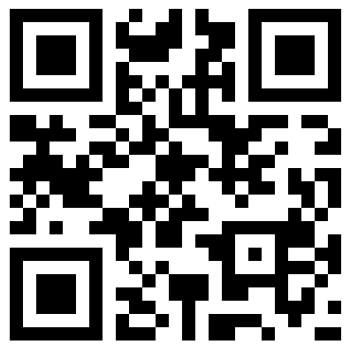
How You Can Help
Consider forming and registering a Digital Connection Committee by March 15
Existing groups that have a similar focus can register as they are.
The workload is flexible!
Tell people in your professional and personal networks about this opportunity
tiny.cc/OBDinclusion
hannah.buckland@state.mn.us

