Slide 1
Digital Equity Act
Hannah Buckland | Digital Equity Program Lead hannah.buckland@state.mn.us September 29, 2022

Slide 2
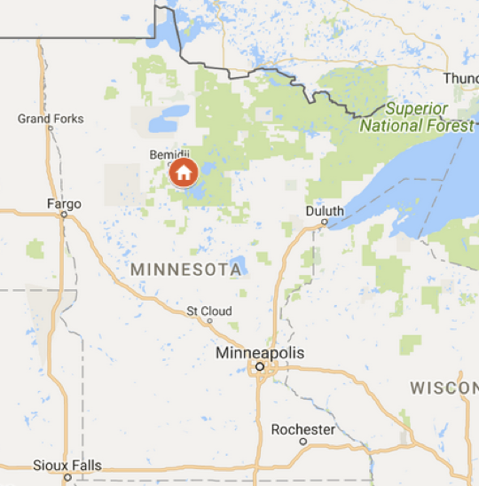
Introduction
Background in librarianship
January 2014 – May 2018: Director of Library Services, Bezhigoogahbow Library (Cass Lake, MN)
June 2015 – January 2019: Member, Governor Dayton’s Task Force on Broadband
May 2018 – May 2019: Service Manager, Hennepin County Library
May 2019 – August 2022: State Library Program Specialist, MN Department of Education
Joined OBD in late August

Slide 3
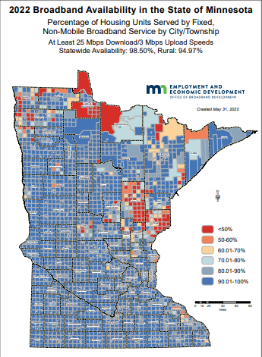
Progress!
Year | # Unserved Cities | # Gigabit Cities
2017 | 186 | 286
2018 | 120 | 446
2019 | 62 | 496
2021 | 31 | 587
2022 | 16 | 678
unserved: fewer than 50% of housing units have access to speeds of at least 25/3
gigabit: more than 25% of housing units have access to speeds of at least 1 gig

Slide 4
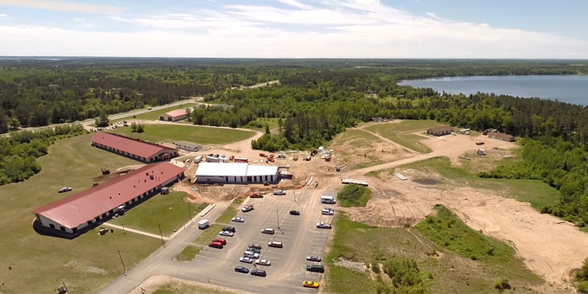
Beyond Broadband Availability

Slide 5
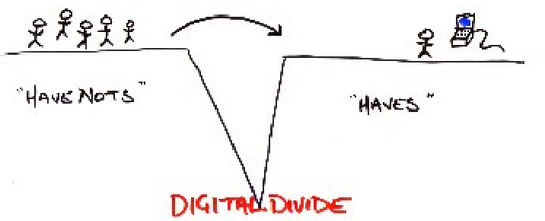
Why not digital divide?
Eubanks, Virginia E. “Trapped in the Digital Divide: The Distributive Paradigm in Community Informatics.” Journal of Community Informatics 3 (2007): n. pag.

Slide 6
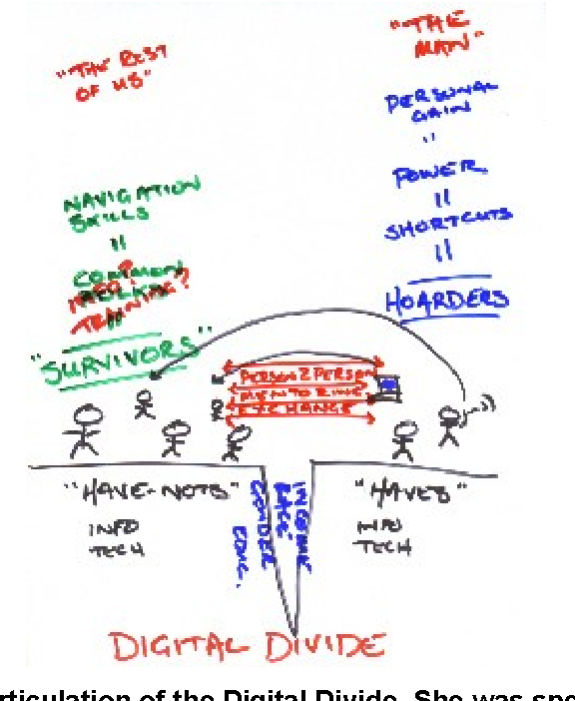
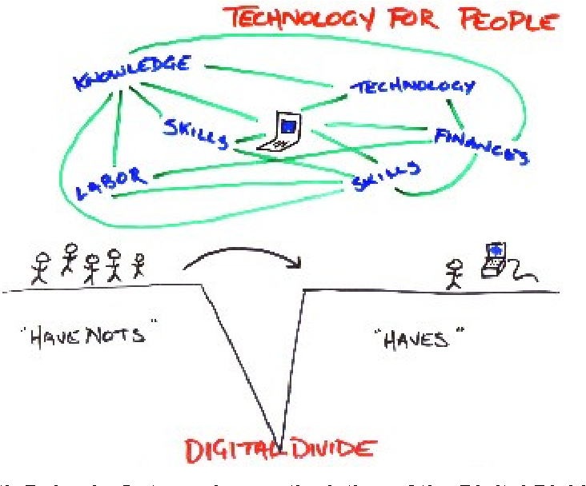
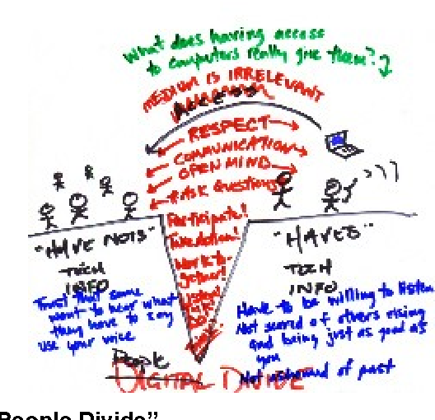
Why digital equity?

Slide 7
Definitions
From the National Digital Inclusion Alliance:
Digital Equity: a condition in which all individuals and communities have the information technology capacity needed for full participation in our society, democracy, and economy. Digital equity is necessary for civic and cultural participation, employment, lifelong learning, and access to essential services.
Digital Inclusion: the activities necessary to ensure that all individuals and communities, including the most disadvantaged, have access to and use of Information and Communication Technologies (ICTs). This includes five elements: (1) affordable, robust broadband internet service; (2) internet-enabled devices that meet the needs of the user; (3) access to digital literacy training; (4) quality technical support; and (5) applications and online content designed to enable and encourage self-sufficiency, participation and collaboration.

Slide 8
Components of Digital Inclusion
Who is using this stool?
Why are they using this stool?
Why aren’t they using this stool?
Is one stool enough?
Would they benefit from a seatback?
Do they want armrests?
What is this stool standing on?
What is the stool made of?
Who built the stool?
Is this stool sturdy?
Devices & Applications
Skills & Support
Internet Connection

Slide 9
Complex Solutions for Complex Problems
Who is using this stool?
Why are they using this stool?
Why aren’t they using this stool?
Is one stool enough?
Would they benefit from a seatback?
Do they want armrests?
What is this stool standing on?
What is the stool made of?
Who built the stool?
Is this stool sturdy?
Trust
Devices & Applications
Skills & Support
Safety
Relevance
Internet Connection

Slide 10
Digital Equity Act: The Basics
Included in IIJA; complementary to BEAD
Provides $2.75B in resources devoted to digital equity
Three funding areas:
$60M in planning grants to states, tribes, and territories
$1.44B in capacity grants to states, tribes, and territories
$1.25B in competitive grants to local governments, anchor institutions, etc.

Slide 11
Digital Equity Act: The Planning Grants
$60M in planning grants to states, tribes, and territories
$1.44B in capacity grants to states, tribes, and territories
$1.25B in competitive grants to local governments, anchor institutions, etc.
MN = $881,905.10; application is under review
Once award is made, we have 1 year to prepare a state digital equity plan
Months 1 – 8: Connecting, listening, facilitating, researching, writing
Month 9: Minimum 30-day public comment period on draft of plan
Months 10 – 12: Revising

Slide 12
Digital Equity Act: The Capacity Grants
$60M in planning grants to states, tribes, and territories
$1.44B in capacity grants to states, tribes, and territories
$1.25B in competitive grants to local governments, anchor institutions, etc.
Funding to carry out activities from digital equity plans once the planning grant period ends
Requires state to submit additional application
5 years to complete activities (approx. early 2024 to late 2028?)

Slide 13
Digital Equity Act: The Competitive Grants
$60M in planning grants to states, tribes, and territories
$1.44B in capacity grants to states, tribes, and territories
$1.25B in competitive grants to local governments, anchor institutions, etc.
Administered entirely by NTIA, not OBD
Applications open 1 month after the first capacity grant award is executed (so…early 2024?)
Four grant periods will run through late 2028
Many unknowns: maximum award amounts, actual timelines, application requirements, etc.

Slide 14
The Digital Equity Plan
Focus on “covered populations:” households below 150% poverty; aging individuals 60+ years old; incarcerated individuals; veterans; individuals with disabilities; individuals with language barriers; individuals who are members of a racial or ethnic minority group; rural individuals
Basic plan components:
Digital equity needs assessment to identify barriers faced by covered populations
Asset inventory including current resources, programs, local plans, etc.
Measurable objectives for state digital equity activities
Outreach and engagement strategy (during plan and for activities)
Connection to BEAD 5-year plan

Slide 15
So…what’s the plan for the Plan?
Starting with the invisible pieces of digital inclusion: trust, relevance, safety
My questions for you:
In your work, what insights about digital equity have surprised you?
How do you envision the Task Force being involved in the planning process?

