Slide 1

Broadband Needs for Transportation
Frank Douma and Adeel Lari
State and Local Policy Program

Slide 2
Overview
Transportation and Telecommunication: “Connection”
Definitions of “Connected”
Note: this is NOT autonomous
Role for Broadband: the backbone
Opportunities for telework and other “virtual” trips

Slide 3
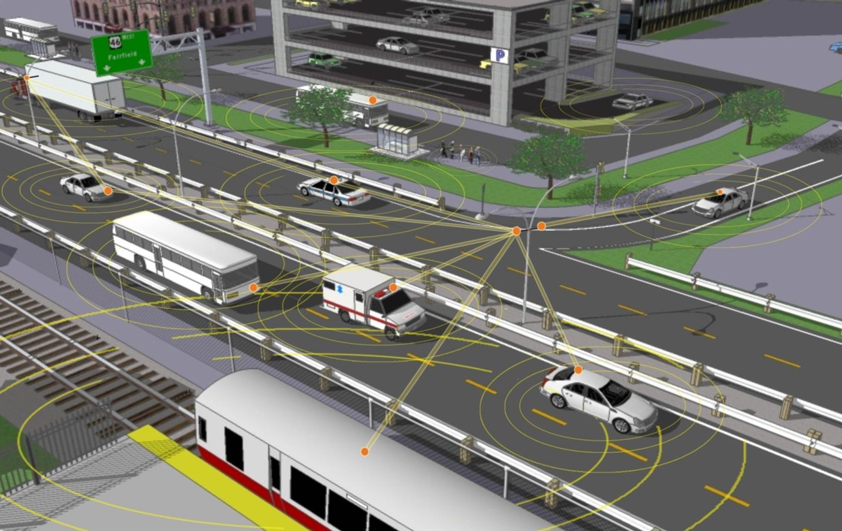
Transportation and Telecommunication
Many transportation technologies rely upon telecomunications to function
Can reduce crashes
Improve traffic flow
Balance growth of e-commerce (Just in time delivery)
https://icsw.nhtsa.gov/safercar/v2v/images/V2V-II-1.jpg

Slide 4
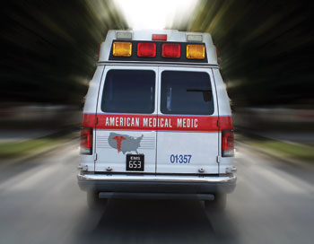
Why the Connection?
SAFETY
United States
35,092 Deaths in 2015
Worldwide
1.25 Million Deaths in 2013
50+ million Injuries
65+ Million Deaths in 20th Century
Economic Cost > $500 Billion/year
90% percent of accidents caused by driver’s error
Notes:
Adeel
Benefits
1) benefits to individuals and society
We’ve always been concerned about the safety of our vehicles and driving and so it is no surprise that the implication mentioned most often is safety. Car manufacturers, tech companies, NHTSA they are all predominantly interested in the safety of these vehicles along with other factors. Much of the benefit is derived in this area.
- In NHTSA’s 2008 crash causation survey it found that close to 90% of crashes are caused by human error. Therefore there is hope that removing human error from the equation could cause a reduction in crashes. American Association of State and Highway and Transportation Officials as well as others note that driver impairment could become less of a factor (Volvo calls them the 4 D’s distraction, drowsiness, drunkenness, driver error).
-currently NHTSA predicts that level 1 techonologies could impact 900,000 rear-end and 29,000 pedestrian crashes each year.
-Before Automated vehicles become widespread there is an increased focused on precursor systems that contribute to crash avoidance – back up cams and warnings at the simplest to dynamic braking and the use of radar and lidar to assess the environment.
-NHTSA recently announced it will focus on the development of V2V communication with the main goal of reducing crashes. NHTSA sees V2V as the next frontier of safety improvements while many manufacturers seeks to focus on the more transformational full Automated vehicles – it is clear that NHTSAs short term goals are somewhat different.
-More than 30,000 crash fatalities occur in the US on a yearly basis. It is a leading cause of death for adults. Therefore, the implications for individuals and families are a change in the risks of the driving experience. For a range of adoption rates we can expect to see improvements in safety for all people on the road. Even reductions in the severity of crashes as noted by GM VP or regulatory affairs would confer benefits
Caveats
-Humans cause a lot of accidents but we must also remember that they prevent a lot too. As a Google driverless car report completed by the New Yorkers notes we must remember that “for every accident (humans) cause , they avoid thousands of others” Humans analyze and observe and react and often make the right choice in complex situations. These reactions are reported, crashes are. The safety bar for SDCs will be high. Google admits that SDCs will have to be near perfect to be allowed on the road. In that case all the benefits can become reality. Google’s Levandowski in the New Yorker “Once you make the car better than the driver, it’s almost irresponsible to have him there”
-NHTSA notes that in iterations before a full SDC or even in a full one there are questions about how a driver will respond to warnings. “Will they get startled” or many others wonder including policy makers in California wonder about how much time a driver would need to have to take control in the case of an emergency. These questions and how drivers react in these situations will certainly have an impact on how safe SDCs are. In addition, NHTSA also points out that how well these system integrate with the drivers way of thinking or are easy to use for a broad range of drivers will matter grately in the transition. From NHTSA directions speech to congressional committee – 1) operationally intuitive, compatible with drivers abilities, supportive of reducing driver error, defers to driver, secure from malicious control

Slide 5
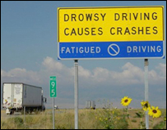
SAFETY
Why the Connection?
Benefits:
  Eliminate Driver Error
  Focus on Crash Avoidance
  Reduce Fatalities
Credit: www.cers.umn.edu
Notes:
Adeel
Benefits
1) benefits to individuals and society
We’ve always been concerned about the safety of our vehicles and driving and so it is no surprise that the implication mentioned most often is safety. Car manufacturers, tech companies, NHTSA they are all predominantly interested in the safety of these vehicles along with other factors. Much of the benefit is derived in this area.
- In NHTSA’s 2008 crash causation survey it found that close to 90% of crashes are caused by human error. Therefore there is hope that removing human error from the equation could cause a reduction in crashes. American Association of State and Highway and Transportation Officials as well as others note that driver impairment could become less of a factor (Volvo calls them the 4 D’s distraction, drowsiness, drunkenness, driver error).
-currently NHTSA predicts that level 1 techonologies could impact 900,000 rear-end and 29,000 pedestrian crashes each year.
-Before autonomous vehicles become widespread there is an increased focused on precursor systems that contribute to crash avoidance – back up cams and warnings at the simplest to dynamic braking and the use of radar and lidar to assess the environment.
-NHTSA recently announced it will focus on the development of V2V communication with the main goal of reducing crashes. NHTSA sees V2V as the next frontier of safety improvements while many manufacturers seeks to focus on the more transformational full autonomous vehicles – it is clear that NHTSAs short term goals are somewhat different.
-More than 30,000 crash fatalities occur in the US on a yearly basis. It is a leading cause of death for adults. Therefore, the implications for individuals and families are a change in the risks of the driving experience. For a range of adoption rates we can expect to see improvements in safety for all people on the road. Even reductions in the severity of crashes as noted by GM VP or regulatory affairs would confer benefits
Caveats
-Humans cause a lot of accidents but we must also remember that they prevent a lot too. As a Google driverless car report completed by the New Yorkers notes we must remember that “for every accident (humans) cause , they avoid thousands of others” Humans analyze and observe and react and often make the right choice in complex situations. These reactions are reported, crashes are. The safety bar for SDCs will be high. Google admits that SDCs will have to be near perfect to be allowed on the road. In that case all the benefits can become reality. Google’s Levandowski in the New Yorker “Once you make the car better than the driver, it’s almost irresponsible to have him there”
-NHTSA notes that in iterations before a full SDC or even in a full one there are questions about how a driver will respond to warnings. “Will they get startled” or many others wonder including policy makers in California wonder about how much time a driver would need to have to take control in the case of an emergency. These questions and how drivers react in these situations will certainly have an impact on how safe SDCs are. In addition, NHTSA also points out that how well these system integrate with the drivers way of thinking or are easy to use for a broad range of drivers will matter grately in the transition. From NHTSA directions speech to congressional committee – 1) operationally intuitive, compatible with drivers abilities, supportive of reducing driver error, defers to driver, secure from malicious control

Slide 6
Why the Connection?
source: National Center for Health Statistics (NCHS)

Slide 7
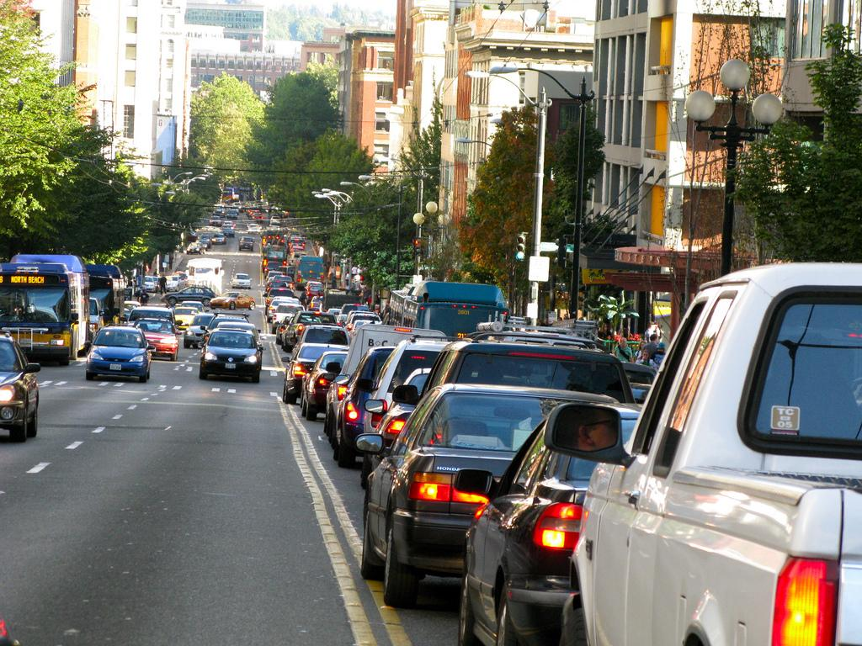
Traffic Capacity
Why the Connection?
Better Infrastructure Utilization
Congestion Reduction
  Increased Capacity
  Gap reduction- low elasticity
    Reduced Lane width
    Smooth merging
Intersection and Bottleneck Management
Credit: kapsch.net
Notes:
benefits to individuals and society
The next large benefit we have seen is the ability for self driving cars to make existing infrastructure more useful and more efficient. As SDCs are built to function on existing infrastructure the results could be capacity benefits without a major rework of existing road infrastructure.
Reasons for this:
Cars that can follow more closely because of error reduction then more cars can enter the roadway increasing capacity
congestion easing – with less crashes as well as potentially faster speeds and more efficient movement around merging, lane changes, etc there could be significant benefits in terms of gridlock avoidance and congestion easing. Americans lose 4.8billion hours at a combined cost of $100billion (KPMG cars) in traffic congestion
-In 2008, Dresner and Stone of the University of Texas at Austin completed research on autonomous intersection management that indicates that autonomous vehicles will allow for new forms of intersection management other than the visual cues that are now used for human drivers. The result will be a “reservation-based” approach to intersection management that they simulate will allow for more efficient movement through intersections while increasing safety.
Lane Use/Width – The accuracy of autonomous vehicles could allow for less distance adjacent to vehicles as well. American Association of State and Highway and Transportation Officials conjecture that their might be less need for rumble strips or guardrails turning the sides of roads as potential spaces for redevelopment. This somewhat depends on vehicle diversity changes but more lanes on a given road width is possible

Slide 8
“Flavors” of Connectivity

Slide 9
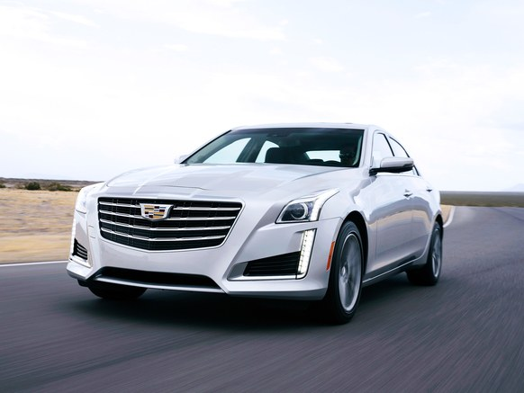
V2V
Closest to large scale deployment
Vehicles communicate safety warnings and other information to other vehicles
Subject to NHTSA Rulemaking: https://icsw.nhtsa.gov/safercar/v2v/
Will be deployed on 2017 Cadillac CTS, among other vehicles in near future
https://www.wired.com/2017/03/cars-now-talk-cars-youre-sort-thing/

Slide 10
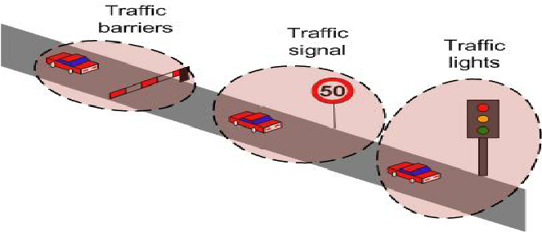
V2I
“Smart Highway”
Infrastructure communicates travel information directly to vehicle
Early Generations deployed (changeable message signs, etc.)
Technology to actually control vehicles shown to be prohibitively expensive
https://www.researchgate.net/profile/Federico_Barrero/publication/272497022/figure/fig4/AS:294750306488323@1447285357438/Fig-5-Vehicle-to-Infrastructure-V2I-communications.png

Slide 11
V2X

Slide 12
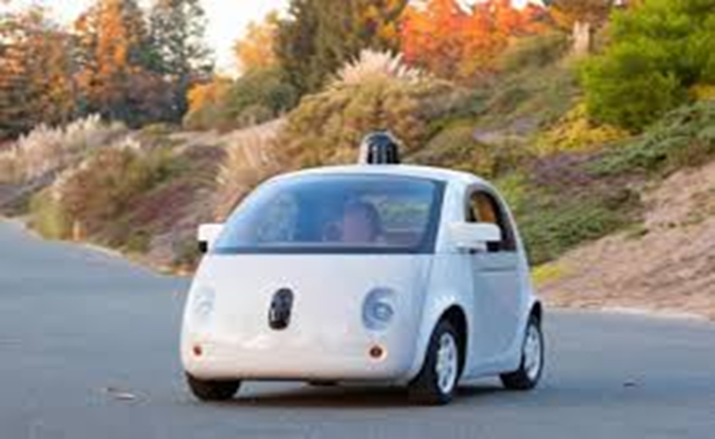
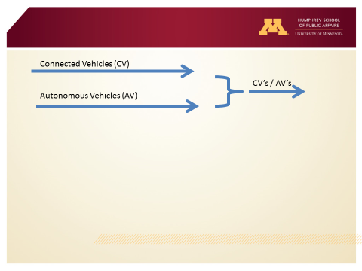
This is NOT Autonomous
Autonomous
  Self-reliant on AI
  Largely developed by private sector
Connected
  receives all information externally
  Largely designed and implemented by public sector
Automated: potential combination
  Leverages flexibility and efficiency of autonomous with
  Benefits of information sharing

Slide 13
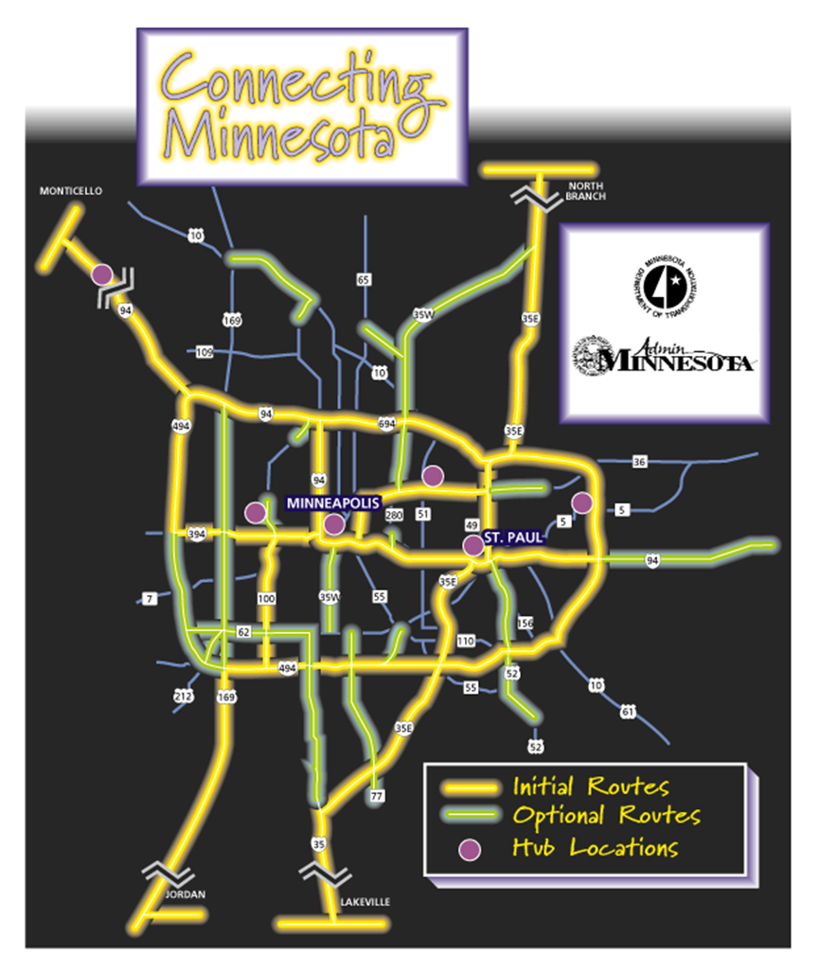
Role for Broadband?
Provide backbone for existing and future V2I and V2V applications

Slide 14
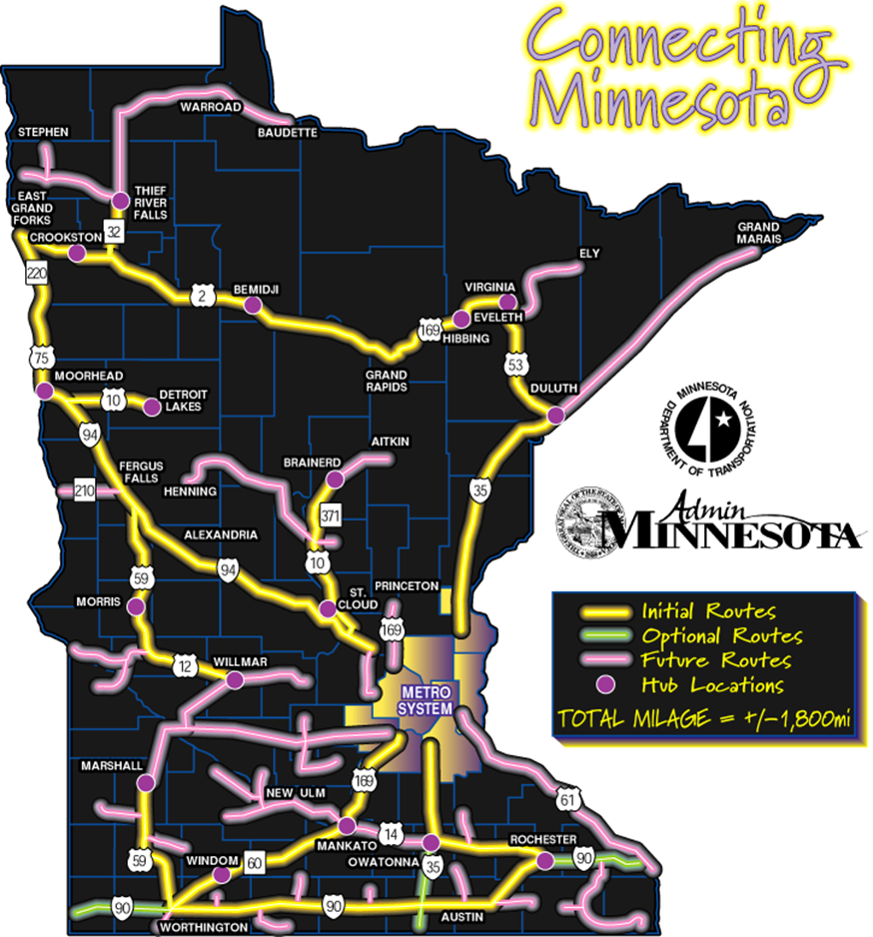
Role for Broadband?
Not a new idea . . .
But one whose time has come?
Connecting Minnesota (1990’s)
  Plan to extend 2000 mile fiber backbone network to within 10 miles of >80% of Minnesota’s population
  Including 1000 miles of freeway ROW
  20% of capacity reserved for public sector uses
  Not fully built out

Slide 15
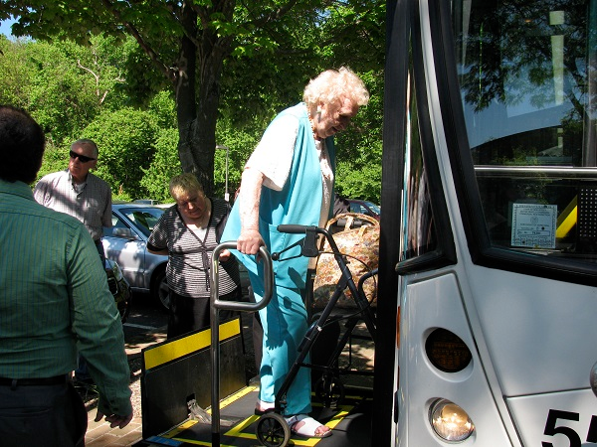
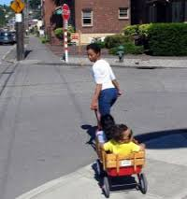
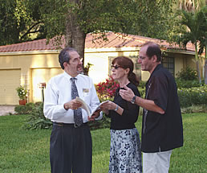
Mobility and Equity
Expanded user base
  Disabled
  Seniors
  Poor
  Children?
Increased Independence
Decreased Cost of Travel??
Notes:
Adeel
benefits to individuals and society
1.New users such as the elderly, disabled, and children may be able to ride in autonomous vehicles at the highest level expanding the use base
2. The reduction in ride alongs (parent transporting children, drop offs at the airport etc) can increase independence for individuals and allow different use of time
3) Travel time is travel cost. If less time is spent idle in a vehicle or in traffic jams mobility is increased. KPMG notes that the average U.S. commuter spends 250 hours behind the wheel of a car think about the cost of that time and how it could be converted into useful time and how much more freedom and mobility comes from the use of that time.

Slide 16
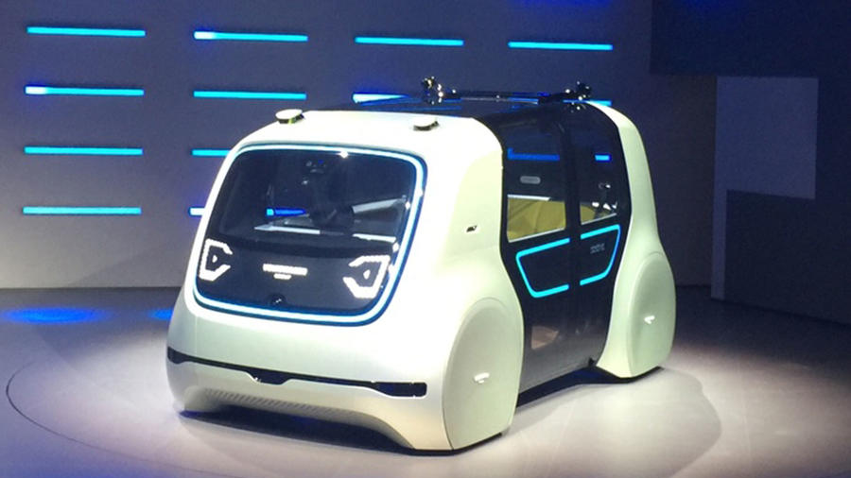
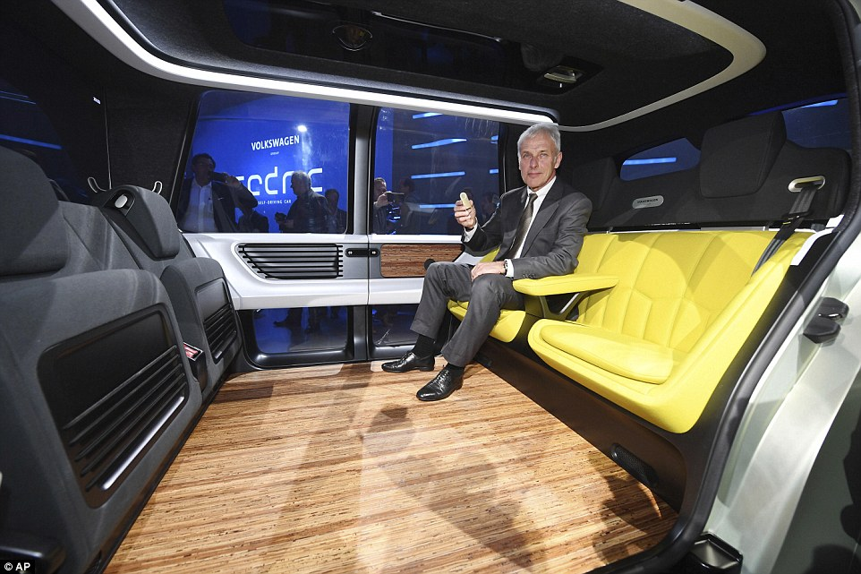
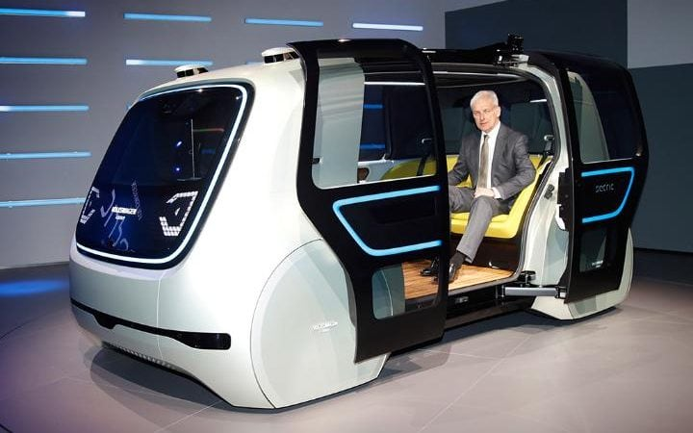
Improved Mobility
http://www.autocar.co.uk/car-news/motor-shows-geneva-motor-show/volkswagen-sedric-concept-previews-self-driving-pod-vehicle
http://www.dailymail.co.uk/sciencetech/article-4287010/VW-unveil-self-driving-car-post-dieselgate-shift.html
http://www.telegraph.co.uk/cars/news/geneva-motor-show-2017-vw-group-unveils-sedric-prototype-driverless/

Slide 17
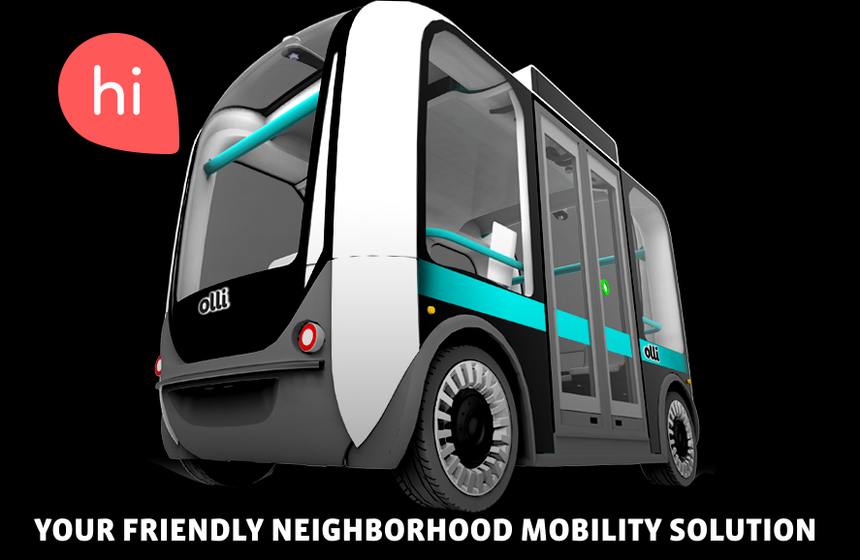
Improved Transit
First and Last Mile Solution for Transit
Complement to existing service
Increase the impact of transit stations on adjoining properties
Greater efficiency in low density
From few blocks to maybe a mile?
https://meetolli.auto/manual.html

Slide 18
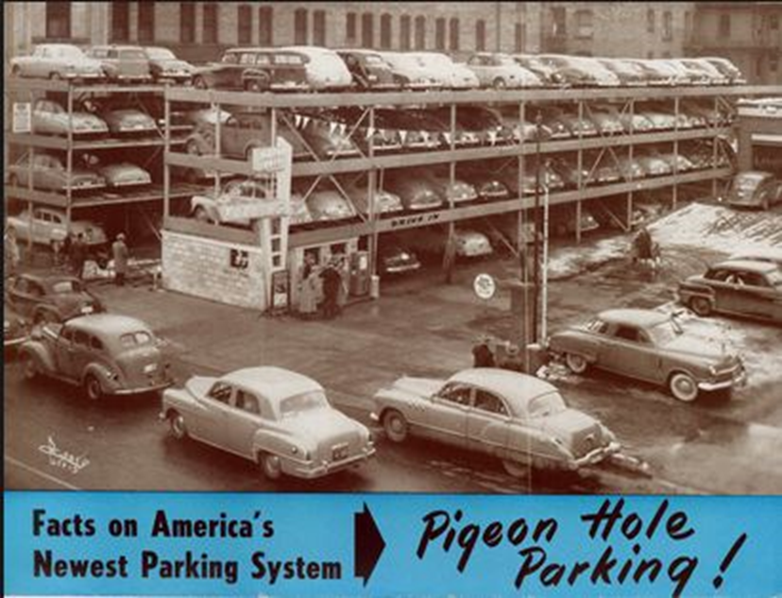
Land Use/Planning
Urban areas will be earliest to be impacted
Parking
  Decoupled from the building
Shoup
  CBD’s > 30% is devoted to parking
McKinsey
  Area devoted to parking will reduce by >60 billion square ft. it is > 40% of current use

Slide 19
Other broadband applications to transportation
Telework
Telemedicine
Greater entertainment options
  Reduce need for peak period travel
  Allow for greater choice in residential and business location
  Improve quality of life

Slide 20
Other broadband impacts
Adds critical amenity to small towns and regional centers
Introduces competition in rural Minnesota
Expands / Improves telecom services statewide
Meets the needs of education and state and local government

Slide 21
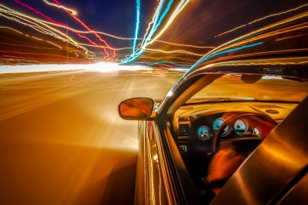
Questions?
Frank Douma
  douma002@umn.edu
Adeel Lari
  alari@umn.edu
Credit: digidreamgrafix] /FreeDigitalPhotos.Net
Notes:
Optional end

