Slide 1
School Broadband Landscape
Governor’s Task Force on Broadband
Thursday, January 11, 2024
Marc Johnson, Executive Director
ECMECC
ECMECC is 43,000 students, 3200 faculty/administrators and 2400 educational support staff from 18 member school districts and Pine Technical and Community College. ECMECC utilizes technology, information and communication tools to expand educational opportunities for students, staff and community members in East Central Minnesota and beyond. ECMECC was founded in 1983 to make great things happen for students. We still do.

Slide 2
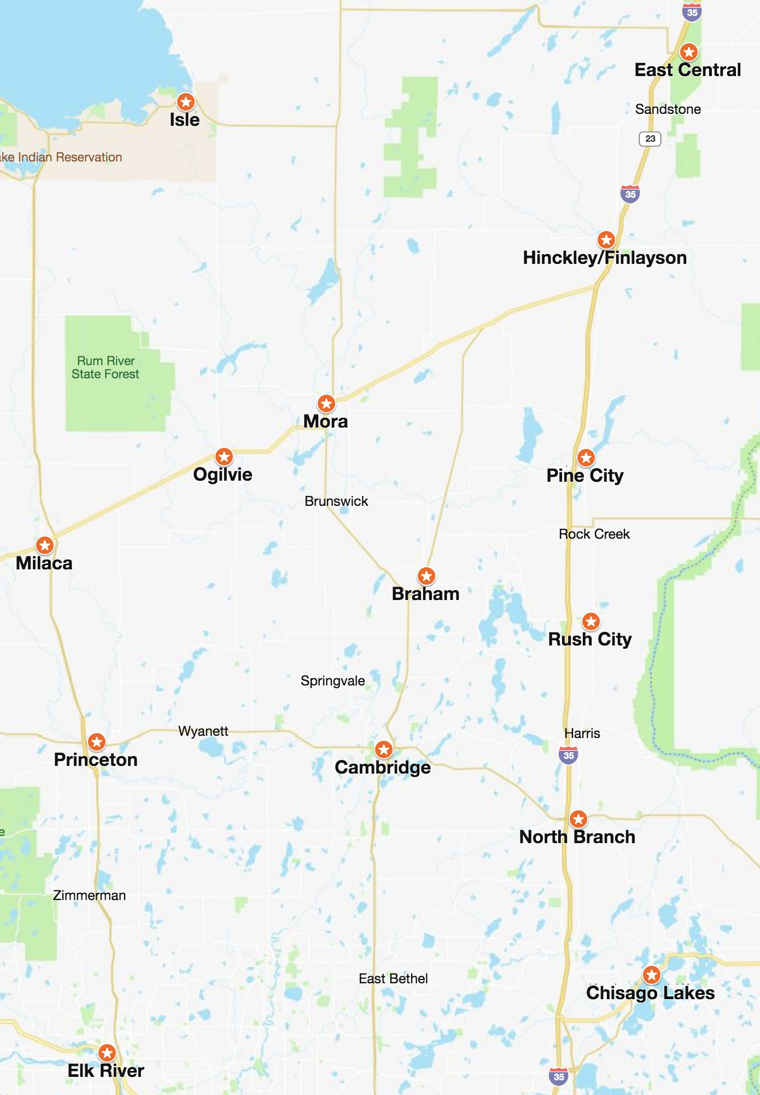
About ECMECC
Cooperative of 14 public schools and Pine Technical and Community College
Educational Opportunities (Distance Learning, Career Academies, Video Conferences)
Classroom Technology (Professional Development, Lending Library, Lake ECMECC, Event Streaming)
Network & Information Security (WAN, Data Center, Firewall, Risk Assessments, Vulnerability Scanning, PD for technology staff)
Advocacy (School Funding, Broadband)

Slide 3
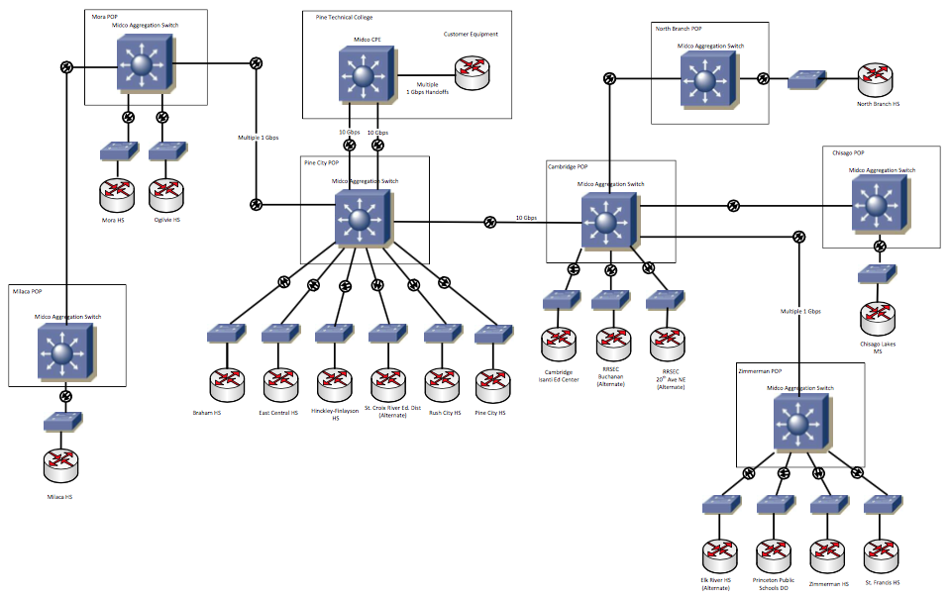
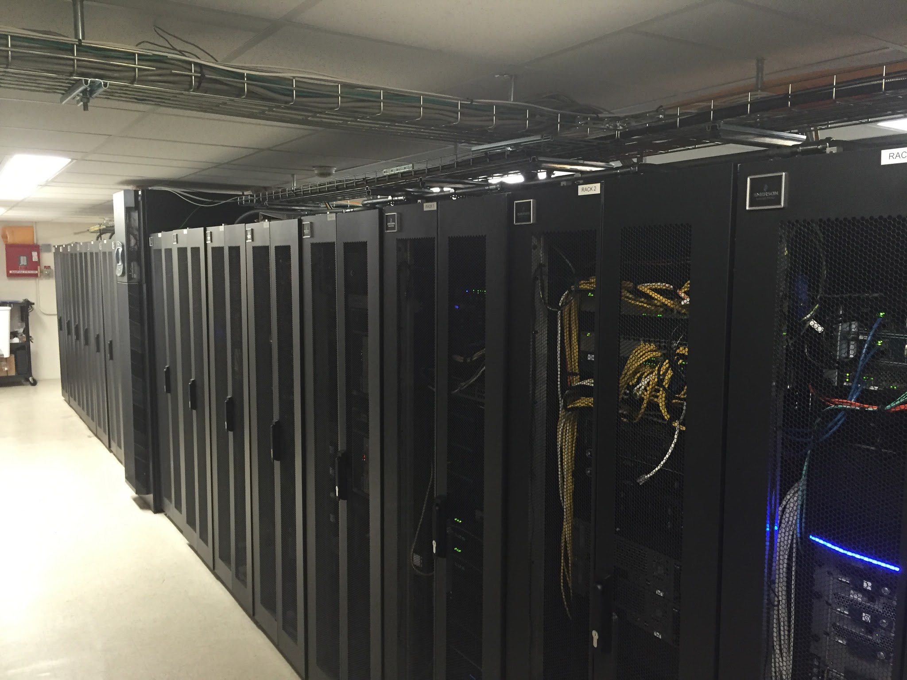
ECMECC Data Network
1-2 Gbps fiber WAN Connecting 14 districts, 2 cooperatives and a regional library system with a hub at Pine Technical & Community College
Started in 2006 through a partnership with local cable television provider
Data Center collocated with PTCC
Virtual Machine “farm” with 175+ VMs for 14 districts/organizations
Shared enterprise level firewall and network security
Utilize MN IT Services (MnIT) for network management and Internet access

Slide 4
Central MN WAN (Internet Services)
Serving Over 60 school districts and 46 library sites for over 20 years
Captures federal E-rate funding
Fully qualifies the districts and libraries for State Telecommunications Equity Aid funding
Full 1Gbps bandwidth available to every entity but overall bandwidth is less through aggregation
State of MN is the Internet service provider (with all state security services)

Slide 5
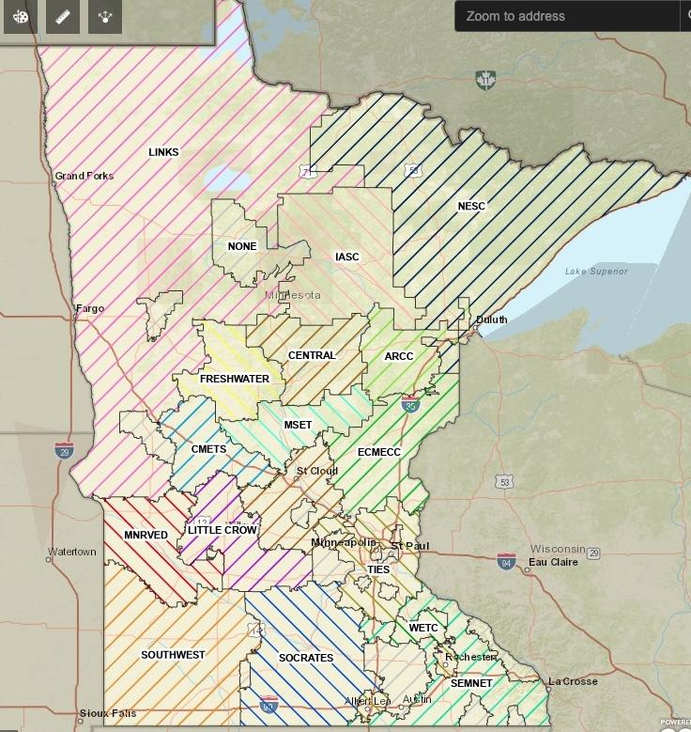
Minnesota Education Technology Networks (METN)
Cooperatives cover nearly 90% of districts
Established through statute or joint powers
Funded through Erate/federal, state aid, membership
Provide Internet and other services
Digital Equity
Community Education
Advocacy
Broadband guides
Affordability guidance
Digital Navigation
Devices

Slide 6
School Landscape and Challenges
Nearly all schools are connected via fiber (Angle Inlet, fixed wireless)
Most have the bandwidth they need to utilize technology fully
Federal rules limit district involvement in community networks
Many have 1:1 device programs (wary of fiscal cliff)
Digital haves and have nots
Rural communities still without high speed access
Families still struggle with affordable service

