Slide 1
Collaborating with Vocational Rehabilitation Services (VRS) in Providing Pre-Employment Transition Services (Pre-ETS)
Training for MPS Staff at Edison High School
Fall 2021
Notes:
Ask principals to start off, and then hand over to MaryAnn at Edison and Jennifer at Southwest

Slide 2
Agenda
Introductory Information
Overview of Pre-Employment Transition Services (Pre-ETS)
Process for Partnership with VRS
Resources
Notes:
MaryAnn at Edison and Jennifer at Southwest
Here is our agenda for today’s training. We want to get through everything and we have a short timeframe- please write your questions on the sheet of paper in your packet. Please hold out till the end to ask questions (jot down your questions as we go!)

Slide 3
Introductions
Jennifer Schneider, MPS Lead Transition Ambassador
Debbie Nelson, MPS Lead Counselor
MaryAnn Sulik, Edison WBL Coordinator
Alyssa Klein, VRS Transition and Pre-ETS Coordinator
Lindsey Horowitz, MDE Transition Specialist
Song Lee, VRS Pre-ETS Representative
Stephanie LoRusso, VRS VR Counselor
Notes:
MaryAnn at Edison and Jennifer at Southwest (read the names and have the person wave)

Slide 4
Who is a “Student with a Disability”?
Has an IEP (in special education); or
504 plan; or
Other medical/mental health documentation
Notes:
MaryAnn at Edison and Jennifer at Southwest
Before we begin today we want to be clear about who a student with a disability is…that is why we have such a large and varied group of school staff here.

Slide 5
What is Vocational Rehabilitation Services (VRS)?
State employment services agency that serves people with disabilities
Division of the Department of Employment and Economic Development (DEED)
Sister agency: State Services for the Blind (SSB)
Partner in the CareerForce system (formerly Minnesota WorkForce Centers)
50 CareerForce locations in the state
VRS serves youth and adults: Any Age 14+!
Notes:
Alyssa
Vocational Rehabilitation Services or VRS is a federal and state funded program that provides employment services to people with disabilities. - every state in the country has a VR program. We are a division of the Minnesota Department of Employment and Economic Development otherwise known as DEED. And State Services for the Blind or SSB is our sister agency that serves individuals who are blind, deafblind or have low vision. So keep in mind that, while we will be referring to VRS only in our presentation today being that most students would be served by VRS, SSB provides the same services to individuals with vision impairments.
VRS is also a partner in the MN CareerForce system, which used to be called Minnesota WorkForce Centers. There are about 50 CareerForce Centers in the state which provide employment related services to any job seeker who needs help finding work or any employer who needs help with finding workers. There are 2 CareerForce locations in Minneapolis: one on West Broadway (just down from the Davis Center) in the North and one on the corner of Lake and Chicago in the South.
Also, it is important to know that VRS serves youth as well as adults. Sometimes young people may not utilize our services while they are in high school, but if they need us, they can always access our services later. Furthermore, sometimes there may be family members that could benefit from our program, so you could always refer them too!

Slide 6
US Dept. of Ed. Laws Coming Together
ESSA
IDEA
(Sp. Ed.)
WIOA
(VRS)
Perkins V (CTE)
Notes:
Lindsey
There are four federal laws administered at the US Department of Education that come together on this effort.
Everyone of course knows that the Every Student Succeeds Act or ESSA is our all-encompassing federal K-12 education law for ALL students. The goal of ESSA “is to provide all children significant opportunity to receive a fair, equitable, and high-quality education, and to close educational achievement gaps.”
Perkins V is the Career and Technical Education or CTE law which expands opportunities for every student -particularly those from historically underserved groups (such as students with disabilities)- to explore, choose, and follow career and technical education programs of study and career pathways to earn credentials of value.
The Individuals with Disabilities Education Act (IDEA) is our federal special education law which ensures free appropriate public education to students with disabilities.
And finally there is the Workforce Innovation and Opportunity Act or WIOA which is designed to strengthen and improve our nation's public workforce system and help get Americans, including youth and those with significant barriers to employment, into high-quality jobs and careers. WIOA is VRS’ federal law. The Rehabilitation Services Administration or RSA is the federal agency that administers state VR programs. It is no coincidence that RSA is also housed at the US Department of Education. In fact, RSA is a sister agency with the federal Office of Special Education Programs: and they make up what is known as OSERS, the Office of Special Education and Rehabilitative Services.

Slide 7
Working together to deliver a more seamless and timely employment support system
E1MN: A STATE-AGENCY PARTNERSHIP ADVANCING EMPLOYMENT FIRST
Minnesota Department of Human Services (DHS)
Minnesota Department of Education (MDE)
Minnesota Department of Employment and Economic Development (DEED)
E1MN page on Disability Hub website
Notes:
Lindsey
And we are taking that spirit of collaboration to the State level here in Minnesota. This year we launched a new enhanced partnership between the Dept. of Human Services, MDE and DEED called E1MN, which stands for Employment First MN. As it says here, we are committed more than ever to deliver a more seamless and timely employment support system for ALL individuals with disabilities.
There is a link at the bottom of this slide to learn more about E1MN. For today’s purposes, what we are doing here at Edison/Southwest HS is a component of E1MN work.

Slide 8
What are Pre-Employment Transition Services?
Notes:
Lindsey

Slide 9
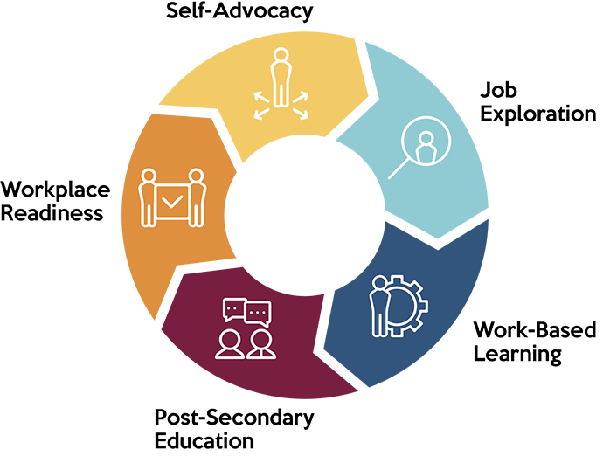
Pre-Employment Transition Services (Pre-ETS) are a part of Transition Services
Job Exploration Counseling
Work-Based Learning Experiences
Postsecondary Education Counseling
Workplace Readiness Training
Instruction in Self-Advocacy
Notes:
Lindsey

Slide 10
Pre-ETS Availability
Are provided in collaboration between schools and VRS
Must be made available statewide to all students with disabilities
Any student with a disability who is age 14-21 can receive Pre-ETS
Notes:
Lindsey
Pre-ETS are provided in collaboration between high schools and VRS. Schools and VRS are required to have Pre-ETS available to all students with disabilities across the state. To do that, VRS has 2 staff assigned to every high school. Any student with a disability who is between the ages of 14 through 21 can receive Pre-ETS.

Slide 11
MPS Pre-ETS Project
VRS has been partnering with MPS for 2+ years on a Pre-ETS project
Schools: Edison and Southwest. Will go district-wide in 2022. (Also a statewide demonstration project!)
Components of project:
Consistent approach for identifying students, providing outreach, tracking, and partnering together
Ensure students with disabilities get full access to general education programming and supports (ie. My Life Plan, Naviance, school counselors)
Jennifer Schneider: MPS Lead Transition Ambassador; each school will have a Transition Ambassador (TA)
Notes:
Debbie

Slide 12
Schools are the primary provider of Pre-ETS…
…but VRS can help fill in the gaps
Notes:
Lindsey
By the very nature of what schools do in educating students, providing Career and College Readiness programming and delivering transition services through IEPs, schools are the primary provider of Pre-ETS services. It is important for VRS to understand how Pre-ETS are currently provided to students at school so that VRS can fill in the gaps.

Slide 13
How Schools and VRS Provide Pre-ETS to Students in MN/MPS
All students ages 14-21
All students with disabilities
Students with disabilities whose needs are not met by school alone
Students with disabilities whose needs are not met by schools and Introductory Career Services
School provides as part of Personal Learning Plans (PLPs)/My Life Plan (MLP) and Career and Tech Ed (CTE)
School provides Pre-ETS as part of PLP/MLP, CTE and IEP transition services
VRS “Introductory Career Services” (“Pre-ETS Only”)
VRS “VR Career Services”
(“Pre-ETS Plus”)
Notes:
Debbie

Slide 14
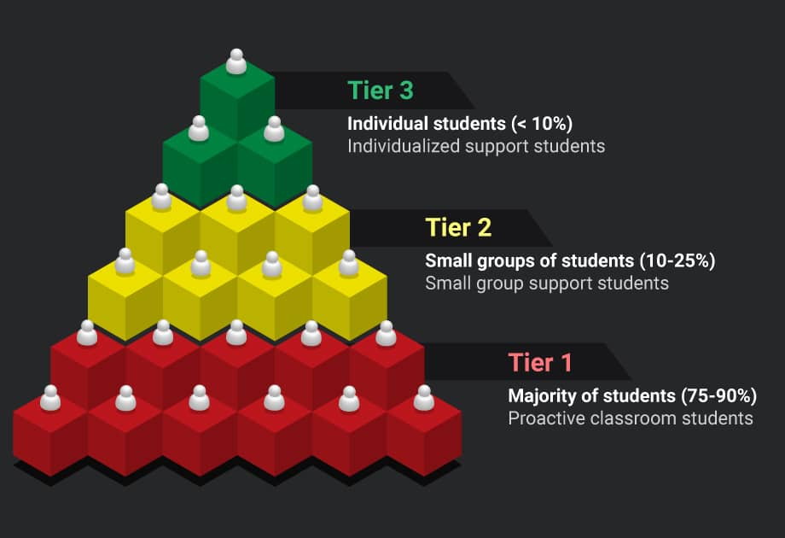
Think “Multi-Tiered System of Supports” (MTSS)
First tier: We want all students with disabilities to have equitable access to services as same age peers (My Life Plan, CTE, etc.)
Second tier: Additional transition supports through special education
Third tier: Additional supports through VRS
Notes:
Debbie
Here is another way to think about it…MTSS grew out of Response to Intervention (RTI) and Positive Behavior Interventions and Supports (PBIS) which are called out in IDEA….

Slide 15
MPS PLP: My Life Plan (MLP)
In MPS, the PLP is met through the My Life Plan curriculum, generally delivered by School counselors and Achieve CCC Coordinators
There are 5-7 lessons for each grade level each year and the lessons are connected to one another and from year to year
Students complete multiple college and career readiness activities at each grade level which include surveys, inventories, discussions, and other hands-on activities that build a personal post-secondary portfolio
The HS grade level themes are: 9th grade - Personal Identity and Social Connections 10th grade – Career Exploration 11th grade – Career and College Research, Purpose, Fit and Match 12th grade – Post-secondary Applications and Advocacy
Notes:
Debbie

Slide 16
VRS: 2 Levels of Services (click here for link)
Introductory Career Services (“Pre-ETS Only”)
VRS staff: Pre-ETS Representative- Song Lee
Typical starting point for 9-11th graders
**We need: Verification of disability**
VR Career Services (“Pre-ETS Plus”)
VRS staff: VR Counselor- Stephanie LoRusso
Typical starting point for 12th graders and Transition Plus students
**We need: Documentation of disability**
Notes:
VR Counselor or Pre-ETS Rep

Slide 17
VRS Contracts with Community Rehabilitation Providers (a.k.a. CRPs or “providers”)
MSS (Edison) and Goodwill (Southwest) are a part of our project.
Others will be added later (will be trained first).
Notes:
VR Counselor or Pre-ETS Rep

Slide 18
NOTE: Other VRS Staff May be Brought In
VRS has staff with specialty caseloads (equitable access):
Indigenous/American Indian
New Americans (immigrant and refugee students/families)
Deaf or Hard of Hearing
Blind, low vision or DeafBlind: State Services for the Blind
Notes:
VR Counselor or Pre-ETS Rep

Slide 19
Why Would I Refer?
Student has unmet Pre-ETS needs
Student needs extra supports after graduation
You have a partner in serving the student!
Notes:
VR Counselor or Pre-ETS Rep
So you would want to refer a student if they have unmet Pre-ETS needs that the school isn’t able to fulfill. You would also want to refer early so that they have plenty of time to be ready for what happens after graduation. Another reason to refer is if you believe the student is going to need extra supports after they graduate from high school. And lastly, by referring a student, you then have a partner in seeing that the students you serve get all that they need.

Slide 20
Opportunity: Transition Ambassador (TA)
Main point of contact at each MPS school to coordinate Pre-ETS with VRS
Acts as a Q-Comp position- $350 stipend plus additional compensated training time as needed
Duties:
Collect VRS Referral forms
Identify each student’s primary school staff and school counselor
Enter students into spreadsheet, and monitor spreadsheet with VRS staff
Help VRS staff set regular dates/times/location to meet with students at school*
Communicate updates with school staff, problem solve as needed
Notes:
Jennifer

Slide 21
Indicate Interest for Edison Transition Ambassador (TA) Position
One easy step! Email:
Eryn Warne, Eryn.Warne@mpls.k12.mn.us, and
Jennifer Schneider, Jennifer.Schneider@mpls.k12.mn.us
Notes:
Jennifer

Slide 22
Process for Partnership with VRS
Notes:
Alyssa

Slide 23
MPS-VRS Pre-ETS Process
1. Complete VRS Referral Form: Give to Transition Ambassador (TA)
2. TA identifies student’s primary school staff, enters referral into VRS spreadsheet, alerts primary school staff and VRS staff of referral
3. Primary school staff and VRS staff connect with student (and parent(s)/guardian(s) as applicable) to explain VRS and give application
4. Student completes VRS application. School staff provides verification OR documentation of disability.
5. Pre-ETS Planning Meeting held, Pre-ETS Planning Meeting Form completed
6. VRS and/or community provider provide Pre-ETS
7. Periodic follow-up meetings and ongoing communication take place
Notes:
Alyssa

Slide 24
Step 1: Complete VRS Referral form
Any staff person (you!) identifies a student needing Pre-ETS services from VRS
Complete VRS Referral Form
Provide to Transition Ambassador (TA)
Notes:
Alyssa

Slide 25
Step 2: TA identifies and alerts school staff, enters referral onto spreadsheet
TA identifies “primary school staff”: Special ed. case manager, 504 coordinator, social worker, school counselor, or others
TA enters student into spreadsheet
TA alerts primary school staff and VRS staff of referral
Notes:
Alyssa
Note that we will have a more automated spreadsheet coming in March that comes from our online case management system

Slide 26
Step 3: Primary school staff and VRS staff connect with student
Purpose: To explain VRS services and give an application packet (application and any needed releases of information)
Ways to connect:
Most ideal: Set meeting at school or on Zoom (complete application at that meeting)
Second choice: At a regularly scheduled time that VRS is available
In a pinch: Email, text, phone call, letter (not as effective- try to use as reminders only)
Notes:
Releases: MPS, Parent(s) if over 18, other primary entities that should be involved in planning

Slide 27
Step 4: Student completes VRS application and needed releases, MPS provides verification or documentation
If not completed in first meeting, identify and communicate who/how student should return the completed application and release(s) to
Discuss ways to follow-up if the student doesn’t hand in application
VRS will connect with primary school staff to get verification or documentation of disability

Slide 28
Step 5: Pre-ETS Planning Meeting
Required attendees:
Student, VRS staff, primary school staff, and school counselor
Optional attendees:
Parent(s)/guardians, work-based learning coordinators, and others as needed
Complete the Pre-ETS Planning Meeting Form

Slide 29
Step 6: VRS and/or community provider provide Pre-ETS
VRS makes referral to provider (CRP) as needed and introduces provider to team
Communication: What, how, when and where Pre-ETS will be provided

Slide 30
Step 7: Periodic follow-up meetings and ongoing communication
Team sets first follow-up meeting at Pre-ETS Planning Meeting
Team discusses how ongoing communication will take place (how and frequency)

Slide 31
Resources
Notes:
Alyssa

Slide 32
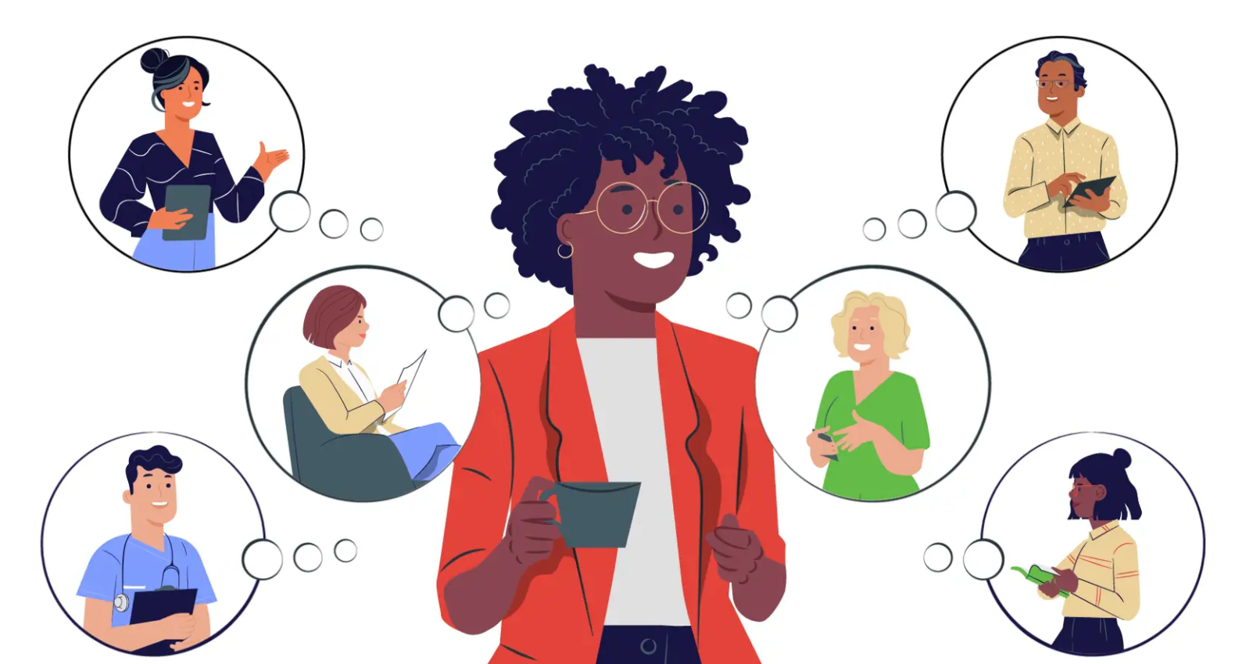
Web Link for Materials
https://mn.gov/deed/job-seekers/disabilities/youth/staff/
Scroll to bottom of page: “Minneapolis Pre-ETS Project”

Slide 33
Flyer and Video for Students
Click here for video
Click here for flyer
Notes:
VR Counselor or Pre-ETS Rep

Slide 34
Contact Information:
VRS Pre-ETS Rep: Song Lee, Song.Lee@state.mn.us
VRS VR Counselor: Stephanie LoRusso, Stephanie.LoRusso@state.mn.us
VRS Pre-ETS Lead: Alyssa Klein, Alyssa.Klein@state.mn.us
MPS Lead TA: Jennifer Schneider, Jennifer.Schneider@mpls.k12.mn.us
Edison WBL Coordinator: MaryAnn Sulik, MaryAnn.Sulik@mpls.k12.mn.us
MPS Lead Counselor: Debbie Nelson, Deborah.Nelson@mpls.k12.mn.us
MDE Transition Lead: Lindsey Horowitz, Lindsey.Jo.Horowitz@state.mn.us
Notes:
Alyssa

