Slide 1
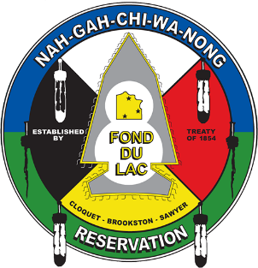
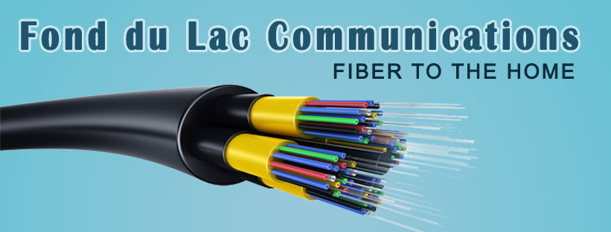
Broadband Development Fiber to Home
Fond du Lac Band of Lake Superior Chippewa

Slide 2
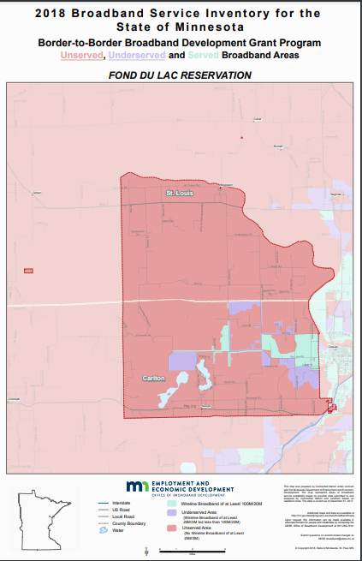
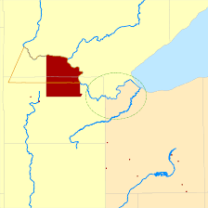
History
2005
How do we serve the entire Reservation with Broadband Internet?
Challenges
Lack of Density (4,000 people over 100,000 acres)
Topography (not ideal for towers and/or wireless)
Vegetation (pine needles break up a wireless signal)
Cost $6.5 - $10 Million (in 2006)
Notes:
History
In 2005 Fond du Lac Reservation MIS (IT) began investigative work on how to deploy broadband/Internet to the entire Reservation. RFP process was done to find an engineer to look at deployment of broadband at Fond du Lac.
Lack of density , of customers, topography, vegetation\ were all initial issues that cropped up.
The consultant recommended towers and wireless solutions to the area.
There were two rough designs and cost estimates. One design with 3 towers and the other with 6 towers.
Tower solutions has issues with topography- poor line of site and vegetation in summer, leaves and in particular pine needles broke up the wireless signal.
The cost of these options ran about 6.5 to 10 million dollars in 2006. They did not provide complete coverage due to topography and geography.

Slide 3
History
2007
2008
2009
Directed to begin looking for grant funding
Great Recession
ARRA Program
USDA
BIP and BTOP
Discussions with USDA/EDA
Encouraged to Apply
Funding Requests
Not Economically Feasible
Notes:
At this time in 2007 the FDL Planning Division was brought in to start looking for grant funds.
2008 arrived as did the great recession. ARRA programs came out and USDA had increases to the BIP and BTOP broadband programs. FDL applied to BIP but was denied because we were not rural enough.
FDL applied to BIP- ARRA but again was denied because it was not economically feasible.
2009
This lead to discussion with EDA. We expanded our experiences with USDA and EDA said to apply because it was a good project. After a very lengthy process they denied the application because it was not economically feasible.

Slide 4
The Change
2010-2011
Abandon Idea of Towers and Wireless
New Direction → Fiber to the Home
Reliable
Same Cost but Complete Coverage (Topography, Geography and Vegetation not an issue anymore)
Hired a new firm to complete a high level feasible study
Notes:
2010-2011
Now the thought process changed at FDL as did technology and the cost of technology.
FDL abandoned the towers and wireless model to look at lines and ultimately Fiber to Home. The technology was more proven how and cost had decreased. Similar cost and complete coverage. Issues of topography, geography and vegetation all are greatly reduced.
A new firm was hired to come up with a high level determination if it was feasible or not.

Slide 5
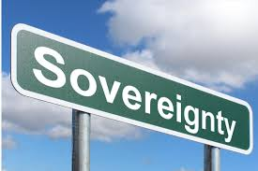
Strategy
2012-2016
Having a Seat at the Table and Community Engagement
MIS/IT Staff Active in State and Regional Broadband Groups
Governor’s Task Force
Tribal Leadership meeting with USDA
Blandin Broadband Community
Computer classes
Increased Wireless/Wifi access @ Community Centers and K-12 School
“App” Development Camp with Youth
Notes:
2012-2019
Fond du Lac staff also began to work the project in other ways. MIS/IT staff became active in State and regional broadband groups and coalitions- Governor’s Task Force.
FDL Planning staff also working with Blandin and became a Blandin Broadband Community after writing a successful grant.
FDL Chairwoman also would meet with USDA on lack of service to FDL, Indian Country and the State.
New approaches proved the way to promote an idea, assist in policy development, become more active in broadband initiatives active in the State and local organizations.

Slide 6
Partners
NESC
Middle Mile (2009)
Connected 3 Community Centers and Several FDL Government Buildings
2010 Broadband Initiative Program – Technical Assistant Grant
2015 USDA Community Connect Application Development
Notes:
NESC
Fond du Lac participated in two projects with Northeast Service Cooperative. The first was a middle mile project that was developed in 2009. NESC built a 1000 miles of fiber in Northeast Minnesota to connect community facilities to a fiber network. That project was completed and several FDL buildings were connected including 3 community centers.
The second project with NESC was the 2010 Broadband Initiative Program- Technical Assistant grant. This grant paid for a study to create a regional plan that identified broadband engineering model to connect communities in the most need and to expand future small business opportunities.

Slide 7
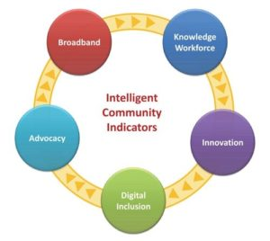
Partners
Blandin Foundation
Blandin Broadband Community
2012-2016
MN Intelligent Rural Community Program
Distribute PC’s for People
Free Computer Classes (Basic – Advanced)
iPads in the Classroom
“App” Development Camp for Kids
Hot Spots
Community Outreach Meetings
Notes:
Blandin 2012-2016
The Fond du Lac Band became a Blandin Broadband Community and Alumni. This program was a part of the Minnesota Intelligent Rural Community Program. As a BBC multiple departments worked together- MIS, Planning, OJS, Human Services and Community Services. Project goals were PC’s for people, free computer classes, ipods in the classroom, App Camp, Installation of 13 Hot Spots, and Community outreach meetings.
From 2016 to present there has been public outreach at community events such as the Health Fair and Enrollee Day.

Slide 8
MORE GRANTS
2015
Worked with NESC to apply for TWO USDA Community Connect Grants
St. Louis County
Carlton County
1000+ homes combined with up to 1GB Speed, synchronous, Fiber to the Home
Notes:
2015
Worked with NESC to apply for two USDA Community Connect Grants. One for St. Louis County and the other for Carlton County. These would cover up to a 1000+ homes with up to 1 GB speed, synchronous, fiber to the home.
These were not funded

Slide 9
First Success
2016
Fine tuning grants that were submitted in 2015
Resubmission
Approved!!!
Woah… Now what?
Notes:
2016
Even though the two grants of 2015 were not funded Fond du Lac rewrote those two proposals with NESC and submitted those for 2016 funding cycle.
These grants were approved.
2016-2017
Fond du Lac worked with NESC and USDA to allow the Reservation to become the grantee verses NESC. This would be a smoother and more effective arrangement for Fond du Lac to be in charge of grants.

Slide 10
Total Grants (5)
2016
2017
Initial two USDA Community Connect Grants moved into FDL’s name
Band applied for a 3rd USDA Community Connect Grant
2018
$8,967,211 in Grant Funding
$3,458,527 in Cash Match
(FDL Development)
HUD – ICDBG Grant Secured and DEED Border to Border Grant Funded

Slide 11
Becoming an ETC (Eligible Telecommunications Company)
Fond du Lac Communications
Utility Easements
Landowner Consent Requirements
Service Line Agreements
Charter the Corporation
Petition to FCC to become an ETC
Federal and State Regulations
Which apply to us as a Tribal Government
On or Off Reservation
(Do they apply to both Band Members and Non-Band Members?)
Notes:
Negotiating with NESC (With FDL taking ETC Status they are now able to be the lead in the USDA Grants)
Creating Fond du Lac Communications
Researching Utility Easements, Landowner Consent Requirements, Develop Service Line Agreements, Charter the Corporation (do we become a separate entity (enterprise) or a Division within existing tribal entity?

Slide 12
Marketing
Notes:
Working with a Consultant to develop a marketing plan.
Sending out Letters, Posters, Door Hangers, Spreading the Word and Communicating with Customers. We wanted to do it BETTER and make sure that the customers trusted us and felt like our service was top notch (in Speed, Quality, Affordability)

Slide 13
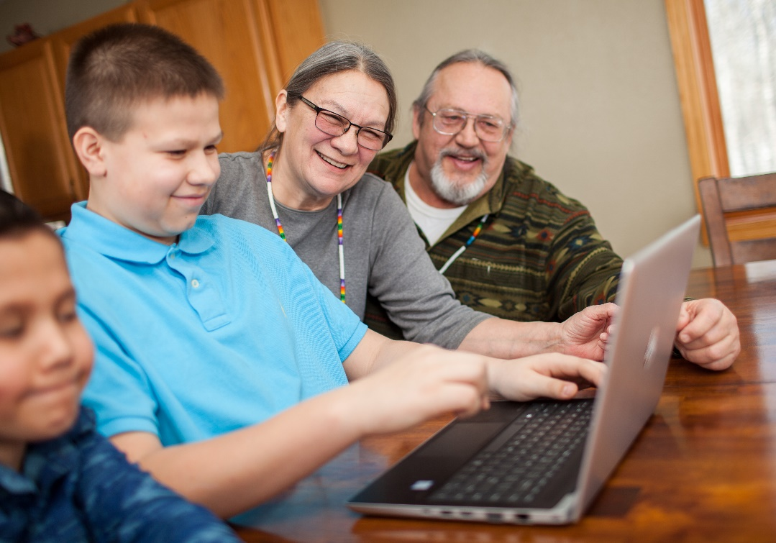
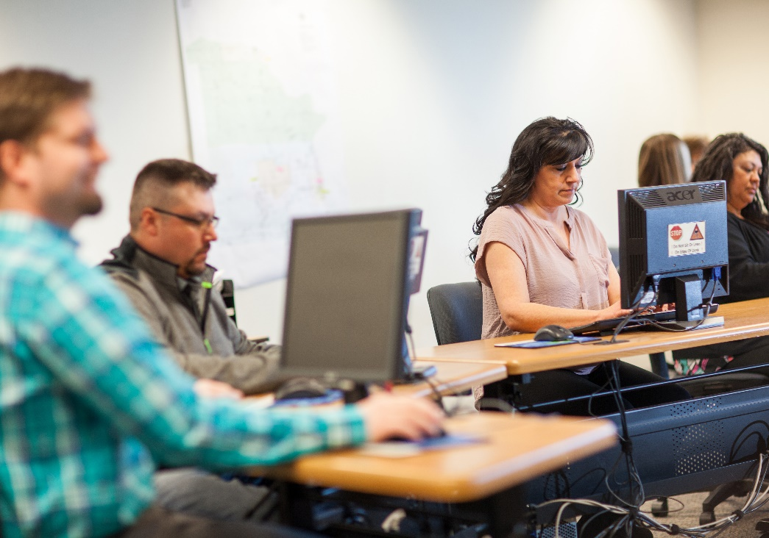
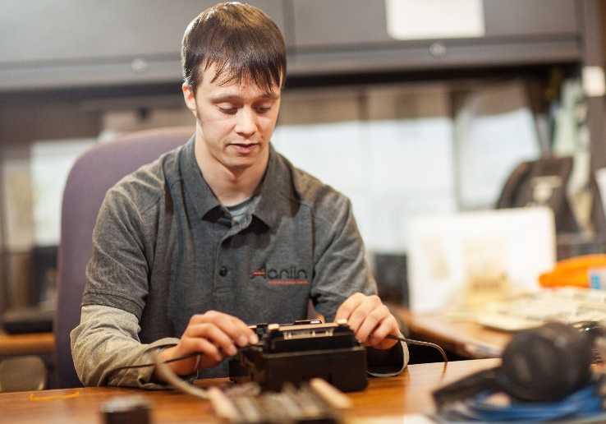
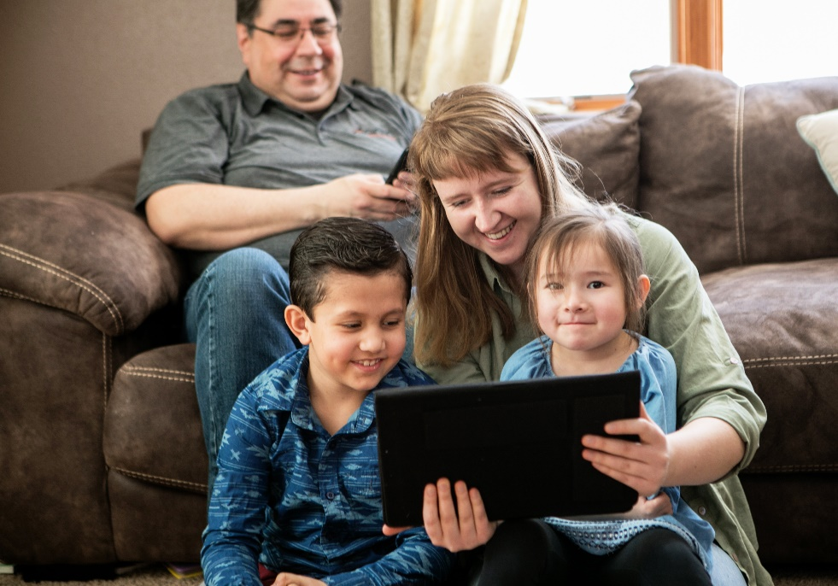

Slide 14
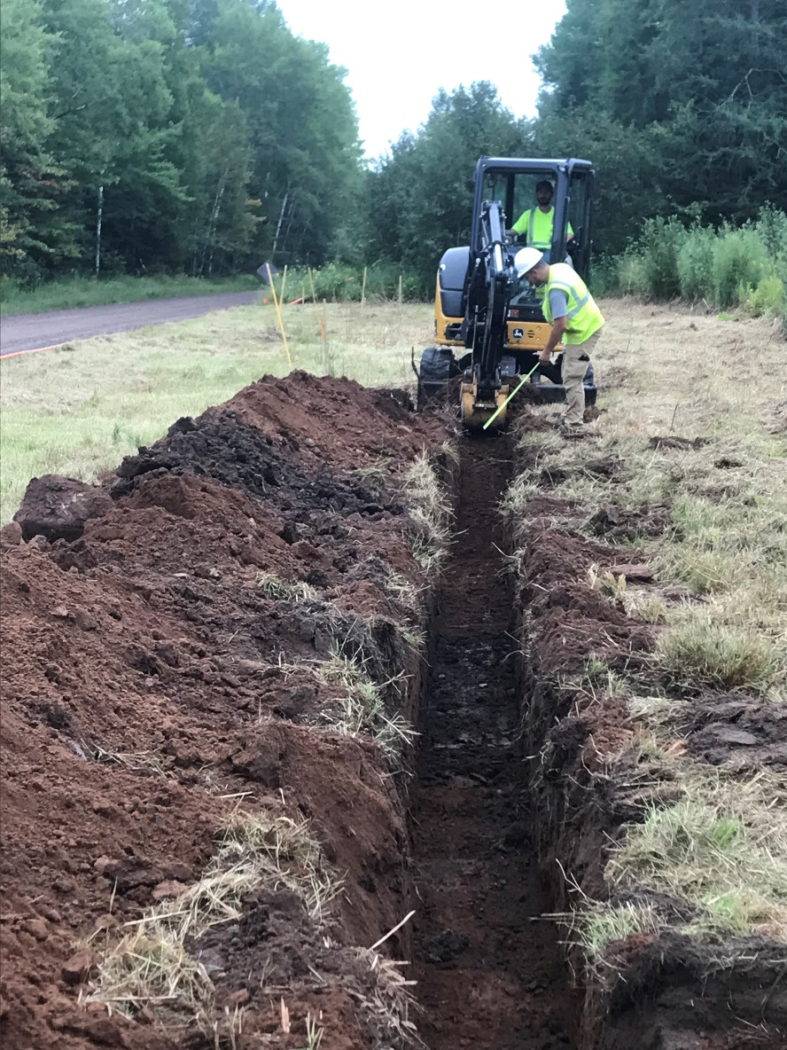
Challenges
Topology
Wetlands/Rocks
Materials
Inspection Failures
Weather
Late Spring Thaws, Early Freezes,
Wetter Summers, Colder Winters
Labor
Labor Shortages
Skilled Labor

Slide 15
Current Status
Over 1,000 Homes ready for Road to Home Connection
Over 530 Homes ready for Service Subscription
Website up and running www.aaniin.net
First customers were turned on as test subjects

Slide 16
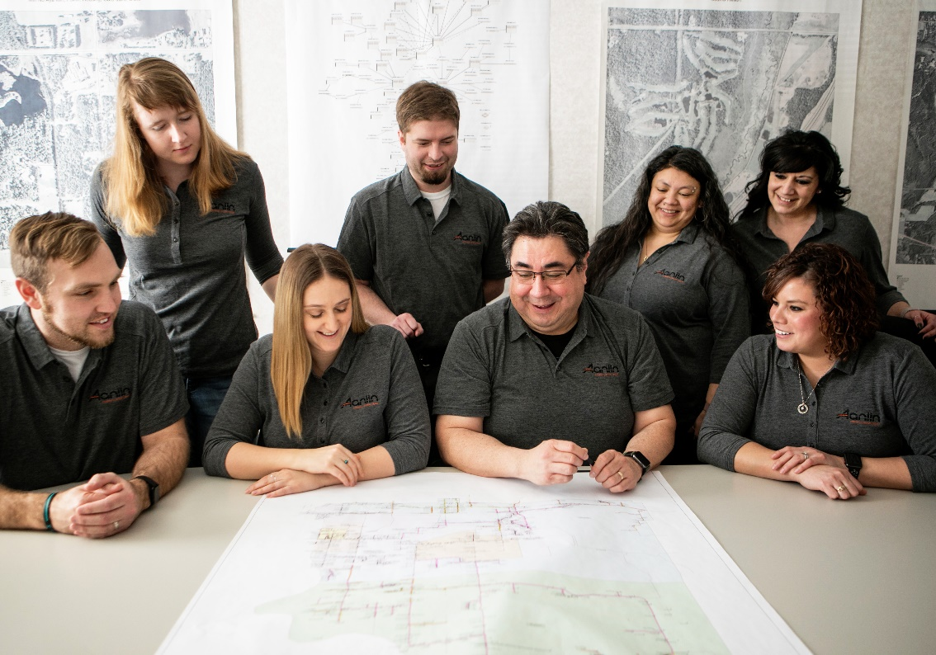
Project Team
Planning Division
MIS Division
Legal Division
Accounting Division
Executive Director of Enterprises

