Slide 1
How to use the Graduate Employment Outcomes tool
to assess labor market outcomes
of Minnesota graduates
Tool’s entry page:
http://mn.gov/deed/geo
Alessia Leibert, Research Project Manager
Minnesota Department of Employment and Economic Development

Slide 2
Unique advantages compared to existing information sources (post-graduation surveys, ACS)
First example of micro-level data sharing between the workforce and education sectors, allowing us to build a longitudinal system to measure program success in the medium-term
Census data do not suffer from sampling errors which restrict the detail that can be published
MN is the only state that collects information on hours worked, allowing us to calculate hourly wages and track full-time employment trends
Notes:
These data tell us as much about Minnesota’s economic opportunities for our college graduates as it does about the schools themselves.

Slide 3
Data Sources
Wage records from all employers subject to Unemployment Insurance (UI) taxes in MN
Postsecondary graduation records from the MN Office of Higher Education (OHE), which collects them from public and private schools
The matching is based on SSN

Slide 4
What happens to graduates?
No records: Unemployed? Self-employed? Employed outside MN?
100%
All MN Grads
Time 0
74%
Grads found in UI recs
Time 1
72%
Grads found in UI recs
Time 2
Time 2
70%
Time 0
Grads found in UI recs
Time 3

Slide 5
Who will use the tool?
Prospective students, to set realistic expectations for employment and wages following graduation
Parents and career counselors, to help prospective students plan their education
Education program planners interested in understanding the employment dynamics of their graduates for improvement purposes
Policy makers interested in evaluating the alignment between educational program offerings and labor market demand
Notes:
These data tell us as much about Minnesota’s economic opportunities for our college graduates as it does about the schools themselves.

Slide 6
To answer what questions?
What majors and degrees offer the best chance for employment after graduation?
What hourly pay can a graduate expect?
Were graduates employed intermittently or continuously during the year? PT or FT?
Which industries are likely to employ people with certain credentials? At what wages?
Are training programs aligned with labor market demand?

Slide 7
Key Employment Outcomes
Tab 1:
hourly wage trends
industries of employment
Tab 2:
FT status (job quality and stability)
FT wage trends (long-term earning prospects)
Tab 3:
employability in MN (match rate)
enrollment status

Slide 8
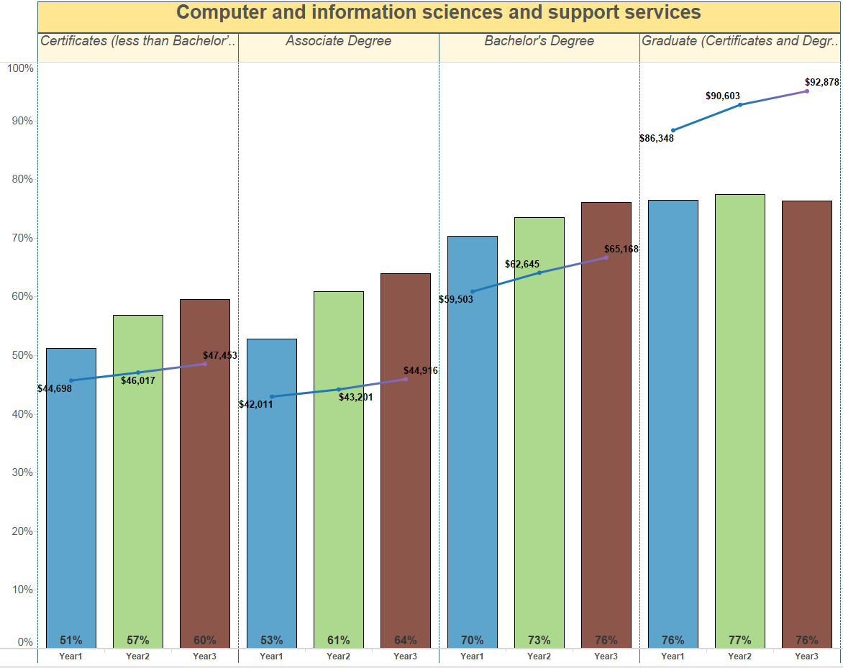
Vertical Comparisons (same major)
Notes:
Purpose of vertical comparison: see if, within the same academic areas, people who complete higher level credentials are earning more than those who complete lower level or shorter term credentials.

Slide 9
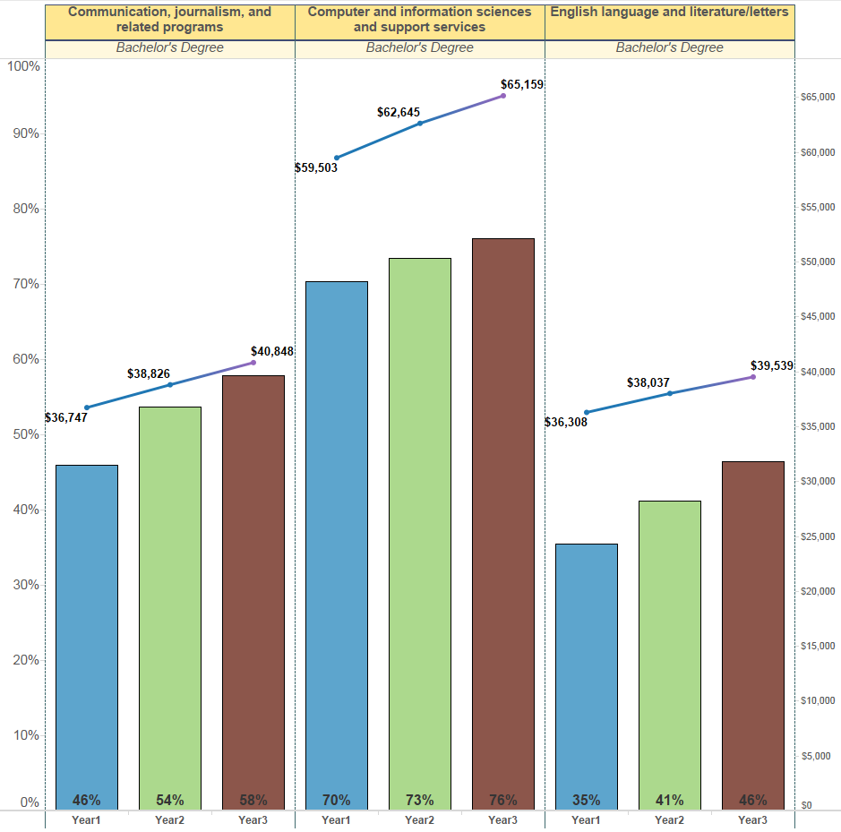
Horizontal comparisons (same education level)

Slide 10
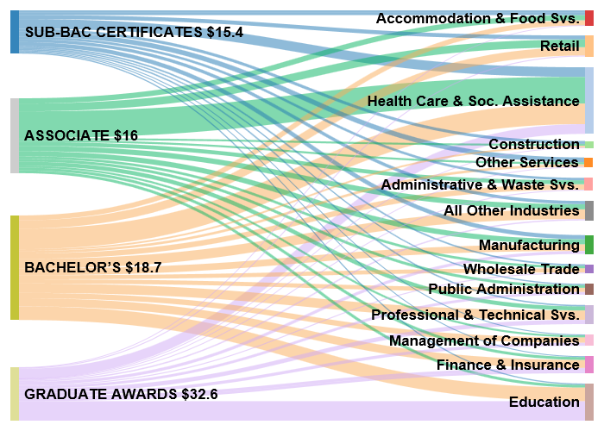
Higher Degrees Lead to Jobs in High-skill Industries
EMPLOYED GRADUATES
INDUSTRIES OF EMPLOYMENT AFTER 2 YEARS
Notes:
more education in general translates into more income because higher degrees are more likely to lead to jobs in high-skill industries.

Slide 11
For More Information
Explore our research in more detail:
http://mn.gov/deed/newscenter/publications/review/April-2014/college-education-pay.jsp
Or contact me: Alessia.Leibert@state.mn.us

