Slide 1
Integrated Resource Team
RMCEP has been chosen to advance services to youth and adults with disabilities through MN Disability Employment Initiative
An approach, not a new program
A series of best practices designed to reduce barriers and make program services more effective for youth with disabilities ages 14-24
Notes:
Thanks for allowing me to highlight a concept and practice that can improve WIOA program outcomes.

Slide 2
Best Practice -The IRT Model
A TEAM…not a meeting !!
Shared Consumers
Shared Resources
Shared Outcomes
Let’s talk about a few examples …
Notes:
Hand out the list of types of agencies and local community providers.

Slide 3
What is an IRT?
Anyone who shares the goal of future success for the youth is welcome to partner together to exponentially drive progress toward that goal.
Inter-agency collaboration starts with relationship building > information sharing > reinforcing themes across all life domains > celebrating successes together.
Willingness to sync meetings so that insights, progress, new tasks or focus areas can be shared.

Slide 4
IRT – Participant Driven
Members are identified by the participant as having an important role in their life.
Formal providers: teachers, county case manager, jobseeker services, community providers
Informal supporters: friends, family, mentor, coach, pastor, boss, etc.
Communicate insights and build a common employment goal and sequence of services

Slide 5
IRT as a Transactional Investment
Communication is reciprocal
Every member adds value
Information becomes insight

Slide 6
Purpose and Content
Guided by “What is important TO?” and “What is important FOR?”
We help our clients balance the “dignity of risk” … creating satisfaction vs. assuring safety & health. In other words, we make room for mistakes or set backs. “Go into the world and get a few bumps and bruises.”
When experiencing barriers, redirect by asking “What’s Possible?” or “How might we?”

Slide 7
Guideposts For Success
Provide framework of discussion for IRT meetings and a blueprint for a career pathway
School Based Preparatory Experiences
Career Preparation and Work Based Learning Experiences
Youth Development & Leadership
Connecting Activities
Family Involvement & Supports
Notes:
The two go hand in hand.

Slide 8
Guideposts Key Principles
High expectations for all youth, including youth with disabilities;
Equality of opportunity for everyone, including nondiscrimination, individualization, inclusion, and integration;
Full participation through self determination, informed choice, and participation in decision-making;
Independent living, including skills development and long-term supports and services;
Competitive employment and economic self sufficiency, which may include supports; and,
Individualized, person-driven, and culturally and linguistically appropriate transition planning.

Slide 9
From Search Institute
Expanding possibilities for teens means “connect me with people and places that broaden my world.” These three everyday actions expand possibilities as youth transition to high school and beyond:
Inspire me to see possibilities for my future.
Broaden horizons in my world by exposing me to new ideas, experiences, and places.
Connect me to others by introducing me to people who can help me grow.

Slide 10
IRT – Team is Unique to Each Participant
They join us…We join them
Ask permission of participant to be included in IEP and County Case Management meetings
Any IRT member can call a meeting
Notes:
IEP and County Case Management are more formally scheduled, but an IRT can be as impromptu as a situation that arises at a work experience site, at home, or anywhere in the community.

Slide 11
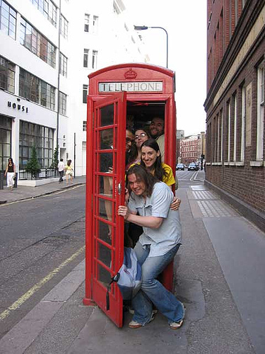
IRT… Few or Many

Slide 12
Simple
Youth
School
RMCEP

Slide 13
Complex
Youth
Family
RMCEP
MH Counselor
Medical
Juvenile Justice
Voc Rehab
Friends
School
Job
County

Slide 14
RMCEP Integrated Resource Team
Relationship first
Everyone needs a champion
Build a career path of the participant’s choosing
Information shared on DEI Youth Profile who may contribute to DEI Youth Action Plan
Fluid and flexible

Slide 15
Identifying IRT Partners
Note potential partners as soon as they are identified from your agency application, any assessment or documentation from the school (IEP), an intake tool, or meeting
Incorporate them in the ISS or Employment Plan in WorkForce One
Select WIOA/MYP Activities that match assets, needs, and career pathway goals
Reflect Guideposts for Success and IRT services in Case Notes, Using Subject Line

Slide 16
RMCEP Integrated Resource Team
Assessments conducted by other partners which have been completed within the year of RMCEP enrollment, can be shared/reviewed at the IRT.
eliminate duplication of assessments
ascertain specifics of disabilities and related services or accommodations needed
appropriate Release of Information will be in place

Slide 17
RMCEP Integrated Resource Team
The IRT supports the Employment Plan or Individual Service Strategy.
Identifies academic classes, programs, or trainings that will improve both basic and occupational skills
Guide tasks or activities that logically follow the youth/young adults’ chosen career pathway
Notes:
On WorkForce One we have Plan Templates set up to collect this specific information. As time goes on , potential IRT members can lessen or grow.

Slide 18
WorkForce One>Manage Program>Plan Template
Template Name 3. Agency Official WIOA Out-of-School Youth
Goal Immediate goal:
Long term employment goal:
Summary of situation at time of enrollment:
Needs related to Guideposts for Success Areas
School Preparation:
Career Preparation:
Youth Development & Leadership:
Connecting Activities:
Caring Adult Support:
Integrated Resource Team (IRT) Partners list:
This plan is the working plan for the following programs also:
Notes:
Send around 3 EP Templates, Example of one youth EP, Case notes, and discuss.

Slide 19
Workforce GPS Website
https://disability.workforcegps.org/resources/2019/Integrated_Resource_Team_Information_and_Resources
IRTs provide the opportunity for comprehensive, wrap-around services on behalf of an individual with a disability or other challenges to employment by bringing together diverse programs and services that meet the needs of a particular job seeker.

