Slide 1
Community Investment for the Future Sustainable Energy Shift

Slide 2
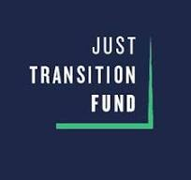
Project Overview
Convene a year-long just transition process for Itasca County and the greater northern Minnesota region.
Develop an action plan to ensure a thriving economy, supported by an informed community, as we work through our energy transition.
The action plan will include a community-driven just transition vision and series of recommended pathways or actions that will allow the region to collaboratively identify and pursue federal funding and other resources in alignment with its vision.

Slide 3
Outreach & Engagement
Steering Committee
Taskforce
Community Townhall
5 Steering Committee Meetings
5 Taskforce Meetings
Oct 2023 – Dec 2024
Attend Town Halls
February Event
5 in person meetings
3 hours each
Feb – Nov
February Event
May Series – 6 Townhalls
Oct Series – 6 Townhalls
Community Surveys
Steering Committee
Information
Education
Engagement
Task Force
Town Halls

Slide 4
Task Force Sector Engagement
Education
Industry
Private Sector
State & Local Government
Tribal Nations
Childcare
Economic & Comm. Dev.
Utilities
Entrepreneur
Forest Products
Expert Consultants
Labor
Community Member
Non-Profit
Student

Slide 5
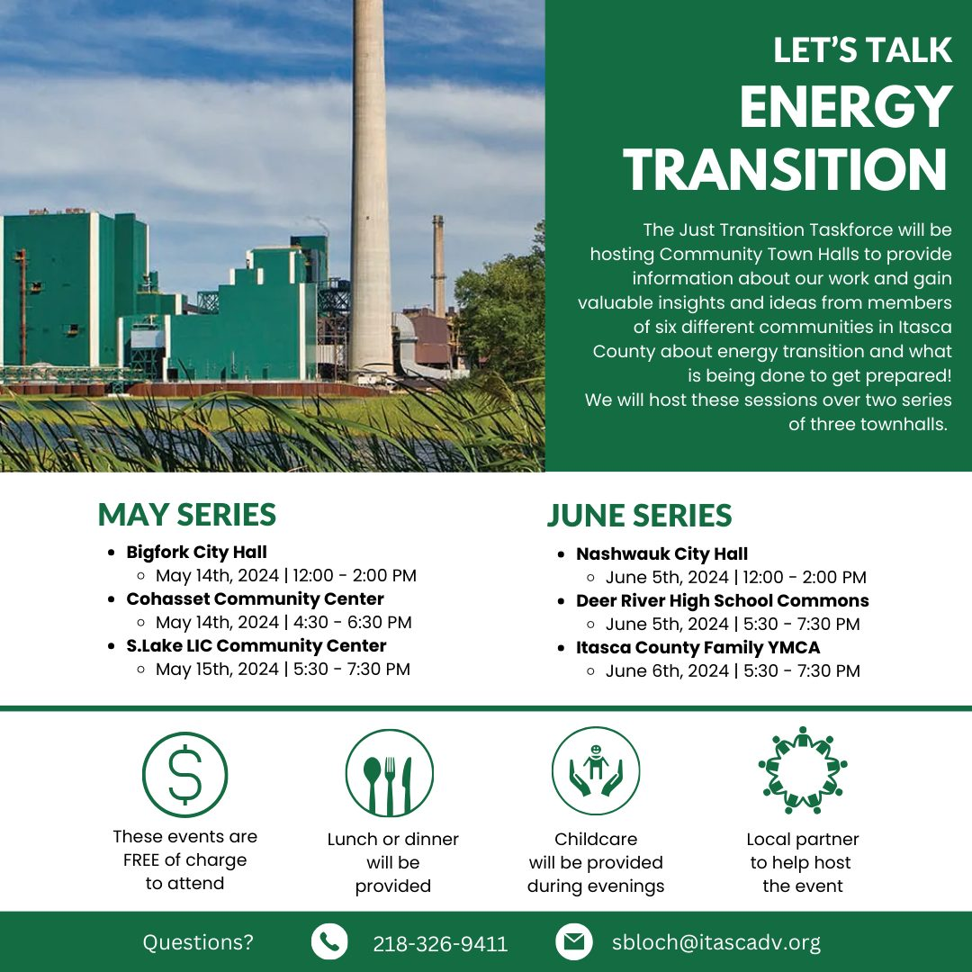
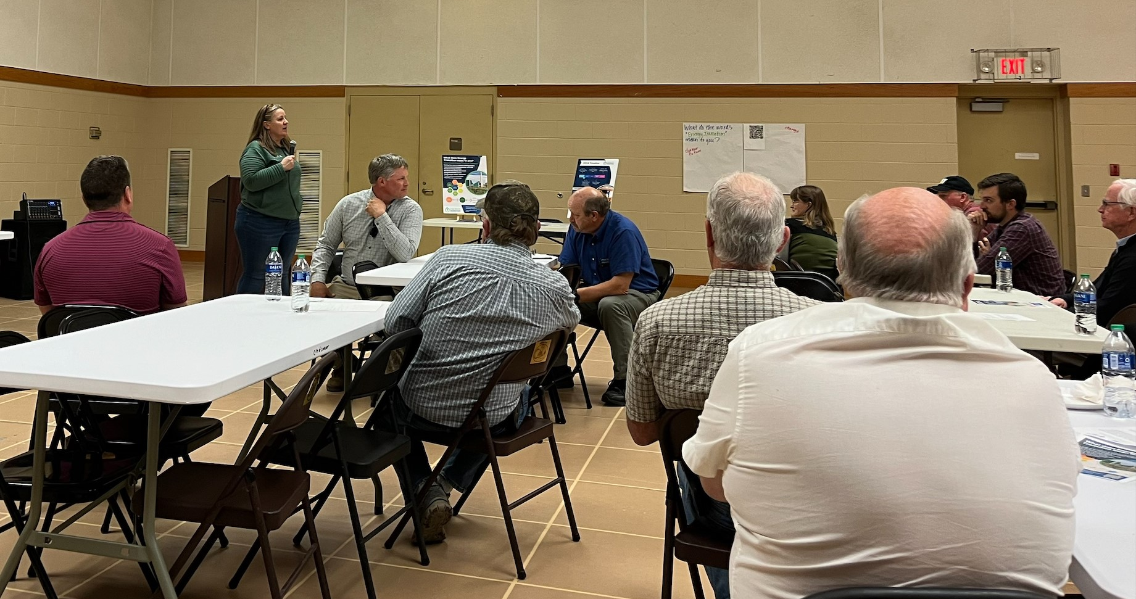
Town Hall Series

Slide 6
2024 -2025 Timeline
Learning
Jan – Apr
Learn about Energy Transition, challenges and opportunities
Creating
May – Aug
Creating our action plan through facilitated workshop sessions.
1st Community Townhall Series
Drafting
Sept – Oct
Draft Action Plan/Report
2nd Community Townhall Series
Feedback & Finalize
Action Plan
Dec 2024 – 2025+
Develop project plans, committees, grant writing, etc.
Nov
Work on finalizing plan and present draft at Summit.
All Task Force Meetings are complete – The Draft Report is being reviewed by the Task Force and will be finalized in December.

Slide 7
Task Force Action Areas
Developing Entrepreneur and Business Opportunities
01
Mobilizing Community Engagement
02
Leveraging Partnerships and Advocacy
03
Promoting Economic and Community Development
04
Advancing Sustainability Initiatives
05
Providing Workforce Support
06

Slide 8
February 5 & 6, 2025
Economic & Community Development Focus
Community Investment for the Future Sustainable Energy Shift

Slide 9
Collaboration & Coordination
Projects
Grants
Partners
Opportunity
Just Transition Fund Technical Assistance
DOE Energywerx Grant – Capacity Building-Cohort 2

Slide 10
Questions?
Tamara Lowney, IEDC
tlowney@itascadv.org,
218-242-0572

