Slide 1
2024 E1MN Regional Meetings
A Presentation to Special Education, Lead Agency (County/Tribal Nation), Vocational Rehabilitation Services (VRS), and State Services for the Blind (SSB) Leadership
January 2024
Notes:
Alyssa
Hello everyone, we are excited to update you, our Special Education, Lead Agency (County and Tribal Nations), Vocational Rehabilitation Services, and State Services for the Blind leadership, on regional meetings that will be coming up in 2024 for Employment First Minnesota, otherwise known as E1MN.

Slide 2
E1MN Coordinators
Alyssa Klein and Holly Sunderman, Department of Employment and Economic Development (DEED)
Cole Sorensen, Department of Human Services (DHS)
Kara Tempel, Minnesota Department of Education (MDE)
Notes:
Alyssa
First, we will introduce ourselves, your state level E1MN Coordinators:
Hi, I am Alyssa Klein from the Department of Employment and Economic Development or DEED
I am Holly Sunderman from DEED as well
I am Cole Sorensen, from the Department of Human Services
And I'm Kara Tempel from the Minnesota Department of Education

Slide 3
Presentation outline
Short review of E1MN and the MN Transition Framework
Tell you about E1MN regional meetings scheduled for 2024
Notes:
Alyssa
Our agenda for this presentation is to go through some reminders about what E1MN and the MN Transition Framework are, and then give you more detail about the regional E1MN meetings that will be held in 2024.

Slide 4
Review
Notes:
Alyssa
Let’s start with a review of E1MN and the MN Transition Framework

Slide 5
Fall 2023 Presentations to Leaders
October 2023 Special Education Director’s Forum
Click here to view recording
20 Minute Presentation from MDE, DHS, DEED Leaders
Starts at 1:29:40
Access link to presentation slides by selecting "Info" from the menu at the lower right of the player window.
Notes:
Alyssa
In the fall of 2023 leaders from our 3 agencies, MDE, DHS, and DEED, presented on E1MN to special education administrators at the MDE Special Education Director’s Forum, to county supervisors at the MN Association of Social Services Administrators (or MACSSA) meeting, and to VR managers at a statewide VRS meeting.
On this slide we have the link to the Special Education Director’s forum recording. You can view that 20-minute presentation by going to 1 hour, 29 minutes and 40 seconds into the presentation. At this link you will also find the presentation slides by selecting “Info” from the menu at the lower right of the player window.
Because our leaders explained E1MN in that forum, we won’t go deep into it for today’s presentation, but we will have a few high-level reminders next.

Slide 6
Working together to deliver a more seamless and timely employment support system
E1MN: A STATE-AGENCY PARTNERSHIP ADVANCING EMPLOYMENT FIRST
Minnesota Department of Human Services (DHS)
Minnesota Department of Education (MDE)
Minnesota Department of Employment and Economic Development (DEED)
Notes:
Alyssa
So what is Employment First Minnesota or E1MN? E1MN is an unprecedented collaboration between our 3 state agencies, DHS, MDE, and DEED.
Our mission is to work together to deliver a more seamless and timely support system for youth and adults with disabilities. We want people to get the services they need, when they need them.

Slide 7
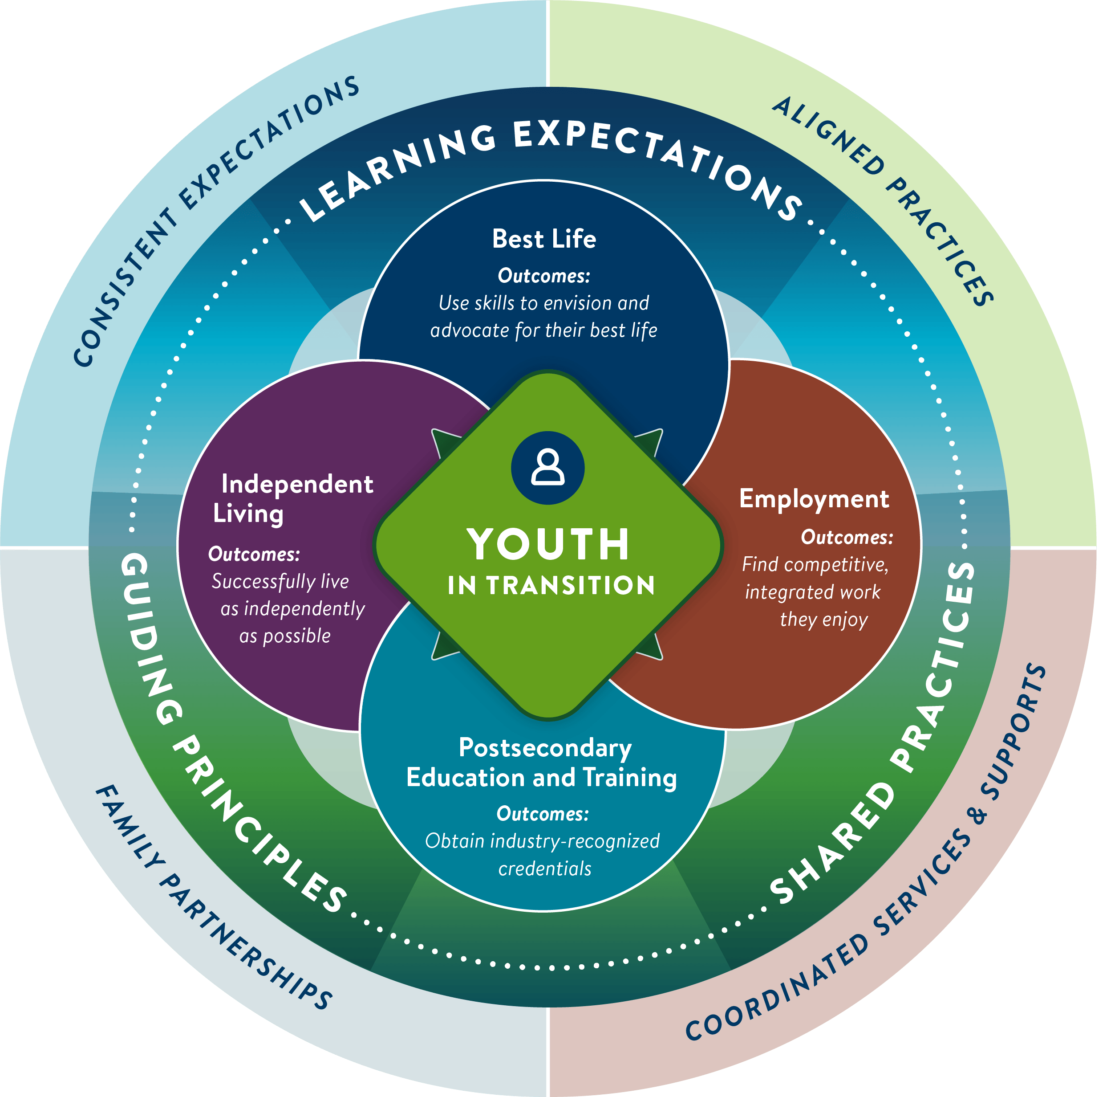
Transition Planning Today: A Framework to set common goals for all professionals in the system
MINNESOTA’S TRANSITION FRAMEWORK
Align common values, systems and best practices
Facilitate coordination of services and supports
Promote collaborative partnerships with youth, families and professionals
Ensure consistent transition planning expectations for youth and families
Sets the “North Star”
Notes:
Alyssa
The Minnesota Transition Framework was created out of E1MN to set common goals across our agencies in serving ALL youth with disabilities across our system. The framework graphic has four concentric rings, with the youth in transition at the center, topics that support the transition to adulthood such as independent living and employment as the second ring, key elements like guiding principles and shared practices in the third ring, and then finally our goals are highlighted in the outer ring of this visual here. Those goals are to:
Align common values, systems and best practices
Facilitate coordination of services and supports
Promote collaborative partnerships with youth, families and professionals
Ensure consistent transition planning expectations for youth and families
Another way to think about the framework is that it sets the “North Star” for all of us to work towards.

Slide 8
Professional partnerships
MINNESOTA’S TRANSITION FRAMEWORK
The framework strengthens the partnership between:
Schools
Vocational Rehabilitation Services (VRS)/ State Services for the Blind (SSB)
Waiver (county/tribe) case managers
Service providers
Notes:
Holly
E1MN and the Transition Framework is all about how we collaborate. This slide reviews who the primary partners are in this work.
Besides the most important people which are the youth and their family members, the following professionals need to be partnering to make transition services most effective for our system. First, is School staff, which includes both special and general education staff. Next are Vocational Rehabilitation Staff, which includes those from Vocational Rehabilitation Services or VRS and State Services for the Blind or SSB. Next are waiver case managers from counties and tribal nations. Lastly are the service providers that we may contract with to deliver transition services. This slide has a graphic representing all these roles, with the youth in the center and each of the other roles surrounding them.

Slide 9
SO…how to move forward
E1MN Role – Year 1
Inform, educate and engage Leadership
Create and support infrastructure for system-wide education and communication
Coordinate to bring together and share best practices
YOU
Recognize and embrace schools, counties/tribes and VRS/SSB as key drivers for change
Partner, coordinate with your school, county/tribe, VRS/SSB supervisors
Message to and lead your staff
Encourage and support staff to coordinate services, align practices, etc.
Seek support as needed from your E1MN partners
Notes:
Holly
The 2023-24 school year is our first year in bringing school districts and charter schools fully into the E1MN effort. This year is about informing, educating and engaging leadership such as yourselves from education, counties and tribes and VR, as well as the staff that you supervise.
We are working to create and support an infrastructure for system-wide education and communication– this includes statewide Regional Meetings that will begin in February.
The regional meetings are a way to coordinate across our agencies to bring together and share best practices for serving youth in transition.
We are asking you, as special education, county and tribal nations, and VR leaders to recognize and embrace your role in driving the system change we want to make through E1MN. We ask that you partner and coordinate with your leadership counterparts at schools, counties and tribes, and VRS/SSB …That you message information about E1MN and the MN Transition Framework to your staff and ask that they participate in the upcoming regional meetings…and that you seek support if/when you need it!

Slide 10
E1MN Regional Meetings
Notes:
Holly
So let’s talk more about the E1MN Regional Meetings.

Slide 11
Levels of Collaboration
Person
E1MN Local Teams
E1MN Regional Meetings
E1MN State Planning Team
Notes:
Holly
We put this graphic together to emphasize the levels of collaboration that are key for E1MN. It shows a pyramid with 4 levels.
Let’s start at the bottom: At the State level, those of us here from DEED, MDE, and DHS work together as an E1MN planning team. This team works regularly on state level interagency initiatives and are the technical assistance providers to all of you across the E1MN system.
The regional work will be the state level E1MN Planning Team, convening meetings that include school, VRS, SSB, and waiver staff to learn and share best practices for forming and sustaining strong E1MN Local Teams. This is the second level of the pyramid.
On the third level, E1MN Local Teams include a school district or charter school, the VRS/SSB staff, and waiver staff that support the students in that district or charter school.
Finally, and most importantly, is the person level which is at the top of the pyramid. The work we do at the state, regional and local level to partner, all leads to the right people being at the table to support people with disabilities and for the right services to be provided to them.

Slide 12
2 Rounds of E1MN Meetings Scheduled in 2024 (All are virtual & scheduled from 2:00-4:00 p.m.)
February:
Region 1 - Northern Minnesota, Tuesday, February 13
Region 2 - Central Minnesota, Wednesday, February 14
Region 3 - Southern Minnesota, Thursday, February 15
Region 4 - Hennepin, Carver Counties, Tuesday, February 20
Region 5 - Anoka, Ramsey Counties, Wednesday, February 21
Region 6 - Dakota, Scott, Washington Counties, Thursday, February 22
Notes:
Cole
In 2024 we currently have two rounds of E1MN Regional Meetings scheduled. The first round will take place in February. We have divided the state into 6 regions. The regions and the dates are listed here. Note that these are all virtual and are scheduled from 2:00 to 4:00 p.m. Also note that after reviewing these regions and dates that we will show you a map of the regions.
Region 1 is Northern Minnesota. This meeting will take place on Tuesday, February 13. Northern Minnesota includes roughly 30 counties, 6 tribal nations, along with all of the school districts and VRS/SSB teams within those regions.
Region 2 is Central Minnesota and will take place on Wed. Feb. 14. This region includes 11 counties and 1 tribal nation.
Region 3 is Southern Minnesota and will take place Th. Feb. 15. This includes 38 counties and 3 tribal nations.
Region 4 is Hennepin, Carver Counties and will take place on Tue. Feb. 20.
Region 5 is Anoka and Ramsey Counties and will take place on Wed. Feb 21.
And finally, region 6 is Dakota, Scott and Washington Counties along with one tribal nation, and will take place Thursday, Feb. 22.

Slide 13
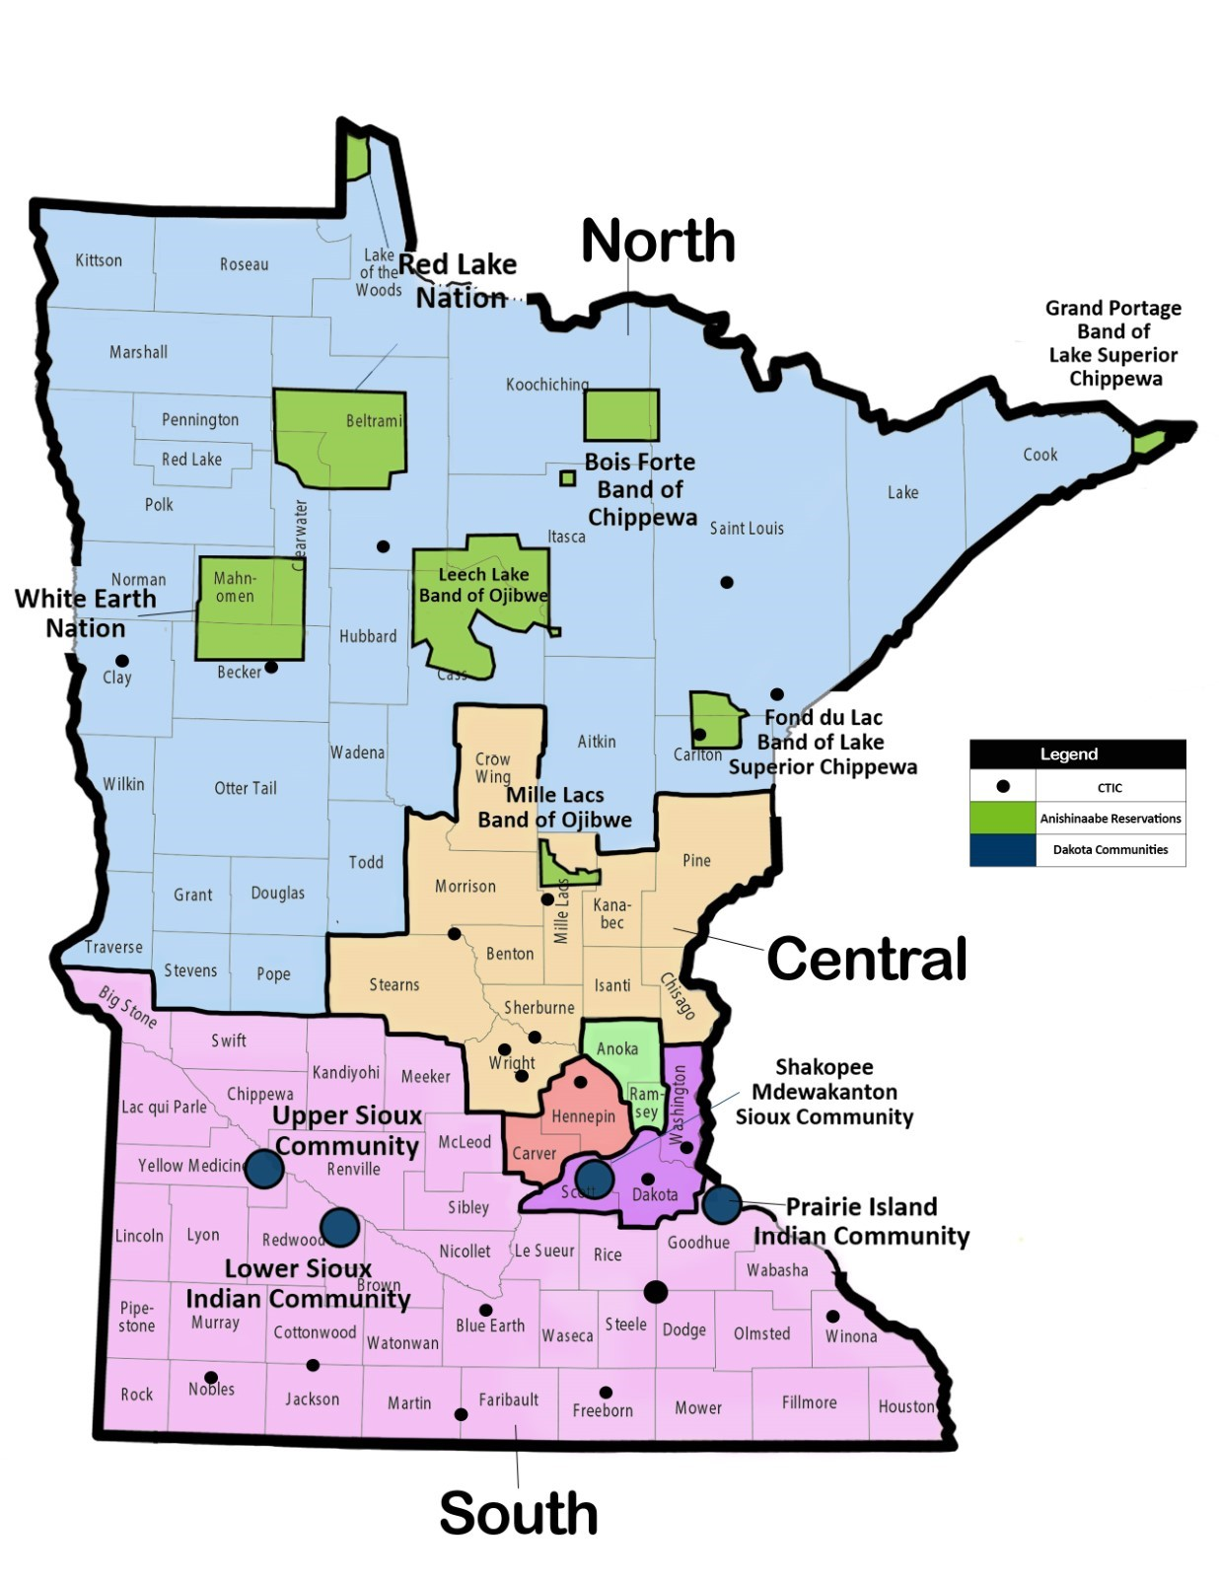
Regional Meeting Map
Notes:
Cole
Here is a map that shows the regions that were described in the last slide. It is a map of Minnesota showing counties and tribal nations which has been color coded to show the regions of the state. North is in blue, Central is this orange area, South is pink. Then we have the 7 county metro divided into three as follows: Hennepin and Carver counties, Anoka and Ramsey counties, and then Washington, Dakota, and Scott counties.
When we send out the registration you will see the counties, tribal nations, and school districts that are included in each region listed out in text format to help people identify which regional meeting they should attend.

Slide 14
April/May Meetings: (All are scheduled from 2:00-4:00 p.m.)
Region 1 - Northern Minnesota, Tuesday, April 23
Region 2 - Central Minnesota, Wednesday, April 24
Region 3 - Southern Minnesota, Thursday, April 25
Region 4 - Hennepin, Carver Counties, Tuesday, April 30
Region 5 - Anoka, Ramsey Counties, Wednesday, May 1
Region 6 - Dakota, Scott, Washington Counties, Thursday, May 2
Notes:
Cole
The second round of meetings will take place in April and May and here are the regions and dates for those. Again, all meetings will be scheduled from 2 to 4 pm. Region 1, which is Northern Minnesota, will be on Tuesday April 23rd; region 2, Central Minnesota, will be on Wednesday April 24th; region 3, Southern Minnesota, will be Thursday April 25th; region 4, Hennepin and Carver counties, will be on Tuesday April 30th; region 5, Anoka and Ramsey counties, will be on Wednesday May 1st; and finally region 6, Dakota Scott and Washington counties, will be on Thursday May 2nd.
This won’t be all…there will be more planned in the next school year, likely starting in October, and you will get advanced notice of those as well.

Slide 15
Who should attend regional meetings?
You as local leaders!
Schools:
VRS/SSB:
Managers
Counselors
Pre-ETS Representatives
E1MN Liaisons
Administrators
High school and 18-22 program staff
Case managers
504 coordinators
Work coordinators
Counselors
Social workers
School nurses
Others!
Waivers:
Supervisors/Managers
Waiver case managers
E1MN Employment Liaisons
Notes:
Kara
We encourage you as local leaders to attend and help in the formation of your local E1MN team. In this slide we list the possible school staff, VRS and SSB staff, as well as waiver staff we hope will attend these meetings. From the schools and districts, the roles include administrators, high school and age 18 to 22 transition program staff from both general and special education; IEP case managers and 504 coordinators; work coordinators; counselors; social workers; school nurses and others involved with supporting youth with disabilities. For VRS and SSB, the list includes managers, counselors, Pre-Employment Transition Services representatives and E1MN liaisons. Finally, for the waivers, the list includes supervisors and managers, waiver case managers and E1MN employment liaisons.

Slide 16
Summary of Regional Meetings
Are all virtual!
Who should come: School, VRS/SSB, county/tribal waiver staff
What will happen:
Review E1MN and Transition Framework
Develop E1MN Local Teams: Review Roles
Review Data
Complete an E1MN Local Team Transition Assessment
Select and Implement a Transition Framework Strategy in 2024-25 School Year
Notes:
Kara
So, to summarize the information you need to know about the E1MN regional meetings,
All meetings will be virtual to make them easy to access for all participants throughout the state.
Attendees include school and school district, VRS, SSB and county/tribal waiver staff.
We will discuss specific topics at each of the regional meetings. At the first meeting in February we will review E1MN and Minnesota's Transition Framework. Additionally, we will discuss E1MN local team development. There is a new page on the Disability Hub website that reviews all of the roles that schools and districts, VRS/SSB and County/tribal waiver staff have in serving youth with disabilities. The webpage in linked in the slide and we encourage you to review it prior to the meeting.
In the second meetings in April and May we will review youth outcome data across our agencies to allow local teams to identify and acknowledge their strengths as well as the disparities and plans to address them moving forward. We will also unveil an E1MN Local Team transition assessment for teams to complete. This assessment will allow teams to select and implement a Transition Framework Strategy for the 2024-25 school year.

Slide 17
Communication
Presentations to school, county, VR and leaders in fall 2023
CTIC leaders
Broad communications coming in January 2024
Notes:
Kara
As we mentioned at the beginning of this video, presentations were delivered to leaders in special education, counties and VR this past fall.
The E1MN team has assembled a list of all the Community Transition Interagency Committees, or CTICs, that are currently in operation and we identified 23 CTICs that meet across the state. CTIC leaders were invited to and participated in a meeting on November 15, 2023 to learn about the upcoming work and for us to get feedback from them. We hope CTICs can add E1MN to their meeting agendas to help support the work.
Finally, there will be broad communications coming out to all audiences in January 2024 through our agency listservs and communication channels, including information on how to register for the regional meetings.

Slide 18
Questions?
If you have questions about E1MN or the upcoming regional meetings you can submit an E1MN Request Form.
Notes:
Kara
If you have any questions about E1MN or the upcoming regional meetings, please complete an E1MN request form, linked on this slide.
Thank you all for watching and we look forward to seeing you at the regional meetings.

