Slide 1
Energy Transition Advisory Committee
City of Fergus Falls & Virtual - July 26, 2022
Impacted Community- Coal Plant

Slide 2
Organization
Call to order
Roll call

Slide 3
Agenda
Call to Order and Roll Call
Welcome by Mayor Ben Schierer
Presentation by Jesse Heier, Executive Director Midwest Governor’s Association, Presentation on the MGA Power Plant Community Planning Report and next steps
Presentation by Dan Pfeiffer, Xcel Energy, Economic Development efforts in MN and Transition in other states
Presentation MN Dept of Revenue presentation – Jon Van Nurden, State Assessed Property Supervisor
Presentation MN Dept of Employment & Economic Development presentation – Catalina Valencia, Executive Director, Business Development
Approve June 28, 2022 Minutes – Roll Call vote
Task Force updates
Community Engagement
Economic Diversification
Re-Use of Assets
Tax Base – Financial Assistance
Workforce
Executive Committee Report
State Statute 116.5493 (b) (1) Report
Survey work - Update
Other
Old Business Discussion
Public Comment
Next Meeting – August 30, 2022 at 11am, City of Granite Falls
Adjourn – Roll call vote

Slide 4
Welcome by Fergus Falls Mayor Schierer
Population
Impacts
City Planning for the Power Plant transition – past, current, anticipated
Advice
Notes:
Mayor McComber

Slide 5
Presentation MGA
Jesse Heier, Executive Director
Midwest Governors Association

Slide 6
Presentation Xcel Energy
Dan Pfeiffer

Slide 12
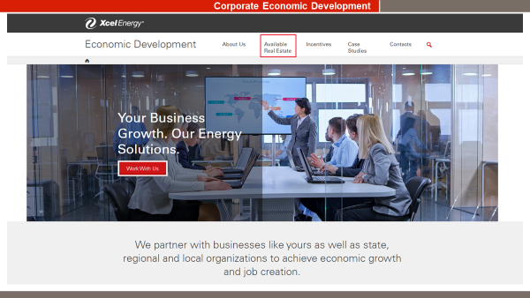

Slide 13
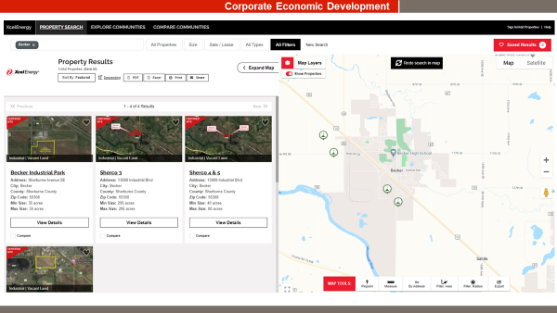

Slide 14
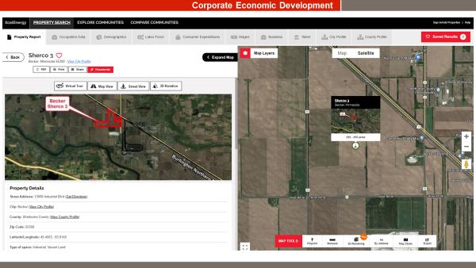

Slide 16
Presentation Revenue
Jon Van Nurden – See separate slide deck.

Slide 17
Presentation DEED
Catalina Valencia

Slide 18
ETAC June Minutes
Approval for the June ETAC meeting is requested.
Roll call vote

Slide 19
Energy Transition Advisory Committee Purpose
The Energy Transition Advisory Committee is established to:
Develop a statewide energy transition plan
Advise the governor, the commissioner, and the legislature on transition issues, established transition programs, economic initiatives, and transition policy.

Slide 20
Task Force Presentations
Community Engagement
Workforce
Tax Base/Financial Assistance
Re-use of Assets
Economic Diversification
Other

Slide 21
Community Engagement Task Force
Met on July 11
Researched
Granite Falls – their power plant will be demolished this fall.
Education for community on long-term environmental issues – ie Coal Ash storage that will remain after the plant closes.
Importance of working with all people, including Native American.
More presenters are planned
How to get MN as a priority location.
The ask was made and the Feds stated, that they “aren’t updating the “25 priority places” now but would welcome input regarding transitioning assets, communities, and workers to inform our planning.” Recommended that communities with comments please due so with the survey Vita sent
Plan Recommendation:
Funds for marketing for impacting communities. (similar to last month)
Notes:
Michael Child’s Jr.

Slide 22
Economic Diversification Task Force
Met on July 13
Presentation by:
Adam Walters, State of Pennsylvania Playbooks key items:
Developed to handle a public policy problem
Each playbook has phase 1 and phase 2 environmental work, current infrastructure for the site, cost for demolition and abatement, highest and best use analysis of the property, robust market analysis – include workforce, demographics, worked with county, city, colleges/universities/etc. Community vision was important.
Funding was ½ US EDA grant and ½ State of PA
Easy Playbook had a separate RFP, competitively bid
Playbooks were extensively marketed by PA – in PA and nationally. State has funding for marketing.
Had consent of property owners they worked closely and well
2 of the Playbook properties recently sold. He feels Playbooks helped with the development and interest.
Time to complete Playbooks was approximately 4 months.
State Legislature appreciated the Playbooks.
Kristin Lukes, DEED, Community Transition Grant (2021)
She answered questions from the Task Force about the history and current situation with the grants.
Task Force asked her for advice on how to improve the grants, if they were to be funded in the future. Issues – each community is in a different part of the closing process, hard to compare.
Points
MN DEED has not been allocated funds in the past for marketing, many other states have been given millions to market. Need for marketing funds for DEED to assist in redeveloping the sites.
Plan Recommendation:
Playbooks similar to Pennsylvania for all impacted communities & property owners that have interest. State &/or Federal funding to cover the cost.
Notes:
Tamara

Slide 23
Re-Use of Assets Task Force
Met on July 13
Presentation:
Denise Wilson, Environmental Quality Board.
Different environmental reviews, differences, what they review and process.
AUAR (Alternative Urban Area-wide Review) is important for Shovel-ready certification for redevelopment
Chet Bodin, MN Business 1st Stop
Interagency group covering 9 agencies, effective in assisting a developer on the State review process
He brings the agencies and their funding information together
Kristin Lukes, DEED Redevelopment
She educated on the application, eligibility, goals (create jobs, taxes &/or other public benefits), 50% match, 2 grant rounds per year,
Program does not cover environmental costs
Recently no funding from legislature. DEED leadership moved money from a different area to fund this important program ($2 to $3M/yr)
Of importance
Many power plants are along rivers that are Federally protected
Rail, infrastructure, etc can all be amenities for redevelopment.
Community input on re-use of site is important.
King Plant must have a redevelopment plan per the IRP
Research:
Goal to meet with St. Paul on the Ford site redevelopment
Plan Recommendation: drafting beginning
Notes:
Mayor Mary

Slide 24
Tax Base/Financial Assistance Task Force
Met on July 8 & July 22
Presentation:
Nick Greene, Dept of Revenue
Understanding LGA, County Aid, Fiscal Disparities,
LGA takes time to adjust to ensure stability for LGA communities- full adjuctment will not happen the year after closure.
Fiscal disparities covers Cohasset and Oak Park Heights. The funds used help other communities in the region – ripple effects.
Jon Van Nurden, Dept of Revenue
Understanding Assessment process, Solar and Wind production, personal property and real estate taxes
Coal and Nuclear plants pay City, County, School and State taxes. Some solar only pay only ag property tax
Discussion on Utilities challenging taxes
Each power plant valuation is done on its own. Uses many inputs.
Research:
RDF/RDA
Compare, contrast and find gaps for the plan &/or recommendations
Plan Recommendation - drafting beginning
Notes:
Shane Zahrt

Slide 25
Workforce Task Force
Met on July 5 and 20
Presentation
Jerry Mulhern, Unemployment Insurance
Understanding typical UI process and supports for any involuntarily separated worker
The website has great information
Retraining, unemployment insurance length, requirements were all presented.
Roy Smith, IRRRB
Example of regional/sector partnerships to supply trained workforce to local industry
IRRRB has been retraining people, and coordinating for
Holly Stanton, Xcel Energy
Understand how one energy production employer is supporting its workforce as transitions happen
They start planning for re/training 2 years for plant closure
They have not laid off any worker from their 11 plant closures.
They keep their retrained workers within 50 miles of their original power plan
Research
Kristin, Dick and Luke are working on a flow chart on the retraining process.
Recommendation – drafting beginning
Notes:
Abby

Slide 26
Executive Committee Report
ETAC Plan Outline is complete
Asked State Agencies for input on Statute Requirement – in process
School survey update
Stakeholder survey update
Impacted community update
Notes:
Marshall

Slide 27
Old Business/Discussion

Slide 28
Public Comment

Slide 29
Next Meeting
August 30, 2022 at 11am
Virtually and at
Granite Falls City Hall
Future Planning September 27 – Cohasset
October 25 – Prairie Island

