Slide 1
Hiring Difficulties in Manufacturing
Alessia Leibert | Research Project Manager, Labor Market Information Office

Slide 2
Overview
Findings: In the 2019 Minnesota Hiring Difficulties Survey, manufacturing employers attributed one out of three hard-to-fill vacancies (34 percent) to skills gaps
factors driving hiring difficulties (occupation, industry, geography, firm size)
Skills identified by employers as hardest to find
Best practices to address skills-related hiring difficulties
Potential causes of misalignment between post-secondary training programs and skills sought by employers, and possible solutions
Role of high schools in preparing students for careers in manufacturing

Slide 3
Main research goal: measure to what extent hiring difficulties are attributable to skills gaps
A skills gap is the difference between an employee's (or job applicant’s) current skills vs. the skills necessary to meet job requirements.
Skills gaps become more apparent during the hiring process. So we measured them through job vacancies.
Vacancies were selected on the basis of occupation.
Conducted in-depth phone interviews with HR recruiters about 1,072 estimated job vacancies to determine if they were hard-to-fill, distinguishing skills-related from non-skills related reasons.
Response Rate: 67% (146 establishments)

Slide 4
Hiring difficulties and wage offers by occupation

Slide 5
Why are machinists and machine-tool programmers hardest to fill?
1. Highest impact of technological change on skills: These occupations have become more skilled and specialized as a result of automated technologies, but workforce skills haven’t kept up. Also, skills are often too machine-specific to be taught in a standardized curriculum
2. Long and uncertain training path: Full competency in Machining and CNC is acquired through OJT lasting from one month to many years. In the current labor market, hiring for skills that can only be built through years on the job is much harder than hiring for skills that can be built in the classroom
3. Lack of industry-recognized skills certifications: Unlike in welding, only one industry-recognized standard certifies competency levels in machining-related occupations: the National Institute for Metalworking Skills (NIMS) Credentialing program. Some employers considered it inadequate/obsolete
4. Shrinking pipeline of “trainable” people: talent pool used to come from high school VocEd or people with prior experience as machine operators, but both pipelines have dried out. People with the right kind of skills already have good jobs. High turnover in entry-level machine operator jobs nobody to train/promote from within

Slide 6
Hiring difficulties by industry

Slide 7
Hiring difficulties by region

Slide 8
Supply vs Demand factors = different policy implications
What was the biggest problem?
DEMAND
SUPPLY
DEMAND REASONS (56%)
Inconvenient shifts
Uncompetitive wages
Inconvenient location
Undesirable work environment, or low-tech image of job/industry
Ineffective advertising
SUPPLY REASONS (44%)
Lack of applicants with the right degree or credential (15%) SKILLS GAP
Lack of applicants with the right experience or skills acquired through OJT (19%) SKILLS GAP
Very few applicants, or lack of interest for the job (10%)
60% MENTIONED TOGETHER

Slide 9
The skills gaps problem is more pronounced in manufacturing and other trades. Why?
The skills that employers have the most trouble finding are taught through vocational/ technical training provided either in high school, or some college, or on-the-job.
The good news:
Even the newest technologies - like machine learning and robotics - build upon a foundation of traditional math and mechanical skills. We know how to teach them.
The bad news:
Problem solving skills are becoming more critical, and they are not easy to teach!
New generations lack exposure to opportunities to develop mechanical and problem-solving skills at the time in their lives when career aspirations are formed
Lack of interest: 68% of hard-to-fill positions attracted very few candidates, with 10 or fewer applications being the norm. Turnover and retirements further reduce the pipeline and make it hard to train the next generation of workers

Slide 10
What skills are hardest to find? Comments from employers
“The younger generation is not as mechanically inclined so they require extra training when they are hired. It would help if candidates had a hobby with cars and fixing things.”
“In our company, machinists do not just run the machines but also do the programming, repair, and set up of the machines. They need to understand the entire process of using the machine. This mix of skills is hard to find.”
“It’s a lot of math and problem solving. Our products are not standardized, new issues emerge that require problem solving. It is hard to find somebody that has that tenacity to work through it.”
“What most applicants went to school for isn't really going to apply. Their knowledge at a competitor makes more sense because our system is not a common software. They have to have some versatility of computer knowledge.”

Slide 11
Comments from employers (continued)
“You almost can't hire for maintenance mechanics, you have to grow and train them within. Because of the age of the people with these skills, they are going to age out of the workforce before we can replace them. Furthermore, the position we are trying to fill is the night shift, and we are located in a small community. We received only one application.”
“Most high schools do not offer VoTech programs. Most tech colleges do not offer programs for Tool Makers. A company could address the problem by hiring someone with a CNC degree and train them to make tools, but we can’t compete with them.”
“I would pay for someone to take welding classes at the local technical college and I would offer an apprenticeship program if anyone was interested in working for us, but there isn’t anybody. I don’t know what we can do for that other than immigration.”

Slide 12
Comments from survey respondents in 2012
“Applicants had training but no practical experience on our machines.”
“There is no feeder mechanism for the colleges anymore for most of these occupations. Colleges are just responding to demand from high school, and with no demand for machining or programming or setups there is no incentive for the colleges to offer those classes. It's not just a matter of gaps in post-secondary training, but of lack of interest for manufacturing and lack of training at the K-12 level.”
“Firms steal people from other firms, competing on wage.”
"There are trade schools (2-year program for machining) where the lowest level machinist comes from. In our area all qualified machinists are being pulled by other machine shops. So we recently started an apprenticeship program to recruit people with some mechanical background and put them through 6-8 weeks of training. We’ll continue running those programs until we get enough people. There is really no end in sight."

Slide 13
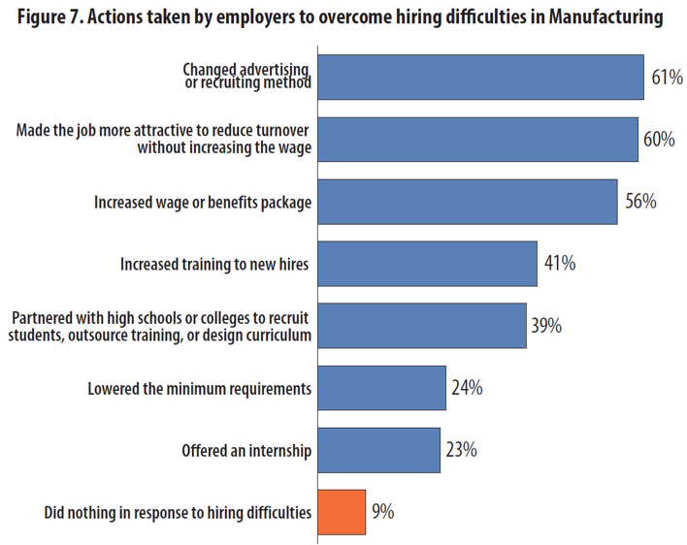
How are employers responding?
Employers’ responses tell us a great deal about the nature of their challenges and the most effective solutions.
Trending up compared to 2012:
Measures to reduce turnover
Training new hires
Recruiting from schools and partnering with them on curriculum
Promoting from within

Slide 14
Best practices #1: invest in measures to reduce turnover and train new hires
Strategies aimed at providing structured OJT and reducing turnover help bridge shortages before they turn into full blown hiring difficulties.

Slide 15
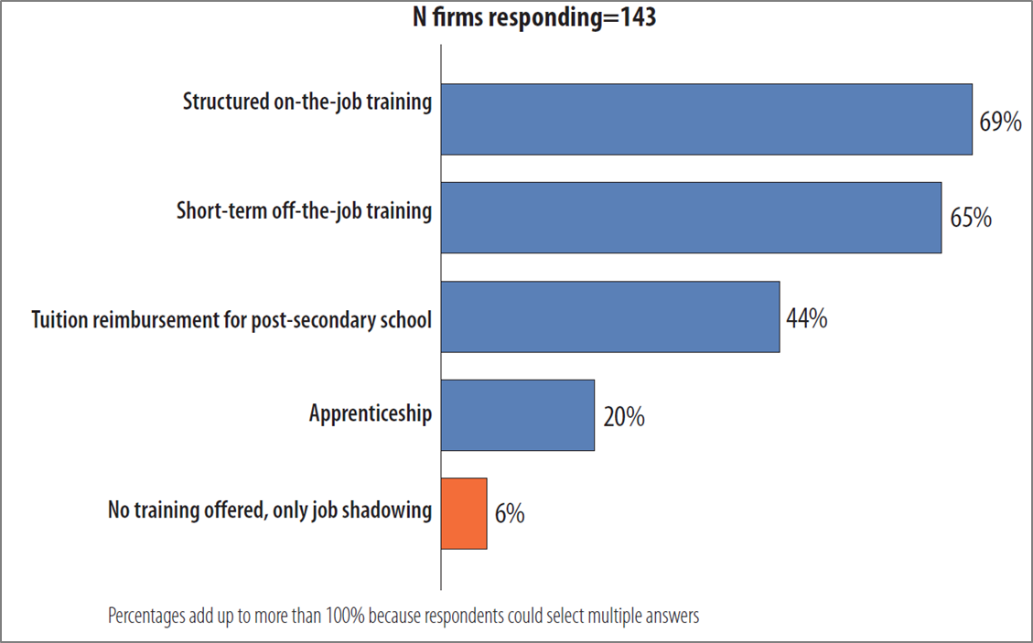
Best practices # 2: combine internal and external training
Type of training offered to new hires or incumbent workers

Slide 16
Best practices # 3: remove disincentives faces by firms (especially small-sized) in the delivery of work-based training
Small firms are at a disadvantage in the talent race in two major ways:
fewer resources to offer OJT and tuition reimbursement, let alone higher wages
less organizational capacity to identify training gaps as they emerge, train the trainers, and offer career growth opportunities However, survey results show that OJT is effective in reducing the likelihood of hiring difficulties even in small firms, and suggest that interventions focused on enhancing the capacity to deliver structured OJT through technical assistance make sense. State-sponsored initiatives respondents mentioned as meeting their needs:
The Minnesota Apprenticeship Initiative (MAI) funded by DEED and DOLI offers grants to assist employers with costs associated with developing apprenticeship programs.
The Pipeline Training program (funded by DOLI) supports employers in delivering work-based training together with classroom training through a partner college.

Slide 17
Other examples of best practices
Improve retention through more flexible schedules, enhanced benefits, career ladder opportunities, linking skills mastery to pay raises
Internships to high school students
Tuition reimbursement for new hires interested in obtaining a post-secondary credential (often combined with part-time work while in school)
Expand collaborations with colleges around curriculum development
Improve the quality of internal training by assessing skills needs, training the trainers, and investing in equipment to simulate the real work environment (e.g., welding and machining laboratories)
Use automation to replace labor or make the job more attractive and safe
Expand recruiting efforts to immigrants and underrepresented minorities

Slide 18
Causes of misalignment between post-secondary programs and employer skills needs
Some programs do not exist in certain regions of the state where employers need them the most. Example: the Occupations In Demand tool shows no programs in Computer Numerically Controlled Machine Tool Programming in NW Minnesota: https://apps.deed.state.mn.us/lmi/oid/CIP_SchoolDetail.aspx?id=514012&geog=2701000000
Some programs teach only the basics. They don’t teach how to work on a wide variety of machines developing problem-solving skills.
Some programs are not inter-disciplinary enough. Employers need programs that incorporate welding fundamentals, programming, and operation of mechanical, electrical, and automated systems.
Some employers are uncertain about how best to develop the skills they need. Post-secondary training? Short-term OJT? Apprenticeships? Uncertainty makes it hard to communicate needs and engage with post-secondary schools

Slide 19
Effective responses at the high school level: employer-driven Career and Technical Education (CTE), robotics programs
Goal: expose kids to the new, knowledge-based manufacturing jobs. Example: robotics programs like FTC and FRC. Kids learn Java coding, building, use of tools, engineering design, electricity and physics, Computer-Aided Design (CAD), problem-solving, and more

Slide 20
Whose job is it to fill skills gaps? Coordinated interventions at three levels:
HIGH SCHOOLS:
redesign CTE to develop the foundational skills that make a worker trainable. This would remove the disincentives employers face in investing in OJT and other work-based training
promote manufacturing careers with students and parents to combat misconceptions EMPLOYERS:
invest in internal training that picks up from where a student left off, be it a CTE high school course or a PS certificate
partner with schools to identify key competencies and whose role it is to teach them, and collaborate on providing trainers and equipment to improve the quality of the training
POST-SECONDARY INSTITUTIONS:
expand manufacturing-related vocational and associate degree programs, especially in Greater Minnesota, engaging local employers in curriculum design and skills certifications
make programs more multi-disciplinary and tailored to the needs of local employers

Slide 21
Thank You!
Explore our research in more detail:
https://mn.gov/deed/data/lmi-reports/hiring-difficulties-mn/
alessia.leibert@state.mn.us
651-259-7392

