Slide 1
Closing the Digital Divide
Governor’s Task Force on Broadband
May 20, 2020

Slide 2
Extensive Fiber and Fixed Wireless Network

Slide 3
Connecting and Innovating
Fiber is our backbone for innovation, including fixed wireless
  10,000 miles and growing
Multiple delivery methods to best serve customers: fiber, hybrid fiber-coax, and fixed wireless
Over 400,000 customers across 5 states
  120 MN communities served
  80,000+ MN customers
90% of MN markets have access to affordable Gig and growing

Slide 4

10G Evolution
Leverages recent advances
to build upon our Gig capability
Features fiber-smart, 2-way speeds
and carrier-class 10G speeds for
future generations of network technology
Brings world-class capability to rural Minnesota

Slide 5
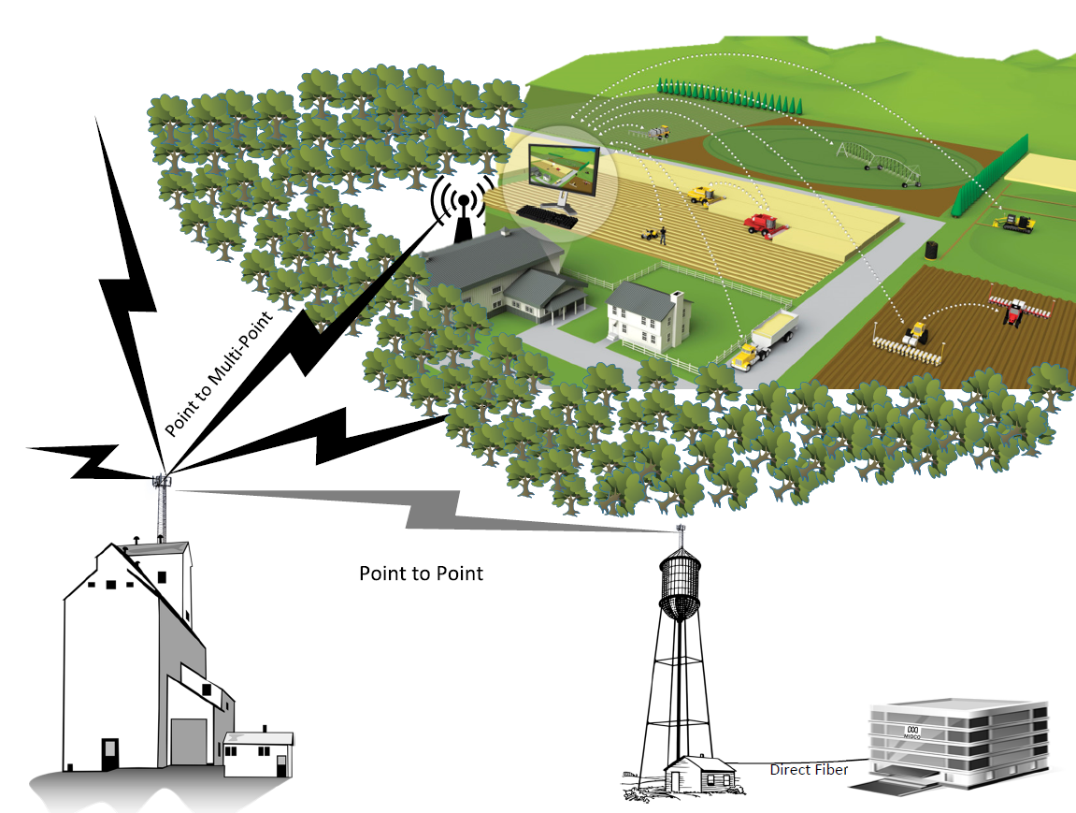
Fixed Wireless Connects Rural America

Slide 6
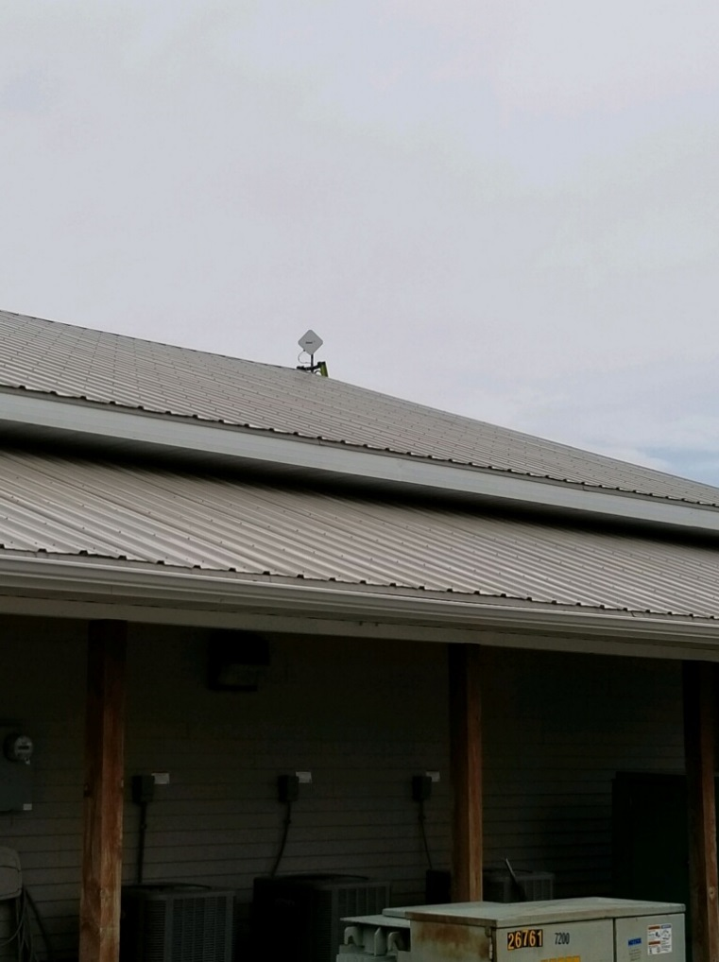

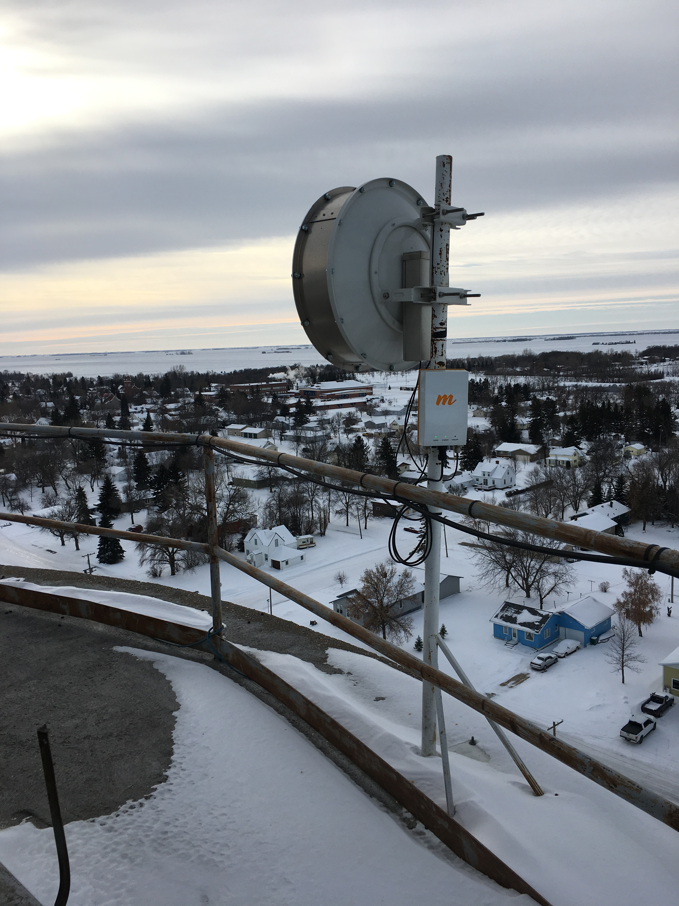
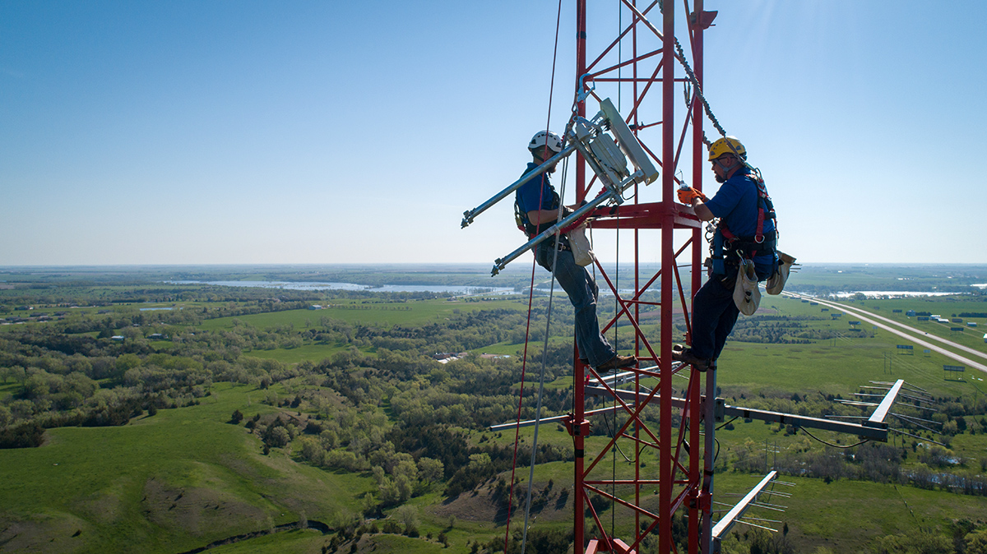
Fixed Wireless in Rural America

Slide 7
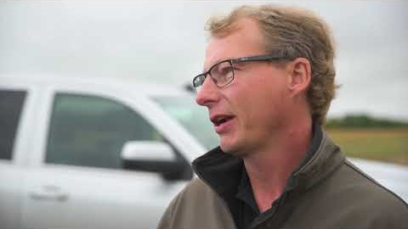
What Fixed Wireless Means for Rural America

Slide 8
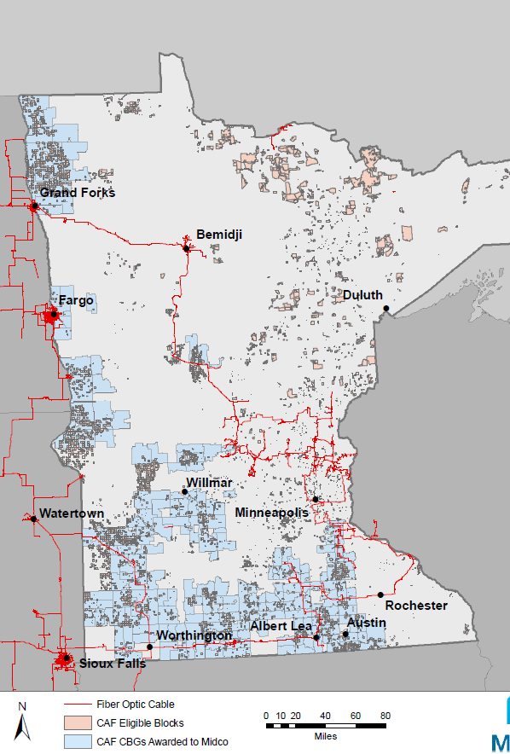
Midco Edge OutSM to Serve Rural Minnesota
Awarded $28 Million in CAF Phase II in Minnesota
  $38.9 Million Total
7,410 CAF locations awarded in Minnesota
  9,371 Total
100,000+ new homes passed
100/20+ speeds will be offered; no data caps
3-6 year build out; starting in 2019

Slide 9
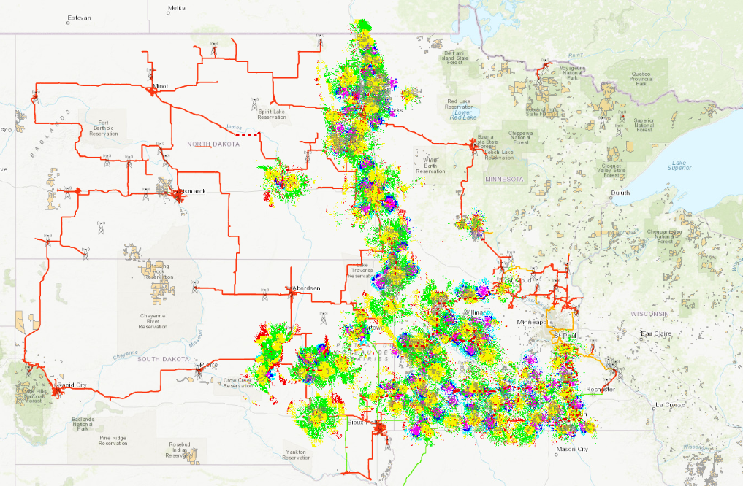
Midco Edge OutSM to Serve Rural America

Slide 10
Examples of Serving Rural Minnesota
Le Sueur County
Blue Earth County

Slide 11
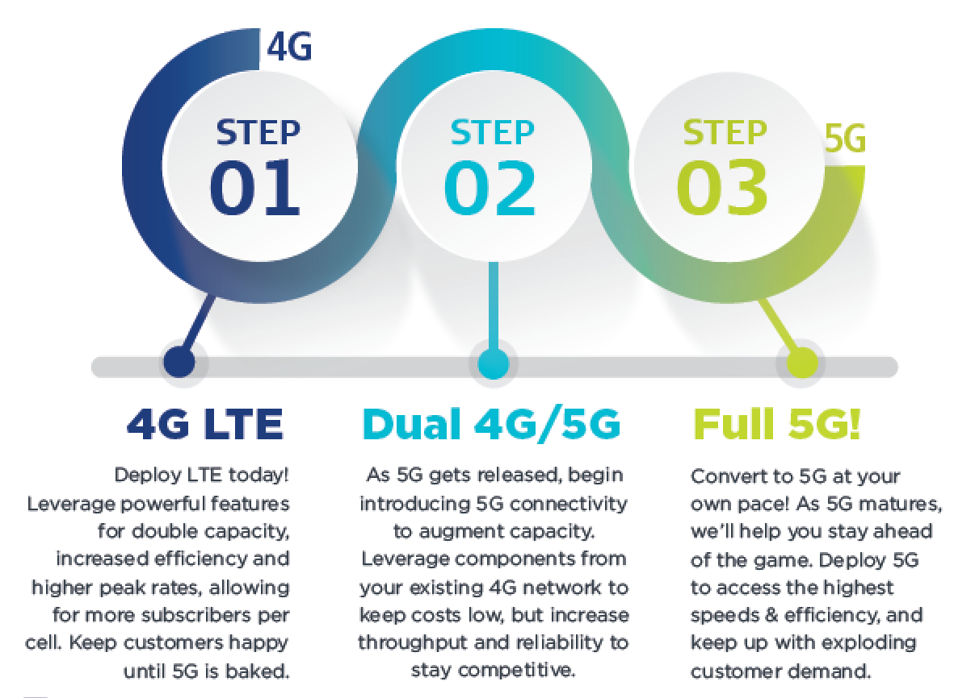
Building Fixed 5G LTE Network
5G fixed path with LTE, standards-based equipment
Faster speeds
Notes:
While we have access to the 3.5 GHz, the possibility of using other spectrum bands means that we can propel our fixed wireless product to a fixed 5G product
Fixed 5G gets us faster speeds for our customers and an ability to compete against the mobile 5G threat

Slide 12
Minnesota Broadband Partnerships
2015-2017 – Midco awarded more than $2.2 million in Border-to-Border Grants
  Little Fork to International Falls
  Canby to Marshall
  Porter, Taunton, Minneota, Ghent
  Annandale East, Wanamingo
2020 - Awarded nearly $900,000 for two Minnesota Border-to-Border Grants
  HFC Deployments in Renville and Scandia
Midco is committed to working with local partners
  DEED Office of Broadband emphasizes local partnerships

Slide 13
Office of Broadband Development – MN Model
  Strong, collaborative relationships with partners
    Facilitates and promotes broadband infrastructure development
  Competitive grant rounds
  Geographically dispersed
  Target unserved
  Challenge process

Slide 14
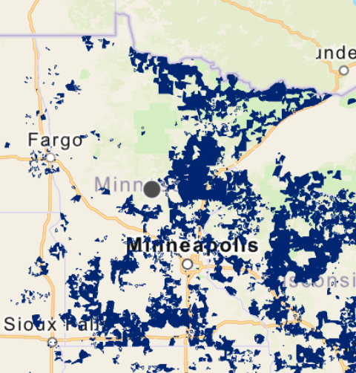
Rural Digital Opportunities Fund
  Next Round of FCC Funding- “CAF III”
  Similar approach to CAF II
  Reverse Auction Begins October 22, 2020
  Final Eligible Areas Expected by Late May-Early June
*Preliminary Eligibility Map for Minnesota

Slide 15
Contact Information
Justin Forde, Senior Director of Government Relations
  (701) 532-2017
  Justin.forde@midco.com
Melissa Wolf, Government Relations Manager
  651-214-5493
  Melissa.wolf@Midco.com

