Slide 1
IRP Update
Jennifer Kuklenski
Senior Public Policy Advisor
ETAC Meeting
April 23, 2024

Slide 2
Integrated Resource Planning
IRPs consider full range of power sector investments to meet new demand for electricity in affordable manner.
New generation sources
Demand-response and dual-fuel
Energy efficiency and conservation
Transmission and distribution
IRPs incorporate society-wide perspectives and public participation to find outcomes that balance economic, environmental, and social considerations while maintaining a reliable electric system.

Slide 3
Process Timeline
Engagement Meetings
February – October 2024
Process Summary
Nov - Dec 2024
IRP Filing
Mar. 1, 2025
IRP 101 Webinar: Build a shared understanding of Minnesota Power and the IRP Regulatory Process
Meeting 1: Level-setting for the process; discuss “customers and host communities” considerations.
Meeting 2: Level-setting for the process; discuss “environment and utility” sections of the issue map.
Meeting 3: Review advisory groups’ findings and recommendations, discuss cross-cutting issues, and provide final input to the resource plan.
GPI to develop process summary and send to participants for review
Nov - Dec
IRP 101 Webinar
February 21
Joint Meeting 1
May 7
(Grand Rapids)
Joint Meeting 2
June 3
(Duluth)
Joint Meeting 3
October (TBD)
Technical Advisory Group (TAG)
Monthly meetings; March – September
IRP Filing
Societal Cost-Benefit Advisory Group (SAG)
Three meetings; May - September
Modeling and Analysis
NOTE: Dates and topics are subject to change to meet the group's needs.

Slide 4
2025 IRP: Key Areas of Focus
Pathways to achieve 100% Carbon Free energy by 2040 while maintaining reliable and affordable energy:
Post BEC 3 & 4 Coal Operations
Viable replacement technologies
Just transition for workers & host community
Baseload retirement study for Hibbard
Customer programs and products
Changing demand and load
Technological readiness and costs
Transmission to support the transition

Slide 5
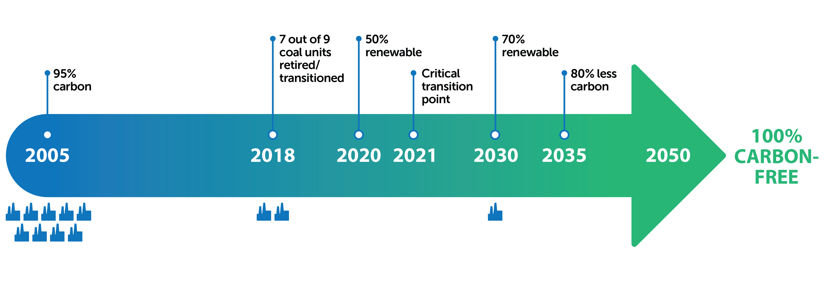
WE ARE COMMITTED TO MAKING A SUSTAINABLE & JUST TRANSITION
to a reliable, affordable and carbon-free energy mix for our customers.
2040

Slide 6
MP’s Clean Energy Transition
Since the 2015 IRP…
MP Generation has eliminated 180 positions as a result of:
Early closure of Boswell 1 & 2
Rapids Energy Center refueling
Laskin Energy Center refueling
Idling of Taconite Harbor Energy Center
Mission change for the Hibbard Renewable Energy Center
Rescaling of professional and technical services group
From 443 employees in 2015 to 263 employees today

Slide 7
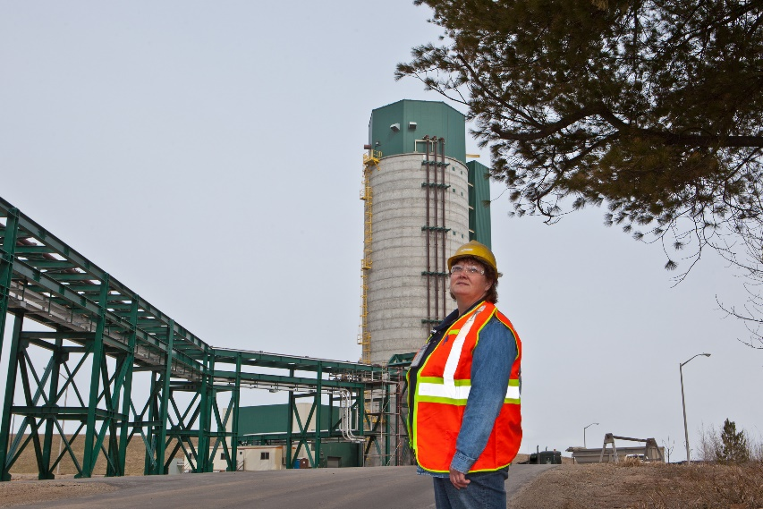
MP’s Clean Energy Transition
With time and thoughtful transition, MP managed this downsizing through hiring freezes, relocations, and planned retirements.
Of 180 positions eliminated in 4 years, only 5 employees were laid off.
Rehire preference for employees laid off.
Jane Orazem
Ash Handling
Technician
Troy Brutlag
Fuels Operations
Boswell Energy Center Units 3 & 4 currently employ 161 people

Slide 8
Generation Supply

Slide 9
Stakeholder Engagement
Technical Advisory Group
Societal Cost-Benefit Advisory Group
Will inform the IRP modeling assumptions and discuss other IRP technical issues as needed.
Geared towards participants with technical expertise (i.e., familiar with modeling assumptions).
Next Meeting: May 20 @ 1pm
Will inform development of a societal cost benefit analysis for any Minnesota Power generation facility, including but not limited to the Hibbard Renewable Energy Center and Boswell Unit 4.
First Meeting: June 3 @ 11:30am
The first joint meeting will be held on May 7 @ 8:30am
Optional Boswell Tour on May 6 @ 2:30pm

Slide 10
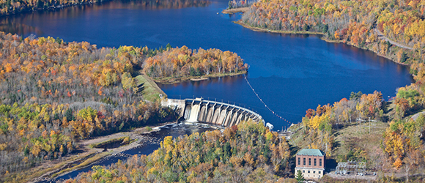
Questions?
Contact: Jennifer Kuklenski
jkuklenski@mnpower.com

