Slide 1
Placement 101
How to Navigate the State System and Get a Job

Slide 2
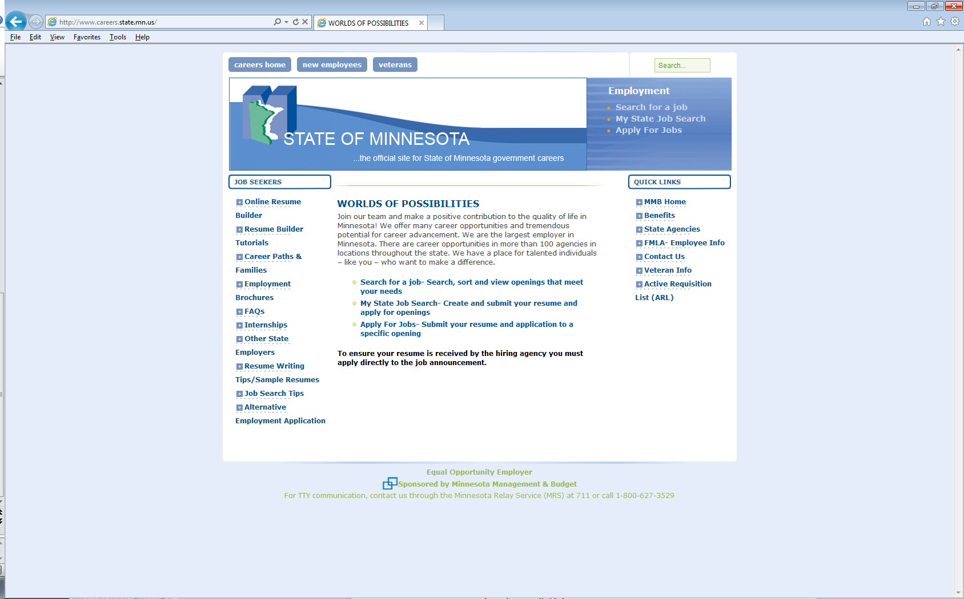
Overview-How it Works
http://www.careers.state.mn.us/
First you need to create an account

Slide 3
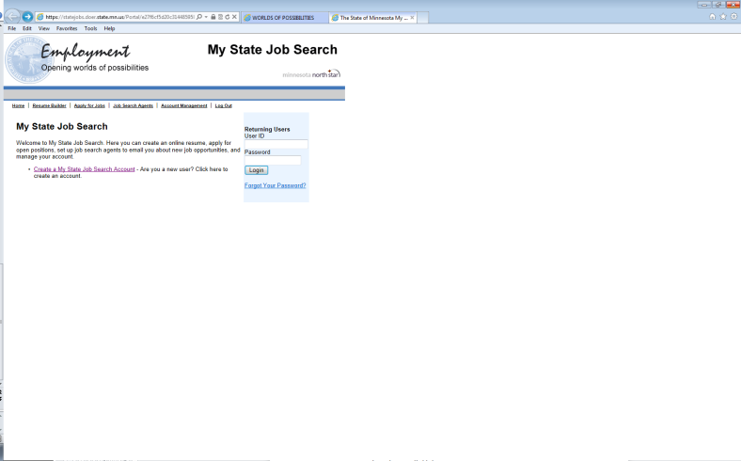
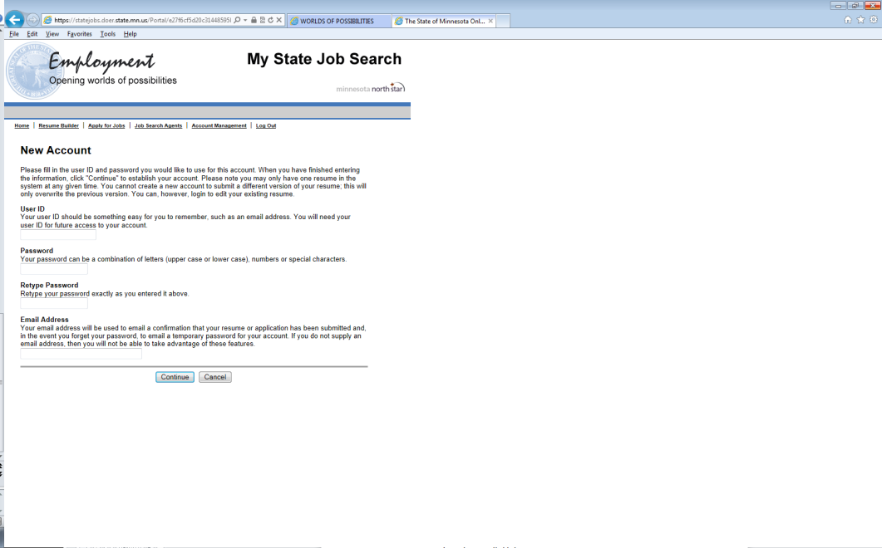
Overview My State Job Search

Slide 4
Overview
My State Job Search
From this page you can go to
Resume builder
Apply for jobs
Job search agents
Account management

Slide 5
Creating a Resume
Tips for creating a resume
The system times out -60 minutes
There are 7 tabs you may fill out
Be complete and thorough
Make sure you view your final resume.
Once that is done you must SUBMIT your resume to the system
If there are JOB SPECIFIC questions on the announcement- you MUST answer them on this page

Slide 6
Job Search Agents
Create Search Agents to help you in your search
You can select up to 5 search agents for desired criteria

Slide 7
Apply for Jobs
This tab allows you to search and apply for jobs
Under “who may apply” make sure you select “All Applicants”
Leave your search more broad---you never know what a job might be titled and may miss a good opportunity

Slide 8
Apply for Job Continued
Read the ENTIRE announcement
Check Minimum Qualifications
Check if there are Job Specific Questions to Answer
Check who to Contact for More Information
Make sure your resume has the key words listed in the Minimum Qualifications
If good to go, check the box “Apply for this job”

Slide 9
Screening Process
There are three ways to get tossed out in the screening process
Computer system-key words
Human Resources
Hiring Manager
Goal is to whittle the pile of resumes down to a manageable number for interviews

Slide 10
How to Make it Through the Screening Process
Review the posting-find name of the contact person listed
Call that person and ask if they are the hiring manager-if not, get the hiring manager’s name, number and email address
Email them a cover letter and nicely formatted resume
Follow up with a phone call
Remember-you want to stand out in a crowd

Slide 11
Employer Perspective
So what gets you tossed out
Resumes that don’t explain how your job experiences fit with the job posting
Poorly written-spelling errors other grammar issues
Incomplete information---Hiring Manager is not going to read between the lines—Don’t make me guess
You have 30-60 seconds to make an impression!

Slide 12
Reality
The reality is there are usually 100 up to 300 applications for each job posting, you need to do everything you can so your resume is NOT tossed out

Slide 13
Other Features
Links to Other State Employers
MnSCU
Judicial Branch
Legislative Branch
Met Council
U of MN

Slide 14
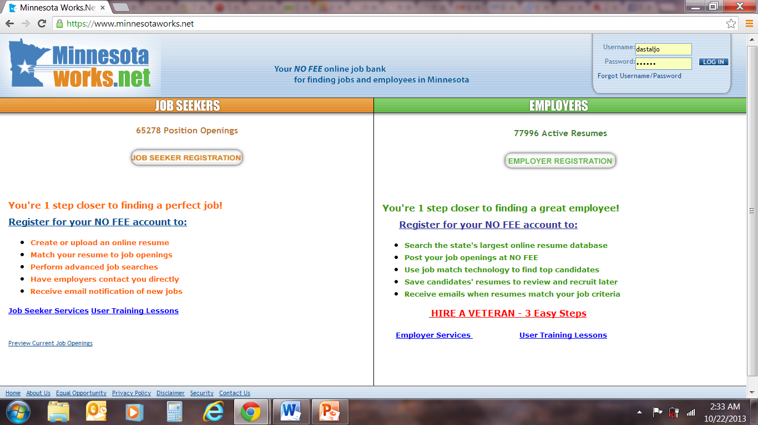
MinnesotaWorks.net
Different from MNWorks.net

Slide 15
Who is MinnesotaWorks.net for?
MinnesotaWorks.net is for MN employers and MN job seekers
All employers with government contracts are required to post on MinnesotaWorks.net and/or make a good faith effort to recruit using the site
Requirement for those on unemployment insurance and public assistance and those receiving dislocated worker services
All workforce center classes now require a MinnesotaWorks.net account
Free for employers and job seekers

Slide 16
Recruiting
Recruiters use postings to search resumes
Get bumped to the top of search results
Name and your objective… Do not use excess or fluffy language in your objective
State agencies may post but are not required.
Some but not all positions may be posted

Slide 17
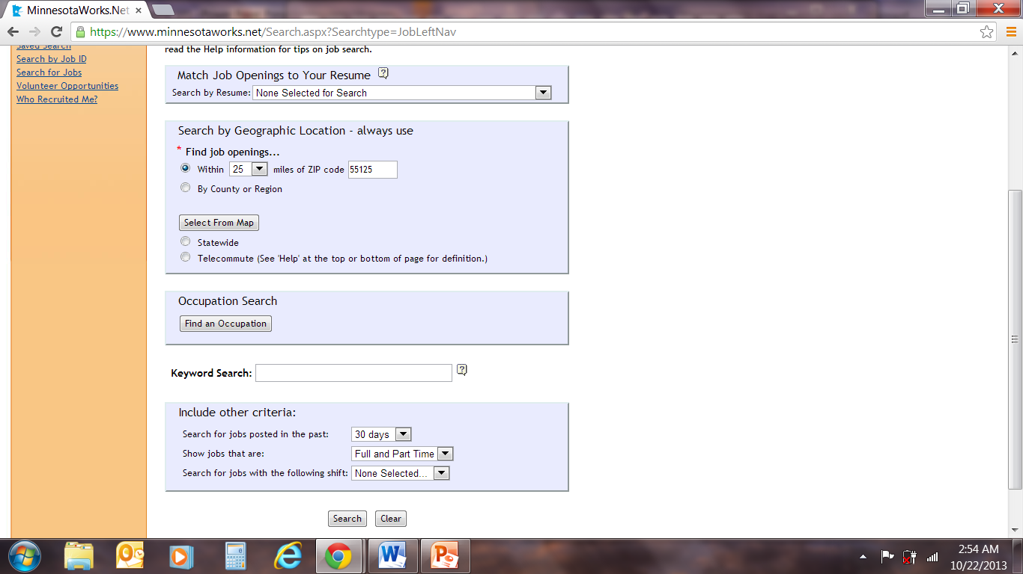
Applying
Search For Jobs
Apply for posting
Make sure you meet minimum qualifications
Tweak your resume
Follow the instructions

Slide 18
Considerations
Intermediate JAWS users
Resumeix being eliminated
Changing to more mainstream business approach

