Slide 1
Training for Educators: What are Pre-Employment Transition Services (Pre-ETS)?
Recorded January 2021

Slide 2
Agenda
Introductory Information
Overview of Transition Services
Review of Pre-Employment Transition Services (Pre-ETS)
Pre-ETS and Work-Based Learning Programs
Resources

Slide 3
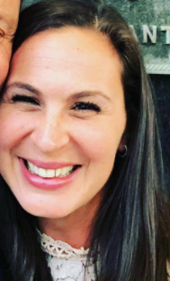
Introductions
Lindsey Horowitz
MDE Transition Specialist
Erin Larsen
MDE Work-Based Learning Specialist
Alyssa Klein
VRS Transition and Pre-ETS Specialist
Sheila Koenig
SSB Transition Coordinator

Slide 4
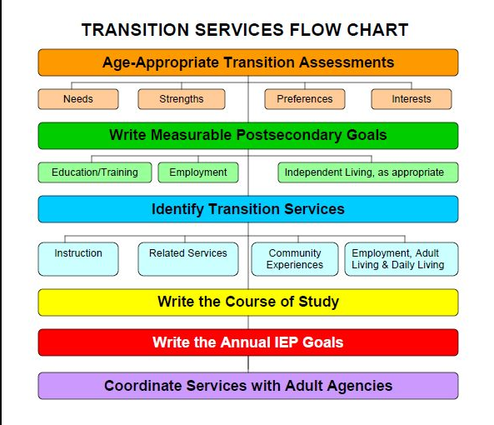
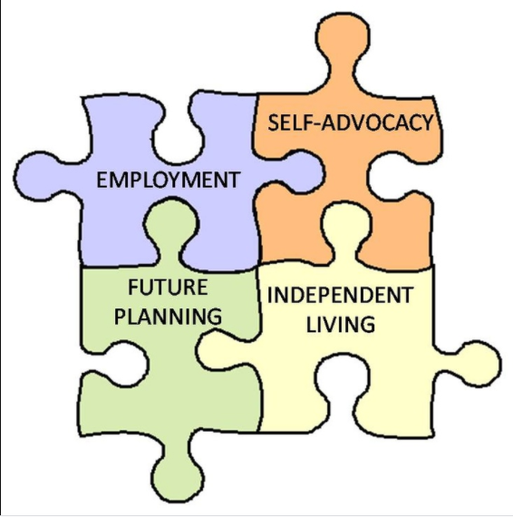
MDE Special Education-Transition
Secondary Transition Planning is the process of preparing students for life after high school and includes planning for postsecondary education or training, employment, and independent living.

Slide 5
MDE CTE

Slide 6
Vocational Rehabilitation Services (VRS) and State Services for the Blind (SSB)
State employment services agencies that serve people with disabilities
Divisions of the Department of Employment and Economic Development (DEED)
Partners in the CareerForce system (formerly Minnesota WorkForce Centers)
50 CareerForce locations in the state
VRS/SSB serve youth and adults: Any Age 14+!

Slide 7
Services VRS/SSB Provide
Career Counseling
Job Training
Job Placement
Services to Keep a Job
Pre-Employment Transition Services
And more!

Slide 8
Collaboration more important than ever before…
Schools
Community Providers
VRS/SSB
Counties

Slide 9
NEW from US Department of Education
Letter on the Importance of Collaboration Between Special Education and Vocational Rehabilitation Related to Secondary Transition
A Transition Guide to Postsecondary Education and Employment for Students and Youth with Disabilities

Slide 10
Updated DEED-MDE MOU
How VRS/SSB and schools collaborate
Have Pre-ETS available to all students with disabilities
Work together for outreach to students
Inform and engage all school staff
Invite VRS/SSB staff to IEP meetings
Include students with disabilities in school PLP activities
Schools are allowed to provide “Directory Information” to VRS/SSB
Funding decisions

Slide 11
What are Transition Services?

Slide 12
What is Transition?
noun tran·si·tion tran(t)-ˈsi-shən
Passage from one state, stage, subject, or place to another: change
A movement, development, or evolution from one form, stage, or style to another
-Merriam Webster Dictionary

Slide 13
What is meant by transition for youth with disabilities?
When adolescents are moving into adulthood and are planning for postsecondary education, careers, health care, financial benefits, housing, and more.
Continuation of service across both child and adult service systems
The transition from youth to adulthood is critical for every young person.

Slide 14
Transition
Transition
IDEA
(Special Education)
WIOA
(VRS/SSB)

Slide 15
IDEA Definition of Transition Services
A coordinated set of activities for a child with a disability that
Is designed to be within a results-oriented process, that is focuses on improving the academic and functional achievement of the child with a disability to facilitate the child’s movement from school to post-school activities, including postsecondary education, vocational education, integrated employment (including supported employment), continuing and adult education, adult services, independent living, and/or community participation.
-34 C.F.R. § 300.43(a)

Slide 16
IDEA Definition of Transition Services (continued)
Is based on the individual child’s needs, taking into account the child’s strengths, preferences, and interests; and includes-
Instruction;
Related services;
Community experiences;
The development of employment and other post-school adult living objectives and;
If appropriate, acquisition of daily living skills and a functional vocational evaluation.
-34 C.F.R. § 300.43(a)

Slide 17
Transition Policy and Practice
Transition age: grade 9- 12 (21)
Special transition age activities and focus

Slide 18
VRS/SSB Transition Services
WIOA and IDEA have the same definition of transition (slide 15)
Pre-ETS are a part of transition services

Slide 19
What are Pre-Employment Transition Services (Pre-ETS)?

Slide 20
Required by WIOA
President Barack Obama signed the Workforce Innovation and Opportunity Act (WIOA) into law on July 22, 2014.
Amends the Rehabilitation Act of 1973
Key changes impacting youth with disabilities:
Pre-employment transition services (Pre-ETS)
Limitations on the use of subminimum wage
Final regulations published 08-19-16

Slide 21
Pre-ETS Availability
Are provided in collaboration with secondary schools
Must be made available statewide to all students with disabilities
Any student with a disability who is age 14-21 can receive Pre-ETS

Slide 22
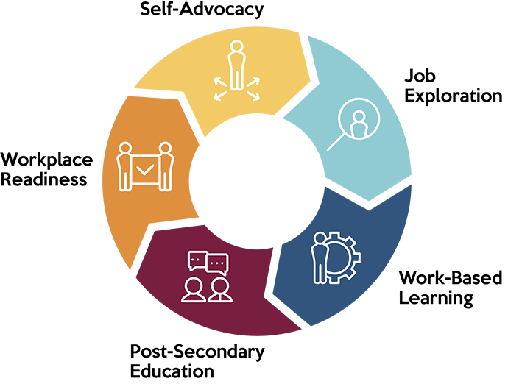
Pre-Employment Transition Services (Pre-ETS) 5 Required Services
Job Exploration Counseling
Work-Based Learning Experiences
Postsecondary Education Counseling
Workplace Readiness Training
Instruction in Self-Advocacy

Slide 23
Pre-ETS are a Component of Transition Services
Schools provide them as a part of transition services included in IEPs
Schools provide them to all students: Personal Learning Plans (PLPs) are required for all students in MN
VRS/SSB provides them to students eligible for VR as a part of broader transition services on the Employment Plan
VRS/SSB provides them to students potentially eligible for VR

Slide 24
Schools are the primary provider of Pre-ETS…
…but VRS and SSB can help fill in the gaps

Slide 25
Transition and Pre-ETS
All Special Ed. and VR Services
Pre-ETS Services
Transition Services
General Education

Slide 26
VRS/SSB Student Career Services
Who do we serve?
Any student with a disability age 14 and older that needs Pre-ETS
Why would I refer?
Student has unmet Pre-ETS needs
Early start to career planning
You have a partner in serving the student!

Slide 27
VRS: Two VRS Staff Assigned to Every School
VR Counselor and Pre-ETS Representative
No wrong door: Send referrals to either staff person
Find the staff assigned to your school

Slide 28
SSB: Team Approach
Each student is wrapped around by a team:
Rehabilitation counselor (assigned based on region)
Vocational rehabilitation technician
Pre-ETS Coordinator
Pre-ETS Work Opportunities Navigator
Pre-ETS Assistive Technologist
To make a referral: Contact Sheila Koenig, Sheila.Koenig@state.mn.us

Slide 29
VRS and SSB Contract with Community Partners
Community Rehabilitation Programs (CRPs)
Centers for Independent Living (CILs)
CareerForce Partners

Slide 30
Pre-ETS are Provided Through School Work-Based Learning Programs

Slide 31
Types of Work-based Learning
Program Name | Diversified Work-based Learning | Career Pathway Work-based Learning | Diversified Youth Apprenticeship | Career Pathway Youth Apprenticeship
Program Codes | 000750 (ACTE-SPED) 0009090 (Diversified) | 019090 (Agriculture) 079090 (Health) 099090 (Family and Consumer Science) 049090 (Marketing) 149090 (Business) 179090 (Trade and Industrial) | 0009095 (Diversified) | 019095 (Agriculture) 079095 (Health) 099095 (Family and Consumer Science) 049095 (Marketing) 149095 (Business) 179095 Trade and Industrial)

Slide 32
Work-based Learning Requirements
Program Name | Diversified Work-based Learning | Career Pathway Work-based Learning | Diversified Youth Apprenticeship | Career Pathway Youth Apprenticeship
Career Seminar Course Required | Yes | Yes | Yes | Yes
Related Career Pathway Instruction Required | No; however previous experiential learning opportunities are recommended | Yes; at least one course from the related career field | 120 hours of related career field instruction per year | 120 hours of related career field instruction per year
Required Hours of Work Experience | Local decision; typically 90-120 hours | Local decision; typically 90-120 hours | 450 hours per year | 450 hours per year

Slide 33
Key Components of WBL

Slide 34
NEW: MDE Work-Based Learning Framework
Serves as a guide for three work-based learning courses that can be taught in an approved work-based learning program
Developed in partnership with work-based learning coordinators and Vocational Rehabilitation Services counselors from across the state.
Work-based Learning Framework

Slide 35
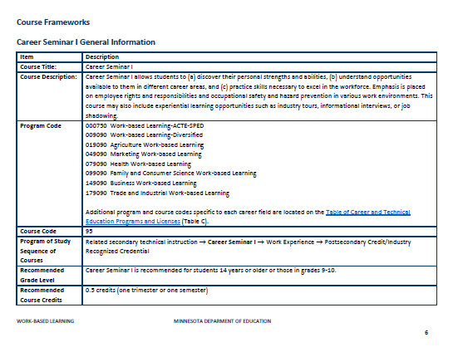
NEW: MDE Work-Based Learning Framework (continued)

Slide 36
NEW: Pre-ETS Framework
Defines the five required Pre-Employment Transition Services
Outlines performance measures
Aligns with the WBL framework
Will align with the Transition Framework…
Pre-ETS Framework

Slide 37
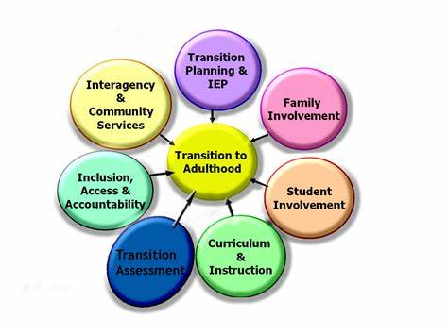
Coming Soon: Transition Framework!
Transition Framework in collaboration with:
Education
VRS

Slide 38
Resources

Slide 39
MDE Resources
Work-based Learning Website
CTE Program Approval
Postsecondary Resource Guide
Employment Resource Guide
Special Education Transition Webpage

Slide 40
VRS Resources
Educator page on VRS website
Find VRS staff assigned to your school
Video
Partnership Guide
MN Pre-ETS Toolkit
More!

Slide 41
SSB Resources
BRIDGE to Success Program
Videos for Parents, Students, and Educators
The Spectacle Newsletters
Blind Abilities Podcasts
And more!

Slide 42
Contact Information
Lindsey Horowitz, Lindsey.Jo.Horowitz@state.mn.us
Erin Larsen, Erin.Larsen@state.mn.us
Alyssa Klein, Alyssa.Klein@state.mn.us
Sheila Koenig, Sheila.Koenig@state.mn.us

Slide 43
Pre-ETS Funding
The pre-employment transition services provided under the VRS VR program are funded by a grant from the U.S. Department of Education with a state match. For federal fiscal year 2020, the total amount of federal grant funds used for these services is $6,374,138 (78.7 percent). The state appropriation indirectly supports the pre-employment transition spending and amounts to $1,725,148 (21.3 percent).
State Services for the Blind’s vocational rehabilitation program is funded by a grant from the U.S. Department of Education with a state match. For Federal Fiscal Year 2020, the total amount of federal grant funds used for these services is $8,901,006 (78.7 percent). The state match appropriation is $2,409,040 (21.3 percent). Pre-employment transition services are funded by a 15 percent set aside of the federal grant, which is $1,335,151.

