Slide 1
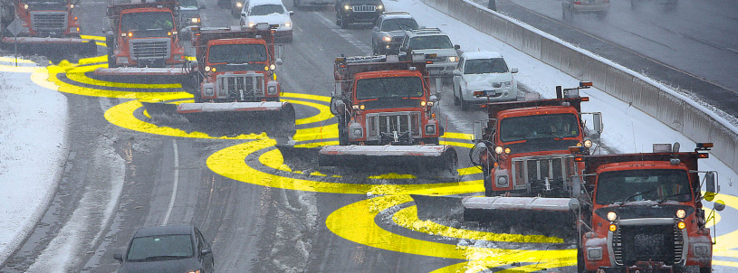
Preparing for Connected and Automated Vehicles in Minnesota
Ray Starr
MnDOT Assistant State Traffic Engineer - ITS
March 22, 2017

Slide 2
Outline
What is Happening Nationally?
What is Happening in Minnesota?
How Does This Affect Communications?
Automated Vehicles
Vehicle to Infrastructure (V2I) Communication
Vehicle to Vehicle (V2V) Communication

Slide 3
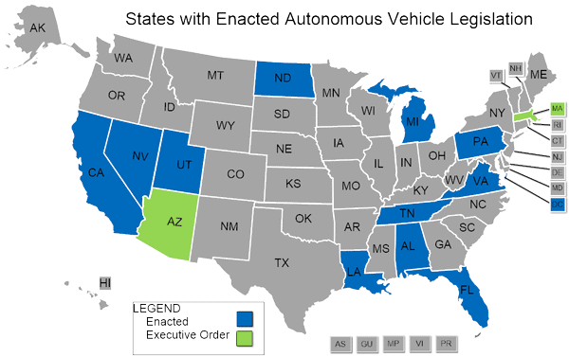
Automated Vehicles Nationally
Policy / Regulations
  NHTSA’s Federal Automated Vehicles Policy
  States’ Legislation
Planning Impacts
Technology Development and Testing
  Taxi/Rideshare
  Trucks/Platooning
  Transit Vehicles/Shuttles
  Dealing with Weather

Slide 4
Minnesota Automated Vehicles Policy
MN is “OPEN for Business”
Minnesota Jurisdictional AV/CV Committee
Minnesota Guidestar
MnDOT Examining Statutes/Rules
  ID Statutes/Rules Limiting AVs
  ID Possibilities within Current Statutes/Rules
  Currently Not Promoting Legislation

Slide 5
Minnesota Automated Vehicles Planning
Planning Challenge
  Every bridge we build today will carry AVs and non-AVs in its service life
  Unknown timeline and effects
MnDOT Approach
  Monitor AV progress and pilots
  Wait until 3-5% of vehicles are AV before adjusting road design
  Revisit during next planning cycle

Slide 6
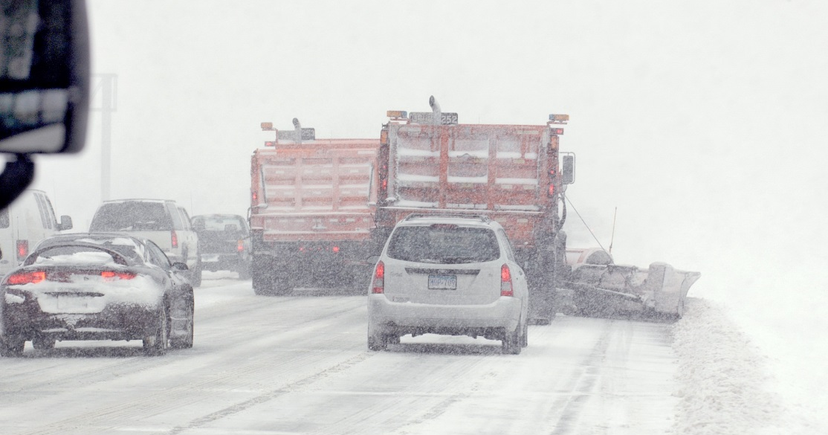
Minnesota Automated Vehicles Technology
Proposed Proving Ground
  Snow/Ice
  Cold
  Salt
Local Companies’ Product Development for Weather Challenges
U of M Driver Assistance Technology for Bus Shoulder Use and Snow Plows

Slide 7
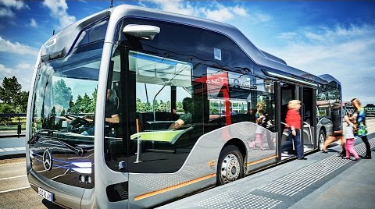
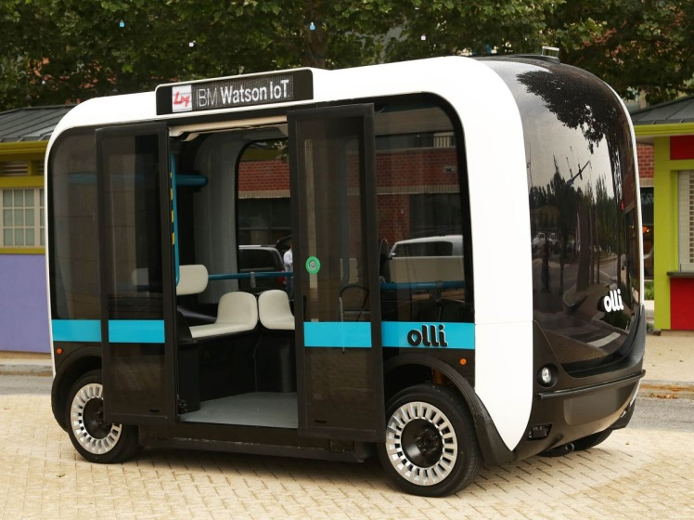
Minnesota Automated Vehicles Technology
Autonomous Bus Project
Research autonomous bus in cold weather climate conditions
Phase 1
  Define and Plan Project
  Identify vehicle technology partners
Phase 2 Objective
  Perform Test / Demonstration

Slide 8
Automated Vehicles and Communications
Not Currently Connected for Driving
  Use On-Board Sensors and Maps
Sharing Vehicle Learning Among Vehicles
Over-the-Air Software Updates
Potentially Could Crowd Source Mapping & Updates
Potentially Could Download Maps

Slide 9
V2V Connected Vehicles
Automated Vehicles
Vehicle to Infrastructure (V2I) Communication
Vehicle to Vehicle (V2V) Communication

Slide 10
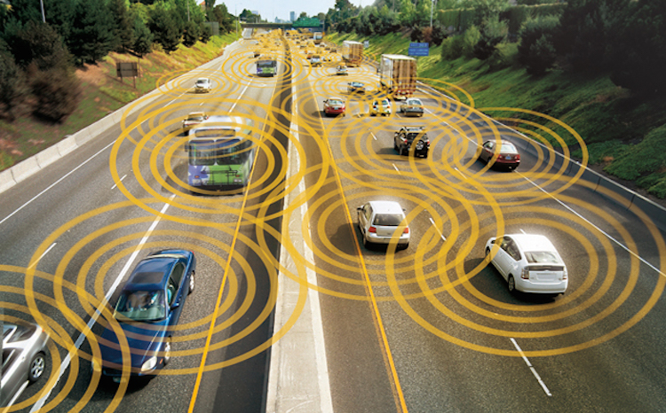
V2V Connected Vehicles
Dedicated Short-Range Communication (DSRC)
Different Than “Connected Cars”

Slide 11
V2V Nationally
NHTSA Notice of Proposed Rule Making:
All new light duty vehicles to transmit/receive a Basic Safety Message via DSRC
V2V Complements In-Vehicle Sensor-Based Technologies
  Not restricted by the same line-of-site limitations
  Longer detection distance
  Not affected by adverse weather
  Supports Automated Vehicles

Slide 12
Minnesota V2V
V2V Support for Gang Plowing
  U of MN Research
  Coordinate Snow Plow Movement

Slide 13
V2V and Communications
DSRC is Local Communications Only
  Future 5G Could Offer Device-to-Device Direct Communications
  Others Want the 5.9 GHz Spectrum
Security Credentials Require Periodic Connection to Back Office System

Slide 14
V2I Connected Vehicles
Automated Vehicles
Vehicle to Infrastructure (V2I) Communication
Vehicle to Vehicle (V2V) Communication

Slide 15
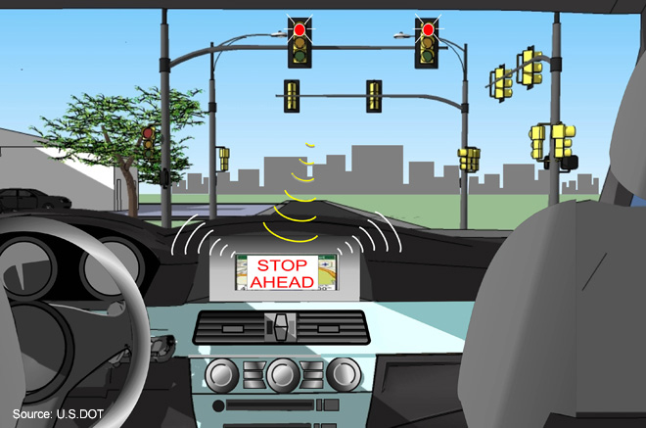
V2I Nationally
USDOT Work with Auto Makers
  Red Light Violation Warning
  Curve Speed Warning
  Reduced Speed Zone Warning
Signal Phase and Timing (SPaT) Challenge
  Broadcast Current Color of Traffic Signal Indications

Slide 16
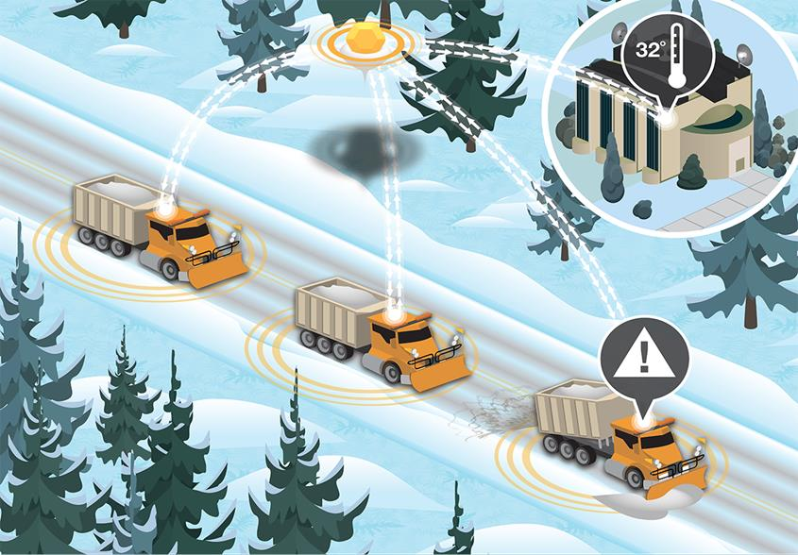
Minnesota V2I
Current/Past Work:
Integrating Mobile Observations

Slide 17
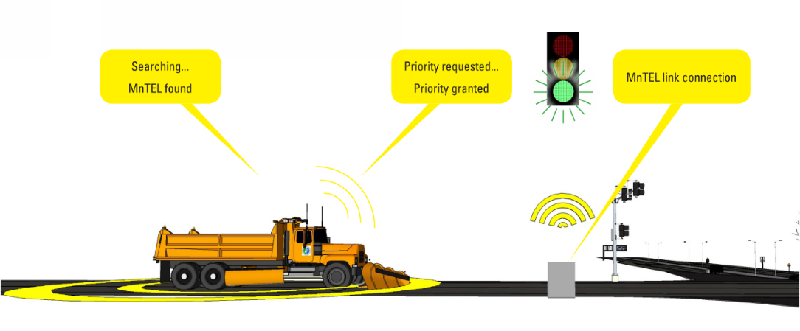
Minnesota V2I
Planned “Connected Corridor”
SPaT
Snow Plow Priority
Maintenance Vehicle
Warning System

Slide 18
V2I and Communications
DSRC Vehicle to Roadside Local Communications
  Future 5G Could Offer Device-to-Device Direct Communications
DSRC Vehicle to Back Office Using Backhaul
  2-Way
Cellular Vehicle to Cloud
Remote Configuration of Roadside Equipment

Slide 19
Connected Automation
Automated Vehicles
Vehicle to Infrastructure (V2I) Communication
Vehicle to Vehicle (V2V) Communication

Slide 20
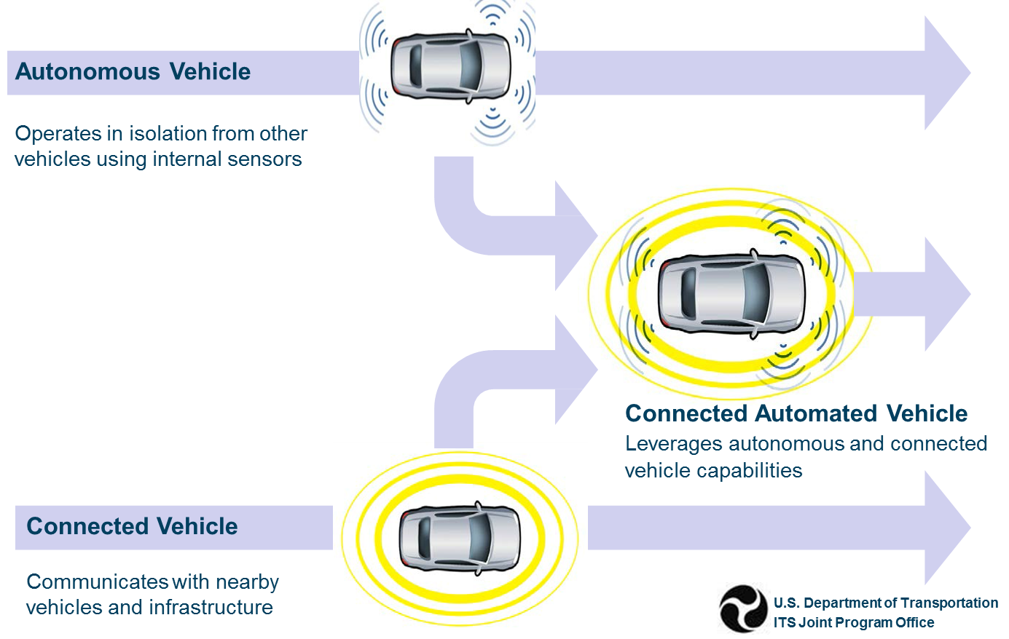
Connected Automation

Slide 21
Thank you again!
Ray Starr, PE
Ray.starr@state.mn.us
651-234-7050

