Slide 1
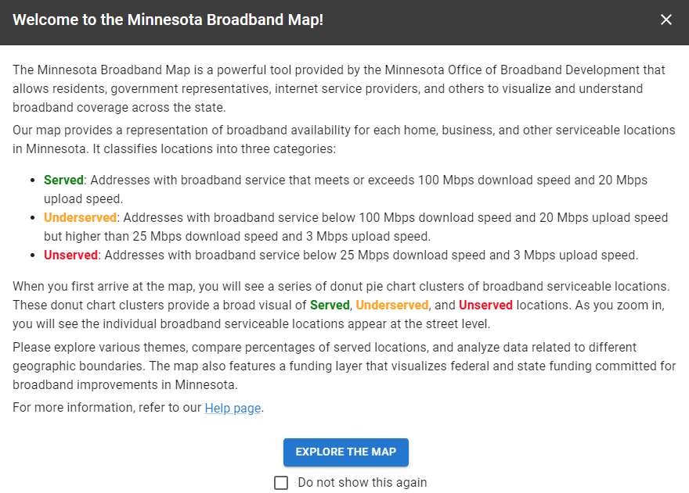
Minnesota Broadband Navigator™ Quick-Start Guide

Slide 2
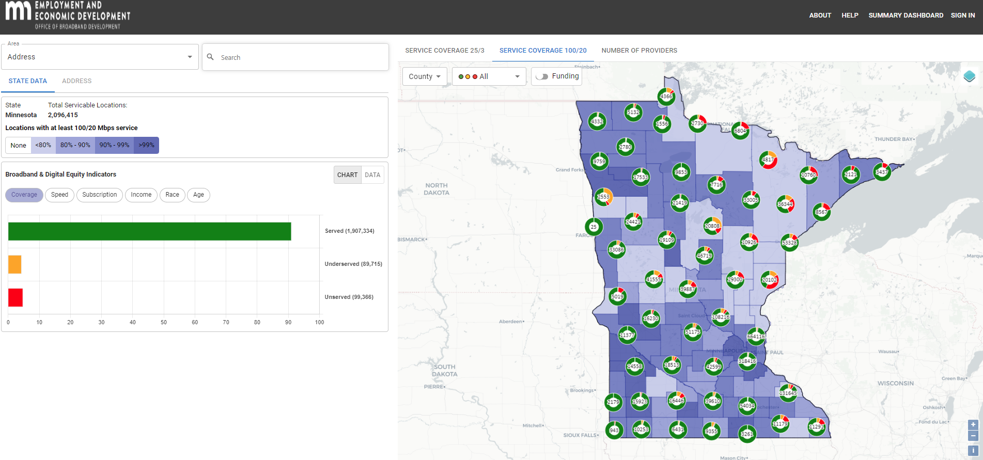
Resident - Step 1
STEP 1
Find your home or organization
Select ‘Address’ as the area search type
Type in and select your address in the search box

Slide 3
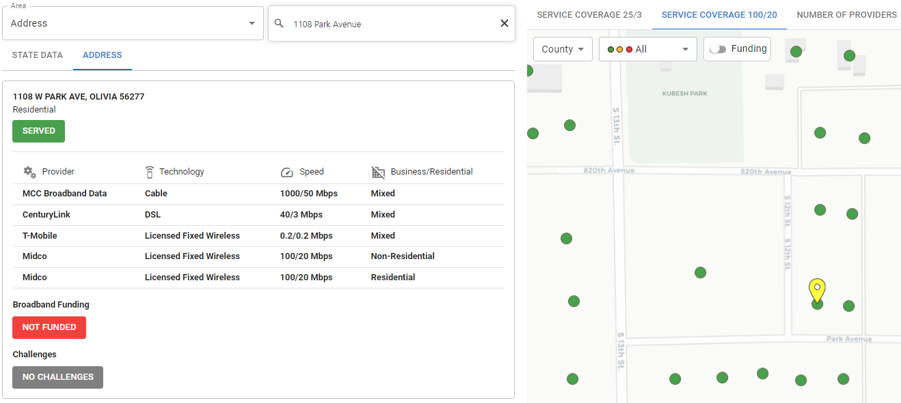
Resident - Step 2
STEP 2
Review information associated with selected location

Slide 4
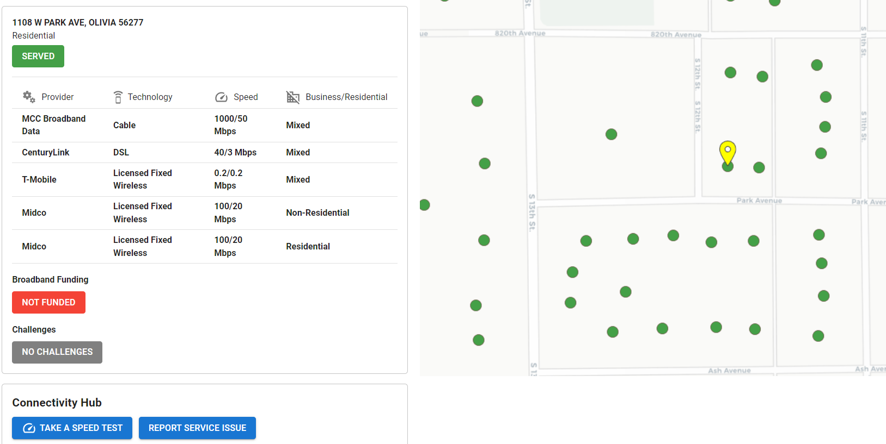
Resident - Step 3
STEP 3
If you have slow or unreliable internet:
Take a speed Test!
You’ll be prompted to run a speed test, and, if your results are below 200/40 Mbps, you’ll be asked for information to remind you to take another test in > 24 hours
You need to take a total of 3 speed tests to submit a challenge

Slide 5
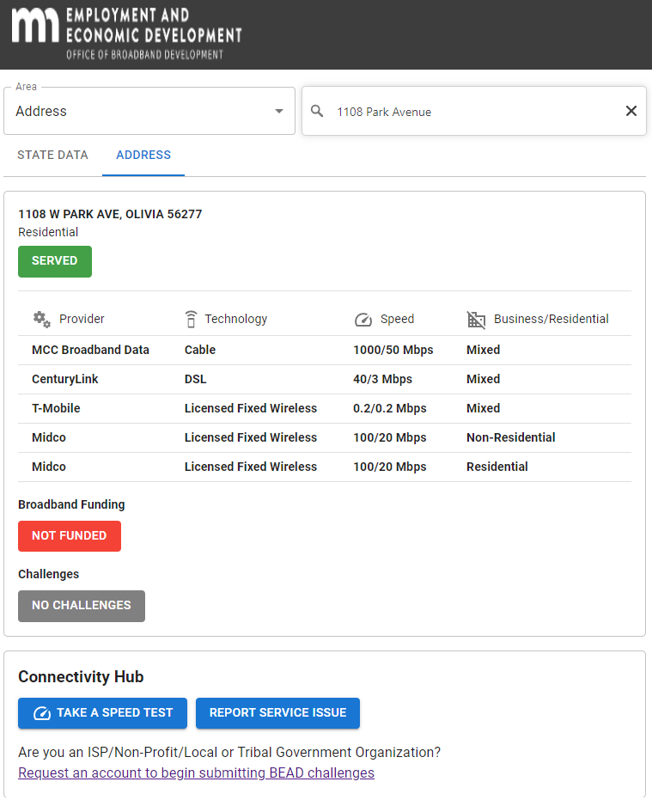
Resident - Step 4
STEP 4
Have another service issue?
Availability Issues – There are issues (untimely installation, excessive cost, equipment, other issues) with service listed on the map
Data Cap – Provider listed on the map has data caps on the service
Business Service Only – The provider only provides business service to this location

Slide 6
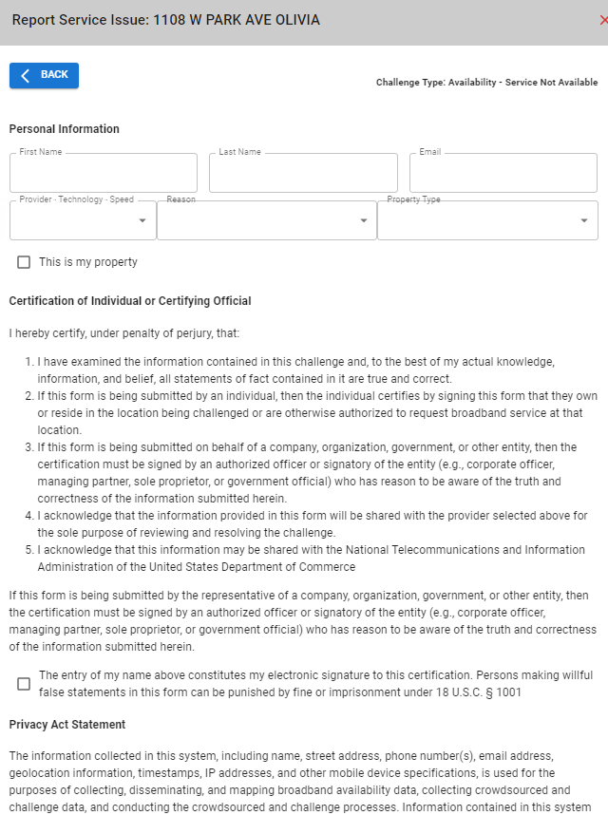
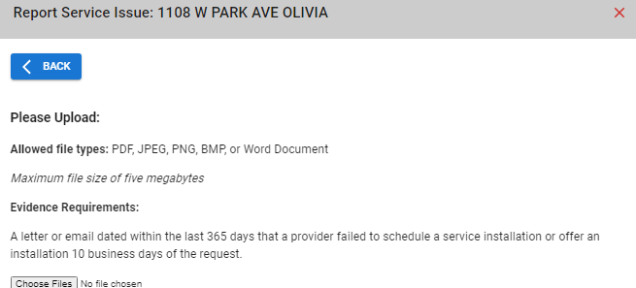
Resident - Step 5
STEP 5
Submitting Service Issues:
Fill out the form with your information
Read and acknowledge the certifications
Upload the required documentation
Submit the form

Slide 7
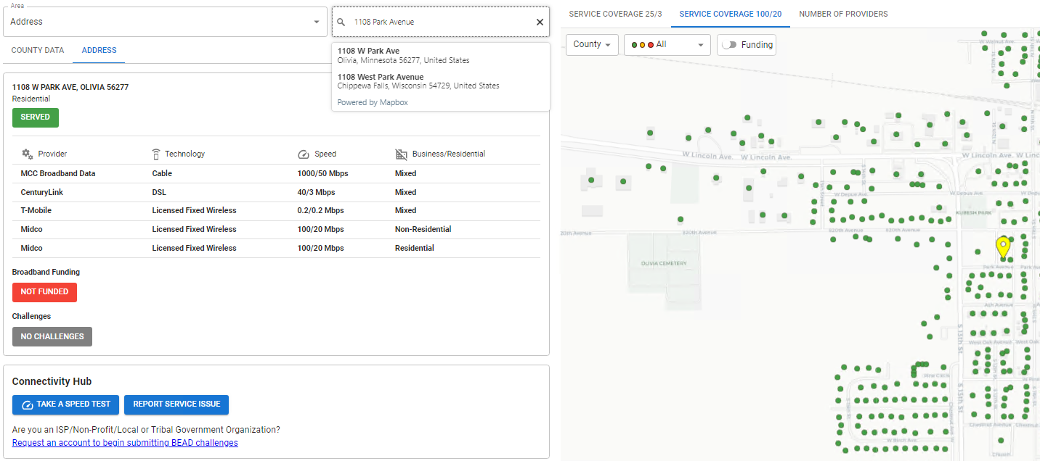
Eligible Challengers - Step 1
STEP 1
Find your home or organization:
Select ‘Address’ as the area search type
Type in and select your address in the search box

Slide 8
Eligible Challengers - Step 2
STEP 2
Request an account:
Fill out the form
Your application will be reviewed and you will be notified by email once access has been granted

Slide 9
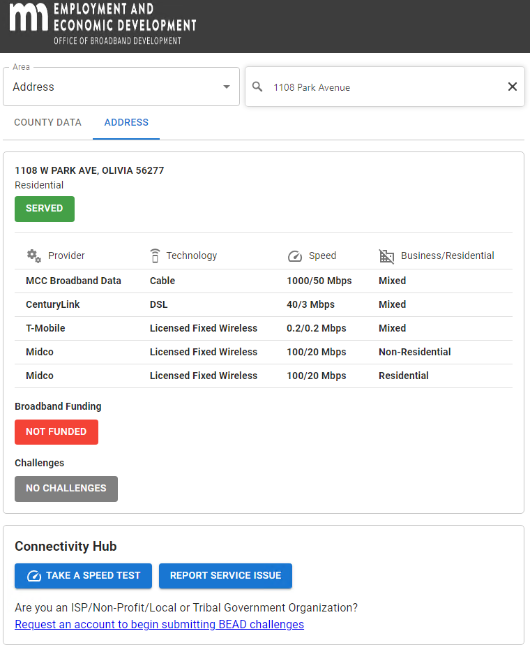
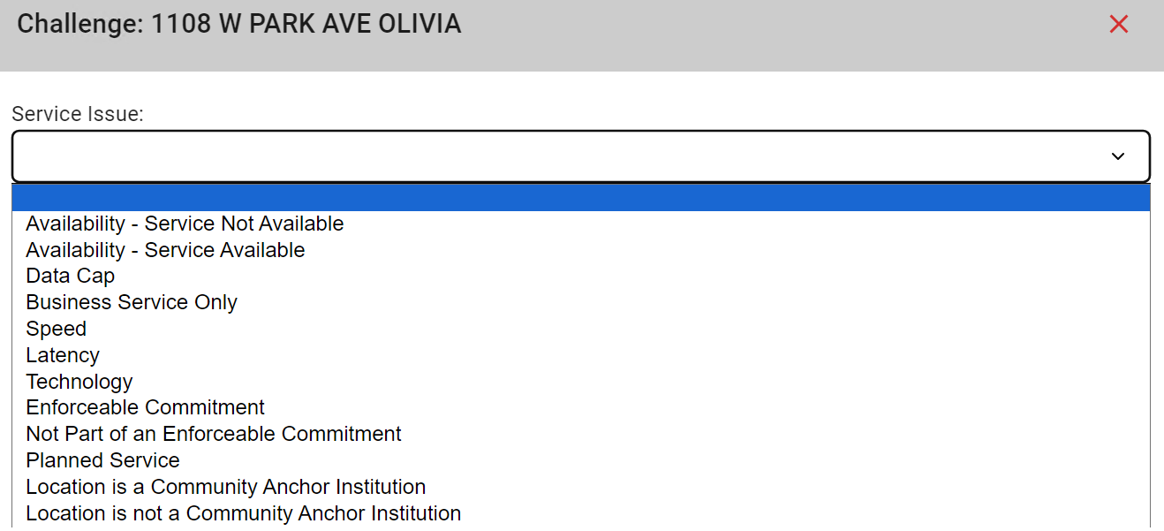
Eligible Challengers - Step 3
STEP 3
Want to submit a challenge? Choose one of the challenge types below:
Availability – Service Not Available
Availability – Service Available
Data Cap
Business Service Only
Speed
Latency
Technology
Enforceable Commitment
Not Part of an Enforceable Commitment
Planned Service
Location is a Community Anchor Institution
Location is not a Community Anchor Institution

Slide 10
Eligible Challengers - Step 4
STEP 5
Submitting Service Issues:
Fill out the form with your information
Read and acknowledge the certifications
Upload the required documentation
Submit the form

