Slide 1
Satellite Broadband: High Speed Internet Everywhere Steven Hill President Satellite Broadcasting & Communications Association
www.sbca.org | 800-541-5981 | info@sbca.org

Slide 2
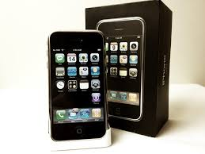
Satellite Broadband Generation 1- Past
1,700,000 customers
Capacity limited growth
10/1 speeds
Service limitations
Legacy technology
Much like the original iPhone, satellite internet has evolved
www.sbca.org | 800-541-5981 | info@sbca.org

Slide 3
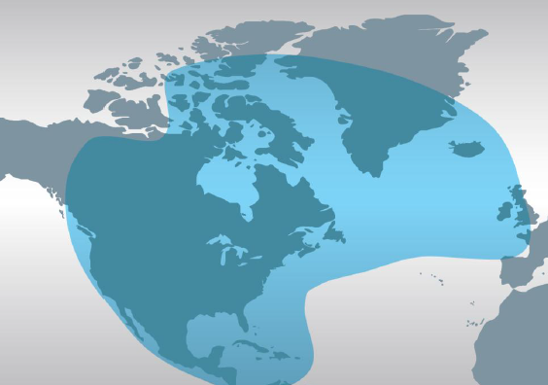
Satellite Broadband Next Generation- Present
2017 2 new satellites deployed
High speed 25/3+ available everywhere today
100Mps service in select markets
Fast, secure, reliable
Competitively priced
Unlimited plans
No hard data limits
Target underserved markets
www.sbca.org | 800-541-5981 | info@sbca.org

Slide 4
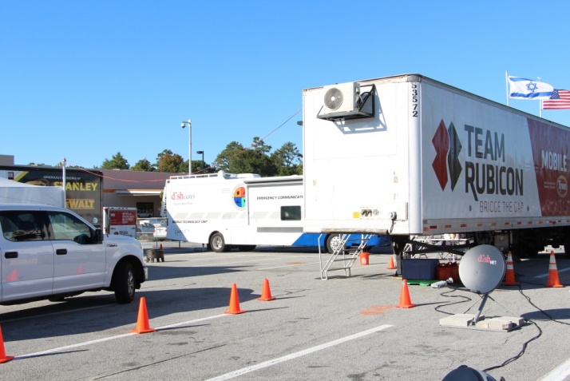
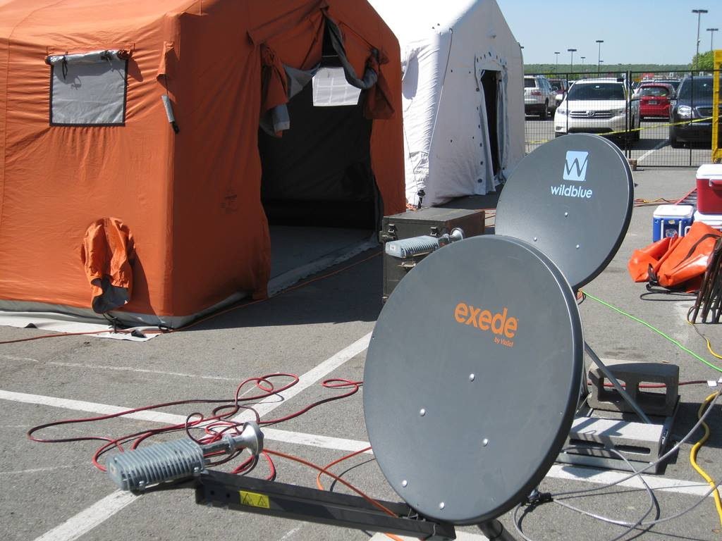
Satellite Broadband – Disaster Recovery and Relief
Easy set up and removal
Fast high speed communications
Essential part of long term relief efforts
Relief centers
Medical
Public safety
Government
2017 Deployments
Texas Floods 18
Puerto Rico Hurricane 40
Florida Hurricane 5
Texas Tornado 1
Tennessee Wildfires 1
MO Floods 1
250,000 hours of TV and Internet donated since 2015
www.sbca.org | 800-541-5981 | info@sbca.org

Slide 5
Satellite Broadband – Future
More satellites launching in 2020
Speeds of 100Mbps nationally
Significant US private investment
Technology will drive the market
www.sbca.org | 800-541-5981 | info@sbca.org

