Slide 1
GWDB Committees & Task Force Structure
Ben Baglio, GWDB Director
GWDB Quarterly Full Board Meeting
Wednesday, March 4, 2020 | Bloomington

Slide 2
Current Standing Committees
Committee membership: GWDB voting & non-voting members, others involved in the work. Members appointed by the Chair.
Committees tasked with providing policy recommendations for full GWDB to consider.
Each committee’s recommendations, if approved by full GWDB (likely September), then included in the next GWDB Legislative Report (2021).
Committees will review recommendations made previously, and members will also have opportunity to bring forward new recommendations.

Slide 3
GWDB Committee Structure
Full GWDB
Operations
CPP
REC
DEC
Executive

Slide 4
Policies Focus & Priorities
Scope/breadth of committees creates helpful structure/categories for GWDB policy recommendations & Legislative Report.
Scope of each is also quite wide, making harder to narrow the focus.
Racial equity or equity for people with disabilities not done in isolation.
Other WIOA state boards have had similar experiences with their committee work, structure, and what/how to prioritize efforts.
Many states have turned to a task force model in order to utilize existing structure but more easily focus the work.
Flexibility measures in WIOA create ability for state boards to restructure as needed.
GWDB will be rolling out task force model/structure in 2020.
Hone in on particular topics; beef up Legislative Report.

Slide 5
Task Force Structure
Full GWDB
Operations
CPP
REC
DEC
Executive
Task Force(s)
Task Force(s)
Task Force(s)

Slide 6
GWDB Task Forces
Members will include GWDB members (voting & non-voting) & others appointed by the GWDB Chair.
~7-11 members (as needed).
Task Forces will have a designated chair & lead staffer from state.
Each task force will be tied to a mid-way memo & report or white paper at the end with recommendations.
Recommendations get bumped up to the committee housed under.
Will feed into the 2021 Legislative Report.
Will meet 3-6 times over 3-6 months.

Slide 7
Career Pathways Partnership: Connected Task Forces in 2020
CPP
Industry Recognized Credentialing
CPP Chair & Vice Chair will lead.
GWDB Director will staff.
Input for NGA/Strada Grant work.
Solicit more comprehensive input from industry on needs.
Credentials of value.
International Credentials/Experience:
DEED Assistant Commissioner of Immigrant & Refugee will staff with support from GWDB.
Look into programs & best practices existing in other states.
Internship programs.
Connecting needs & community needs.
Industry Recognized Credentialing
International Credentials & Work Experience
Spring – Summer, 2020

Slide 8
Disabilities Equity Committee: Task Force on Connecting Workforce Development and Mental Health Services
Staffing & leadership TBD.
Members: GWDB, other business reps, mental health community (including statewide advisory board on mental health), local workforce board staff.
Purpose stems from discussions around the need for wrap-around support services.
Other services (like MH supports) may benefit those consistently looking for work or having issues retaining.
Customer-centered, whole-person approach.
Existing mental health services tied to workforce development limited only to those served by VRS, only for “severe mental illness”.
Goal is to examine existing infrastructure that could be utilized by workforce development system.
Utilize technology?
Certified Peer Specialists?
“Check a box” approach to providing additional services for those in CF locations?
DEC
Connecting WFD & MH Services TF
Summer, 2020

Slide 9
Other GWDB Task Forces
Other potential topics/issues in “the hopper” for the future; rolled out over time.
Wrap-around services & integration with workforce development system:
Child care, housing, transportation.
Other TFs will be rolled out over time.
Reminder:
TFs will meet 3-6 times.
Full committees 1-2 times in 2020 (review & approve recs for Leg. Report).
Staff support inside & outside the GWDB – investment!
Will need GWDB member volunteers.

Slide 10
Gauging Member Interests & Priorities
See the interests and preferences sheet in your packet.
Submit your form to GWDB staff today.
Electronic version will go out soon too.
Provide your info and tell us more about your preferences, interests, and areas you’d like the GWDB to hone in on.
We’ll utilize this information to:
Place folks onto GWDB Committees & Task Forces.
Establish topics for future task forces.
Solidify topics we want the GWDB to discuss before 2021 Leg. Report.
Reminder:
Committees: will meet 1-3x in 2020 to establish policy recommendations.
Review and/or approve task force recommendations.
Task Forces: 3-6x over a 3-6 month period.

Slide 11
Questions or Comments?
Thank you!
Ben Baglio, GWDB Director
Office: 651-259-7688
Cell: 612-391-2536

Slide 12
2020-2023 WIOA State Plan: Review & Approval Vote
GWDB Quarterly Full Board Meeting
Wednesday, March 4, 2020 | Bloomington

Slide 13
Workforce Innovation and Opportunity Act (WIOA)
WIOA Goals/Intent: Aims of the Law
Strategic alignment of workforce development programs.
Collaboration between state funded agencies/entities and with business and labor.
More flexibility for governors and state agencies.
Increased accountability and transparency of federal funding.
Improved services for businesses and job seekers.
Emphasis on Career Pathways & work-based learning programs.
Training to be based on industry needs and economy.
Improve services to individuals with disabilities.
More focus on people with systemic barriers to employment.
Oversight/advisory role of GWDB (state board) through State Plan.

Slide 14
WIOA: MN Outcomes (so far)
Alignment ongoing (cross-agencies, cross-sector, WFD + Higher Ed.)
Other states same implementation/alignment issues.
Different funding streams and federal reauthorization processes: silo factories; stream-braiding.
State agencies and entities across the country still learning how to implement utilize flexible funding measures.
Innovative, collaborative work at local level.
Rebranding of MN’s workforce centers as CareerForce locations has improved services but more needed for both job seekers and employers.
Equity and disparities in MN still among the worst in the nation for economic and employment outcomes.
Performance: often comparing apples & oranges; gauging/comparing impact difficult.
Particularly hard to compare across WIOA Title programs, across agencies

Slide 15
WIOA State plan
WIOA requires state agencies/entities to produce a State Plan as to how they will use WIOA funds and monitor programs.
Largely a compliance document, less of a forward-looking plan.
Strategic elements of State Plan must be approved by vote by GWDB’s voting membership.
GWDB votes to authorize staff to submit the plan to US DOL at same time.
Current draft plan is posted online for public comment, which will close after today’s GWDB vote.
Revisions to the State Plan will be due in 2022. Staff starting early.

Slide 16
WIOA Combined Plan Overview
A strategic vision and goals for preparing an educated and skilled workforce based on the economic analysis of:
existing and emerging in-demand industries and occupations to understand the skill needs of employers;
the educational and skill levels of the workforce;
the system’s on-going development needs to bridge the gap between employer and workforce needs.
Combined Plan: submit WIOA Core Programs & other programs together in the same plan.

Slide 17
WIOA Core Programs
Adult programs
Dislocated worker programs
Youth programs
Wagner-Peyser Act programming (job services)
Adult Education and Family Literacy programs
Vocational Rehabilitation programs

Slide 18
Partner Programs
Also included in Minnesota’s Combined Plan:
CTE programs (Perkins V) - DHS
Minnesota Family Investment Program (MFIP) - DHS
Supplemental Nutrition Assistance Program (SNAP) - DHS
Trade Adjustment Assistance Program (TAA) - DEED
Jobs for Veterans State Grants (JVSG) - DEED
Senior Community Service Employment Program (SCSEP) - DEED
Reintegration of Ex-Offenders Program (Second Chance Act) - DOC

Slide 20
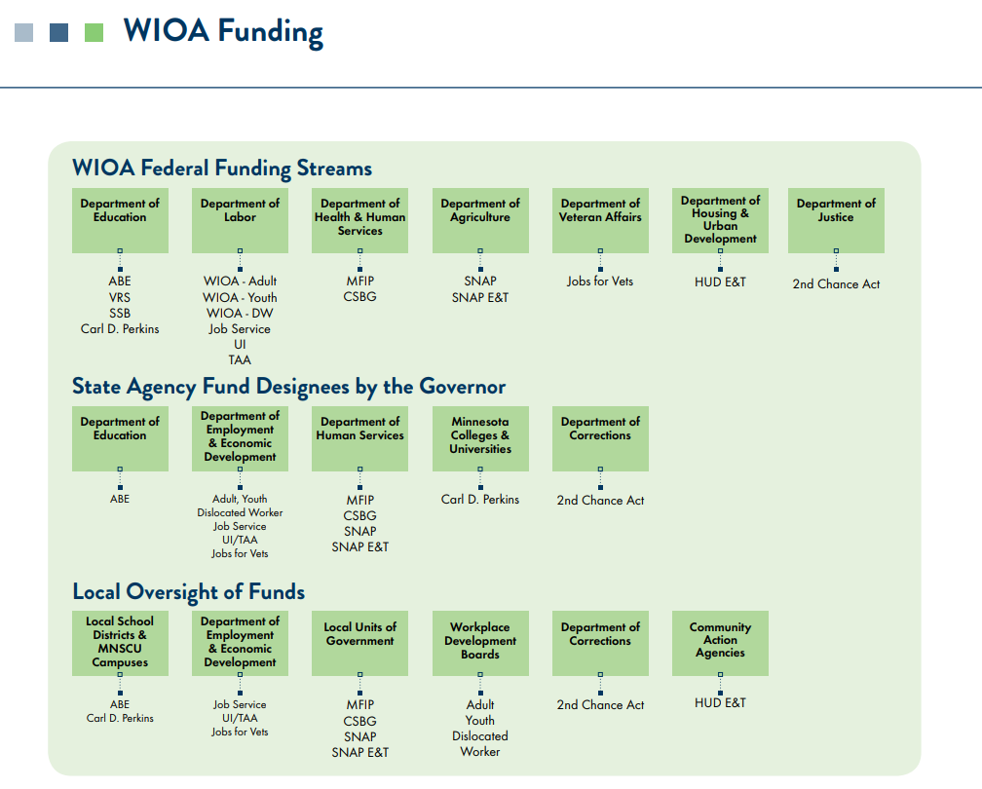
WIOA Required Program Partners

Slide 21
Process and Work to Date (WIOA State Plan 2020-2023)
GWDB Operations Committee
WIOA Report earlier this year.
Guidance for staff during Plan development.
Approved draft state plan (pending necessary updates from staff).
State Program Administrators: face-to-face meetings; ongoing for 2022 revisions
More communication with local boards than previously; input received.
First draft of the State Plan posted January 17; supplemental doc also online now.
Will be posted until GWDB approves.
Info/action needed from US DOL (performance measures – ongoing).
To be submitted at a later date.

Slide 22
Background/Process
MN’s first four-year plan approved in 2016 (GWDB; US DOL)
Mandated two-year revisions approved in 2018.
Added “gender” to our state’s targeted equity goals/focus in 2018.
Staff utilized language from 2018 Revised Plan as guide here.
Authors: at least a dozen folks from across agencies.
Some programs submitted components of other required plans.
Work was coordinated by GWDB and DEED staff.
Needed today to ensure timely State Plan completion:
GWDB approval of strategic elements of the plan.
GWDB authorization for state staff to submit plan to US DOL.

Slide 23
2020-2023 State Plan Vision Statement
Proposed Vision Statement:
Our vision for Minnesota is a healthy economy where every
Minnesotan has meaningful employment and a family-sustaining
wage, and where all employers are able to fill jobs in demand.
Prioritizing Diversity, Inclusion, and Equity across all aspects of the system.
Identifying the ways the system falls short in serving the communities with the most need.
Creating more equitable systems within the workforce development system.
Creating an Age-Friendly State.
Preparing for Future of Work.
Technology-related: Automation, A.I., other advancements impacting the workforce & how/what we train.
The Green Economy: enormous amount of jobs projected within the green energy sector, but also need to look at how this will effect other industries (workers and businesses).

Slide 24
2020-2023 State Plan Mission Statement
Proposed Mission Statement:
To create a Career Pathway System that aligns local, state, and federal resources, policies, and services to meet the workforce needs of business and industry, and improves access to employment, education, and training services for Minnesota’s current and future workforce.
Aligns with WIOA goals/intent.
Emphasis on Career Pathways.
Through a more strategically aligned Career Pathways system other goals can be accomplished.
Like the vision statement: we can help businesses and workers through this mission and work.

Slide 25
2020-2023 State Plan Goals
Proposed State Plan Goals:
Reduce educational, skills training and employment disparities based on race, disability, gender, or disconnected youth.
Build employer-led industry sector partnerships that expand the talent pipeline to be inclusive of race, disability, gender, and age to meet industry demands for a skilled workforce.
Based on 2016 and 2018 goals developed by the GWDB.
“Age” has been added to #2.
Ensuring that older Minnesotans are able to sustain themselves and their families through dignified employment opportunities.
Based on the priorities/intent of WIOA (emphasis on equity for those with barriers and career pathways).

Slide 26
Six Statewide Strategies to Achieving Goals
Business Engagement
Create business-led sector partnerships to guide the development of career pathways in occupations in demand that support family sustaining wages.
More robust and thoughtful services to businesses through this engagement.
Community Engagement
Communities facing greatest disparities.
Service providers.
Customer-Focused Design
Reviewing existing practices & making changes where needed.
Funding and Resource Needs
Mindful assessment of funding as it relates to priorities, goals, and outcomes.
Policy and System Alignment
Ongoing (cross-sectors, cross-agencies).
System Management
Developing tools like the WIOA Dashboard & Report Card for measures.
Ongoing work to assess impacts.

Slide 27
Before we continue:
Any questions about the
strategic elements of the
State Plan, or about the
plan in general?

Slide 28
GWDB Operations Committee
Dive deeper into the State Plan on behalf of the full GWDB.
Special meeting in January: State Plan walkthrough of all pieces.
February meeting: updates on State Plan, public comments.
Motion regarding the State Plan was approved via electronic vote.
Motion now needs to be addressed by full GWDB today.
If authorized by GWDB vote today, GWDB staff will facilitate the submission of the State Plan to U.S. DOL tomorrow.

Slide 29
State Plan Voting Process for Today
GWDB Voting Members not being asked to approve the plan in its entirety, just the strategic elements guiding the work.
GWDB Non-Voting Members: Input valued here.
Vote: Roll call vote of voting members.
Designees of a voting member from the same organization/entity may place a vote on behalf of who they are representing when their name is called.
If this is you: state your name + “voting on behalf of ____” + “vote is yea/nay”.
Quorum: simple majority of voting members or designees, excluding any vacancies.
23 of 45 voting members.

Slide 30
GWDB State Plan Vote
GWDB Operations Committee Chair:
Mayor Elizabeth Kautz, City of Burnsville
Motion for Consideration from the Operations Committee:
Approve the strategic elements of the draft WIOA State Plan for federal program years 2020-2023.
Authorize GWDB staff to submit the WIOA State Plan to the U.S. Department of Labor on behalf of Governor Walz and the GWDB.

