Slide 1


Julio Caesar, Ph.D.
Raymond Robertson, Ph.D.
David J. Heistad, Ph.D.
Superintendent Les Fujitake
April 28, 2021

Slide 2

Purpose
How can we use an information system to rigorously evaluate K–12 workforce programs to generate the highest impact results?

Slide 3
Why does MN K-12/higher education workforce development system need improvement?

Slide 4
2016 Minnesota Ninth Graders >> 2019 Seniors
84% Graduated
16% Did not Graduate
Source = Mn Dept. of Ed Report Card and the State Longitudinal Data System; Total n = 68,314; Graduated n = 57,171

Slide 5
Is the Minnesota Graduation Rate Improving?

Slide 6
Minnesota Annual 4-Year Graduation Rate
Source = Mn Dept. of Ed

Slide 7
What is the trend for Minnesota HS graduates going to college (2- or 4-year)?

Slide 8
Minnesota Grads Enrolling in College
Note. * n represents the number of students enrolling in college. Source: State Longitudinal Data System

Slide 9
Most recent data available
How are Minnesota 2017 non-college-going high school graduates doing?

Slide 10
Concern – Earnings

Slide 11
Why Workforce Development is important for Minnesota’s future?

Slide 12

Research Literature
Only 16 percent of children who grow up in poverty manage to become economically successful adults.
Intergenerational Poverty
Lack of skilled workers is one of the biggest threats to the economy.
Source. https://www.vic.gov.au/ndis-workforce-longitudinal-research-study-year-one
McKinsey Global Institute report

Slide 13
Report on our progress developing a K-12/higher education
Workforce Development Information System
(WDIS)

Slide 14

The WDIS will be designed to provide data to help continuously improve the K-12/Higher Education workforce development system

Slide 15






Our WDIS is a Unique Differentiating Asset for MN
Research Agreements to share data

Slide 16
Research agreements needed to access data to longitudinally track a student’s progress to career and/or college
Also known as “Pathways”

Slide 17
Longitudinally Study of Pathways
Postsecondary Education
Middle School
High School Graduates
Work

Slide 18
WDIS is built and continuously being improved.
How is this WDIS being used to improve our
K-12/higher education workforce development system?

Slide 19

Bloomington Career & College Academy
Watch: BCCA in Action

Slide 20
Pathway Research Findings

Slide 21
Longitudinal Study of Programs

Slide 22
Longitudinal Study of Programs

Slide 23
Longitudinal Study of Programs

Slide 24
Return on Investment Research
RESEARCH QUESTION:
How do we calculate the ROI for these different workforce development programs?

Slide 25
ROI Empirical Approach
Second Outcome:
Degree and Labor Market Measures
First Outcome: Choice
Degree
Baseline Data
Postsecondary Education
Labor Market Measures
High School Graduates
Income Level
Job Stability
Wage Growth
Industry of Empl.
Work
Labor Market Measures

Slide 26
Based on Current Population Survey Data (U.S. Census Bureau)
Wage Estimates
Conditional
Weekly
Earnings
Based on
Education
Level

Slide 27
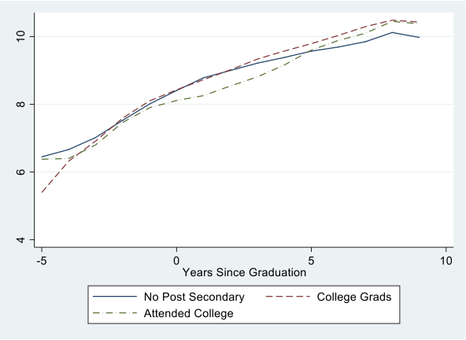
Path to Economic Success
The y-values are the natural log of annual earnings.
The lines show how being in college generates a short-run cost in terms of wages, but a long-run payoff.
Therefore, earnings is one of our three key economic outcome variables.

Slide 28
ROI Preliminary Results
Comparing the earnings for those who go straight into the labor force:
  Statistically insignificant 9% higher wages for BCCA using regression with state-wide observations
  A very significant increase of about 100% using PSM and matching within BPS
Average Treatment Effect (ATE)
  What would happen if more people went into the BCCA
  More than 50% increase in wages (both State and BISD comparison groups)
  Positive college-bound effect (State comparison group only)
Average Treatment Effect on the Treated (ATET)
  What the effect of the BCCA is on those who go into the BCCA
  Slightly smaller but significant wage effects for both comparison groups.
  Slightly larger college-bound effect for state comparison group

Slide 29
Summary / Closing
Every year our Database continues to evolve and grow
We welcome Workforce Development Research Question

Slide 30

End

