Slide 1
WIOA Youth Overview
Kay Tracy & John Olson
Youth Services Team
MN Dept. of Employment & Economic Development
December 11, 2017

Slide 2
Today’s session
Negotiation Process
WIOA Youth Formula Program Allocations: National/State/Local
Federal Funding/Youth Served in Minnesota
Homeless/Runaway Youth Data
Other Populations; Exiter Comparisons
Performance Overview
Questions and Answers

Slide 3
Negotiation Process
DEED issues youth planning instructions in December.
WDAs submit local workplan and local performance goals in April.
DEED negotiates Minnesota state-level performance goals with DOL in May or early June.
When state-level performance is set with DOL, the DEED Youth Team negotiates with each WDA to finalize “local” performance goals.
Notes:
PY 16: WDAs 6, 7, 12, 14 and 16 PY 17: WDAs 7, 9, 12, 16 w/o any ASUs

Slide 4
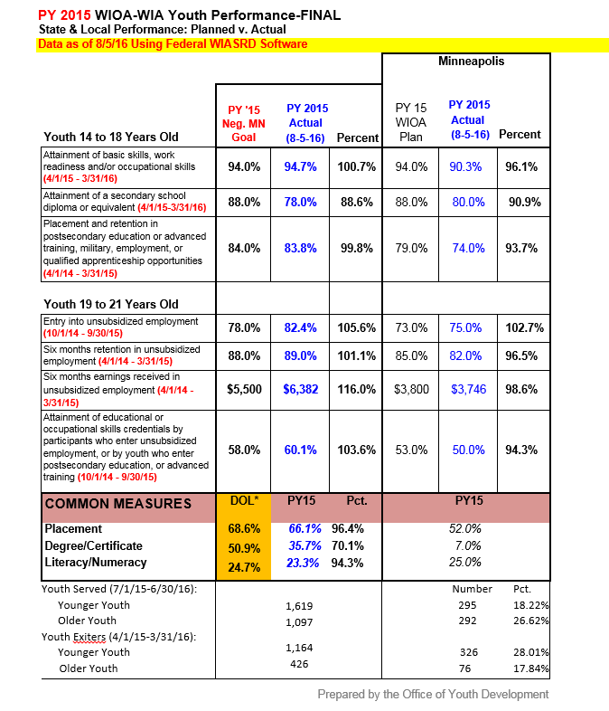
Sample Monthly Report under WIA (to be updated under WIOA)
Source: US Dept. of Labor, WIASRD software
Other Considerations:
Federal reporting is still under development; issues remain with quarterly reports and ability to generate outcomes at WDA level.
MNPerforms software is also still being developed to provide monthly performance updates from Minnesota PIRL files.

Slide 5
Federal Funding/Youth Served in Minnesota: 2007 to 2017
Notes:
WIA funding through 2014. WIOA funding starting in 2015. Does NOT include any ARRA Youth funds from 2009.

Slide 6
Comparison of PY10 to PY17 WIA/WIOA Youth Allocations by WDA

Slide 7
Statutory WIOA Youth Allocation Formula
1/3 of allocation is based on the WDA’s relative share of the number of unemployed in areas with an unemployment rate of 6.5% or higher.
1/3 is based on the WDA’s relative share of the number of unemployed in excess of 4.5% of the civilian labor force (in the WDA or in the areas of substantial unemployment within the WDA—whichever is higher).
1/3 is based on the WDA’s relative share of the number of youth between the ages of 16 and 21 whose income or family income is at or below poverty or below 70 percent of the lower living standard income level. CEPs have a statutory and slightly different—and more flexible—definition.
Notes:
WIOA Law 128(b)(2)(A)(i)

Slide 8
Long-Term Factors Influencing State/WDA-Level WIOA Allocations in Minnesota
The current statutory formulas used for WIOA Youth allocations date back to the Job Training Partnership Act of 1982 (JTPA) and were also used under the Workforce Investment Act of 1998 (WIA).
In 1982, Minnesota’s average annual unemployment rate was 7.9%; 2016 was 3.9%
JTPA and WIA served youth between 14-21; WIOA is expanded to ages 14-24 at time of enrollment. Yet allocations only based on economically disadvantaged youth ages 16-21.

Slide 9
Recent Factors Influencing State/WDA-Level WIOA Allocations in Minnesota
In PY 2016, five of 16 WDAs had ZERO Areas of Substantial Unemployment (ASUs) for the first time EVER.
For PY 2017, four WDAs had zero ASUs.
In PY 2017, DOL removed the 130 percent ceiling on the share of funds any WDA could receive.
The 90 percent limiter remains in place.
Notes:
PY 16: WDAs 6, 7, 12, 14 and 16 PY 17: WDAs 7, 9, 12, 16 w/o any ASUs

Slide 10
Homeless/Runaway Criteria
A participant meets the homeless criteria if the participant, at program entry:
(a) Lacks a fixed, regular, and adequate nighttime residence; this includes a participant who:
(i) is sharing the housing of other persons due to loss of housing, economic hardship, or a similar reason;
(ii) is living in a motel, hotel, trailer park, or campground due to a lack of alternative adequate accommodations;
(iii) is living in an emergency or transitional shelter;
(iv) is abandoned in a hospital; or
(v) is awaiting foster care placement;
Notes:
Participant Individual Record Layout (PIRL) item 800/Also WIOA section 681.210 (c) (5) and 681.220 (d)(4)

Slide 11
Homeless/Runaway Criteria (cont.)
A participant meets the homeless criteria if the participant, at program entry:
(b) Has a primary nighttime residence that is a public or private place not designed for or ordinarily used as a regular sleeping accommodation for human beings, such as a car, park, abandoned building, bus or train station, airport, or camping ground;
(c) Is a migratory child who in the preceding 36 months was required to move from one school district to another due to changes in the parent’s or parent’s spouse’s seasonal employment in agriculture, dairy, or fishing work; or
(d) Is under 18 years of age and absents himself or herself from home or place of legal residence without the permission of his or her family (i.e., runaway youth).
Notes:
Participant Individual Record Layout (PIRL) item 800/Also WIOA section 681.210 (c) (5) and 681.220 (d)(4)

Slide 12
Homeless and/or Runaway at Time of Enrollment as Pct. Of Total Served by WDA

Slide 13
WIA Youth Performance: PY 2013 to 2015
All Youth |  |  | PY 2013 |  |  |  | PY 2014 |  |  |  | PY 2015
 |  |  |  | Percent of |  |  |  | Percent of |  |  |  | Percent of
Younger Youth |  | National | Minnesota | Nat. Avg. |  | National | Minnesota | Nat. Avg. |  | National | Minnesota | Nat. Avg.
Skill Attainment Rate |  | 82.0% | 95.4% | 116.3% |  | 77.1% | 97.3% | 126.2% |  | 78.4% | 94.7% | 120.8%
Diploma or Equivalent Rate |  | 73.6% | 88.4% | 120.1% |  | 71.8% | 87.4% | 121.7% |  | 69.6% | 78.0% | 112.1%
Retention Rate |  | 64.9% | 91.7% | 141.3% |  | 65.7% | 81.7% | 124.4% |  | 66.6% | 83.8% | 125.8%
Older Youth |  | National | Minnesota |  |  | National | Minnesota |  |  | National | Minnesota
Entered Employment Rate |  | 68.2% | 83.0% | 121.7% |  | 71.1% | 88.1% | 123.9% |  | 71.7% | 82.4% | 114.9%
Employment Retention Rate |  | 82.6% | 91.2% | 110.4% |  | 83.0% | 89.9% | 108.3% |  | 85.5% | 89.0% | 104.1%
Earnings Change in Six Months |  | $4,485 | $5,786 | 129.0% |  | $4,455 | $5,310 | 119.2% |  | $4,820 | $6,382 | 132.4%
Employment & Credential Rate |  | 39.3% | 58.3% | 148.3% |  | 38.1% | 68.5% | 179.8% |  | 38.6% | 60.1% | 155.7%
Homeless/Runaway Youth |  |  | PY 2013 |  |  |  | PY 2014 |  |  |  | PY 2015
 |  |  |  | Percent of |  |  |  | Percent of |  |  |  | Percent of
WIA Younger Youth |  | National | Minnesota | Nat. Avg. |  | National | Minnesota | Nat. Avg. |  | National | Minnesota | Nat. Avg.
Skill Attainment Rate |  | 78.0% | 92.9% | 119.1% |  | 74.0% | 91.7% | 123.9% |  | 72.7% | 89.7% | 123.4%
Diploma or Equivalent Rate |  | 60.9% | 91.2% | 149.8% |  | 58.6% | 84.2% | 143.7% |  | 53.8% | 63.0% | 117.1%
Retention Rate |  | 59.6% | 96.4% | 161.7% |  | 65.7% | 71.7% | 109.1% |  | 66.0% | 88.0% | 133.3%
WIA Older Youth |  | National | Minnesota |  |  | National | Minnesota |  |  | National | Minnesota
Entered Employment Rate |  | 63.7% | 76.4% | 119.9% |  | 69.8% | 90.5% | 129.7% |  | 67.6% | 80.4% | 118.9%
Employment Retention Rate |  | 78.6% | 96.9% | 123.3% |  | 79.6% | 82.5% | 103.6% |  | 81.9% | 86.0% | 105.0%
Earnings Change in Six Months |  | $3,832 | $4,835 | 126.2% |  | $3,816 | $4,758 | 124.7% |  | $4,334 | $3,889 | 89.7%
Employment & Credential Rate |  | 31.6% | 45.0% | 142.4% |  | 30.9% | 72.0% | 233.0% |  | 33.6% | 59.7% | 177.7%

Slide 14
Questions?
Kay.Tracy@state.mn.us
651-259-7555
John.R.Olson@state.mn.us
651-259-7547

