Slide 1
The Minnesota Youthbuild Program
Costs and Benefits to the
State of Minnesota
Nancy Waisanen, Youthbuild Coordinator
February 5, 2011

Slide 2
Roadmap
Background
Model Design
Outcomes
Benefits
Costs
Calculating Return on Investment (ROI) using direct benefits and costs to the State

Slide 3
Background: Minnesota Youthbuild
The Minnesota Youthbuild Program:
Helps at-risk youth complete their high school education;
Provides construction training
work readiness, and leadership development training;
Transitions youth into employment and/or post- secondary enrollment.

Slide 4
Background: The ROI Study
The ROI estimates for Minnesota Youthbuild were part of a one-time study commissioned by the Minnesota Youthbuild Coalition.
The model estimates ROI from the perspective of the State of Minnesota over a two year period.
The study lacks a comparison group, but net impacts are estimated using research literature to surmise the characteristics of a theoretical comparison group.

Slide 5
Model Design: the Cohort
The treatment cohort was defined as the new group of participants enrolled for an average of twelve months at the beginning of the yearly program cycle (July 2001 to June 2002).
This group consisted of 398 youth (ages 16-24): - 90% had dropped out of high school
- 66% were youth offenders - 75% were on public assistance
- 55% had chemical abuse or use issues
- 33% had disabilities
- 23% had experienced homelessness
- 20% were pregnant or were teen parents

Slide 6
Model Design: Data Collection
Program participants were tracked for up to four years after enrollment in the program.
Data were collected 6, 12, and 24 months after exit: - Rates of unsubsidized employment - Hourly wages - Job Title - Enrollment in post-secondary institutions
Re-arrest, re-conviction, and return rates to prison were collected for participants with one or more offenses prior to enrollment

Slide 7
Outcomes
Data collection revealed the following participant outcomes on which the ROI estimate was based:
91% of participants successfully completed high school or obtained a GED
39% of participants entered post-secondary education
80% of participants entered unsubsidized employment, at an average wage of $11.60/hour
5% of participants with one or more offenses prior to enrollment were re-arrested and/or re-convicted within two years after enrollment in the program.

Slide 8
Benefits: (Net) Increase in Wages
Program data shows that Youthbuild graduates find unsubsidized, full-time employment paying an initial wage of $11.60.
In addition, fringe benefits of approximately 25% of wages have also been obtained by most Youthbuild graduates.
The model assumes that, in the absence of training, Youthbuild participants would have been employed at minimum wage ($5.15) with no fringe benefits. This is based upon the research literature, including similar assumptions made by the State Demographers’ Office in “Measuring the Benefits of Twin Cities Rise” (1995).
Thus, a Youthbuild graduate nets $6.45 more per hour than a similar non-participant.

Slide 9
Benefits: Increased State Tax Revenues
Increased state tax revenues (for income, sales, and excise taxes) are determined using the net increase in wages and the findings of the 2001 Minnesota Tax Incidence Study by the MN Department of Revenue:
Doing the math, this translates into $1,571-$463 = $1,108 in additional taxes for each Youthbuild graduate*. This translates into a statewide increase of $352,605 in taxes collected. *This accounts for the 80% of participants (318 of 398) who found work. The assumption is that the same proportion of individuals would have found work without participation in Youthbuild, but at a lower wage.

Slide 10
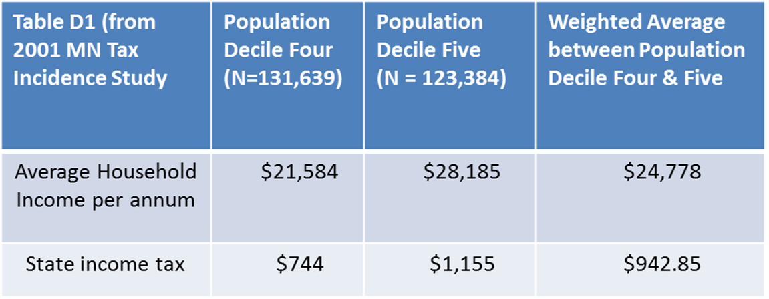
Example: Calculating MN Income Tax Burden
Households without Dependents

Slide 11
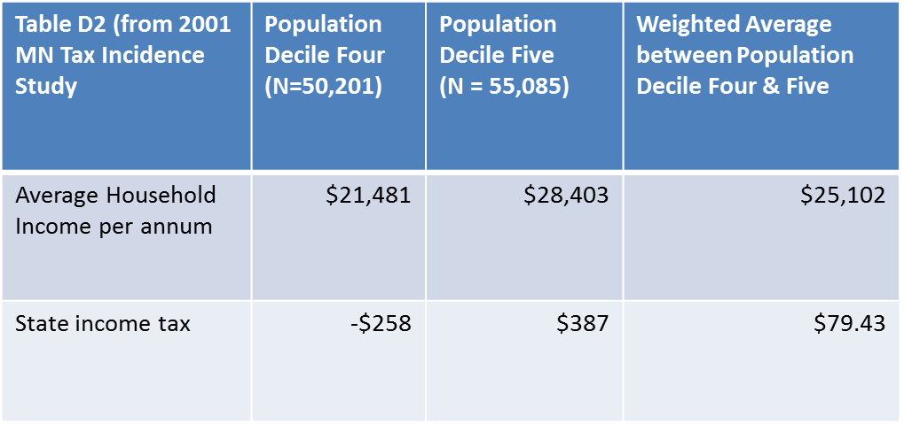
Example: Calculating MN Income Tax Burden continued
Households with Dependents

Slide 12
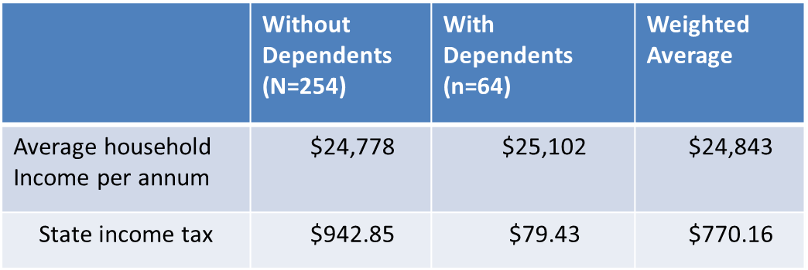
Example: Calculating MN Income Tax Burden continued.
For Average
Youthbuild
Participant
(254 x $942.85) + (64 x $79.43) = $770.16
318

Slide 13
Benefits: Incarceration Avoidance
The model estimates outcomes only for individuals who have previously been arrested, convicted, or imprisoned.
Sixty-six percent (263) of Youthbuild PY 2002 participants had a prior criminal record. Of these, 5.3% (14) were re-arrested, reconvicted, or imprisoned within two years of their enrollment in Youthbuild.

Slide 14
Benefits: Incarceration Avoidance cont’d
The two year recidivism rate for a similar cohort is 27%, according MN Department of Corrections 2001 report. In a cohort of 263, this would translate to 71 individuals:

Slide 15
Benefits: Incarceration Avoidance (Cont’d.)
In 2001, the average cost per adult inmate per year was $31,485.
The median prison sentence for adult offenders in 1994 was 30 months. Furthermore, in Minnesota nearly all imprisoned offenders are required by law to serve at least two-thirds of their sentence. Thus it is assumed that the average prison sentence is 20 months.
Thus, it is estimated the State saved roughly $3 million for the PY 2002 cohort.

Slide 16
Benefits: Notable Exclusions
Economic Multiplier
Increased Employee Productivity
Increased Federal Tax Revenues
Reduced Probation, and Parole Costs
Decreased Public Assistance Costs
The benefits of affordable housing built by participants

Slide 17
Costs: Investment by Minnesota Taxpayers
In 2002, the state’s total cost of operating and administering Youthbuild for its 398 participants was $877,000.

Slide 18
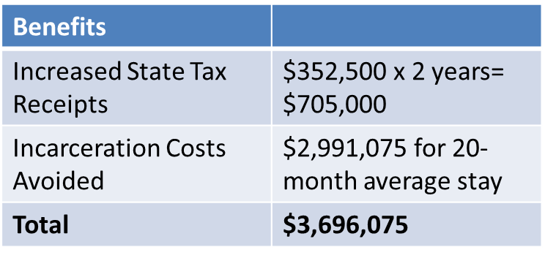
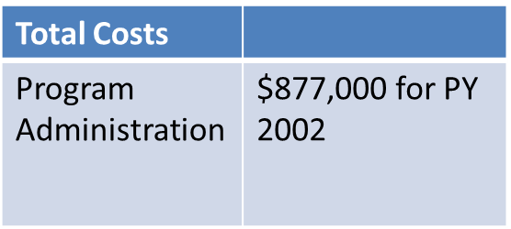
Calculating Return on Investment (ROI)
No discount is used; where necessary, a subtotal is scaled
Thus, the two year ROI equals: 3.2 where ROI = (benefits-cost)/cost

