Slide 1
TANF Youth Innovation Projects – Strategies for Operating During COVID-19 Emergency
DEED Office of Youth Development
November 9, 2020

Slide 2
TANF Youth Innovation Project Background
Funded by an Interagency Agreement between Minnesota Departments of Human Services (DHS) and Employment and Economic Development (DEED) using TANF funds
Partnership between DEED, DHS, and Minnesota Association of Workforce Boards (MAWB)
Project began in 2009 with a focus on teen parents and goal to improve long-term employment and educational outcomes and work participation rates

Slide 3
Current Project
Eligible participants:
  Teen parents, ages 16-24, who receive cash benefits under MFIP
  Youth, ages 14-18, who are on the cash grant in MFIP household
Served 151 youth in 2019 (40% teen parents, 60% youth in MFIP household)
Served 90 youth so far in 2020 (54% teen parents, 46% youth in MFIP household)
Allocation $300,000 per year
Period of project: March – December 31

Slide 4
Activities
Career counseling/labor market information
Work readiness training
Work experience (uses employer pre- and post-assessment of work readiness skills on the work site)
Introduction to career pathways
Preparation for post-secondary education and long-term employment opportunities
Financial literacy training

Slide 5
Objectives of Today’s Webinar
Learn more about TANF Youth Innovation Project design in three local Workforce Development Areas
Identify challenges faced as a result of the COVID-19 pandemic
Share creative ideas to keep youth engaged and building skills and experience during the COVID-19 pandemic
Identify opportunities presented by the COVID-19 pandemic to improve service delivery

Slide 6
Today’s Presenters
Linda DeHaven, MFIP Program Manager, Minneapolis Employment and Training
Bridgett Backman, Employment Services Manager, Anoka County Job Training Center
Heather Gleason, Assistant Director, South Central Workforce Council

Slide 7

Minneapolis Employment and Training
Linda DeHaven| MFIP Program Manager
Linda.DeHaven@minneapolismn.gov

Slide 8
Pre-Pandemic Program Design
Step Up Youth in MFIP households ages 14-18
  Internships and work readiness training
MFIP Teen Parent ages 16-24
  Internships in health care and other pathways

Slide 9
Changes Due to the Pandemic
Focused on MFIP Teen Parents – did not serve Step Up youth
Internships were done in-person using staggered scheduling, social distancing and full PPE
Fewer internships as students were concerned with exposure to virus for themselves, their children and other family members
Students were more comfortable with online training options as opposed to in-person jobs
Therefore, we increased the amount of training opportunities

Slide 10
Training and Digital Services
Offered online career exploration, GED Prep and Accuplacer prep/testing
Driver education to prepare for delivery jobs
Health Care Training
  6 youth in Certified Nursing Assistant (CNA) online training, in-person clinical and assistance with board certification
  11 youth in Basic Life Support (BLS) Training through Minneapolis College – online training and certification

Slide 11
New Opportunity
HCMC’s Hospital Equity and Inclusion Department brought forward a unique pilot model
Pilot to create a cadre of Healthcare Ambassadors - starting as a response to the pandemic but could continue post COVID-19
This internship would be focused on young women of color who have a career interest in healthcare or human services
The interns would receive the same type of online training that the hospital staff receive
The Ambassadors would begin this year by doing telephonic outreach to see if people have questions about COVID-19 and deliver information as well as tangible support such as burner phones, food, face masks and hand sanitizer

Slide 12
Challenges of Implementing New Opportunity
Time frame was too short - hospital leadership was concerned that starting late summer and ending December 31 wouldn’t allow for full experience
Some potential youth were ineligible for MFIP because of receiving Unemployment Insurance benefits
Again, concerns about transportation and child care exposing participant and child to virus.
2 participants had children in child care centers that experienced a COVID outbreak – had to drop internship and quarantine for 2 weeks
We are hoping that this pilot can be used in our 2021 program

Slide 13

Anoka County Job Training Center
Bridgett Backman| Employment Services Manager
Bridgett.Backman@co.anoka.mn.us

Slide 14
Pre-Pandemic Program
TANF Youth Innovation Program model pre-pandemic:
place eligible youth between 14-16 yrs. old, mostly in the summer months*, in work experience placements that fit their interests, locations and or geographic considerations such as transportation and then worked to fill openings at existing or new job sites.
Typically, we had no problems spending out our awarded funds and frequently requested additional funds if they became available.
* Some youth worked into the school year.

Slide 15
Changes/Adaptations
Early on, we knew we were going to need to rethink almost all of our traditional approaches from outreach, to safety, to site options, etc.
We pulled together a group of youth providers and hosted two Web Ex meetings, first to get a pulse of what other programs were planning and a second meeting a month or so later to see what programs actually did and what they learned.
We explored the Earn & Learn Models from other local areas and decided to shift to planning for that option later in the summer.

Slide 16
Earn & Learn Model
Using a stipend model
Earn up to $50/week or $100 per pay period, max program earnings of $500 (additional weeks/earnings needs to be cleared with counselor first)
Access to Coursera was promoted; but also allowed other learning options such as classes offered by the YMCA, YIPA, and others.
Typically – if they are doing non-school required learning in the amount of 5 hrs. per week, they can earn the stipend – if they report into their counselors (that are acting as worksite supervisors in this model) with a call or email relaying what they focused on/learned that week. This is case noted.

Slide 17
How the Plan Was Accomplished
Created an internal plan.
Sought approval from our finance team.
Created a new tracking system to interface for payroll/payments.
Options: Built the plan to be flexible in design so we can adjust as needed. Some youth were in work experience and may finish or shift to EARN Model, other will only do the EARN model and others may start with EARN and then shift to a regular work experience or do both simultaneously.
Curated a list of possible of courses in Coursera as it was a time aligned resource.
Started to promote and build enrollments.

Slide 18
How the Plan Was Accomplished, cont.
Tracked as Work Readiness activity.
Anoka uses a sub type code in WF1 to track.
Anoka uses a local program in Workforce One Correspondence (data base driven structure) but you could use a spreadsheet (Excel style) to generate obligations in advance so accounting knows a payment will be coming due/payroll in process substitute.
Have asked for guidance (from DEED) on Coursera and possible MSG’s/credentials on the Adult side of programming.
Plan to evaluate and gather client feedback in an e-survey.

Slide 19
Noteworthy….
Time intensive for finance
Time intensive for counselors
Can be a hard sell to clients (ISY) while taking classes online already
Can be a good option for youth with transportation issues or health issues
Creating a flyer vs. emails (text heavy with details) is a better option
Starting conversations with the youth early and often about this option as it can be a start and stop option (but we encourage them to complete a week at a time)

Slide 20
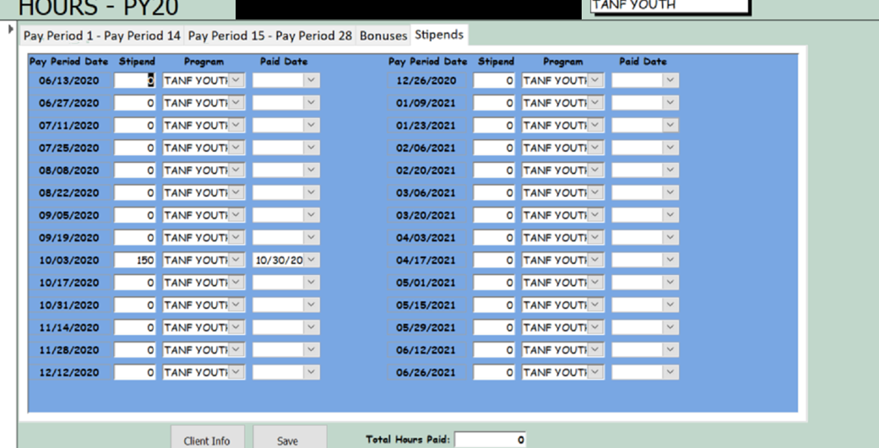
Screen Shot of Internal Tracking

Slide 21
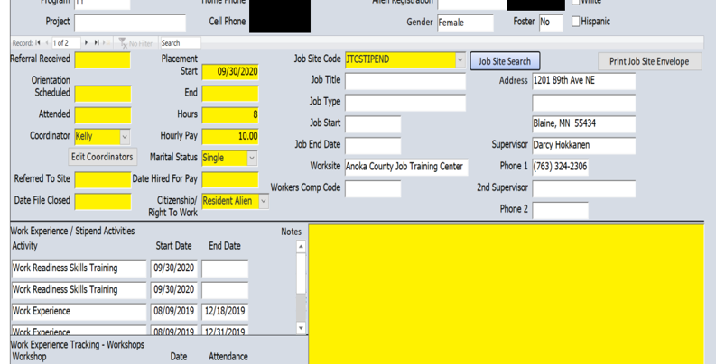
Screen Shot of Internal Tracking

Slide 22
Results and Next Steps
We enrolled fewer people and spent less per person than originally anticipated from the original grant application but are optimistic that some youth will find good benefits in this new flexible model for their individual needs, interests and future career planning.
We expected a slower year this year but hope next year to use what we build to offer another option for our participating youth that impacts them and their families in many positive ways.

Slide 23
Resources
Coursera List curated by Anoka staff (can send out after webinar)
Financial Literacy resources – live on Anoka website under Empowers:
https://www.anokacounty.us/3956/Money-Matters-Spending-Saving-Tips
Updated Handbooks, samples of our handbooks include:
  Job Search for Youth
  Youth Work Experience*
  Worksite Supervisor
*Includes a COVID section

Slide 24

South Central Workforce Council
Heather Gleason| Assistant Director
hgleason@workforcecouncil.org

Slide 25
South Central TANF Program
9 Counties of South Central MN
MN Valley Action Council - Youth Services Provider
$32,000 TANF Youth Funds
Served 15 youth so far

Slide 26
South Central Pre-Pandemic
Recruitment: MFIP Providers
  5 of 9 counties MVAC is the youth provider and MFIP ES provider
  Strong partnerships with MFIP providers
Services:
  Career Counseling
  Work Readiness
  Work Experience – 12 weeks/200 hours
  Training
  Support Services

Slide 27
Adjustments and Opportunities from Pandemic
Recruitment – Decreased customer traffic in MFIP
    Energy Assistance
    AGAIN Thrift Stores
    Food Shelves
    School Newsletters – Career Corner, Peach Jar
    CareerForce Partners

Slide 28
Adjustments and Opportunities from Pandemic
  Virtual Recruitment
    School Counselors Community of Practice
    Work Based Learning Coordinator Community of Practice
    County Networking Meetings
    Homeless Prevention Response Teams
    Virtual Classrooms
    Social Media

Slide 29
Adjustments and Opportunities from Pandemic
Soft Hand Off Referrals
  Joint virtual meeting with youth/parent, youth counselor and referring organization
Work Experiences – Creative positions!
  Outdoors – agriculture, groundskeeping
  Increased demand - food shelves, retail
  Remote work – scanning paperwork, assembling packets
Support Services
  MVAC provided transportation to worksites with agency vehicles that were not in use during shutdown

Slide 30
Virtual Services – Skills for Success
Skills for Success Videos - Featuring four local employers in healthcare, manufacturing, agriculture and construction
  Employment Skills
  Interviewing
  Maintaining Employment
Teaser video will be distributed to schools soon!

Slide 31
Virtual Services – “Get Started”
Best Practices from the City of Minneapolis, City of St. Paul and Anoka County – Thank you for sharing your great models!
“Get Started” Program
  4 weeks @ 5 hours per week
  1 hour per week with youth counselor
  Earn $50 stipend for successfully completing weekly activities
  Implementation January 2021
In the past, youth attended two workshops equaling 8 hours of work preparation. “Get Started” = 20 hrs of work readiness instruction

Slide 32
Questions?

Slide 33
Thank You!
Lynn Douma, Program Coordinator
Lynn.Douma@state.mn.us
651-259-7536
https://mn.gov/deed/programs-services/office-youth-development/special/tanf/

