Slide 1
Energy Transition Advisory Committee
City of Granite Falls & Virtual - August 30, 2022
Impacted Community- Coal Plant

Slide 2
Organization
Call to order
Roll call

Slide 3
Agenda

Slide 4
Welcome by Granite Falls Mayor Dave Smiglewski
Population
Impacts
City Planning for the Power Plant transition
Words of Wisdom
Notes:
Mayor Dave Smiglewski

Slide 5
Presentation Coalition of Utility Cities
Shane Zahrt, Senior Attorney/Lobbyist,
Flaherty & Hood, P.A.

Slide 6
Presentation to the Energy Transition Advisory Committee
Shane Zahrt, Flaherty & Hood, P.A.
August 30, 2022

Slide 7
More about CUC
Presentation agenda:
CUC history—Who and what is CUC, anyway?
CUC priorities over time
Power plant retirement and community transition work
Ongoing work and priorities

Slide 8
But first, what is a “utility city”
The Coalition of Utility Cities is a group of 8 cities that host large, baseload power plants owned by investor-owned utilities
5 Xcel, 2 Minnesota Power
Together, they host 4 coal plants, 2 nuclear, 1 natural gas

Slide 9
CUC Member Cities
Becker
Cohasset
Granite Falls
Hoyt Lakes
Monticello
Oak Park Heights
Red Wing

Slide 10
About CUC
Formed in 1997
Cities formed the Coalition to have their interests represented at the legislature
Historically focused on taxation
Cities collectively represent nearly 50,000 residents

Slide 11
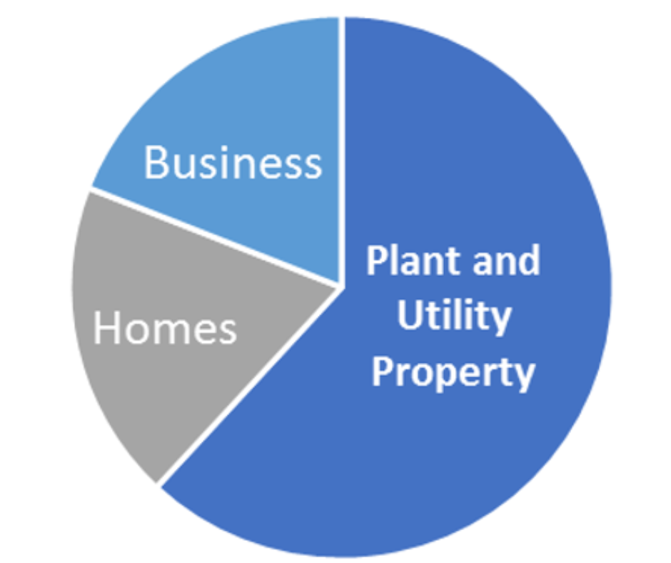
Why does CUC exist?
Host Community Tax Base Includes:
Utility property is often the largest share

Slide 12
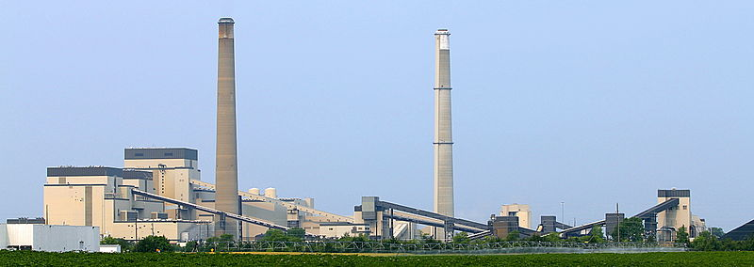
How CUC came to transition work
CUC was not formed to address power plant closures, but found itself naturally positioned to do so
Xcel 2015 IRP was a key turning point (proposed the early retirement of Sherco units 1 and 2)
“We don’t know the answers, and sometimes we don’t even know the questions.”

Slide 13
Timeline of CUC transition work
2017-18: Community-led efforts to understand the coming transition. This work led to the CEE-authored impact study published in 2020.
2019-20: Formulated Community Energy Transition Grant legislation and introduced to legislature in 2019. Legislation passed in May, 2020.
2020-21: Developed Energy Transition Office legislation and introduced in March, 2021. Legislation passed in June, 2021.
2022: Formulated and introduced tax base transition aid bill and upgrades/additional funding for CET grants. Both programs were included in final omnibus bills that the legislature failed to adopt.
Today: Actively engaged in ETAC/transition work as well as issues that impact ongoing plant operations.

Slide 14
CUC transition work
But the CUC’s big picture efforts are only part of the story.
In the meantime, every host community in the state has been working tirelessly to prepare and/or cope with the impact of impending retirements.
Each of these communities has a story and a massive task in front of it. CUC’s role is to push for the tools to help make their goals a reality.

Slide 15
CUC goals for ETAC and transition plan
Address gaps in the state’s ability to support communities and workers
Gain a seat at the table in power plant closure discussions
Produce actionable recommendations for the legislature and the communities themselves
Position Minnesota to harness federal resources
Continue to identify and address both known and unknown impacts

Slide 16
Discussion of other CUC work/research
The CUC plays an ongoing role in providing insight to member cities on taxes, monitoring legislation, and participating in Public Utilities Commission dockets.
Local leaders continue to lead the way in navigating the transition for their communities.

Slide 17
Questions and Discussion?
Contact information:
Shane Zahrt
SAZahrt@flaherty-hood.com
(651) 295-1123

Slide 18
Presentation DEED
Catalina Valencia
See separate presentation slide deck

Slide 19
ETAC July Minutes
Approval for the July ETAC meeting is requested.
Roll call vote

Slide 20
Energy Transition Advisory Committee Purpose
The Energy Transition Advisory Committee is established to:
Develop a statewide energy transition plan
Advise the governor, the commissioner, and the legislature on transition issues, established transition programs, economic initiatives, and transition policy.

Slide 21
Task Force Presentations
Community Engagement
Workforce
Tax Base/Financial Assistance
Re-use of Assets
Economic Diversification
Other

Slide 22
Community Engagement Task Force
Met on August 8 & 19
Presentations by:
Jennifer Cady, MN Power
Discussed their community communication
They offer Tribal training to their employees and key customers
CEE was a very important partner in the community planning process
Tami Gunderzik – Xcel Energy PIE (Partners in Energy)
Partners in Energy is a program from Xcel Energy that supports the communities we serve by helping them develop and implement these energy plans. Each community has its own unique energy needs and priorities, and Partners in Energy services are tailored to complement each community’s vision.
identify local energy priorities
They assist in implementation and support of the communities PIE plan
Notes:
Michael Child’s Jr.

Slide 23
Community Engagement Task Force, cont.
Plan Recommendation
Previous
Funds for marketing for impacting communities.
New
ETAC to annually review the plan to ensure accuracy with the changing times.
Educate legislators on the Power Plant closures and its impacts. Legislative energy committees (both House and Senate) on a bus tour to an impacted community.
Drone footage of each Power Plant site, being careful of security issues, to show land, surrounding environment and the integration of the plant within the community/region.
Xcel Energy work with each impacted community where they supply electricity to offer PIE.
Frequent communication of Power Plants and communities before, during and after closures with each other and to the public to address concerns and educate.

Slide 24
Economic Diversification Task Force
Met on August 17
Points
No presentations at the meeting
Discussed former presenters, what was learned and what to propose to ETAC for inclusion within the plan
Plan Recommendation:
Previous
Playbooks similar to Pennsylvania for all impacted communities & property owners that have interest. State &/or Federal funding to cover the cost.
New
Dept of Commerce to use socio-economics & externalities in their modeling for their comments during IRP process.
For solar siting, zoning shall be controlled by the local government unit. Frequent communication with the landowner, power company, state agencies and local government regarding the project.
Department of Revenue to create stable valuations of power plants.
Training and skills for impacted workers are important. Training shall be allowed upon the knowledge of the closure, not after closure. (Training and workforce is important to Economic Diversification.)
Updated previous recommendation (added time period) Priority points for impacted communities and counties on state grant programs for a period of years before and after closure to assist the community in their rebuilding efforts.
Funding for Regional Development Commissions to write and assist in grant administration for impacted communities.
Work to create one standardized shovel-ready program.
Notes:
Tamara

Slide 25
Re-Use of Assets Task Force
Met on August 17
Presentation:
Melanie McMahan, City of St. Paul – Redevelopment of Former Ford Plant
Site lacked infrastructure
Site had contamination. Property owner brought land to a residential site standard at their own cost. Clean-up is much more extensive for residential than for industrial. Owner paid for AUAR – City supervised.
Ford plant was not a huge tax base.
Lessons Learned
Work with the community – they had numerous community meetings on a variety of topics
Partnerships are important – property owner, City, non-profits (they covered many of the studies to have the expertise that City Staff lacked.)
Communicate that the City does not own the site – manage expectations
Recognize that public support is needed. Make it clear what funds are being used and why.
City’s can require zoning. Most everything else they cannot without incentivizing.
Of importance
Reiterated how important relationships are for site redevelopment
Redevelopment will take more than 10 + years
Reiterated how every redevelopment project is unique, but has similarities.
Our ETAC plan is straight-forward, yet very complicated – validated our initial deductions
Interested in any of Mc Mahan’s information, please let Carla know
Plan Recommendation: drafting continuing
Notes:
Mayor Mary

Slide 26
Re-Use of Assets Task Force
Met on August 17
Presentation:
Melanie McMahan, City of St. Paul – Redevelopment of Former Ford Plant
Site lacked infrastructure
Site had contamination. Property owner brought land to a residential site standard at their own cost. Clean-up is much more extensive for residential than for industrial. Owner paid for AUAR – City supervised.
Ford plant was not a huge tax base.
Lessons Learned
Work with the community – they had numerous community meetings on a variety of topics
Partnerships are important – property owner, City, non-profits (they covered many of the studies to have the expertise that City Staff lacked.)
Communicate that the City does not own the site – manage expectations
Recognize that public support is needed. Make it clear what funds are being used and why.
City’s can require zoning. Most everything else they cannot without incentivizing.
Of importance
Reiterated how important relationships are for site redevelopment
Redevelopment will take more than 10 + years
Reiterated how every redevelopment project is unique, but has similarities.
Our ETAC plan is straight-forward, yet very complicated – validated our initial deductions
Interested in any of Mc Mahan’s information, please let Carla know
Plan Recommendation: drafting continuing
Notes:
Mayor Mary

Slide 27
Workforce Task Force
Met on August 2
Presentation
Peter Wasberg, Otter Tail Power
Otter Tail started working with Union immediately upon closure decision
Plan included not filling vacant positions, less people on shifts, employees were given an incentive to stay until plant closed. Met monthly.
Before announcement 47 people. 24 at plant closure still worked at plant. All employees were given options to stay with company. 4 retirements, 4 took different jobs elsewhere, remainder transferred within the company.
They had great employees that they wanted to keep.
Vendors were not hugely impacted.
Biggest recommendation to others is communication
Josh Skelton, MN Power
Significant communication within the community and with employees
MN Power had a previous Coal Plant closure at Taconite Harbor.
Today Boswell has 162 employees
90 contractors will be impacted with a Cohasset closure.
The location at Cohasset has $1B in infrastructure. They are planning to have something at the plant – not sure what, just not coal (Boswell 5 – need to train people for that new power production).
Recommendation: drafting continuing
Notes:
Abby

Slide 28
Survey Analysis Team
116J.5493 MINNESOTA ENERGY TRANSITION PLAN.
(b) (2) analyze the estimated fiscal impact of impacted facility retirements on local governments;
School
Spreadsheet – see doc
City, Prairie Island Native American Community & County
Spreadsheet – see doc
Bar Graph – see doc
See documents related to the memo and Data from surveys.

Slide 29
Survey Analysis Team
Stakeholder Survey
Survey deadline extended to September 5th to obtain more comments
Please continue to ask Stakeholders to complete

Slide 30
New location: Schroeder Township

Slide 31
Plan Composition Update
Outline
See separate docs on webpage as it is much easier to read

Slide 32
Plan Composition Update
Community Engagement draft
See separate docs on webpage as it is much easier to read

Slide 33
Plan Composition Update
Economic Diversification draft
See separate docs on webpage as it is much easier to read

Slide 34
Plan Composition Update
Re-Use of Assets draft
See separate docs on webpage as it is much easier to read

Slide 35
Plan Composition Update
Tax Base – Financial Assistance draft
See separate docs on webpage as it is much easier to read

Slide 36
Plan Composition Update
Workforce draft
See separate docs on webpage as it is much easier to read

Slide 37
Plan Composition Update
State Transition Plan 116J.5493 (b) (1) identify the timing and location of impacted facility retirements and projected job losses in communities;
Draft beginning
Notes:
Marshall

Slide 38
Plan Composition Update
State Transition Plan 116J.5493 (b) (2) – analyze the estimated fiscal impact of impacted facility retirements on local governments;
Schools

Slide 39
Plan Composition Update
State Transition Plan 116J.5493 (b) (2) – analyze the estimated fiscal impact of impacted facility retirements on local governments;
Cities, Prairie Island Native American Community and Counties
Draft beginning – still waiting for data from a few locations

Slide 40
Plan Composition Update
State Transition Plan 116J.5493 (b) (3) – describe the statutes and administrative processes that govern how retired utility property impacts a local government tax base;
DEED Attorney Memo

Slide 41
Plan Composition Update
State Transition Plan 116J.5493 (b) (4) review existing state programs that might support impacted communities and impacted workers, and project the effectiveness of each program's response to the effects of impacted facility retirements;
State Departments have submitted information
Currently being analyzed by the 5 Task Forces and the Executive Committee

Slide 42
Plan Composition Update
State Transition Plan 116J.5493 (b) (5) recommend how to effectively respond to the economic effects of impacted facility retirements.
Information is being analyzed.
Anticipate draft recommendations at the September ETAC meeting

Slide 43
Presentation Xcel Energy
John Hunt, Principal Engineer &
Jim Bodensteiner, Principal Environmental Analyst
Xcel Energy
Granite Falls Power Plant Transition

Slide 44
Old Business/Discussion

Slide 45
Public Comment

Slide 46
Next Meeting
September 27, 2022 at 11am
Virtually and at
Cohasset – Location TBA
Future Planning October 25 – Prairie Island

