Slide 1
BRIDGE to Employment
Programs for Minnesota Teens
who are Blind DeafBlind, or Low Vision
State Services for the Blind

Slide 2
Bridge
a connecting, transitional, or intermediate route or phase between two adjacent elements, activities, conditions
Goal of BRIDGE to Employment is to connect students with programs and services that prepare them for college and career success.

Slide 3
Youth Employment
Basic Skills
Role Models
Initiative
Discovery
Goal Setting
Experience

Slide 4
B R I D G E

Slide 5
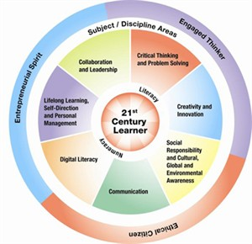
Basic Skills
Non-visual Literacy
Mobility
Access to Technology
Independent Living

Slide 6
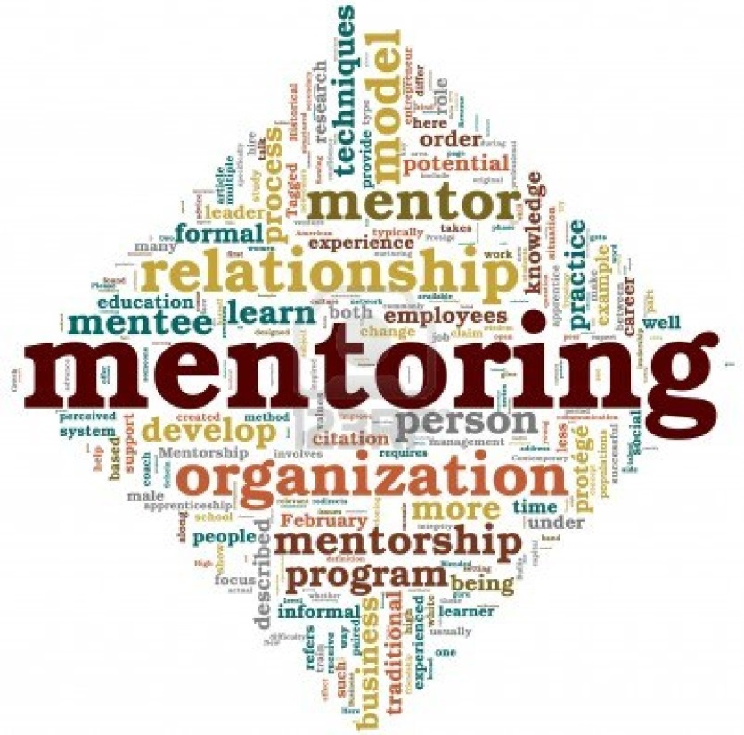
Role Models

Slide 7
Initiative
Taking the First Step
Confidence and Growth Mindset in action
Problem Solving
Peer Connections
Support Seminars

Slide 8
Discovery
Career Exploration
Job Shadowing
Job Fairs
College Visits

Slide 9
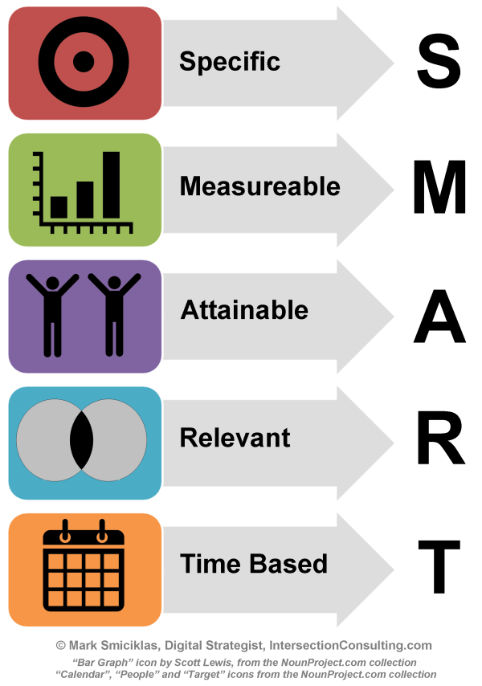
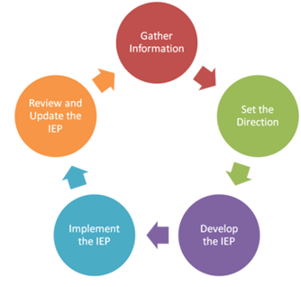
Goal Setting
Active role in IEP Goal setting and planning with SSB counselor

Slide 10
Experiences
Internships
Summer Work
Volunteer/Service Opportunities

Slide 11
SSB offers
Year-Round and Summer Teen Programs
Career Exploration
Mentoring
Paid and volunteer work experience
Technology assessments and resources
Teen Podcasts
Peer Connections
Partnerships with Schools

Slide 12
To Learn More, Contact: Sheila.Koenig@state.mn.us

