Slide 1
Adoption challenges in rural minnesota
Governor’s Broadband Task Force
March 24, 2022

Slide 2
Rural disparities in access
94.2% of the 171,000 unserved households in Minnesota are rural.
93.3% of the 240,000 underserved households in Minnesota are rural.
as of October 2021

Slide 4
MN statewide household broadband ACCESS rate = 87%
Hennepin county 89.0%
Ramsey county 88.5%
(32% of state population)
Counties with highest rates:
Washington county 92.6%
Scott county 92.3%
Carver county 91.9%
Dakota county 91.5%
Anoka county 90.8%
Sherburne county 90.6%

Slide 6
Rural community characteristics:
Compared to urban areas, Minnesota’s rural communities are:
Older
Poorer
Less educated

Slide 7
First leg - devices
70% - access to a device was a moderate or significant barrier to program participation.
80% - both access to the internet and digital literacy skills were moderate or significant barriers to participation.
Digital Equity Community Needs Assessment Report, LiteracyMN Dec 2020

Slide 8
Second leg- internet
Affordability is the biggest barrier for non-users
High monthly fees
Eligibility requirements
Other vital priorities, like rent and food

Slide 9
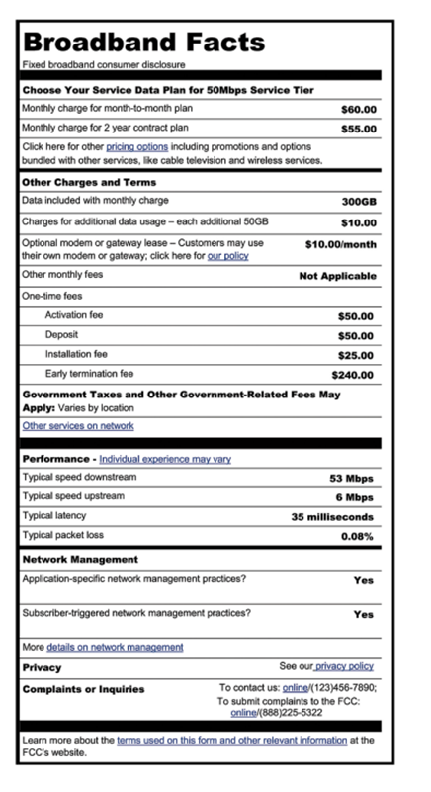

Slide 10
Third leg – skills and supportive services
LiteracyMN
Libraries
Partnership for ConnectedMN
METNs
Local broadband champions

Slide 11
