Slide 1
Introduction to Customized Employment Presented by Vocational Rehabilitation Services
Margie Webb | margie.webb@state.mn.us

Slide 2
What is Customized Employment?
Customized employment (CE) is an interest-based negotiation between the job seeker and employer. CE is a process that allows individuals with disabilities and employers the opportunity to negotiate job tasks and/or reassign job duties to improve overall contribution in the workplace. For employers, customized employment allows an employer to examine its specific workforce needs and fulfill those needs with an employee’s specific skills.

Slide 3
Customized Employment Process
Phase #1 Discovery
Phase #2 Job Development
Phase #3 Employment Supports

Slide 4
Phase 1: CE Discovery
Exploration
Translating information discovered into a Customized Employment Plan
Visual Resume or other type of business marketing materials
Team Collaboration “Town Hall Style” final meeting for Discovery

Slide 5
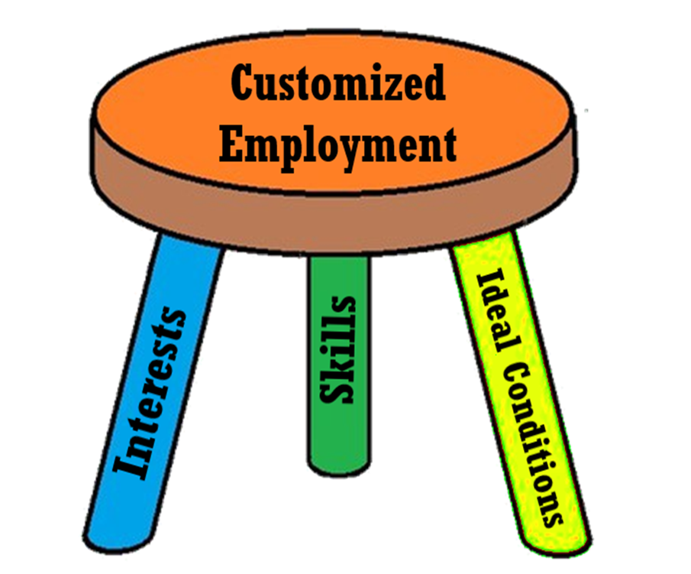
CE Discovery Components
Identify benefit information
Home visit
Interview at least 5 people who know job seeker
Life activities
Summarize all skills, interests, conditions of employment
Theme development and theme testing

Slide 6
Key Components of Visual Resumes
Cover page- portrait photo & name
Skills & attributes page
Quality photos- 10-12 photos of task engagement
Where I am at my best page- ideal conditions
Potential contributions
Conclusion/contact page

Slide 7
Job Development
Placement Plan
Use of Employer Presentation, Visual Resume, Information interviews
Identifying unmet business needs
Customizing tasks, creating task list or job description that didn’t exist

Slide 8
Employment Supports
Job analysis
Use of natural supports
Initial supports
Systematic instruction
Long term supports

Slide 9
Funding CE Discovery and CE Job Development
Discovery services are funded hourly, must be on the current contract with VRS
CE Job Development is funded through PBA
Regular CE PBA
E1MN PBA for those who individuals who are open to waivered services and require intensive employment supports

Slide 10
Billing CE Discovery
Since CE is hourly, can be billed monthly
Monthly invoices should meet standard billing requirements (sample form available upon request)
MN CE plan should be sent with monthly invoices as your detailed description of service delivery
Important to update team & counselor Discovery progress at least monthly

Slide 11
MN CE Practitioner Requirements
Current contract in place containing CE services on contract
Complete a 40-hour ACRE-Association of Community Rehabilitation Education approved training course with an emphasis in CE
Meet VRS Competency Review Standards
Submit ACRE Certificate
Submit a completed Discovery document
Submit visual resume or marketing materials for a job seeker

Slide 12
MN CE Course Information

Slide 13
Foundations for Minnesota CE Curriculum
Essential Elements of Customized Employment for Universal Application as MN CE Curriculum
http://www.leadcenter.org/resources/tool-manual/essential-elements-customized-employment-universal-application

Slide 14
Minnesota CE Trainers
Jolene Juhl, MSOCS
Lindsay Alexander, MSOCS
Margie Webb, VRS

Slide 15
Questions
Margie Webb, Margie.webb@state.mn.us

