Slide 1
Child Labor Standards in Minnesota
Dave Skovholt Outreach Coordinator| Labor Standards

Slide 2
The “Three Paths” of Minnesota Child Labor Standards
Question | Minor <14 Years of Age | Minor <16 Years of Age | Minor <18 Years of Age
Can the Minor Work? | Generally not able to work except by exemption or by permit. | Generally able to work at 14 years of age. | Generally able to work at 14 years of age.
Are There Occupations That the Minor May Not Engage In? | Subject to all hazardous occupations restrictions—unless an exemption is met. | Subject to all hazardous occupations restrictions—unless an exemption is met. | Subject to hazardous occupations restrictions for minors under the age of 18 unless exemption is met.
What Hours Can the Minor Work? | Between 7:00 a.m. – 9:00 p.m. only, maximum of 8 hours in 24-hour period and 40 hours in a week. Employment during school hours requires employment certificate. | Between 7:00 a.m. – 9:00 p.m. only, maximum of 8 hours in 24-hour period and 40 hours in a week. Employment during school hours requires employment certificate. | High school students cannot work after 11:00 p.m. on evening before school day or before 5:00 a.m. on school day, except can work until 11:30 p.m. and at 4:30 a.m. with written parental permission.
Can the Minor Work During School Hours? | If working during school hours, must obtain employment certificate—unless an exemption is met. | If working during school hours, must obtain employment certificate – unless an exemption is met. | No limitation on working during school hours.

Slide 3
Special Concern: The Presence of Liquor
Generally, minors under the age of 18 cannot work in rooms or areas where liquor is consumed or served, or in tasks prohibited by law that involve the sale, service, dispensation, or handling of liquor.
Minors who have reached the age of 16 can be employed:
As a Busser, Dishwasher, and Host in rooms/areas of a restaurant, hotel, motel, or resort where the presence of intoxicating liquor is incidental to food service or preparation;
As a Busser, Dishwasher, Host, or Server in rooms/areas where the presence of 3.2 percent malt liquor is incidental to food service or preparation;
To provide musical entertainment in those rooms/areas where the presence of intoxicating liquor and 3.2 percent malt liquor is incidental to food service or preparation; and
In occupations not prohibited by law in rooms or areas where no liquor is consumed or served.

Slide 4
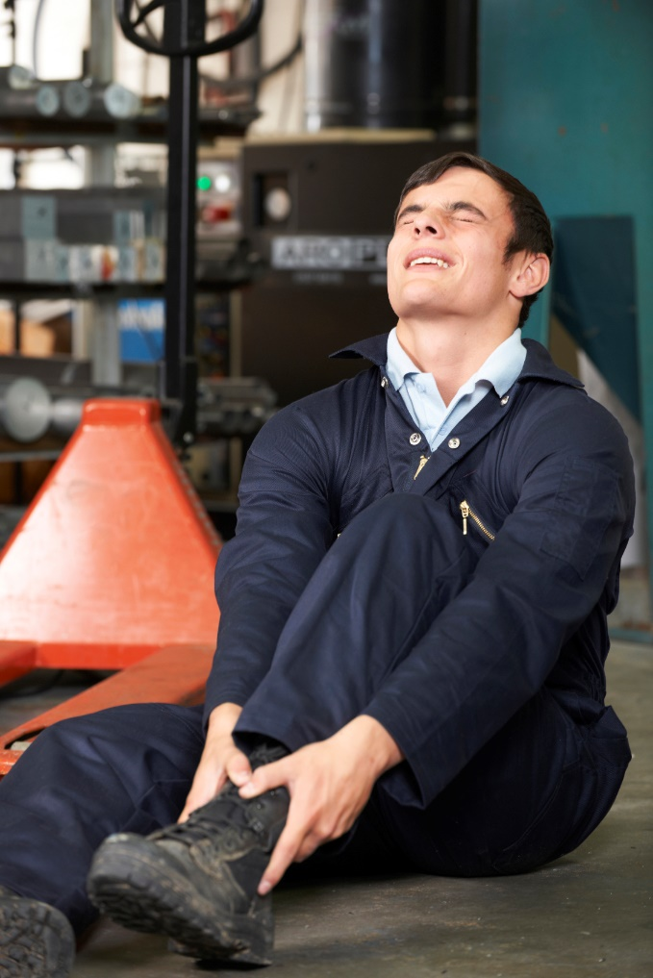
Hazardous Employment Activities
Examples (subject to limitation in the rule or exemption)
Under 18 (Minn. R. 5200.0910):
In or about construction or building projects, logging or lumbering operations, paper mills, sawmills; to operate or assist in the operation of power-driven machinery; to drive certain motor vehicles; or to work in rooms or areas where certain alcohol is served or consumed, or in any tasks involving the serving, dispensing, or handling of alcohol that are consumed on premises.
Under 16 (Minn. R. 5200.0920):
To lift, carry, or personally care for patients in hospitals or nursing homes; to operate or assist in the operation of machinery including farm type tractors and other self-propelled vehicles, snow blowers and other power-driven lawn and garden equipment; in walk-in meat freezers or meat coolers; or in any occupation in agriculture that the U.S. secretary of labor finds to be hazardous for minors under the age of 16.

Slide 5
Hazardous Employment Activities – Statue and Rule-based Exemptions
Approved training programs:
State-approved apprenticeship training program or a training program approved by the Division of Vocational-Technical Education, Minnesota Department of Education
Minors participating in training programs approved by DLI’s commissioner;
Students in a valid apprenticeship program taught or required by a trade union; the commissioners of DLI, MDE, or DEED; the Board of Trustees of MNSCU; or the Board of Regents of the U of MN.
Minors working for a family farm corporation where the minor’s parent is a member of the family farm corporation
Minors working for corporations owned by one or both parents, where the daily corporate business is supervised by the parent(s)
Performer/newspaper carriers/youth athletic referees/home chores/babysitting: 181A.07
Tasks outside the area of hazard
High school graduates who are 17 years of age

Slide 6
DLI Child Labor Exemption Permits
DLI receives applications for child labor exemption permits
Must be filed by the minor’s parent, guardian, school official, or youth employment specialist.
Assessed on a case-by-case basis, granted if the permit would be in the best interest of the minor.
Permits can be sought and may be granted for any of the child labor laws and rules.
Turnaround time varies by season.
Permits are available as fillable PDFs at https://www.dli.mn.gov/business/employment-practices/child-labor-exemptions

Slide 7
State law – Minimum wage
Employer/employee type | Minimum wage rate
Large employer – Any enterprise with annual gross revenues of $500,000 or more | $10.08/hour (2021)
Small employer – Any enterprise with annual gross revenues of less than $500,000 Training wage – May be paid to employees aged 18 and 19 in the first 90 days of employment Youth wage – May be paid to employees aged 17 or younger | $8.21/hour (2021)
J-1 Visa – May be paid to employees of hotels, motels, lodging establishments and resorts working under the authority of a summer work, travel exchange (J) visa | $8.21/hour (2020)
*minimum wage adjusts January 1 of each year.

Slide 8
Employee Notice Form

Slide 9
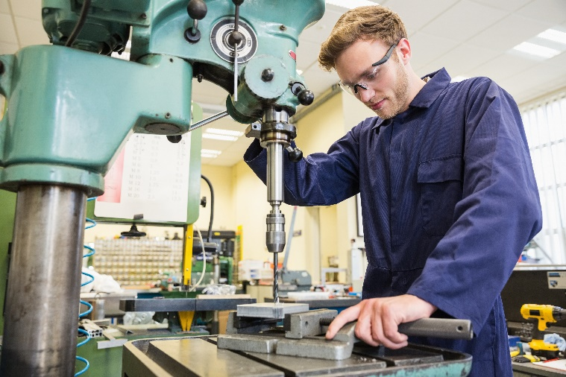
Employee notice
Employers are required to keep a copy of the notice signed by each employee.
Employers are also required to provide employees in writing any changes to the information in the notice before the date the changes take effect.

Slide 10
Thank You!
Visit DLI’s webpage about the new law: www.dli.mn.gov/business/employment-practices/wage-theft-legislation-2019-and-summaries.
View DLI’s child labor materials and overview video: https://www.dli.mn.gov/business/employment-practices/child-labor-laws
Sign up for our Wage and Hour Bulletin: www.dli.mn.gov/business/employment-practices/minnesota-wage-and-hour-bulletin
Contact DLI’s Labor Standards at 651-284-5075 or dli.laborstandards@state.mn.us.

