Slide 1
THIS SLIDE IS HIDDEN and will not display in your presentation. It contains basic information on how to use the CareerForce PPT template to ensure CareerForce’s image is always presented in a professional manner.
DO NOT DELETE this slide until the PPT is final. KEEP IT IN THE MASTER TEMPLATE
Refer to the PPT “How to Use the CareerForce Template” for detailed instructions to create slides using this template.
A few tips:
This template is designed using a multi-level bulleted list. Use the Increase and Decrease List Level buttons in the “Home” Tab/Paragraph section to change levels.
Avoid inserting line spaces—unless separating sections with subheads.
To create a subhead: In the first level bullet position, deselect Bullets option. To begin a bulleted list on the next line, re-select “Bullets.”
Use the color theme created for this template (CareerForce colors) to highlight subheads and emphasize text.
Do not fear white space! PPTs should be concise in content. Do not add line spacing to “fill up” the slide.
Have more information than a slide can hold? Break information to one or more slides. Another option: edit your copy down and utilize the notes section for information you want to communicate to your audience.
Regular copying and pasting text from one PPT to another will not automatically format the copied text to PPT’s design. For easy step-by-step instructions refer to the PPT “How to Use the CMJTS Template.”
NOTE: If you choose not to delete this slide from your PPT, to print the PPT—and not include this hidden slide—in the print Custom Range, choose to print slide 2-(enter last slide number)
This PPT template was designed to be projected on a widescreen monitor.
How to use this template:
To create a new slide, in the Home tab, click the arrow under the “New Slide” button in the menu. This will display the template master slides available. Select the desired layout.
Likewise, to change the template master of a slide, click the “Layout” button right next to the “New Slide” button.
USE THE SPACING, FONT SIZES, ETC., ASSIGNED IN THE TEMPLATE! Use the Paragraph Increase and Decrease List Level functions in the Home tab menu to move to bullet levels. (See the PPT “How to Use the CareerForce Template” for more detailed / how-to instructions.)
DO NOT move title or text boxes, change type sizes, or select Auto-fit to fit content on a slide. (See the PPT “How to Use the CareerForce Template” for recommendations for formatting text.)
DO NOT copy/paste graphics and logos from website pages. Download only hi-resolution clipart from the internet. For logos, contact the company requesting they email you a hi-res JPEG.
Questions or need assistance? Contact the CMJTS executive assistant or your admin. assistant!

Slide 2
Maintaining and Safeguarding Participant Files

Slide 3
Learning Objectives
File Organization
Confidentiality
Disability/Medical Information
Local Youth Plan
Strategies for Recruiting WIOA Youth Participants
Youth Incentives
Notes:
Tera

Slide 4
File Organization
CMJTS uses a file outline as a best practice to keep files consistent. This is especially helpful during file reviews and monitoring visits.
Peer-to-peer file reviews are conducted on a quarterly basis to ensure that forms are up-to-date and in compliance.
Notes:
Tera

Slide 5
Confidentiality
It is our responsibility to make sure that a participant’s confidentiality is not compromised.
Files are kept in locked file drawers
Obtain a release of records form to talk to staff and providers about a participant (on a need to know basis)
Don’t share passwords with anyone
Use secure communication such as encrypted e-mails
Don’t keep confidential files on external storage
Keep computers secure by locking the computer screen every time you leave your desk
Notes:
Tera

Slide 6
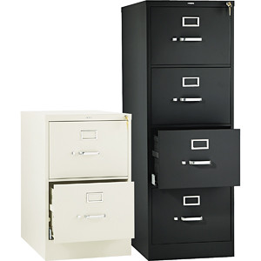
Disability/Medical Information
Keep disability/medical information in separate file and in a separate file drawer.
If the participant discloses personal information in regards to their disability or medical condition the DRC or ES case notes this as private in WF1.
Notes:
Tera

Slide 7
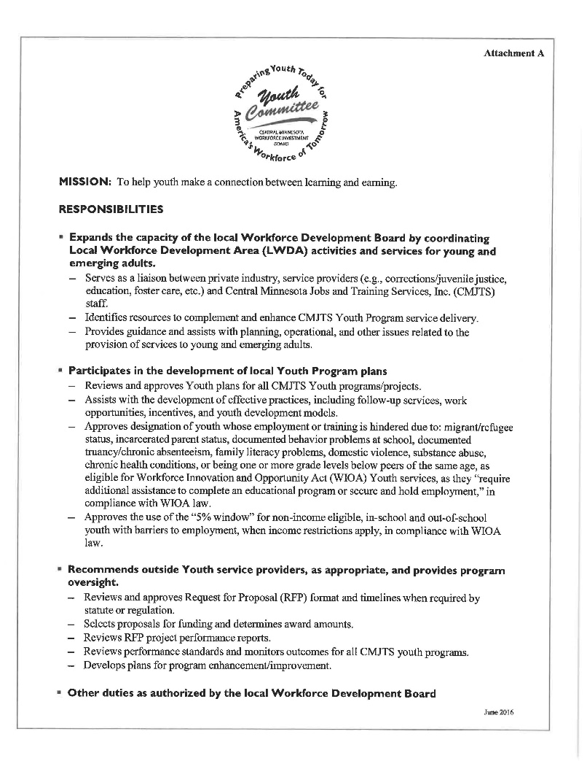
Local Youth Plan
Notes:
Leslie

Slide 8
Strategies for Recruiting WIOA Youth
Go where the youth are…
Schools
Colleges
ABE
Churches
Coffee Shops
Sporting Events
Community Events
Promote youth referrals through other programs
Notes:
Tera

Slide 9
Strategies (Continued)
Our work service area has a low percentage of diverse youth.
To engage this population we have done the following…
Connected with Cultural Liaison, Jehana Schwandt from Ridgewater College. She has provided us with outreach strategies on how to connect with Somali youth.
Met the multi-cultural staff at PACER Center and can utilize their services when needed.
Notes:
Tera

Slide 10
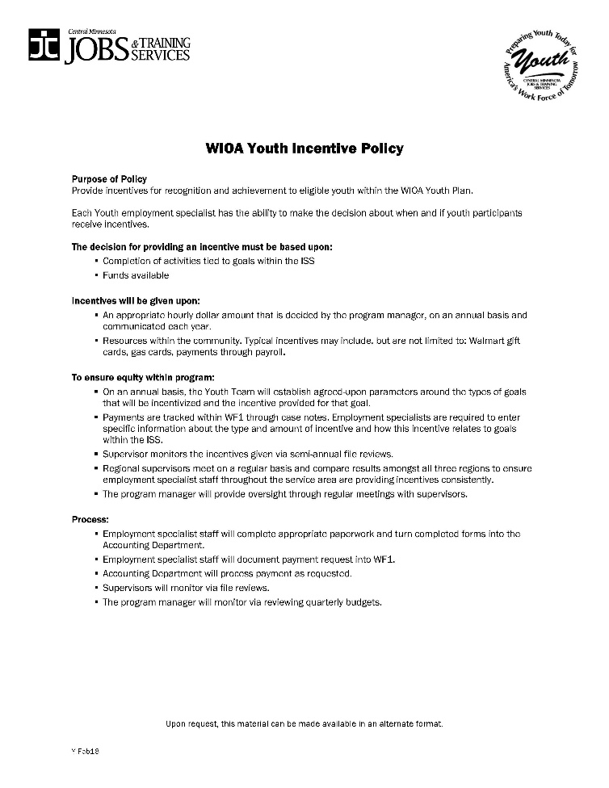
Youth Incentive Policy
Notes:
Leslie

Slide 11
Youth Incentives
Reasons to use youth incentives…
Completion of the CCC assessment
Academic level increases in ABE
GED hours and GED completion
Completing a goal area/action steps on the ISS
Maintaining a 3.0/3.5 GPA or higher and achieve it by the end of the semester (according to the ISS)
Positive WEP evaluations
Obtaining a credential (CNA or completion of college)
Notes:
Leslie

Slide 12
Youth Incentive Forms
A “Youth Incentive Payment Request” form is used for GED stipends
A “Gas, Walmart Card, and Bus Token Support” form is used for assessment completion, goal achievement, credential attainment, etc.
Notes:
Leslie

Slide 13
Questions
Notes:
Leslie

Slide 14
Contact Information
Leslie Wojtowicz
Development Manager
763-271-3757
lwojtowicz@cmjts.org
Tera Brooks
Disability Resource Coordinator
7630710-0999
tbrooks@cmjts.org

