Slide 2
MN Governors Broadband Task Force Kristi Westbrock, CEO/General Manager, CTC April 29, 2020
Notes:
Wasn’t sure about the title…

Slide 3
About CTC
On May 19th, 1950 seven men gathered for the first official meeting of the Crow Wing Cooperative Rural Telephone Company, later known as Consolidated Telephone Company.
Today, CTC continues to set the standard in telecommunications for the Brainerd Lakes Area and beyond. Delivering state-of-the-art internet, TV, and phone services.
Customers - 13,269
Internet Circuits - 11,514
Phone Lines - 13,974
As a technology services advisor, we partner with organizations and communities throughout the nation. We work with utilities, municipalities, and government entities by assisting with system infrastructure and relationships to build the best fiber and wireless networks.
With offices in Brainerd, Baxter, and Crosby, CTC’s members will always have the hometown support they’ve grown accustomed to over the past 50+ years.
As a cooperative, CTC is owned by our members, guided by our board of directors, and driven by our mission…

Slide 4
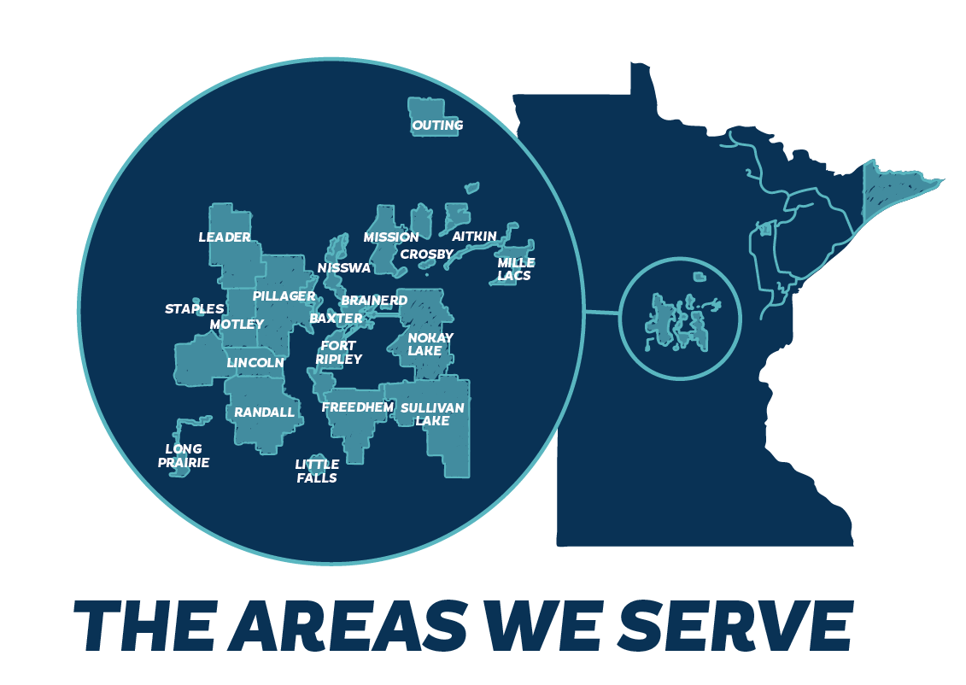
CTC Footprint
Text
Text
Text

Slide 5
Electric Partnerships
Arrowhead Electric
Mille Lacs Electric Cooperative (MLEC)

Slide 6
Funding/Grant Projects
2020 | State of MN Broadband Grant - CTC Brainerd Area
2020 | State of MN Broadband Grant - Bois Forte
2020 | State of MN Broadband Grant - MLEC
2020 | RUS ReConnect - CTC Cherry Township
2019 | Community Connect Grant - Mille Lacs Energy Cooperative
2018 | Mille Lacs Energy Cooperative - Aitkin County Grant
2018 | Todd County Development Corporation
2018 | RUS Community Connect Grant - CTC Moran Township
2017 | City of Long Prairie
2016 | Mille Lacs Energy Cooperative
2015 | State of MN Broadband Grant
2014 | State of MN Broadband Grant
2013 | Crosslake Communications
2012 | ARRA RUS Stimulus Award - Arrowhead Electric Cooperative
2011 | City of Little Falls & Little Falls Community Development
2010 | Brainerd ISD, Local Govt., Health Care
Notes:
How much detail do you want to include? I can just add numbers or we can leave it at the type of award/project.

Slide 7
Total Projects Awarded Funding
All CTC & Partner Applications
Total Locations | Total Funding Applied For | Total Grants Awarded To Date | Total Other Funds Awarded/Committed To Date | Total Grant Funds Awarded or Committed
17160 | $ 59,923,000 | $ 18,410,332 | $ 13,546,000 | $ 31,956,332
CTC Projects
Total CTC Locations | Total CTC Funding Applied for | Total CTC Grants Awarded To Date | Total CTC Other/Committed Funds | Total Grant Funds Awarded or Committed by CTC
6214 | $ 33,523,000 | $ 11,757,587 | $ 9,696,000 | $ 21,453,587

Slide 8
COVID-19 CRISIS

Slide 9
Helping Our Employees
Work from home implementation – March 17
Network Upgrades
COVID-19 Crisis Management – Pandemic Planning
COVID-19 Dashboard
Call Volume
Broadband Consumption
Keeping Employees Engaged
Productivity
Cultural

Slide 10
Employees First

Slide 11
Daily Monitoring of Calls and Network
Notes:
I’m trying to locate the Crosby photo -

Slide 12
Bandwidth Consumption
Overall Peak Bandwidth Internet served to CTC customers and all other wholesale customers
February 32.0 GBPS
March 41.0 Gbps (28% increase)
CTC Customers Only peak bandwidth
February 22.3 Gbps
March jumped to 26.6 Gbps (19% increase)
6:00 AM lowest bandwidth consumption
9:00 PM is always our daily peak for consumption.
Notes:
I’m trying to locate the Crosby photo -

Slide 13
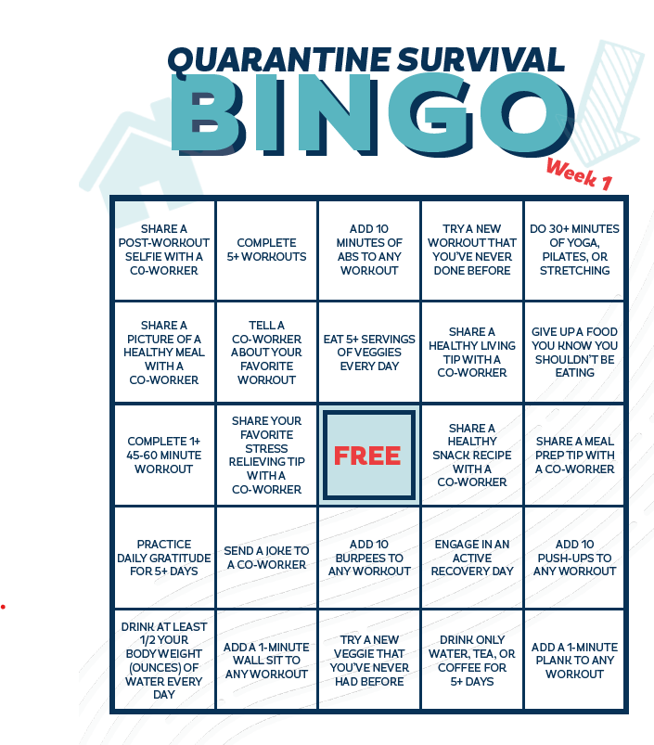
Keeping Employees Engaged

Slide 14
Helping Our Members
FCC Keep America Connected Pledge
Service Discounts
Speed Increases - Doubled
WiFi Hotspots
Broadband in a Box

Slide 15
COVID-19 Response to Members
Keep America Connected Pledge
Not terminate service to any residential or small business customers because of their inability to pay their bills due to the disruptions caused by the coronavirus pandemic
Waive any late fees that any residential or small business customers incur because of their economic circumstances related to the coronavirus pandemic
Open its Wi-Fi hotspots to any American who needs them.
CTC Data – Over 10K per month in business revenue loss due to service suspension and closed businesses.

Slide 16
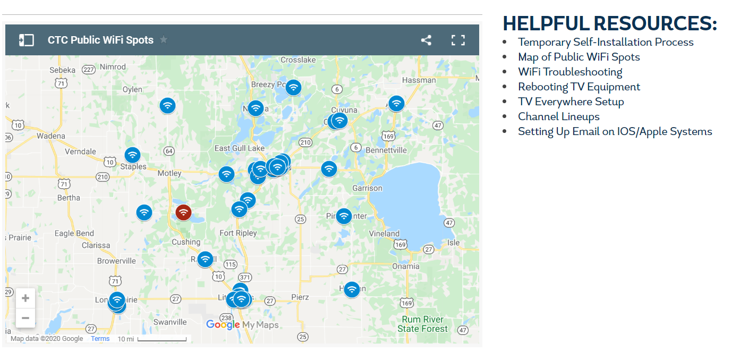
COVID-19 Response to Members
www.goctc.com/Covid web page
Free internet upgrades to residential customers
Nearly 50 WiFi Hotspots throughout service area

Slide 17
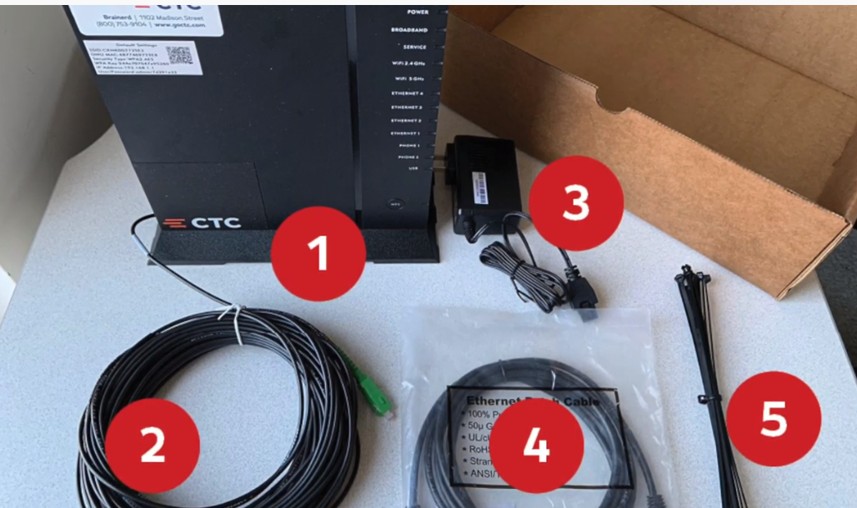
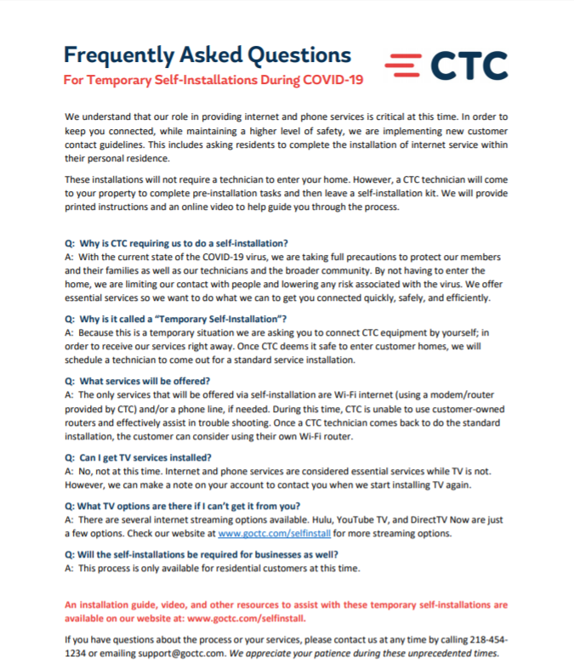
Temporary Self Installation Process

Slide 18
Helping Our Community
Public Schools Mapping
Generate Local Business Revenues
Gift Cards
Appreciation for Local Critical Workers
Keeping our Community Connected/Engaged - Social Media

Slide 19
Brainerd Public Schools
Notes:
I’m trying to locate the Crosby photo -

Slide 20
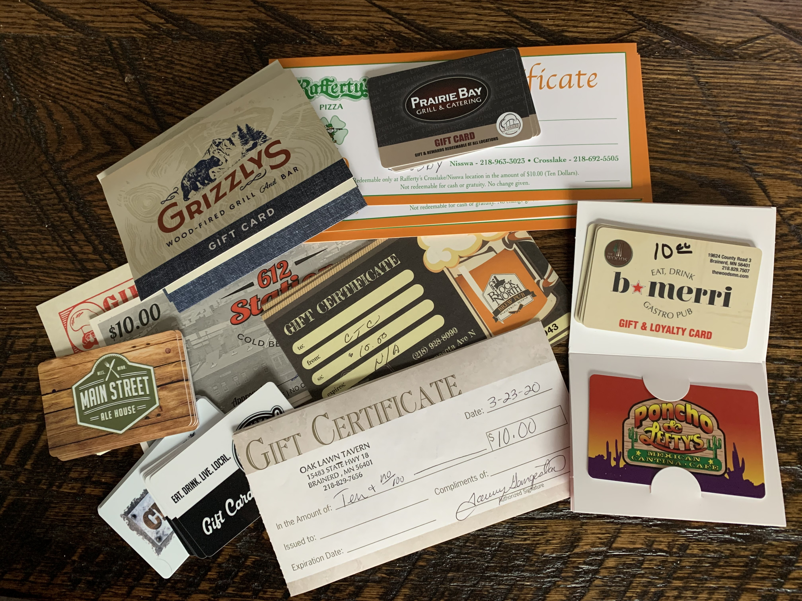
Helping our Community
Gift Cards for Employees to Spend Locally

Slide 21
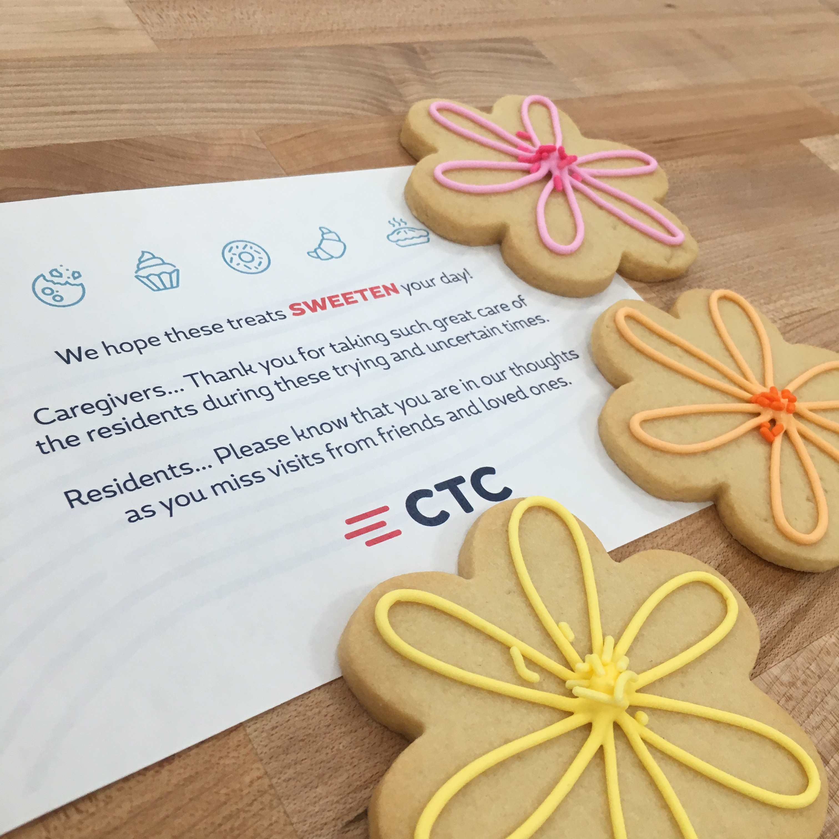
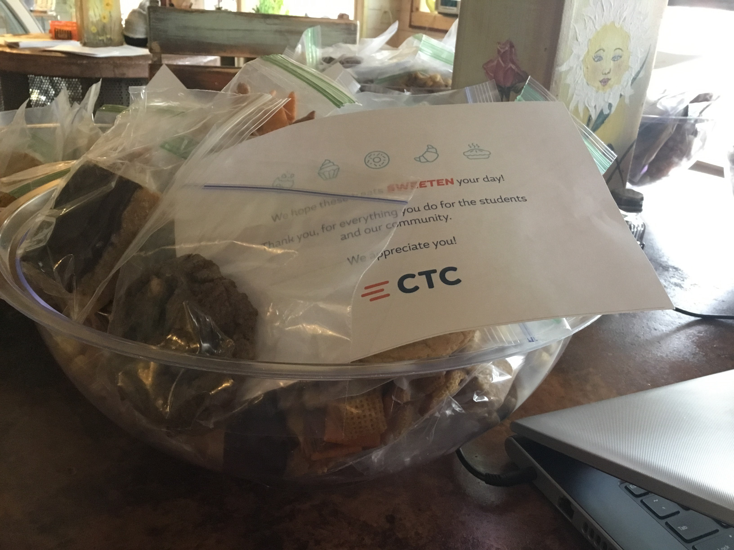
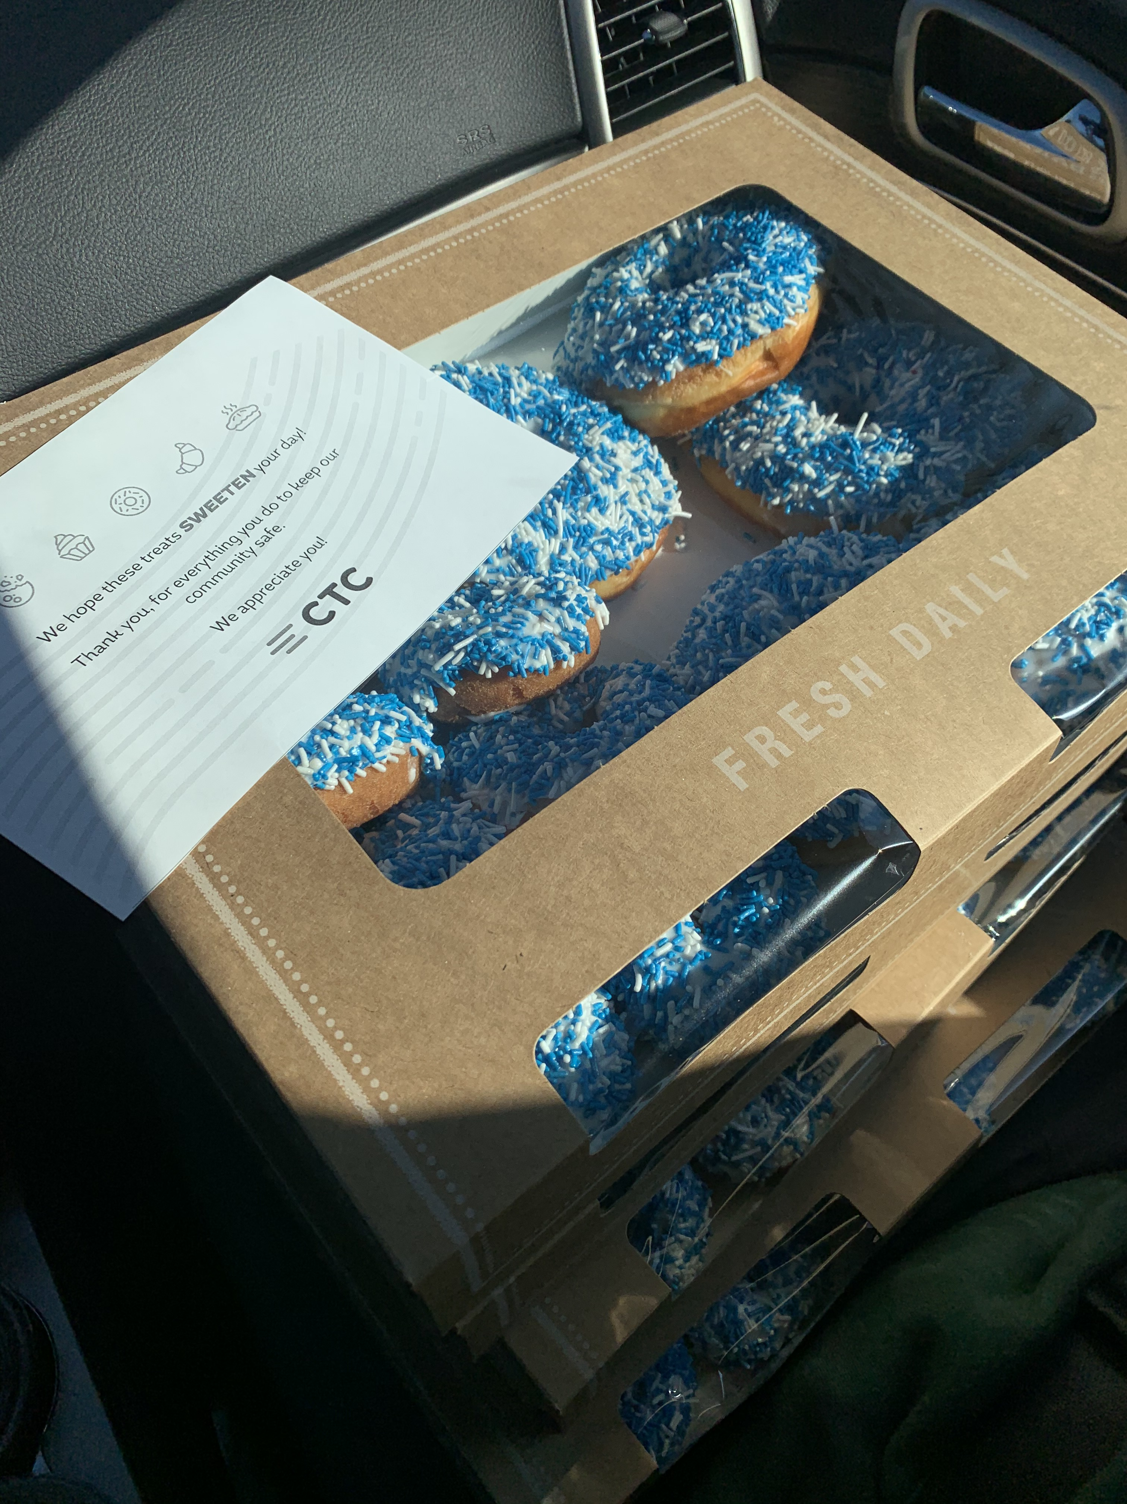
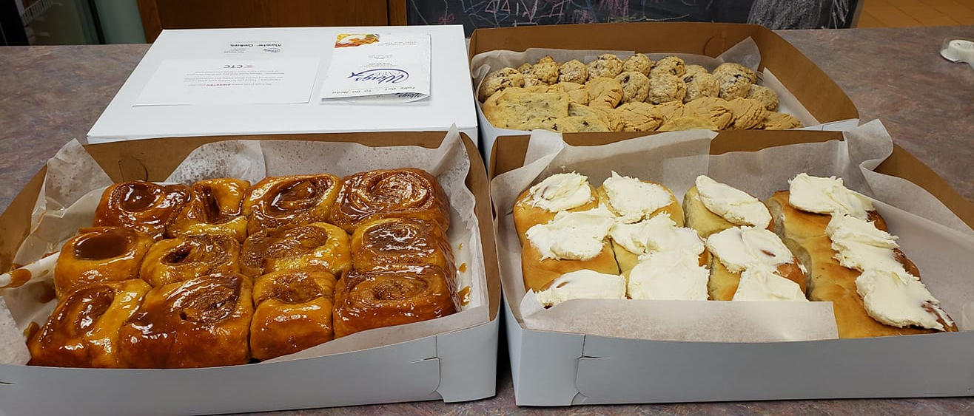
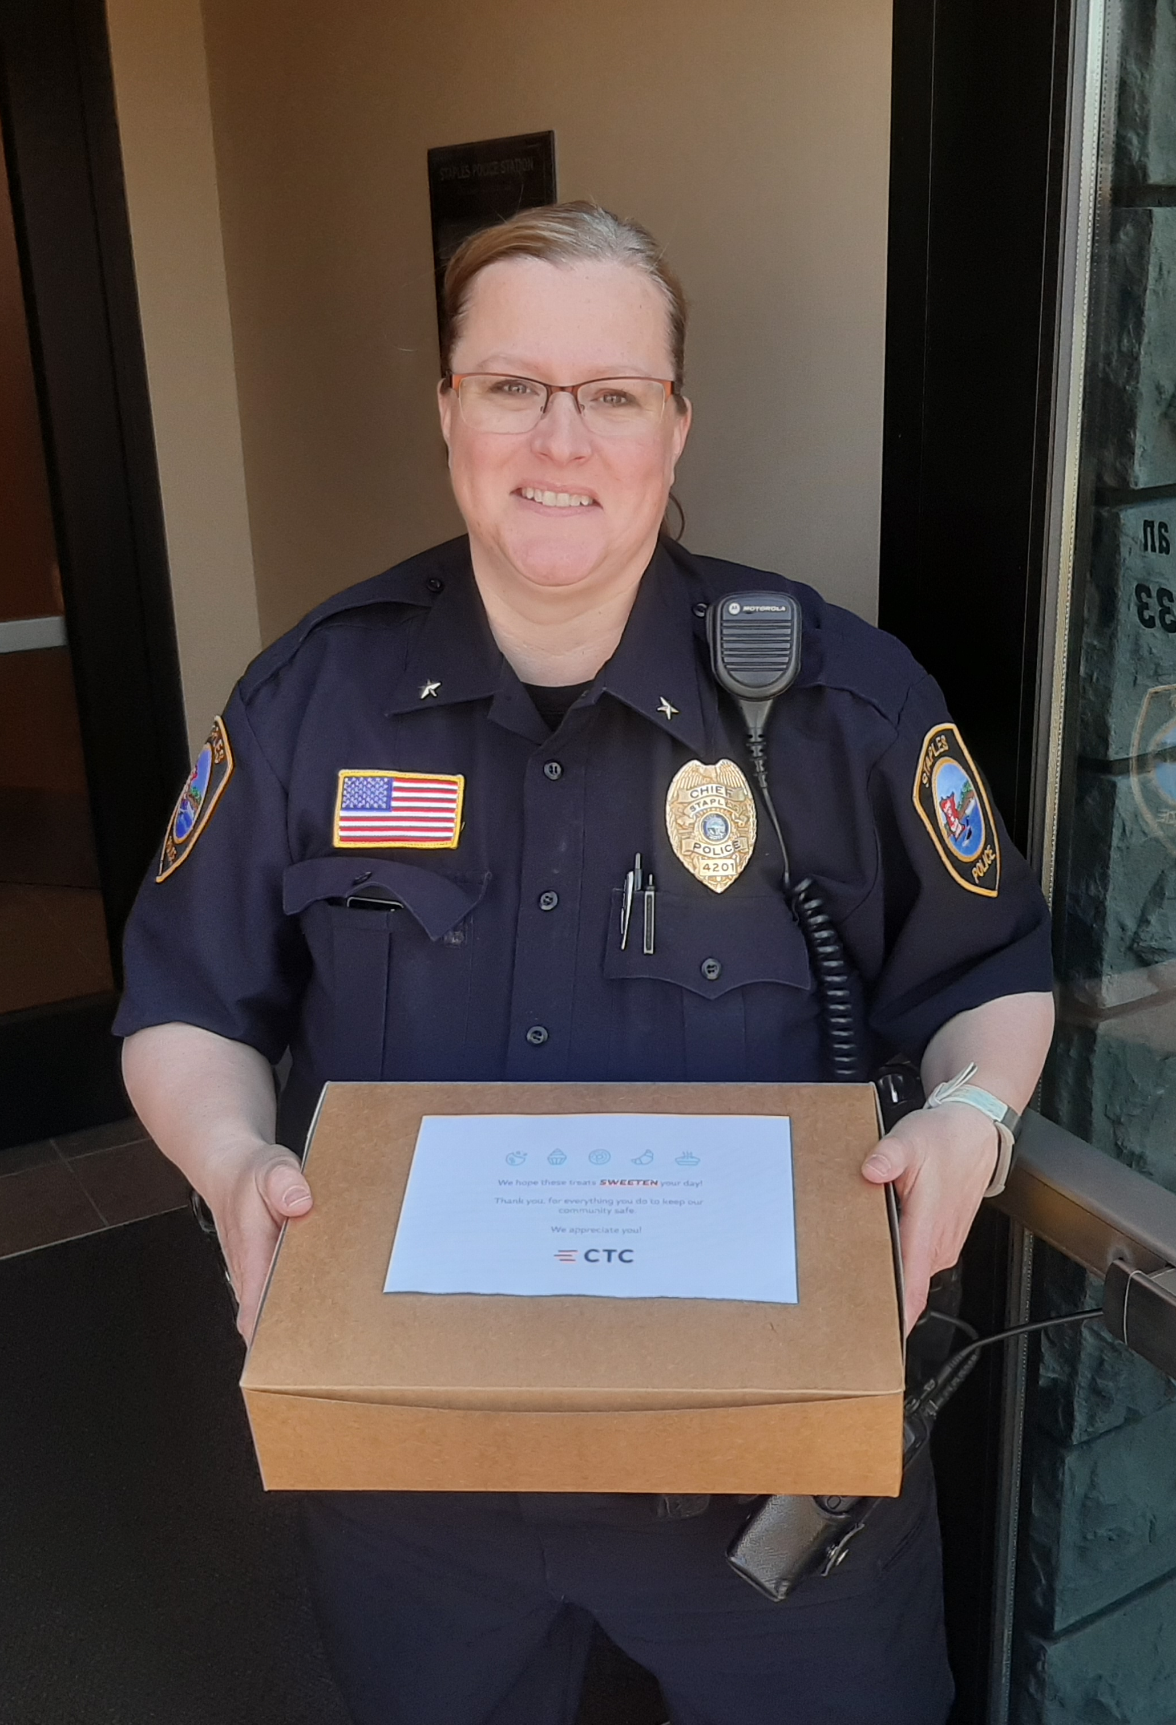
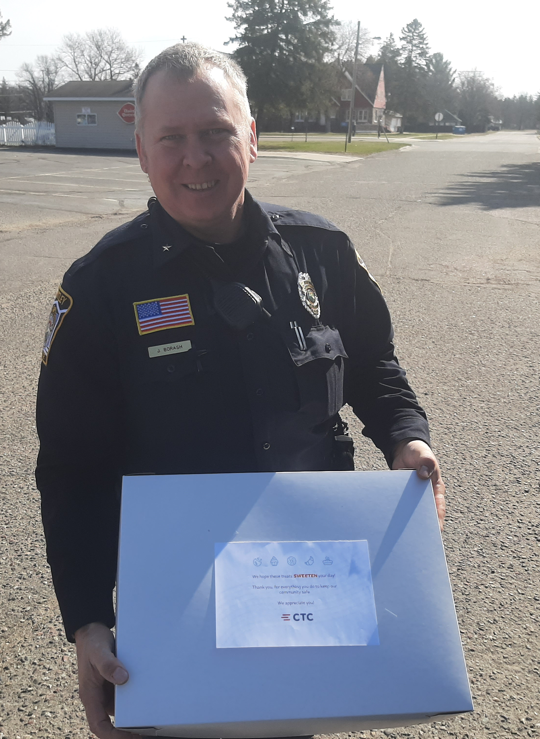
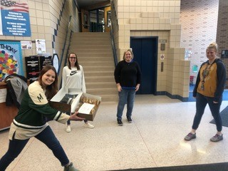
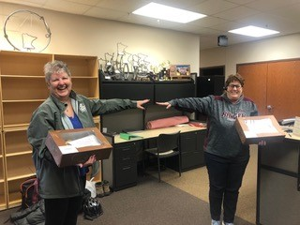
Appreciation for Local Critical Workers

Slide 22
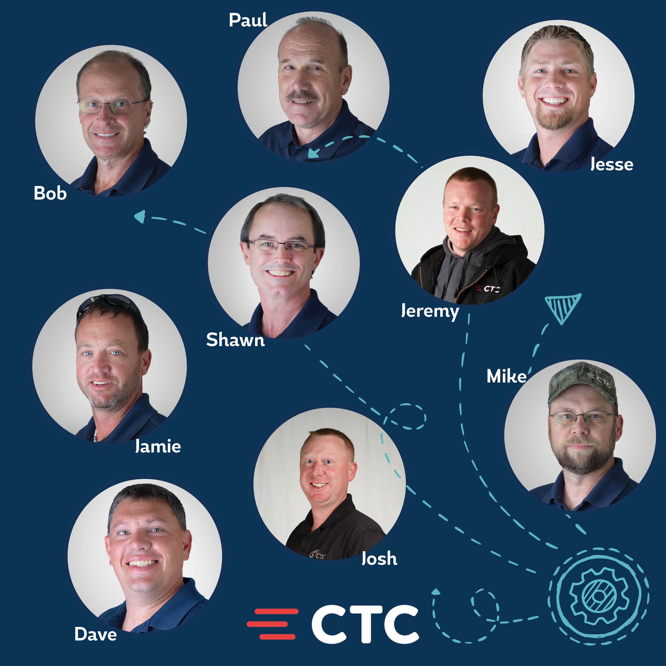
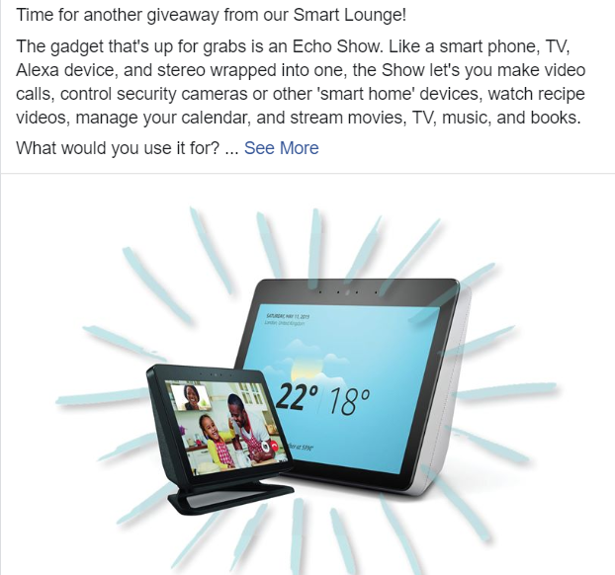
Keeping Our Community Connected/ Engaged –Social Media
Engagement is up 50%
Posts focusing on “Connecting the Community”
We’re here to help
Personal posts – CTC Techs, Employees “working from home”
Keeping members connected at home – what to watch, technology to try, etc.
CTC Technicians
Smart Lounge Giveaway

Slide 23
Q&A

Slide 24
Thank You!

