Slide 1
Giving Youth a
Smart Start to Work and Benefits

Slide 2
Purpose of this presentation
Help you understand how benefits planning is connected and critical to work planning and how YOU have a role
Introduce you to new resources & tools designed just for you to help you integrate benefits planning into your work

Slide 3
The Issues
Reliance on public benefits alone is a path to poverty.
Competitive employment is important for all people, including people with disabilities.
Public benefits can be used as a bridge to a better life when combined with employment.
Benefits planning integrated into employment planning improves outcomes for youth.

Slide 4
Poverty & Disability:
The Inextricable Connection
People with disabilities are poorer, as a group, than the general population.
People living in poverty are more likely than others to be disabled.
People with no reported disability in the labor force: 70.1%
People with reported disability in the labor force: 21.9%

Slide 5
But competitive work IS an option, and professionals are KEY to supporting work
“All people with disabilities are encouraged and supported in exploring work as a viable option to build wealth and social well being.”
National Consortium for Health Systems Development
“Most consumers are motivated to work, provided they perceive that the professionals helping them also embrace the belief in the importance of work and genuinely believe they can work.”
- Rogers, Walsch, Masotta & Danley, 1991
“Educators and social workers are the gatekeepers and unless they are taught and apply employment first principles, individuals are too often steered towards segregated programs.”
- Minnesota Employment First Coalition Report

Slide 6
Fear of Losing Benefits: a primary barrier to seeking work
But…little known:
  Once you get on Social Security Benefits, the SSA (Social Security Administration) has developed policies and services that help SSA beneficiaries reach their work goals.
  People on SSI (Social Security Income) are always better off working.
  There are multiple state and federal work incentives to help people with disabilities work AND maintain benefits.

Slide 7
Incorporating Benefits Planning is KEY for all professionals, and becoming an expectation
Guidepost 2 (career prep)- youth need to…”understand the relationship between benefits planning and career choices.”
Guidepost 4 (connecting activities)- “benefits-planning counseling- including information regarding the myriad of benefits available and their interrelationships so that they may maximize those benefits in transitioning from public assistance to self-suffiency.”

Slide 8
Concerns
“Benefits are very complicated. I’m afraid I will say the wrong thing.”
“I don’t know where to get reliable information.”
“I have enough on my plate, please do not add more.”
“My kids don’t care or ask about benefits.”
“Benefits are private and are not my business.”
“Benefits aren’t a part of what I do, that is what the county does.”

Slide 9
Yet … Benefits can not be ignored
Benefit concerns are a major reason why people with disabilities are not working.
All professionals play a key role in understanding & breaking down the barriers.
We all need to be able to support the same messages about work and benefits.

Slide 10
You can help show the critical connections
When you help young people weave concepts together, they develop the effective, well-rounded life-planning skills that are crucial to success

Slide 11
Disability Benefits 101 – DB101.org
DB101.org brings together:
  Benefits information
  Tools
  Resouces
  To make it easier to:
  Understand benefits
  Learn about work incentives
  Plan for work and set goals
  Build financial literacy
  Manage benefits while working

Slide 12
DB101.org is for ALL in the System
Students
Parents
Teachers
Work coordinators
Related services:
  Nurses
  Social workers
  Counselors
  other
Employment planners for youth (i.e. VR)
Youth in Transition workers

Slide 13
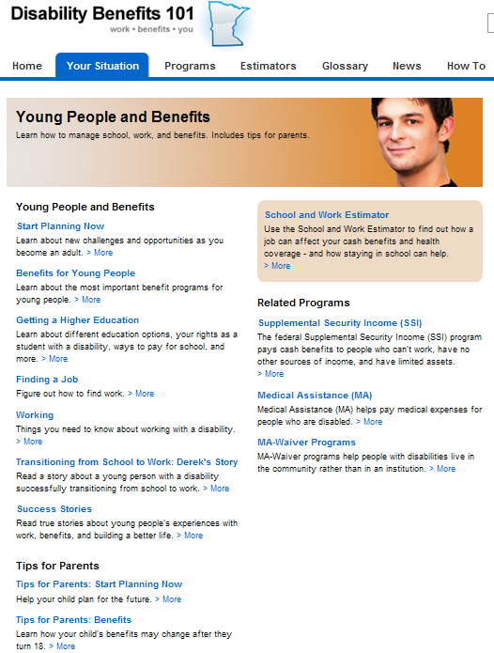
DB101 for Young People
Content - designed for youth and their parents
School and Work Estimator - to show how benefits might be impacted by working

Slide 14
How DB101 Can be Used
Independently
  By people with disabilities and their families to:
    Explore
    Understand benefits
    Learn about work incentives
    Create plans
    Connect to help and other resources

Slide 15
Continued
Facilitated
  Used with people with disabilities to:
    Introduce the site
    Gather information
    Explore possibility
    Debunk myths
    Build engagement
    Plan for work

Slide 16
Continued…
Professional
  A comprehensive resource to use for:
    staff/agency training
    Reference
    Connections to help
    Manuals/applications access
    Clients’ benefits info

Slide 17
About the Disability Linkage Line
Free, statewide information and referral resource.
Single access point for all disability related questions.
Trained options counselors provide one-to-one assistance.
There is no wrong call to the DLL.
Also accessed as online chat on db101.org.

Slide 18
Get A Smart Start Toolkit
A complete, ready-to-use education package about work and benefits
Intended for all professionals who work with youth in transition and their families
Components:
  Facilitator’s Guide that provides background on benefits planning and work planning
  30 minute video broken into 6 chapters
  Sample Learning Plans and Activities for each chapter

Slide 19
Goals of using Get a Smart Start
Put “Benefits” on the radar.
Introduce benefits as bridge to support independence.
Help break down the myths and barriers about work and benefits.
Build self-advocacy skills and give resources to refer to when faced with benefits and work questions.

Slide 20
With which students should I use the Toolkit?
Students who are on a public benefit now; might transition to benefits when they are older.
Tips:
Students & families who don’t receive public benefits also need basic information about benefits – they’re only one job loss, accident or illness away from receiving benefits themselves.
The Toolkit can be used to support financial literacy and life planning for all students … or tailored to meet your students’ specific needs.
You don’t have to be a benefits expert to help the youth you teach or support. (Really!) The Get a Smart Start Toolkit is designed to be used by all kinds of professionals.

Slide 21
Examples of how it can be used
School Work Coordinators or Transition Plus Programs can use it as a classroom curriculum.
Special Education Teachers can use it to improve engagement in Individualized Education Program (IEP) work activities.
Vocational rehabilitation youth in transition workers can use it to incorporate benefits education in their work.
Non-profit youth transition programs can use it to design a workshop.
Youth with disabilities and their families can view the video and do the activities on their own.

Slide 22

Facilitator’s Guide & Activities
Background information
Toolkit applications
How to engage families
Sample activities for you & youth

Slide 23
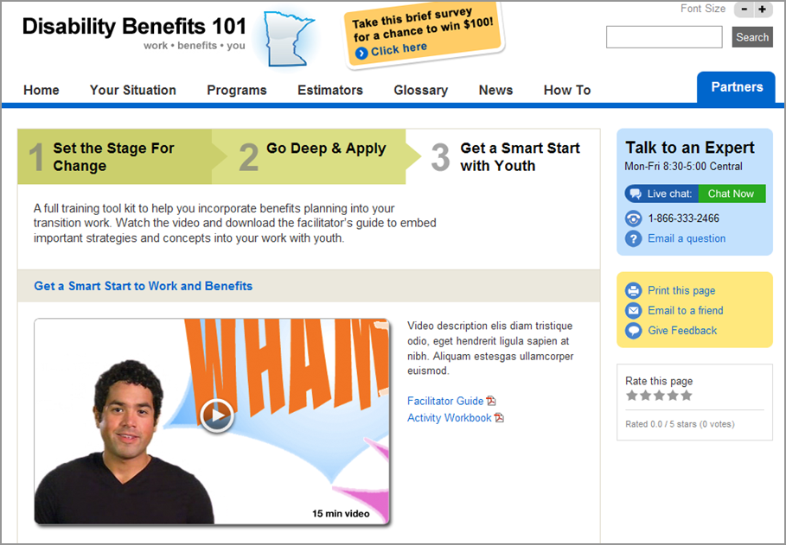
Introductory Chapter of Video
Introductory Video

Slide 24
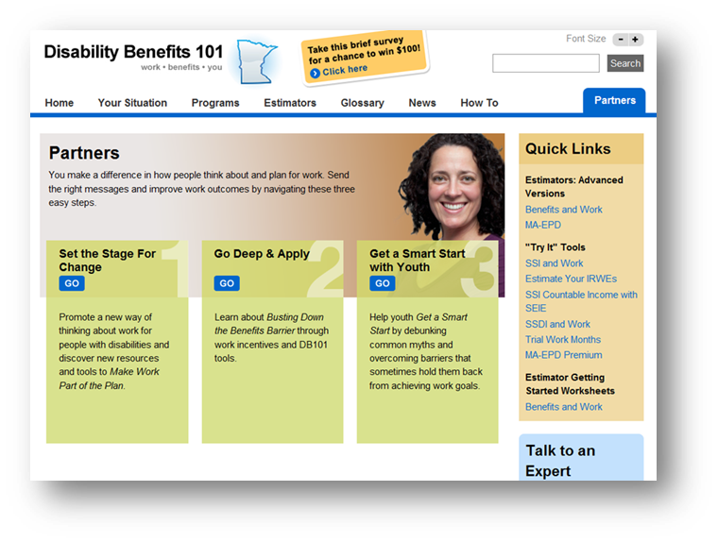
Finding the
Get a Smart Start Materials: db101.org>Partners Tab>Get a Smart Start

Slide 25
What You Can Do Next
Learn more about the importance of teaching about benefits planning – DB101.org
Share the site and information with staff and colleagues
Take the steps to integrate benefits planning into your work with youth
  use the Get a Smart Start materials
Continually use DB101 and DLL along the way

Slide 26
DLL, DB101 & WIC:
Working Together to Expand Benefits Planning Access
DB101 supports exploration & information gathering to help clients overcome barriers, get engaged and make work a part of their plan
Work Incentives Connection helps people remove barriers, develop a formal benefits plan and mange their plan to make work profitable

Slide 27
Behind the Scenes Coordination
DLL, DB 101 & Connection staff are connected by an instant messaging tool which allows:
  state benefits to be verified
  technical assistance to be provided to DLL
  information to be shared and discussed---mutual decisions made about how best to proceed
  problem-solving issues with state benefits
  “soft” handoffs to best resource

