Slide 1
New Frontiers in Autonomous and Connected Vehicle Policy
Government Task Force on Broadband
March 22, 2017
William J. Kohler

Slide 2
Presentation Outline
U.S. Department of Transportation/NHTSA
New Federal Automated Vehicles Policy
Michigan Proposed Legislation
Bills 995, 996 and 997 and Senate Bill 998
California Proposed Regulations
Texas Proposed Law
Notes:
Thanks very much, Tom.
It’s a great honor to be here this morning .
I’d like to first present our credentials, for 2 reasons. One is that we’re proud as a firm to be avidly representing clients on automated vehicle matters, and the second is that by describing to you what we’re doing I can give you a window into the issues and opportunities that are unfolding in this area.
Then, I’ll move on to talk about the federal regulatory scheme relating to this area, and the government’s new Federal Automated Vehicle Policy., which is an important signal as to the government’s intention to significantly regulate automated vehicles.
And then after that, I’ll cover Michigan’s proposed autonomous vehicle legislation., which would be a huge leap forward for Michigan.

Slide 3
William J. Kohler is a senior counsel in Dykema’s Corporate Finance Practice Group. His practice is focused on the automotive industry where he served many years as general counsel at several automotive related companies covering domestic and international matters. Mr. Kohler is an authority on legal issues relating to autonomous and connected vehicles. His work in that area has involved investment transactions, technology development and licensing arrangements, and legislative and regulatory issues. He is the author of "Current Law and Potential Legal Issues Pertaining to Automated, Autonomous and Connected Vehicles," published in 2015 in the Santa Clara High Technology Law Journal.
William J. Kohler, Esq.
Dykema Gossett, PLLC
400 Renaissance Center
Detroit, MI 48243
P: 313-568-6603
E: wkohler@dykema.com
Notes:
Firstly, this guy. I’ve spent my career as a lawyer in automotive, first with Chrysler, then as automotive general counsel for Johnson Controls, chief legal officer of Dura Automotive and now in private practice with Dykema. During the course of my career, I’ve taken particular interest in the industry’s developing financial and commerical scenarios. And so in 2004 I began advising and writing about the automotive bankruptcies that then took place in 2008.

Slide 4
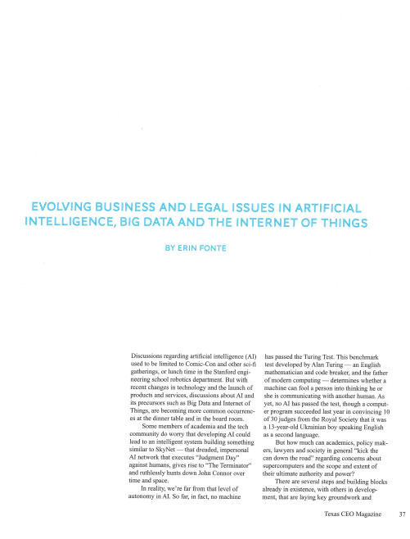
Publications
EVOLVING BUSINESS AND LEGAL ISSUES IN ARTIFICIAL INTELLIGENCE, BIG DATA AND THE INTERNET OF THINGS
Notes:
And a few years ago, I began analyzing the potential legal and regulatory issues regarding autonomous and connected vehicles, and that led to publication last year of a law review article called “Current Law and Potential Legal Issues Pertaining to Automated, Autonomous and Connected Vehicles.”
My colleagues have also published and spoken on a variety of advanced vehicle technology topics, including the article depicted on the right regarding legal issues pertaining to artificial intelligence, and also connectivity, data privacy and technology topics.

Slide 5
Autonomous and Connected Vehicle Practice
Dykema’s nationally recognized Autonomous and Connected Vehicle Team understands the complexities of advanced automotive technologies. Our lawyers are at the forefront of these emerging technologies, and are already helping clients navigate the difficult legal challenges and opportunities that automated vehicles present. The following is a summary of our capabilities and recent experiences involving the transformation of transportation.
Notes:
As a firm, we’re advising car makers, suppliers, insurance companies, technology providers, and investors on a variety of matters.

Slide 6
U.S. Department of Transportation/NHTSA
The U.S. Department of Transportation (DOT) oversees NHTSA
NHTSA was established and given limited powers by the Highway Safety Act of 1970
NHTSA’s essential function is to maximize highway safety
Mission: “to save lives, prevent injuries, and reduce economic costs due to road traffic crashes,” and as to “achiev[e] the highest standards of excellence in motor vehicle and highway safety.”
Notes:
Ok…now for the meat of the matter. I want to start with a quick overview of how the federal safety regulatory scheme operates...to lay a foundation.
The Department of Transportation oversees NHTSA – the National Highway Transportation and Safety Administration, which was established in 1970. NHTSA’s job is to maximize highway safety and as its missions statement says “to save lives, prevent injuries, and reduce economic costs due to road traffic crashes.”
About 38,000 people were killed on U.S. roads in 2015, and roughly 4.4 million were injured. That was an 8 percent increase from 2014, compared with less than a one half of one percent increase between 2013 and 2014 and a 3 percent drop the previous year.
All in, that was the largest jump in fatalities and injuries in 50 years.
These statistics and the recall incidents that have been so controversial over the past few years mean that NHTSA is under a great deal of pressure to live up to its mission, and as much interested in accelerating the deployment of safety-centric technology as it is in ensuring that the technology is safe when it’s deployed.

Slide 7
U.S. Department of Transportation/NHTSA
NHTSA’s powers:
Establish vehicle safety standards for new motor vehicles and motor vehicle equipment.
Require the recall and remedy of vehicles and equipment that do not comply with standards.
Conduct investigations into safety defects.
Require the recall and remedy of motor vehicles and motor vehicle equipment determined to have a safety defect.
NHTSA has announced its interest in regulating autonomous vehicles, as well as its willingness to advance and support the wide adoption of related technology.
Notes:
NHTSA has several powers. One is to establish vehicle safety standards for new motor vehicles. But car makers self-certify their compliance with safety standards, so NHTSA doesn’t currently operate at all like the FDA, which of course must approve medications before they’re sent to market. And as you know that’s typically a time-consuming process.
NHTSA can also require recalls of vehicles that do not comply with standards or that NHTSA determines have a safety defect.
In 2013, NHTSA announced its interest in regulating autonomous vehicles, and its interest in supporting the adoption of autonomous vehicle technology.
Where NHTSA regulates, the states may not. So, in lawyers terms, NHTSA’s regulations regarding automated vehicles would preempt contrary state regulation.

Slide 8
U.S. Department of Transportation/NHTSA
Generally, NHTSA/FMCSA safety regulations preempt any conflicting state regulation
States may issue supplemental regulations if not in conflict with federal standards
State regulations mainly focused on vehicle use (e.g., operator licensing and restrictions, safety inspections, vehicle registration)
Federal Motor Carrier Safety Association (FMCSA)
Incorporation of NHTSA safety regulations plus specialized equipment regulations for commercial vehicles and operator requirements
Unlike NHTSA and passenger vehicles, FMCSA may regulate operation of vehicles through commercial driver regulations (e.g., hours of operation; substance abuse; cell phone restriction rule; video display prohibition)
Notes:
This means that states can issue supplemental regulations when they’re not in conflict with NHTSA’s federal standards .
And it leaves to the states the power to regulate vehicle use – different than vehicle safety standards – involving things like operator licensing, operator restrictions, safety inspections and vehicle registration, as well as the allocation of liability.

Slide 9
New Federal Automated Vehicles Policy
The U.S. Department of Transportation issued its Federal Automated Vehicles Policy on September 20, 2016, pertaining to both highly automated vehicles and lesser-automated vehicles
The policy was issued as agency guidance rather than rules, but it is likely going to be influential in shaping new state laws
The policy advises that NHTSA will investigate any safety concern associated with highly automated vehicles and exercise its enforcement authority to the fullest extent
Notes:
Moving to recent important developments, NHTSA issued its Federal Automated Vehicles Policy last month, and it pertains to both highly automated vehicles and lesser-automated vehicles in a way that I’ll explain in a moment.
The policy was issued as guidance rather than as regulations, but it will be tremendously influential over the automotive industry going forward because of the risks to car makers’ relationships with NHTSA if they don’t abide by it.
In the policy, NHTSA makes it resoundingly clear that it will investigate any hint of a safety concern associated with highly automated vehicles and it will exercise its enforcement authority to the fullest extent. So, NHTSA is signaling that it will serve as a guard dog as technology and its commercialization advances, while at the same time it is saying that it wants to be supportive of the deployment of new technologies.
NHTSA also makes clear that it will treat software in vehicles as “motor vehicle equipment” subject to its regulations, and that it will issue further guidance as to whether external software – outside of vehicles -- that connects to and operates vehicle systems will be considered within its jurisdiction.
The policy is subject to stakeholder comment until November 22, and many including the Motor Equipment Manufacturers’ Association are working on that.

Slide 10
New Federal Automated Vehicles Policy Safety Assessment Requirement
NHTSA requests voluntary Safety Assessments regarding the compliance of highly automated vehicles with each of the following 15 elements of guidance:
Data recording and sharing
Privacy
System safety
Vehicle cybersecurity
Human machine interference
Crashworthiness
Consumer education and training
Registration and certification
Post-crash behavior
Federal, state and local laws*
Ethical considerations
Operational design domain*
Object and event detection and response*
Fall back to minimal risk condition*
Validation methods
* These elements of guidance will also apply to vehicles at the SAE Level 2, with the exception xxof those marked with an asterisk, and might be mandatory in the future.
Notes:
One of the most important aspects of the policy is its request voluntary Safety Assessments for highly automated vehicles with respect to each of these 15 elements:
Data recording and sharing
Privacy
System safety
Vehicle cybersecurity
Human machine interference
Crashworthiness
Consumer education and training
Registration and certification
Post-crash behavior
Federal, state and local laws*
Ethical considerations
Operational design domain*
Object and event detection and response*
Fall back to minimal risk condition*
Validation methods
But it goes further than that in requesting safety assessments with respect to lesser-automated vehicles, specifically those at SAE Levels 2 or higher.

Slide 11
New Federal Automated Vehicles Policy New and Existing NHTSA Powers
The Agency identified four potential additional powers, each of which would require an amendment of the National Traffic and Motor Vehicle Safety Act:
Pre-deployment approval process
Cease and desist power in case of imminent hazard
Expanded exemption authority
Post-sale regulation of software changes
The policy potentially deviates from its current self-certification regulatory structure by requiring pre-market approval
Notes:
In addition, NHTSA identified four additional powers that it may seek through Act of Congress by amendment to the National Traffic and Motor Vehicle Safety Act.
One is a Pre-deployment approval process or pre-market approval, such that NHTSA would in fact serve as a market gatekeeper like the FDA does with medicine. This would be a radical departure from NHTSA’s self-certification scheme of safety standards. It would put NHTSA into the business of determining whether and when vehicle technologies can hit the road.
Another would be a cease and desist power to use in case of imminent hazard. This would have the effect of strengthening NHTSA’s position to act if hazard is suspected.

Slide 12
New Federal Automated Vehicles Policy State Policy Recommendations
NHTSA recommends a model regulatory framework (the “Model State Policy”) for states that wish to regulate procedures and conditions for testing, deployment and operations of highly automated vehicles
The Model State Policy reflects respective federal and state regulatory responsibilities for motor vehicles and their operation
Accordingly, liability and insurance left to states
Notes:
The policy acknowledges the respective federal and state responsibilities that I described earlier.
And it recommends a model regulatory framework for states that wish to regulate procedures and conditions for testing, deployment and operations of highly automated vehicles

Slide 13
New Federal Automated Vehicles Policy In Summation
States should respect boundary between state and Federal powers
States need not regulate automated vehicle safety
NHTSA will use the full force of its powers to ensure safety of automated vehicles, and it may seek additional powers
If states work within the Model State Policy parameters, deployment of automated vehicles will be accelerated
Notes:
The policy acknowledges the respective federal and state responsibilities that I described earlier.
And it recommends a model regulatory framework for states that wish to regulate procedures and conditions for testing, deployment and operations of highly automated vehicles

Slide 14
Michigan AV Legislation
Michigan Senate and House have approved historic autonomous vehicle legislation; on the Governor’s desk to be signed into law
Comprised of four bills: 995, 996, 997 and 998
Permit driverless vehicles on Michigan roads, without new conditions or bureaucracy
Also permit:
Platoons of electronically coordinated vehicles
SAVE Projects
Notes:
Now, I’ll briefly cover Michigan’s pending autonomous vehicle legislation, which was approved by the Michigan Senate on September 7th and is generally in keeping with the new Federal Policy recommendations.
The legislation is comprised of 4 bills, numbers 995, 996, 997 and 998.
Most significantly, the bills in one sweeping statement would permit driverless vehicles on Michigan roads generally without conditions or bureacratic entanglements, though subject to federal safety requirements and of course manufacturers’ due consideration for general product liability principles and the insurabilty of vehicles.
The bills are currently in the House of Representatives, awaiting a floor vote with some modifications. One change that the house is considering would permit the deployment of autonomous vehicles not only by traditional car makers, which is a noteworthy limitation in the Senate version, but also by new entrants that fulfill federal safety requirements, have operated autonomous vehicles for more than 1,000,0000 miles and that satisfy a 10,000,000 dollar insurance requirement or that provide proof of self insurance of that magnitude.
Once these bills are enacted – and its fair to assume they will be -- Michigan will have taken an historic leap toward deployment of autonomous vehicles, and it will assure its place as one of the world’s epicenters for this new technology.

Slide 15
Michigan AV Legislation
SAVE Projects:
Ride-hailing fleets (called “on-demand automated motor vehicle networks”) within certain types of geographical areas (e.g. municipal and regional authority areas, university campuses, senior citizen developments)
Different than the Senate’s original legislation, provides for the deployment of ride-hailing fleets by non-traditional automobile manufacturers, such as Lyft, Uber or Google, provided they meet certain conditions.
Of these conditions, the most significant is the operation of autonomous vehicles on public roads for more than 1,000,000 miles.
Notes:
I’ll like to highlight some features of the other bills…bills 996, 997 and 998.
996 Permits self-certifying vehicle manufacturers to deploy so-called “SAVE projects,” which are on-demand automated motor vehicle networks within certain types of geographic areas including municipal and regional authority areas, university campuses, senior citizen developments or similar areas. Notably non-manufacturers may not participate in SAVE projects and manufacturers may only participate so long as vehicles are equipped with automated driving systems, crash notification technology, and a data recording system. These requirements pertain only to SAVE projects, and perhaps reflect the idea that SAVE projects could be deployed early and therefore be useful for data gathering with respect to vehicle incidents.
997 Excludes roads that are within a mobility research center from the Michigan Vehicle Code provisions that are normally applicable to private roads open to the general public. This provision makes possible the planned American Center for Mobility at old Willow Run Airport, which will be a 335 acre autonomous vehicle test center.
998 Finally, 998 Limits the civil liability of motor vehicle mechanics or motor vehicle repair facilities that repair an autonomous vehicle.

Slide 16
Michigan AV Legislation
The legislation signals Michigan’s desire to be at the center of advanced vehicle technology developments, without significant state regulatory impediments.
Federal laws and regulations, including NHTSA’s regulatory safety scheme and Federal Automated Vehicles Policy, will pertain.
That policy requests that vehicle manufacturers submit to NHTSA voluntary safety assessments for automated vehicle technology, acknowledging compliance with specified safety factors.
Notes:
I’ll like to highlight some features of the other bills…bills 996, 997 and 998.
996 Permits self-certifying vehicle manufacturers to deploy so-called “SAVE projects,” which are on-demand automated motor vehicle networks within certain types of geographic areas including municipal and regional authority areas, university campuses, senior citizen developments or similar areas. Notably non-manufacturers may not participate in SAVE projects and manufacturers may only participate so long as vehicles are equipped with automated driving systems, crash notification technology, and a data recording system. These requirements pertain only to SAVE projects, and perhaps reflect the idea that SAVE projects could be deployed early and therefore be useful for data gathering with respect to vehicle incidents.
997 Excludes roads that are within a mobility research center from the Michigan Vehicle Code provisions that are normally applicable to private roads open to the general public. This provision makes possible the planned American Center for Mobility at old Willow Run Airport, which will be a 335 acre autonomous vehicle test center.
998 Finally, 998 Limits the civil liability of motor vehicle mechanics or motor vehicle repair facilities that repair an autonomous vehicle.

Slide 17
California Proposed AV Regulations
Requires a pre-deployment application including:
Self-certifications as to compliance with state and federal safety requirements;
Certification as to compliance with all aspects of the California Vehicle Code.
Disclosure of operational limitations.
Certification as to incorporation of certain technologies, including a pre- and post-collision autonomous technology data recorder; self-diagnostic capabilities; and a communication system to alert the remote operation of any endangering incidents.
Certification as to technology updates, updates to comply with changes to the California Vehicle Code and mapping updates.
An end-user education plan.
A plan for law enforcement agencies on managing enforcement situations.
Test data including miles, methods, safety-critical incidents and collisions.
A copy of the safety assessment letter delivered by the manufacturer to NHTSA. Note: makes the voluntary federal safety assessment mandatory in California.
Notes:
I’ll like to highlight some features of the other bills…bills 996, 997 and 998.
996 Permits self-certifying vehicle manufacturers to deploy so-called “SAVE projects,” which are on-demand automated motor vehicle networks within certain types of geographic areas including municipal and regional authority areas, university campuses, senior citizen developments or similar areas. Notably non-manufacturers may not participate in SAVE projects and manufacturers may only participate so long as vehicles are equipped with automated driving systems, crash notification technology, and a data recording system. These requirements pertain only to SAVE projects, and perhaps reflect the idea that SAVE projects could be deployed early and therefore be useful for data gathering with respect to vehicle incidents.
997 Excludes roads that are within a mobility research center from the Michigan Vehicle Code provisions that are normally applicable to private roads open to the general public. This provision makes possible the planned American Center for Mobility at old Willow Run Airport, which will be a 335 acre autonomous vehicle test center.
998 Finally, 998 Limits the civil liability of motor vehicle mechanics or motor vehicle repair facilities that repair an autonomous vehicle.

Slide 18
California Proposed AV Regulations
Requires approval of an application if all information is submitted and if the Department is satisfied that the manufacturer’s testing demonstrates that the autonomous vehicles are safe to operate on public roads.
Notes:
I’ll like to highlight some features of the other bills…bills 996, 997 and 998.
996 Permits self-certifying vehicle manufacturers to deploy so-called “SAVE projects,” which are on-demand automated motor vehicle networks within certain types of geographic areas including municipal and regional authority areas, university campuses, senior citizen developments or similar areas. Notably non-manufacturers may not participate in SAVE projects and manufacturers may only participate so long as vehicles are equipped with automated driving systems, crash notification technology, and a data recording system. These requirements pertain only to SAVE projects, and perhaps reflect the idea that SAVE projects could be deployed early and therefore be useful for data gathering with respect to vehicle incidents.
997 Excludes roads that are within a mobility research center from the Michigan Vehicle Code provisions that are normally applicable to private roads open to the general public. This provision makes possible the planned American Center for Mobility at old Willow Run Airport, which will be a 335 acre autonomous vehicle test center.
998 Finally, 998 Limits the civil liability of motor vehicle mechanics or motor vehicle repair facilities that repair an autonomous vehicle.

Slide 19
California Proposed AV Regulations
Makes manufacturers of autonomous vehicles responsible for their safe operation, except when a driver is required to intervene, in which case the driver is responsible.
Requires manufacturers to provide proof of insurance, surety bond or self-insurance.
Establishes information privacy requirements.
Requires that any report of an unreasonable safety-related defect in autonomous technology submitted to NHTSA also be submitted to the Department.
Notes:
I’ll like to highlight some features of the other bills…bills 996, 997 and 998.
996 Permits self-certifying vehicle manufacturers to deploy so-called “SAVE projects,” which are on-demand automated motor vehicle networks within certain types of geographic areas including municipal and regional authority areas, university campuses, senior citizen developments or similar areas. Notably non-manufacturers may not participate in SAVE projects and manufacturers may only participate so long as vehicles are equipped with automated driving systems, crash notification technology, and a data recording system. These requirements pertain only to SAVE projects, and perhaps reflect the idea that SAVE projects could be deployed early and therefore be useful for data gathering with respect to vehicle incidents.
997 Excludes roads that are within a mobility research center from the Michigan Vehicle Code provisions that are normally applicable to private roads open to the general public. This provision makes possible the planned American Center for Mobility at old Willow Run Airport, which will be a 335 acre autonomous vehicle test center.
998 Finally, 998 Limits the civil liability of motor vehicle mechanics or motor vehicle repair facilities that repair an autonomous vehicle.

Slide 20
Texas Proposed AV Law
Just proposed (as a placeholder).
Likely to be non-bureaucratic.
Notes:
I’ll like to highlight some features of the other bills…bills 996, 997 and 998.
996 Permits self-certifying vehicle manufacturers to deploy so-called “SAVE projects,” which are on-demand automated motor vehicle networks within certain types of geographic areas including municipal and regional authority areas, university campuses, senior citizen developments or similar areas. Notably non-manufacturers may not participate in SAVE projects and manufacturers may only participate so long as vehicles are equipped with automated driving systems, crash notification technology, and a data recording system. These requirements pertain only to SAVE projects, and perhaps reflect the idea that SAVE projects could be deployed early and therefore be useful for data gathering with respect to vehicle incidents.
997 Excludes roads that are within a mobility research center from the Michigan Vehicle Code provisions that are normally applicable to private roads open to the general public. This provision makes possible the planned American Center for Mobility at old Willow Run Airport, which will be a 335 acre autonomous vehicle test center.
998 Finally, 998 Limits the civil liability of motor vehicle mechanics or motor vehicle repair facilities that repair an autonomous vehicle.

Slide 21
Other States
Minnesota
Illinois
Pennsylvania
Notes:
MDOT is specifically interested in technologies related to communication and interaction between vehicles and roadways, construction or traffic signs, traffic barrels and traffic barriers.
I think this is exciting because it means that we’ll see technology testing on Michigan roads in the near future.

Slide 22
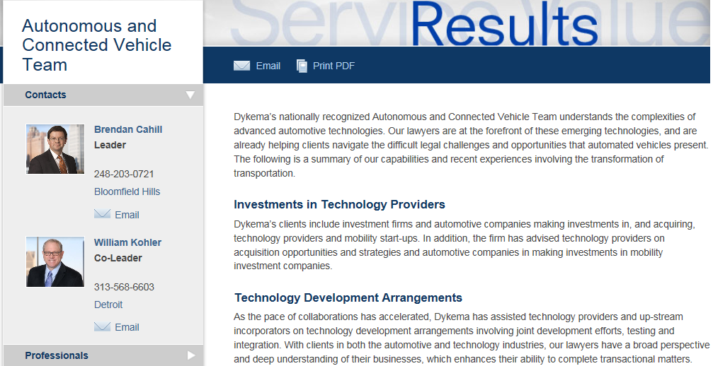
http://www.dykema.com/services-industries-autonomous-and-connected-vehicle-team.html

