Slide 1

Emergency Communication Networks – Transforming with Evolving Technologies
March 22, 2017
Prepared for:
Minnesota Governor’s Task Force on Broadband
Location:
DEED – James J. Hill Conference Room
Presenters:
Dana Wahlberg, 911 Program Manager DPS-ECN
Melinda Miller, FirstNet Program Manager DPS-ECN, Sheriff Chris Caulk, Isanti County

Slide 2
ECN Division Overview
Statewide 9-1-1 Program
  Next Generation 9-1-1 Deployment
Statewide Radio System
  Allied Radio Matrix Emergency Response (ARMER)
FirstNet
  Public Safety Wireless Broadband Network
Alert and Warning
  Integrated Public Alert and Warning System (IPAWS)

Slide 3
ECN Division Overview
  Focus:
  Interoperability between Networks
  Convergence of Networks

Slide 4
~Funding
ECN Division funded exclusively from fees collected from subscriber fees
  Fee collection and distribution described in MN 403 State Statute
  Proposed changes to 403 Statute introduced in 2017 Legislative session
  Aimed at ensuring all devices capable of accessing 9-1-1 are treated equally for fee assessment
  Likely won’t be heard until 2018 session

Slide 5
~Funding
Effective January 1, 2016:
  Wireline .95 cents
  Wireless .95 cents
  VoIP .95 cents
  Prepaid .95 cents (less 3% retailer/2% MDOR)
  Increase from .78 cents

Slide 6
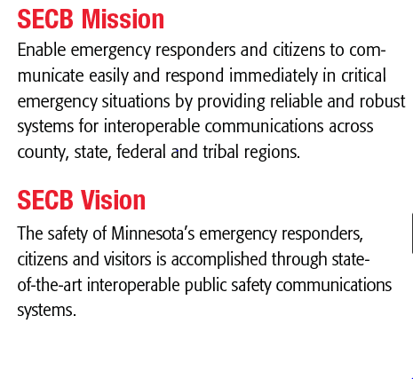
~Governance
Statewide Emergency Communications Board
Role defined in MN 403 State Statute

Slide 7
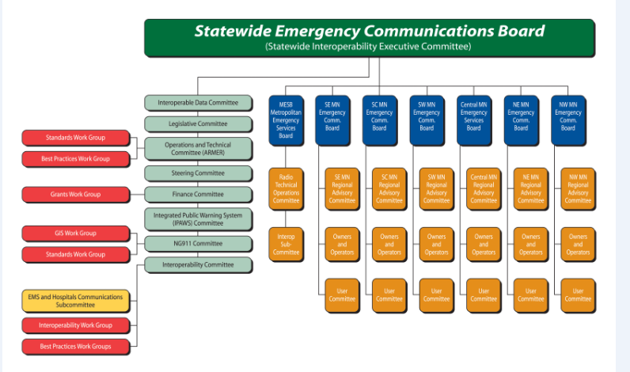
~Governance

Slide 8
~Governance

Slide 9
~Governance
  SECB strategic planning session approved funding for 9-1-1 and ARMER Programs:
    Text to 9-1-1 and creation of statewide GIS centerline for 9-1-1
    ARMER 7.19 upgrade taking us to 2021
  Later approved funding for 9-1-1 Program:
    Firewall initiative for cybersecurity

Slide 10
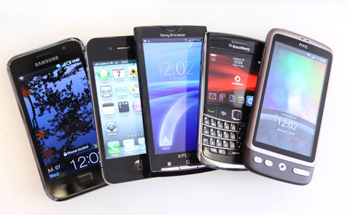

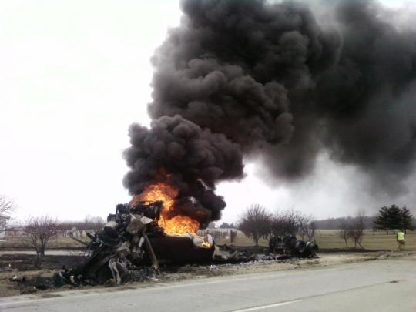
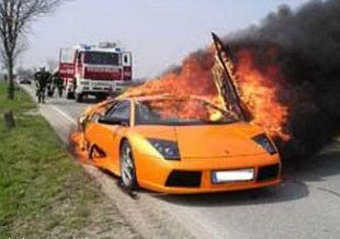
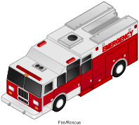

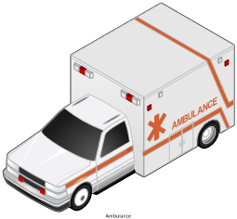
Use Case: Vehicle Crash ~ Present
Bystander makes a voice call
to 911 using iPhone
Text Photo Video
Crash Data sent to Telemetry Service
Telematics Call Center
Operator calls 911
PSAP
PSAPs
Dispatches First Responders/Ambulance
and verbally relay telematics data
HAZMAT
Hospital
Hospital Activates
Burn Unit

Slide 11
~Convergence
      More than 3 million 9-1-1 calls traversed the MN ESInet in 2016.
      New NG9-1-1 features and functionality must continue to be implemented in order to:
        Meet the expectations of the public we serve
        To add value to the FirstNet Public Safety Broadband initiative and meet the needs of public safety responders in the field

Slide 12
Use Case: Vehicle Crash ~FUTURE
Passerby places a voice call to 911
Involved driver texts 911 using iPhone and
Sends Photos & Video of Crash to PSAP
PSAP Forwards Photos & Video
Sent by 911 Caller to LE and Fire
Vehicles Send Telematics Data
Directly to PSAP
DOT
PSAP Sends Data to DOT for Intelligent Traffic Reroute
PSAP
PSAP Forwards Telematics Data sent from
Vehicles to Hospital and Dispatches First
Responders/Ambulance Simultaneously
HAZMAT
Hospital
HAZMAT Acknowledged
at time of crash
Hospital Activates
Burn Unit

Slide 13
~NG9-1-1 Reality
Next Generation 9-1-1 (NG9-1-1)
  People expect to reach 9-1-1 no matter what and to be able to do so using voice, text, picture, video or any over the top application. They assume to be able to get help quickly from any device at any time.
  People expect that 9-1-1 centers can communicate with them the way they communicate with each other. They assume 9-1-1 network technology mirrors consumer technology.
    It is becoming all about DATA
    NG9-1-1 will be rolling out for a long time
    Legacy networks will continue to be supported
    Standards are still evolving

Slide 14
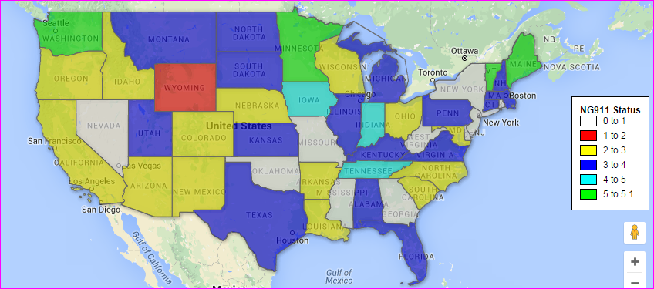
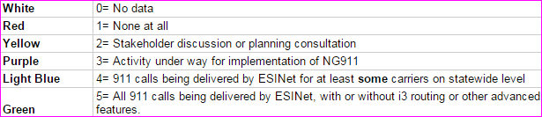
~MN Status
Legend

Slide 15
~Today
  All 104 MN Public Safety Answering Points (PSAPs)
    Are connected to a common IP network backbone referred to as the Emergency Services IP Network (ESInet)
    Includes two diverse circuit paths to all PSAPs each capable of carrying full traffic load in the event one becomes compromised
    Enables selective routing for all wireline, wireless and VoIP calls
    Allows 911 transfers amongst all MN PSAPs to include location and call back information
    Allows for exploring interoperability opportunities with other states
      North Dakota and Minnesota are the first two states to have achieved wireless call transfers across state borders with location and callback information in a pilot project with 911.gov

Slide 16

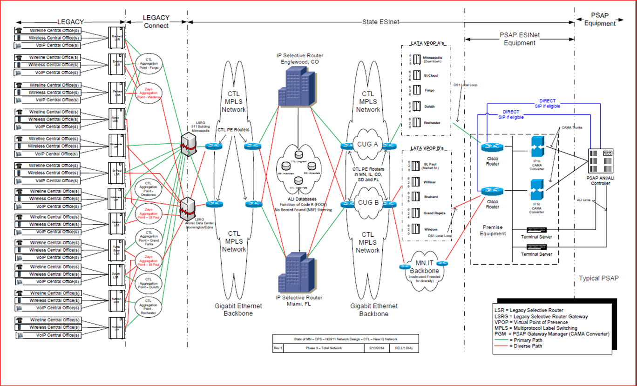
~Today→Future

Slide 17
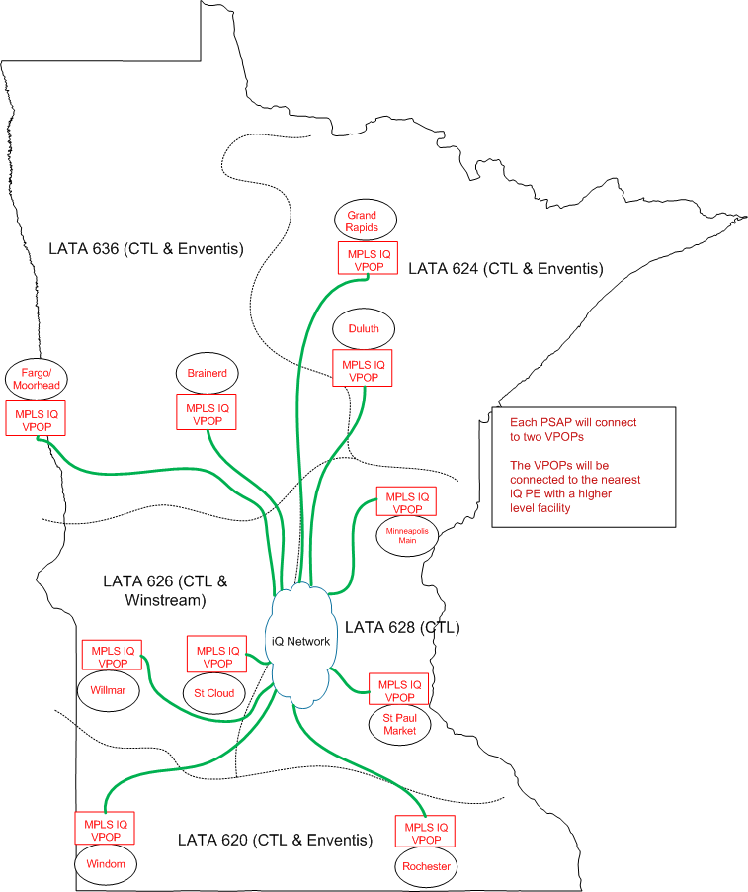

~Today
Diverse PSAP circuits provisioned one from each of two separate Virtual Points of Presence (VPOPS) in each MN LATA

Slide 18
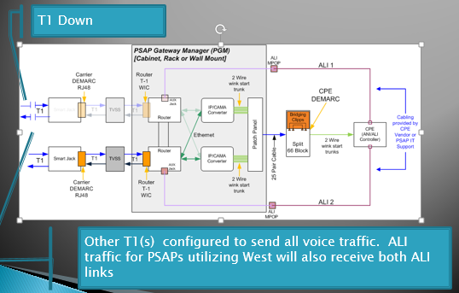
~Today
  Two Diverse IQ Circuits to
  each PSAP
  Each T1 capable of handling
  100% capacity in event
  one T1 goes down
  IQ Circuits provided by MN.iT
  and CenturyLink

Slide 19
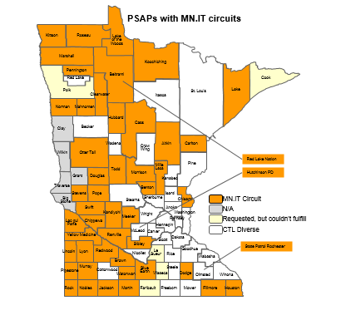
~MN.IT Circuits
    Diverse MN.IT circuit in 50% of MN PSAPs
    Partnering with MN.iTCost affords significant cost savings
    QoS monitored by CTL on both CTL and MN.iT circuits
    Emergency Services IP Network (ESInet) is a pre-requisite for adding features and functionality other than traditional voice as a means for connecting with
    9-1-1
      So what’s next???

Slide 20

~Next!
Text to 9-1-1
“The industry has done its part, the FCC has done its part. Now it’s time for the PSAPs to do their part” – FCC Chairman Tom Wheeler

Slide 21
~Text to 9-1-1
Declaring 9-1-1 access as a core value of American life, the FCC has re-stated its goal of quickly implementing text to 9-1-1 service to the US, saying that if carriers implement it voluntarily, no additional federal regulations would be required. (2014)
  Currently deployed in fewer than 10% of PSAPs across US and Puerto Rico
  Only a handful of states are deployed statewide
  Minnesota is in the process of deploying text to 9-1-1

Slide 22
~Text To 9-1-1
Minnesota’s Vision
  Statewide implementation using a well-planned and
  coordinated deployment approach, starting at a
  regional level
    Seven Regional PSAPs have been identified
    Deployment roadmap & timeline under development
    Additional PSAPs deployed as they become ready
  Single vendor solution for all of Minnesota
  Integrate the solution directly into call center call answering equipment
  Accept text to 911 from all four major wireless carriers and any smaller carriers capable of provisioning
  Ability to transfer text messages between PSAPs
    This technology is still under development between different call answering equipment

Slide 23
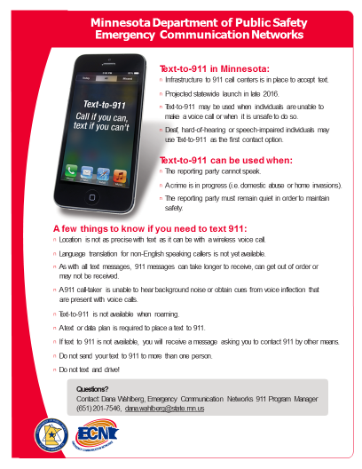
~Text to 9-1-1
    Text to 9-1-1 deployment
      Public education campaign
        Deaf /Hard of Hearing Community Flier

Slide 24
~Text To 9-1-1
Situations texting may be beneficial
  For deaf/hard of hearing/speech impaired
    48 million Americans are deaf or hard of hearing
    7.5 million Americans have speech disabilities
  Where voice networks are congested, service is limited, or wireless phone battery is low
  When making a voice call could endanger the caller
However:
  Text to 9-1-1 is a compliment to and not a substitute for existing voice based 9-1-1 service
  Call if you CAN!! Text if you CAN’T.
Notes:
NENA's Mission is to foster the technological advancement, availability and implementation of a universal emergency telephone number system (9-1-1). In carrying out its mission, NENA promotes research, planning, training and education. The protection of human life, the preservation of property, and the maintenance of general community security are among NENA's objectives.

Slide 25
~Text To 9-1-1
  Limitations of Text to 9-1-1
    Location accuracy limitations
      Limited to Phase 1
    Speed in exchanging information
      Texts may appear out of order
    Language translation services not available
      Solutions under development
    Voice inflection and background noise absent
      No audible prompts to assist call taker with situation assessment
Notes:
NENA's Mission is to foster the technological advancement, availability and implementation of a universal emergency telephone number system (9-1-1). In carrying out its mission, NENA promotes research, planning, training and education. The protection of human life, the preservation of property, and the maintenance of general community security are among NENA's objectives.

Slide 26
Cybersecurity-MN Initiatives
Firewall RFP drafting-worked with industry experts and MN.IT to develop detailed proposal-48 sites in initial phase.
Jun 17-Dec 17
Firewall program implementation-testing, installation, and initial monitoring.
Nov 16-Feb 17
Firewall RFP Release- vendor selection and contract negotiation.
Mar 17-May 17
Notes:
NENA's Mission is to foster the technological advancement, availability and implementation of a universal emergency telephone number system (9-1-1). In carrying out its mission, NENA promotes research, planning, training and education. The protection of human life, the preservation of property, and the maintenance of general community security are among NENA's objectives.

Slide 27
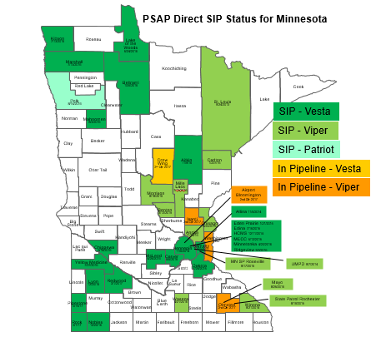
~SIP and Cybersecurity
Statewide firewall procurement and management
  No costs to PSAPs. Will be placed between egress of MN’s 911 provider router and the ingress of PSAP CPE equipment and local LAN.
  Detects abnormal activity & prevent unauthorized access (IDS & IPS) along with 24/7 threat monitoring and protection from a centralized network operation center (NOC).
  Required for Direct SIP PSAPs.

Slide 28
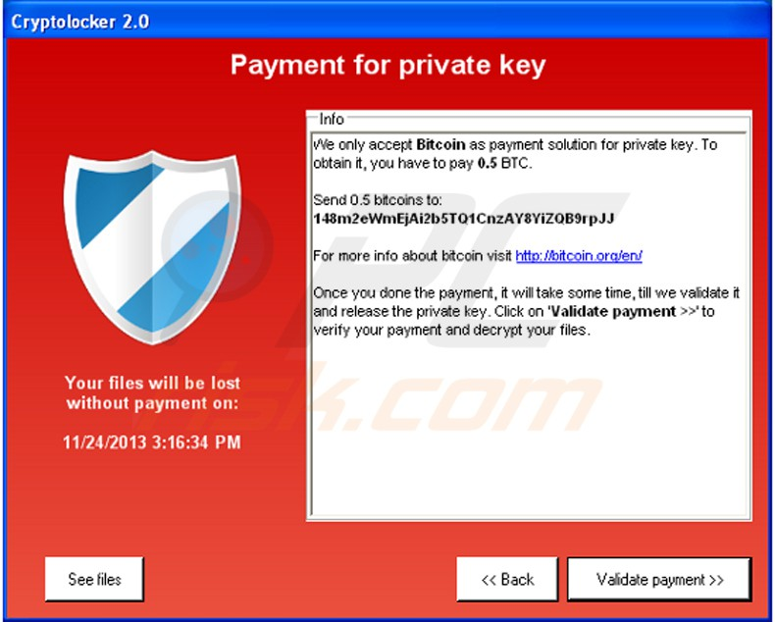
Cybersecurity-Why are we concerned?
“Ransomware attacks on the computer systems of governments, enterprises, and individuals exceeded $1 billion during 2016.”
  MN Judicial Branch website was down for 10 days due to a cyber attack.

Slide 29
~Public Safety Broadband
  Today the PSAP is the broker between the problem and the solution
    Caller dials 9-1-1 and verbalizes the problem
    Call taker/Dispatcher sends help to solve the problem
  Tomorrow the PSAP will receive much more data about an incident much sooner both from the public and from emergency responders in the field
    Caller sends photos/videos
    A vehicle sensor delivers telemetry (e.g.OnStar) information about a crash
    Interfacing with new “wiz bang” applications becoming available
    The call taker/dispatcher becomes the first part of the investigation
Notes:
NENA's Mission is to foster the technological advancement, availability and implementation of a universal emergency telephone number system (9-1-1). In carrying out its mission, NENA promotes research, planning, training and education. The protection of human life, the preservation of property, and the maintenance of general community security are among NENA's objectives.

Slide 30



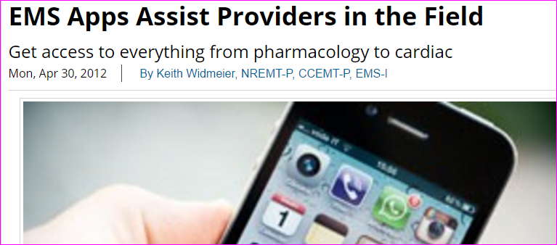


~Apps
Notes:
NENA's Mission is to foster the technological advancement, availability and implementation of a universal emergency telephone number system (9-1-1). In carrying out its mission, NENA promotes research, planning, training and education. The protection of human life, the preservation of property, and the maintenance of general community security are among NENA's objectives.

Slide 31
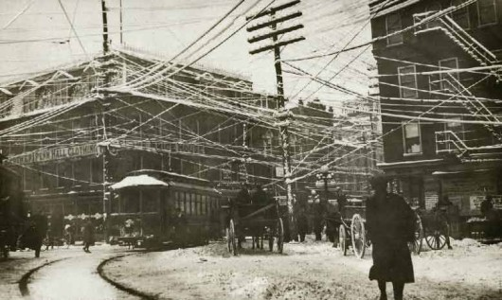
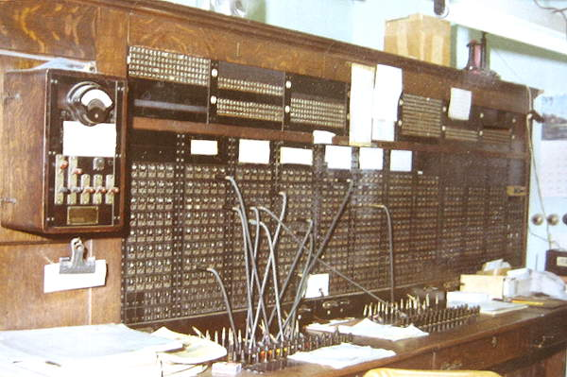
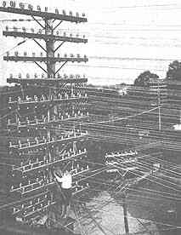

History of Telecommunications

Slide 32
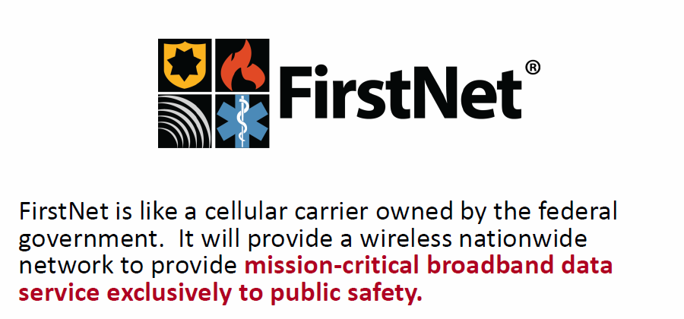
What is FirstNet?

Slide 33
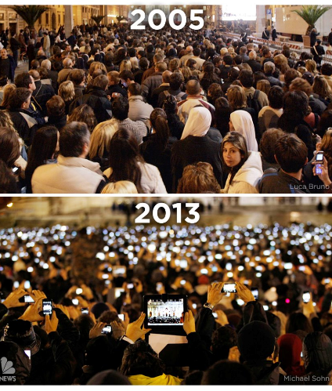
Why do we need it?

Slide 34
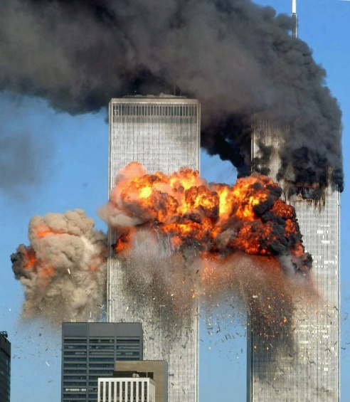
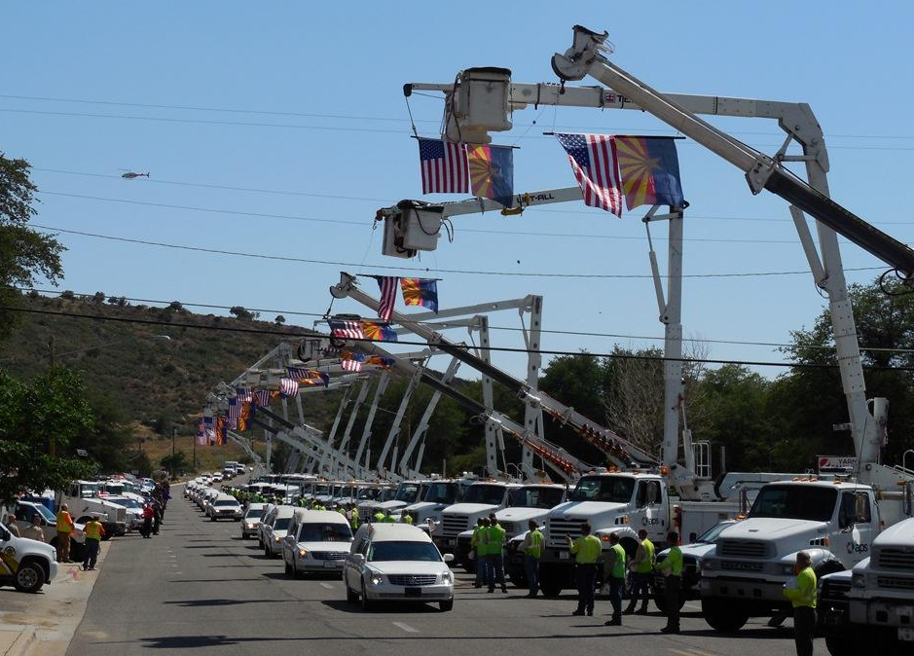
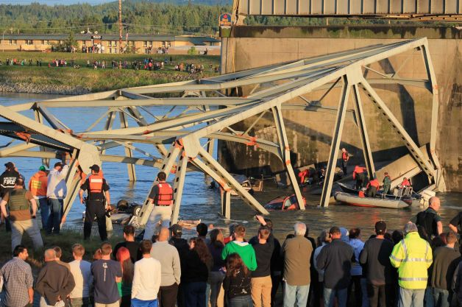
Why is it better than Commercial Service?
Carrier networks are often overwhelmed with commercial traffic during emergency events
Public safety does not want to preempt public communication
Prioritized for pubic safety, designed for public safety, at the request of public safety

Slide 35
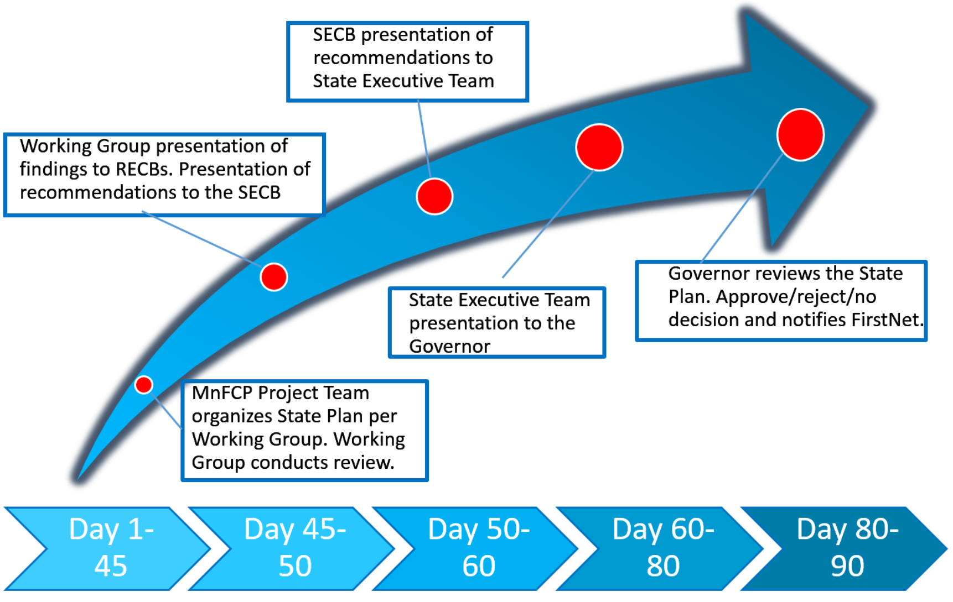
FirstNet Decision Timeline

Slide 36

State Plan Delivery

Slide 37
ARMER to FirstNet Transition
Investments in ARMER important until mission-critical voice is available on FirstNet network to keep network secure and up-to-date
FirstNet initially replaces current
Transition devices will be used—push to talk applications on cell phones

Slide 38
IPAWS
Emergency Alert and Warning Information to the Public.
Designed to alert all citizens with capable devices in a given area.
  Public Safety related information
  Not to inform them of non-emergency items.

Slide 39

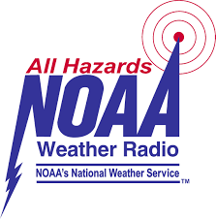

IPAWS
Program designed to enhance public information and warning capabilities for;
  The President of the United States
  Federal,
  State,
  Territorial,
  Tribal, and
  Local jurisdictions.
Notes:
The system can be summed up in the next couple of slides;
The FCC mandates that all licensed Class A – D broadcasters (termed EAS Participants by the FCC) that part of their license agreement is that they have to be able to broadcast a Presidential Message in the time of a national emergency;

Slide 40
IPAWS
Activate the Emergency Alert System on participating;
  Radio
  Television
  Cable
Alert (WEA Capable) cell phones in a defined geographic area
  Even when network traffic is congested
  Uses the cellular providers broadcast channel to push out your message.
Send a message over NOAA Weather Radio

Slide 41
Capabilities
Public Alerting Authority
Your Current Warning System
IPAWS Capability
Land Lines
SMS Text
EAS
Email
Social Media
WEA
< 55 %
%
5 – 10 %
> 85 %

Slide 42
Isanti county Sheriff’s Office
Moving to ARMER- 2011
Increased interoperability
Got rid of old equipment that was so old it could not be fixed
Long term solution to state wide needs for public safety communications needs

Slide 43
Isanti County Sheriff’s Office
Move to NG 9-1-1
Costs, Grants: E9-1-1 and local levy dollars
Able to communicate with various data devices
Able to get 911 calls that are actually for our jurisdiction and no added time needed to transfer 911 calls that are from other areas
Future ability to transfer more data, voice/text and video

Slide 44
Isanti County Sheriff’s Office
Examples
NG911- Phase II call’s
Suicidal party in the woods…
Medical emergency on a tractor in rural township
Immediate calls on west part of county that used to ring into Mille Lacs County PSAP

Slide 45
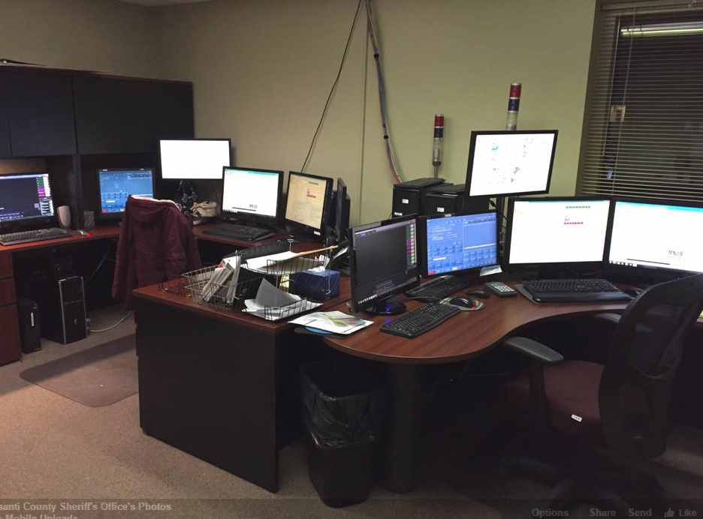
Isanti County Sheriff’s Office
On going cost
Need to remodel
On going Training

Slide 46
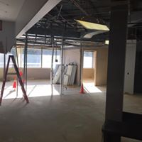
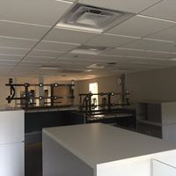
Isanti County Sheriff’s Office

Slide 47
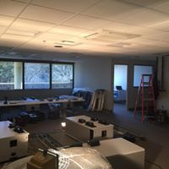
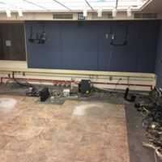
Isanti County Sheriff’s Office

Slide 48


Questions??
Dana Wahlberg
9-1-1 Program Manager
dana.wahlberg@state.mn.us
651-201-7546
Melinda Miller
FirstNet Program Manager
melinda.miller@state.mn.us
Sheriff Chris Caulk
Isanti County
Chris.caulk@sheriff.co.Isanti.mn.us

