Slide 1
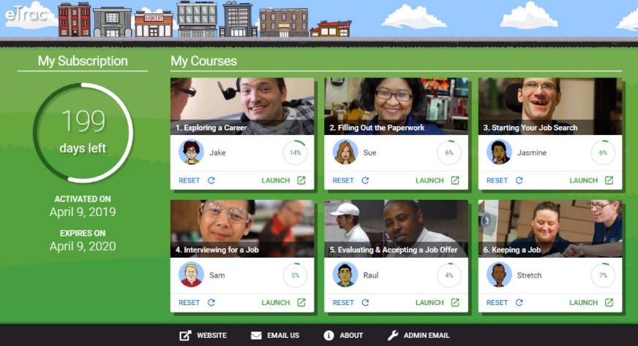
eTrac for Online Job Seeking Skills Training
Randy Bloom – MSS

Slide 2
Overview
Narrated and Animated for Engagement and Accessible!
Animated: Educational content, interactive exercises and videos, and hands-on real-world learning activities.
Accessible: closed captioned, audio descriptions, Screen Reader - Braille Device compatible
Cloud-Hosted Software: Open LMS (Moodle)
Online Learning Management System
eTrac Pre and Post-Assessments test a student’s initial understanding of the topic information and assess knowledge gained after each of the 6 courses
Notes:
SHARE SUCCESS STORIES VIDEO

Slide 3
Accessibility
Close Captioning
Screen Reader, Braille Devices, Magnifiers
HTML5 or Text based versions
Notes:
SHARE SUCCESS STORIES VIDEO

Slide 4
eTrac for Pre-ETS
20-40 hours of total curriculum
Pre-ETS Transition Services:
Job Exploration Counseling
Workplace Readiness Training
Instruction in Self Advocacy
Hours for Pre-ETS reimbursement must be pre-authorized through MN VRS. Each student should receive their own eTrac subscription

Slide 5
Signing Up Counselors and Students
New user enrollment sheet-VRS.xls
Provides basic information for eTrac subscription. Email to rbloom@mssmn.org for set-up!
First name, last name, email address, indicate if the new subscriber is a teacher or student.
Each counselor (Teacher) and student should have their own individual subscription.
Intro emails sent upon set-up (24-48hrs). Includes Facilitators Guide and Tip Sheet
Please call or email if any issues with access!
Notes:
SHARE ENROLLMENT SHEET:

Slide 6
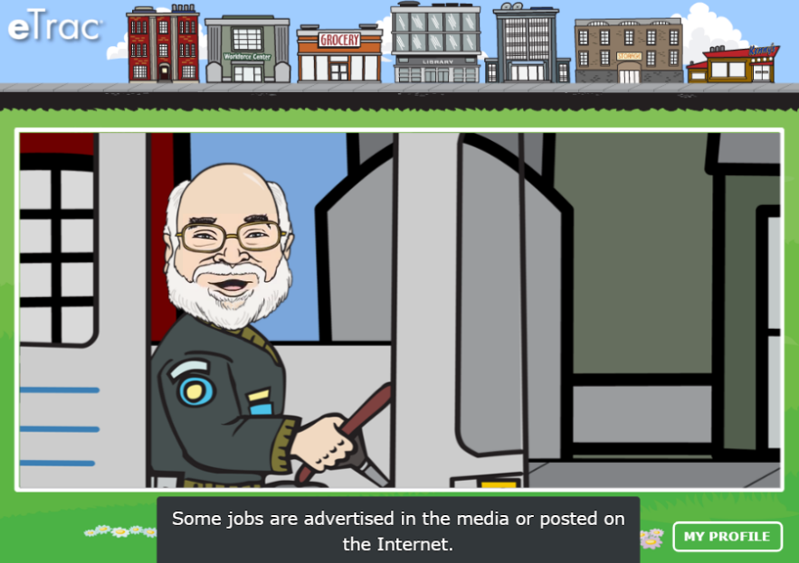
A Closer Look
Logging on to eTrac
https://e-trac.mrooms3.net/
Navigation Overview
Interactive capabilities: Videos, Assignments, Exercises and PDF’s
Grade reports for independent students
Review Facilitation Options
eTrac Best Practices!

Slide 7
Facilitator Guide and Tips Sheet
Covers:
eTrac usage for learning levels
Getting started with eTrac
Grade and activity results for independent learners
Integrating eTrac into your training
Suggestions for maximizing learning

Slide 8
Facilitation Options
1 to 1:
Working with an individual together in person or remotely
Classroom Model:
A group of users works together through the content simultaneously, with ongoing instruction and support throughout the process
Virtual Learning:
eTrac can be facilitated virtually using screen sharing options, phone calls, and virtual check-ins.
Both individual and group models translate well to virtual and distance learning formats.

Slide 9
eTrac Best Practices
Use eTrac in a supervised format vs. independent
Selected from various courses to include in your existing curriculum
Complete and review appropriate exercises within each course
Review selected courses based on individual skills need

Slide 10
Thank you!
Reach out to Randy Bloom for questions, subscriptions or usage instruction needs
rbloom@mssmn.org
Cell 612-581-5570
or
Visit our website: https://www.mssmn.org/etrac
I am available for 1-1 or group training on features of eTrac

