Slide 1
InvisiMax Fixed Wireless ISP
MN – Governor’s Broadband Task Force
Aug. 15th 2017
Dave Giles daveg@invisimax.com
701.739.0136

Slide 2
InvisiMax - Overview
1996, Rural Access – dial up internet – 1998 first fixed wireless
2001 – InvisiMax Wireless ISP – Managed IT services
4200 customers, network covers 14,000 square miles, serving 75 small communities in MN & ND
We use licensed and unlicensed spectrum
NO AREAS are exclusively InvisiMax – multiple broadband providers in every market, i.e. small town of warren has 4, rural areas 2-3
Packages - 5/1 Mbps =$50, 25/5= $80, others = what’s your need?
specialized packages per request 50/50 >100/100> biggest package today is 200 /100 Mbps. Gig service today – not needed by our customers – question is do you need traffic mgmt.? Reality - Most equipment is only 100Mbps capacity
2018 goal – 50 Mbps=$50 100Mbps = $80
Privately funded – NO Gov. subsidy – Profitable/ Sustainability = achievable

Slide 3
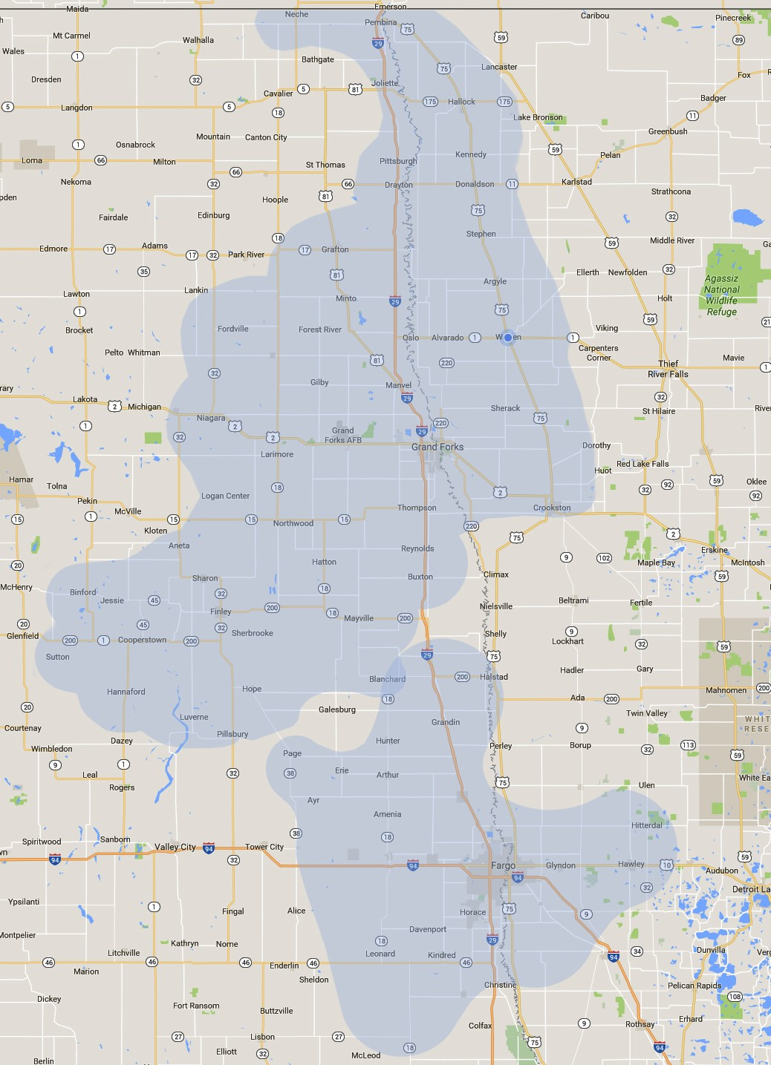
InvisiMax Network 125 + tower locations (commercial towers, water towers, buildings, farm legs) ( Wi-Fi Wi-Max LTE ) 500 + miles microwave backhauls (licensed & unlicensed) LTE less than 2 years 20% converted. Rapidly growing demand. Affordable.

Slide 4
Future of Fixed Wireless ?
GOOGLE Fiber, Stops, announce = FIXED WIRELESS
AT&T Fiber - announces RURAL = FIXED WIRELESS (doing CAF in MN 10/1)
T-Mobile – icurrently Petition, FCC for the CBRS spectrum = FIXED WIRELESS
Microsoft – announces TVWS = FIXED WIRELESS
Awake the sleeping giants = Amazon & Apple ???
a game changer and expect disruptive technologies ! Will include wireless
WISPA – 800+ Fixed wireless operators = FIXED WIRELESS = Fixed LTE
Largest roll up so far = Rise Broadband 200,000 + subscribers
That is a statement
FUTURE OF FIXED WIRELESS IS EXCITING !
It is attracting private equity, providing QOS, innovating technology, mostly non subsidized, and has the power to fight for market share .

Slide 5
What do we see as Future of Fixed Wireless?
Strong future > Forever changing.
Open spectrum = Innovation –
Opportunity = Investors
Government selling spectrum = kills both
Privately held, unused, spectrum sells us out. I hope Rural America is not sold out.
Government not needed Subsidies or unfair subsidy = ability to kill both
LTE – Millimeter wave – TVWS – CBRS etc. = FUTUTRE (education)
WIRELESS (FIXED & MOBILE) along with “Technology” have changed the telecommunications industry - we must change too or at least recognize it.
Fiber Not the only solution = mix
Not every home > every acre. (fixed & Mobile)
FUTURE –not the triple play> Broadband & managed networks (cloud services)
IP Phones – IP TV (service & Content providers are changing)
FUTURE - Fixed wireless industry is ripe for a roll up. (Rise BB 200K)
Wireline & Cable operators = Fixed wireless will be part of their offerings

Slide 6
What impact will IoT have on Fixed Wireless ?
IoT (internet of Technology) ANOTHER , NEW BUZZ WORD
GREAT– it’s part of what has been driving Broadband. Bring it on..
IoT devices have been developing for over a decade. IP based home security, to baby monitors, Pet monitoring, IP based appliances etc. But these devices typically are not bandwidth demanding and most are forecasted to simple data transmission (other than video) They are propagated in bit-size amounts and place little burden on IP based networks assuming speed and latency levels are met.
Need for Speed =(video) > Need for MANAGEMENT of traffic (ioT) = Quality
Managed home routers > smart homes > smart businesses
Affect on Fixed Wireless? GREAT. Need for more, but impact No different than Wireline.
MANAGEMENT OF THE NETWORK will be key.

Slide 7
Importance of Wireline to Fixed Wireless ?
They are Co-Dependent. ! Very important !
Fiber supports wireless networks -
Wireless extends Fiber networks –
economics. WWYD - Your money?
Innovation is accelerating !!! BOTH in WIRELINE & WIRELESS Technologies>
Technology -Innovative antennas MuMIMO along with LTE next generation (5G) are being deployed today at +100 Mbps plus & in Millimeter wave at GIG speeds
Wireline & Wireless = Complement each other.

Slide 8
Impact on Wireless from Cybersecurity
Impact on Wireless is no different than Wireline. (Managed properly)
Security - Key is Core Routers & Servers
Wireless less unsecure is a myth !
Security on every level – enterprise or home, security ( firewalls, passwords )
Hackers are not only across the world > in your company, in your state.
What are your security policies? What are your employees allowed to do?
What do YOU do?
Extreme = Private fiber networks / Private Wireless networks = secondary connections for public internet connectivity.
Ultimately Security /Passwords = are like running from a bear, slowest one gets eaten first. <The lower the security the easier the hack >

Slide 9
Thoughts of Microsoft TVWS Proposal?
Excellent ! – TVWS it is another option / tool in our wireless tool box
Paul Garnet – Runs the Rural Broadband Initiative for Microsoft.
He connected me to Sid Roberts who is the Technical Manager & Global relationships. (partners program)
Microsoft wants everyone connected. Wants to promote their Products,
Cloud services, Cloud computing.
They are not and do not want to be a service provider
They see this as helping to reach more people “ECONOMICALLY” ($30-$80 USA)
They do not manufacture equipment – partner or support with those who do
They are testing a 12/12/12 12 projects - in 12 states - in 12 months to see if they can impact affordable connections.
Summary –
they support more license free or registered spectrum
They will partner on infrastructure investments (Microsoft Partners)
They Recognize the need for “improved data collection”

Slide 10
TVWS - CBRS !! Today is important
TASK FORCE – FEDERAL influence FCC.
Public influence on FCC
MORE UNLICENSED - & AFFORDABLE SPECTURM
Cost of Spectrum affects cost of service ..
Under utilized spectrum
CBRS – Citizen band radio spectrum -
TVWS – TV White Space
Much more.

Slide 11
TASK FORCE
GET EDUCATED ON FIXED WIRELESS
Understand
Support
Educate public
Use in your business
CONSIDER A WISPA MEMBERSHIP (WISPA.ORG)
WIRELESS INTERNET SERVICE PROVIDERS ASSOC
Help influence with the FCC to open more spectrum ! USE IT OR LOSE IT.

Slide 12
THANK YOU
FOR YOUR ATTENTION & THE OPPORTUNITY TO TALK ABOUT FIXED WIRLESS
We bring Value to the Great State of MN. !!
Dave Giles
InvisiMax , Warren MN
daveg@invisimax.com
Personal Cell phone 701.739.0136

