Slide 1
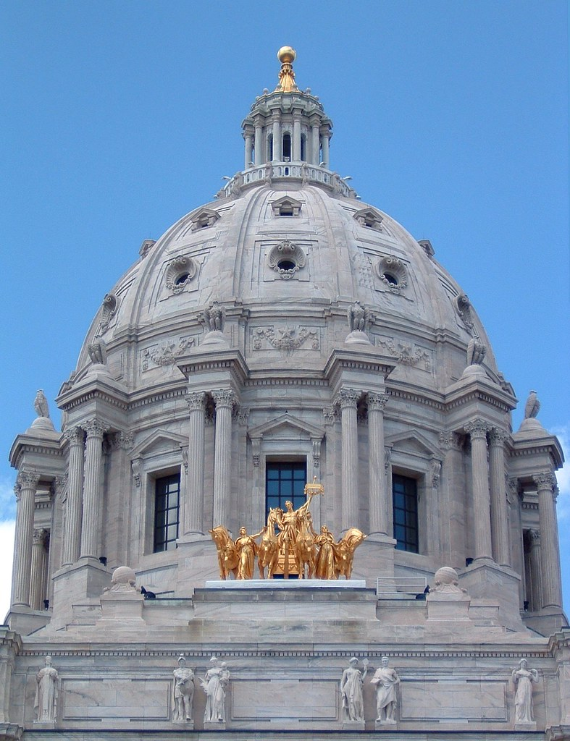
Legislative Advocacy
Governor’s Broadband
Task Force
January 31, 2023
Notes:
Hello everyone and good afternoon,
I was planning to be there in person and had hoped to participate in some of your other content.
The district has put together excellent content for the conference.
Unfortunately, the legislature is in the midst of committee deadlines and there are several bills I am responsible for being heard today
For the legislative update today I will start with the big picture than review some of the county priorities, particularly environmental issues and then finish by looking at a few feedlot bills

Slide 2
Legislative Advocacy
Governor’s Broadband Task Force
What we’ll cover today
Materials
Who to meet with
How to speak with legislators
Messaging and Strategy
Do’s and Don'ts

Slide 3
Legislative Advocacy
Governor’s Broadband Task Force
Materials
1-page Fact Sheet
Information to include:
Map of availability of service in the state
Available state and federal funding
Speed goals
Suggested funding
Concise, easy-to-read, no walls of text!

Slide 4
Legislative Advocacy
Governor’s Broadband Task Force
Materials
Letters and Testimony to Committees
If there is legislation before a committee that you support, sign up to testify in favor and write a letter on behalf of the Task Force.
These letters will be included in the materials committee members receive before the hearing starts.
If you are testifying, submit your Fact Sheet and/or letter ahead of time.
Say “you all have our Fact Sheet/letter in your packets” during your testimony.

Slide 5
Legislative Advocacy
Governor’s Broadband Task Force
Who to Meet With
Senate and House Committee Chairs
Senate Agriculture, Rural Development, and Broadband Committee: Sen. Aric Putnam
House Agriculture Finance and Policy Committee: Rep. Samantha Vang
Senate and House Committee Vice Chairs/Minority Lead
Senate and House Committee members
Senate and House Finance Chairs; Senate and House leadership
Your direct legislators

Slide 6
Legislative Advocacy
Governor’s Broadband Task Force
Do’s and Don’ts
Do:
Be on time.
Have a clear message.
Stick to the script.
Be courteous to staff.
Don’t:
Argue with a legislator. Ever.
Post negative comments on social media. Twitter is not real life.
Lie to or mislead legislators. You will lose your credibility forever.

Slide 7
Legislative Advocacy
Governor’s Broadband Task Force
How to Speak with Legislators
Remember what your mother taught you: BE NICE
Remember that Legislators are human beings
Be respectful of their time. Know how long your meeting is.
Beware of Minnesota small talk—it can eat up an entire meeting.
Use direct language and, after presenting your information, ask if they will support your request.
If they say “no” or “I will think about it,” do not press them. You are not selling them a car.
If they say “yes” say “thank you for your support” and ask them to advocate within their caucus for the issue.

Slide 8
Legislative Advocacy
Governor’s Broadband Task Force
Messaging and Strategy
Develop a set of uniform talking points for your issue.
Tailor this to each of your professions.
Before you meet with a legislator, find out where they are from.
Be ready to talk about how your request would impact their district.
Power in numbers: partner with other organizations that care about your issue. Work directly with their lobbyists or directors to ensure messaging is not conflicting.
Consider writing joint letters from your organizations.

Slide 9
THANK YOU!
Nathan Zacharias
AMC Policy Analyst
nzacharias@mncounties.org

